Slide 1


Reasonable Adjustments Digital Flag
Guidance for General Practice and Primary Care Networks
Bracknell Forest
North East Hampshire
Royal Borough of Windsor and Maidenhead
Slough
Surrey Heath and Farnham

Slide 2
Contents
Slide 1 – Title page
Slide 2 – Contents
Slides 3 and 4 – Introduction
Slide 5 – The six-step process
Slide 6 – Phase One – what do we need to do – (suggestions)
Slide 7 and 8 – How the Reasonable Adjustment Digital Flag is added to the patient’s record
Slide 9 – Examples and case studies
Slide 10 – Resources and further information
Bracknell Forest
North East Hampshire
Royal Borough of Windsor and Maidenhead
Slough
Surrey Heath and Farnham

Slide 3
Introduction
The Equality Act (2010) places a legal duty on all health and care services to make changes to their approach or provision to ensure that services are accessible to people with disabilities as they are for everyone else.
This duty aims to address the recognition that people with disabilities may have equal access to care and services, but without specific adjustments being made, that access may not be equitable.
The Equality Act 2010 legal duty for Reasonable Adjustments is anticipatory which means that adjustments should be made before a person presents for care at any service.
These will be individual to the person involved and might mean:
  Changes to physical environments such as providing wide doors, ramps and tactile signage
  Longer appointments
  Provision of quiet waiting rooms
  Provision of information in an Easy Read format
  Communications with carers or advocates
Bracknell Forest
North East Hampshire
Royal Borough of Windsor and Maidenhead
Slough
Surrey Heath and Farnham

Slide 4
Introduction
The NHS Long Term Plan (2019) includes a commitment to:
“Ensure that Reasonable Adjustments are made so that wider NHS services can support, listen to, and help improve the health and wellbeing of people with learning disabilities and autism, and their families.”
Specifically, it is stated that:
“by 2023/2024, a ‘digital flag’ in the patient record will ensure staff know a patient has a learning disability and/or autism”.
To achieve this, a Reasonable Adjustment Digital Flag (RADF) has been created, visible on the National Care Records Service (NCRS), which will enable the recording and subsequent recognition of identified Reasonable Adjustments, across health and social care in England.
Bracknell Forest
North East Hampshire
Royal Borough of Windsor and Maidenhead
Slough
Surrey Heath and Farnham

Slide 5
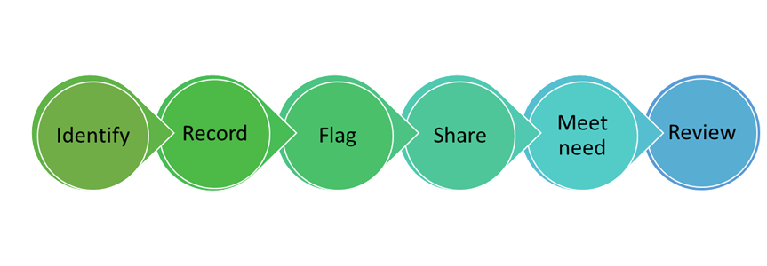
The six-step process
IDENTIFY
Patients can let you know they require a RADF or they can be identified while they are being seen in the practice, for instance as part of their Learning Disability Annual Health Check. This could also be added to any new patient questionnaires/easy read questionnaires.
Think: Make Every Contact Count.
Patients must give their consent for their RADF to be uploaded to the spine.
RECORD
Record the RADF using 2 SNOMED codes including the relevant consent code.
FLAG
The SNOMED code will be pulled through to the NCRS and create a flag that will appear in their record in any health care setting, they attend.
SHARE
Where possible, share the reasonable adjustments information in referrals on to other services.
MEET NEED
Make your best effort to meet the needs identified and discuss with the patient and/or their carers, where this is not possible.
REVIEW
Where patients are attending an annual health check, or at other appointments, review the RADF to ensure that it is still correct and code this review using the appropriate SNOMED code.
Bracknell Forest
North East Hampshire
Royal Borough of Windsor and Maidenhead
Slough
Surrey Heath and Farnham

Slide 6
Phase One – what do we need to do – (suggestions)
Action 1 required: identify patients with a disability or significant impairment
Add disability and reasonable adjustment section on all new patient forms/registration documents and recall, review and appointment letters (e.g you can add a standard line “do you require any reasonable adjustments?”).
Check at first contact.
Identification during standard health checks such as annual health checks, long-term condition reviews or during programmes such as immunisations (e.g. annual influenza campaign).
Opportunistically: at any patient contact with the organisation
Identification through information received in from outside the organisation (such as referral letters, discharge of out-patient letters, community assessments).
Enable and encourage self-identification and optimise awareness (e.g posters, practice website information, practice information screens).
Bracknell Forest
North East Hampshire
Royal Borough of Windsor and Maidenhead
Slough
Surrey Heath and Farnham

Slide 7
How the RADF is added to the patient’s record
The RADF is designed to sit in the patient record on the National Care Record Service (NCRS)/the Spine.
There are two ways to add a RADF to a patient’s record:
By adding it via the NCRS portal
By adding appropriate SNOMED codes to the patient’s GP record
For the purposes of this guidance, we will be recommending all patients identified in GP practices have their RADF added using the SNOMED codes.
To ensure that the RADF appears correctly on the NCRS, two codes need to be added to the patient record.
The appropriate adjustment code which specifies what adjustment the patient needs (more than one of these codes can be used if the patient requires more than one adjustment)
The appropriate consent code.
Bracknell Forest
North East Hampshire
Royal Borough of Windsor and Maidenhead
Slough
Surrey Heath and Farnham

Slide 8
How the RADF is added to the patient’s record
SNOMED codes relating to types of impairment can be found in the attached document or on the NHS Digital website
HERE
Reasonable Adjustments Digital Flag
However, a simplified version of the SNOMED codes is available here:
Consent* and review codes are shown below
** please note that, without the consent code, the RADF will not be uploaded to the NCRS and the RADF will not be visible to other organisations.
Bracknell Forest
North East Hampshire
Royal Borough of Windsor and Maidenhead
Slough
Surrey Heath and Farnham

Slide 9
Examples and case studies
Examples of how Reasonable Adjustments and the RADF has helped individuals, can be found in the following links:
Jamie
Kareem
Bracknell Forest
North East Hampshire
Royal Borough of Windsor and Maidenhead
Slough
Surrey Heath and Farnham

Slide 10
Resources and further information
We have produced some Easy Read resources for patients and their carers about the RADF, these are attached below.
There is a range of RADF resources available on the Frimley ICS Health and Care website Learning Disability and Autism | Frimley Health and Care
NHSE England - What digital flagging means for patients (youtube video)
The NHS Digital page about the RADF can be accessed HERE
The list of national RADF SNOMED codes can be found HERE and Reasonable Adjustments Digital Flag
RADF Webinar NHSE Allied Health Professional Webinar re RADF
If you have any questions or would like more support, please contact Ann Bryant, Learning Disability and Autism Transformation Manager (all age) via email: ann.bryant@nhs.net
Bracknell Forest
North East Hampshire
Royal Borough of Windsor and Maidenhead
Slough
Surrey Heath and Farnham

