Slide 1
Introducing texting alongside letter for child vaccination invitations in Surrey & Thames Valley
June 2025
Child Health Information Services (CHIS)

Slide 2
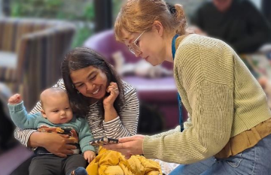
Introducing texting for child vaccination invitations
CHIS currently supports GP childhood vaccination call/recall using 100% letter across Surrey and Thames Valley.
We are transitioning towards text-first approach involving a mixture of texts and letters from July/August 2025, in line with national strategies (NHS Long Term Plan, NHS Ten Year Health Plan, Net Zero). Texts reminding parents to contact their GP to book an appointment will be sent from July 21st in Berkshire, Oxfordshire and Buckinghamshire. Practices will start to see patients attending appointments without CHIS letters from August 4th. Surrey is in phase 2, these changes will be seen in September.
User engagement: CHIS engaged with 1,689 parents/carers and health professionals (including GPs) throughout 2024 to inform the process.
Text was the preferred contact method for the majority of respondents
Improvements were made to the text wording and mixed text/letter approach
It was agreed faster delivery will enable prompt booking and timely vaccination
Pilot findings: the text-first approach was been piloted in West Berkshire and the Thames Valley part of Frimley.
Text-first invitations for childhood vaccination were as effective as the previous letter-only approach (timeliness and uptake) across the full CHIS pilot areas
Texting before letters had a marked positive impact on uptake for children in ethnic minorities and in higher deprivation areas
Notes:
Text was the preferred contact method for the majority of patients (mobile populations, England as a second language as easier translation)

Slide 3
What does this mean for GPs in Surrey & Thames Valley?
What is changing?
From August, families will arrive at vaccination appointments mostly without a physical CHIS letter.
What is staying the same?
Letters will still be used as a follow-up for non-responders, failed texts, where no mobile number is available or if parent expresses a letter preference.
CHIS will continue to send all practices weekly clinic lists of children invited.
Mobile number completeness on children’s records is good across Surrey and Thames Valley, please continue to update records.
Table showing % of CHIS records that contain a valid, UK mobile phone number
Berkshire | 92.0%
Oxfordshire | 86.2%
Buckinghamshire | 94.1%
Frimley | 96.4%
Surrey | 98.0%

Slide 4
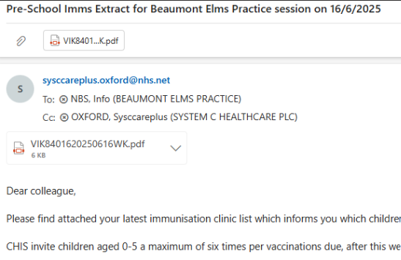
What does this mean for you?
General Practice
Ensure vaccinating nurses have access to the CHIS weekly clinic lists which will be sent to your generic practice email on a Wednesday-Friday, please see below screenshot
Vaccinating nurses should continue to check the child’s GP record and use clinical judgment before vaccinating
Continue to check and update children’s records with an accurate mobile number
Update the child’s GP record if parent has communication preference for letter, this will come through to CHIS
ICBs, Local Authorities, LMCs
Communicate about this move to text-first vaccination invitations to all relevant stakeholders (contact CHIS for additional comms materials if needed)
Explain the many benefits of this change (timely vaccination, better for transient populations, carbon and cost saving, patient preferences)
Let CHIS know if you would like a member of the Project Team to attend a meeting to give a briefing and answer questions
Share all feedback with CHIS to ensure the new process works for all

Slide 5
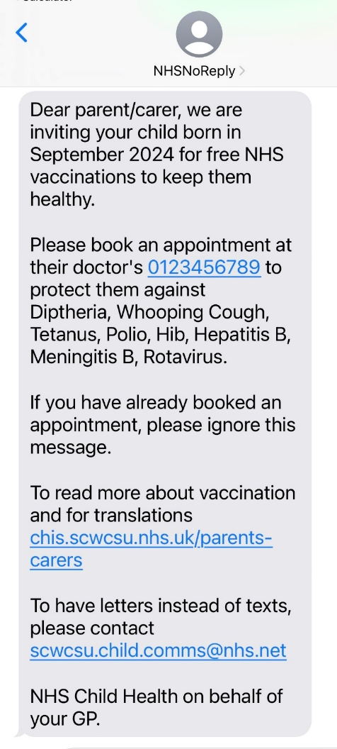
Texting FAQs
How will nurses know what vaccinations children are due without the letters?
Clinicians should always check GP records and use clinical judgement before vaccinating. To see which children CHIS have invited for which vaccinations refer to the clinic lists CHIS email you on a weekly basis.
What if parents don’t respond to the texts?
We have conducted a pilot of this approach in collaboration with NHS England, this approach was found to be as effective as letters, it even resulted in higher vaccination uptake in some areas! If the first text isn’t responded to, a second text will be sent and if that text is also not responded to, a letter will be sent in its place.
Will this cause increased phone calls to our surgery?
No it shouldn’t, CHIS will send the same number of vaccination invitations at the same time as always, they will just be texts instead of letters.
What about patients who face digital exclusion?
If there is no mobile number on record, families will be sent a letter.
If the text does not deliver, families will receive a fallback letter.
If the child does not get vaccinated after two texts, the third invitation will be a letter.
How many invitations does CHIS send?
Up to 6 invites/reminders per appointment. A detailed recall pathway has been developed to visually walk through how the pathway works.

Slide 6
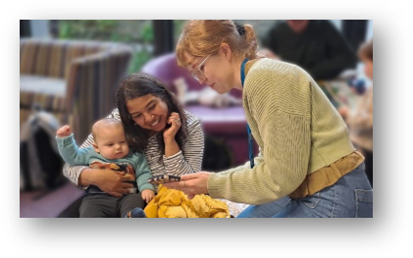
CHIS Project questions and suggestions always welcome
CHIS Team Mailbox: scwcsu.child.comms@nhs.net
Texting Project Manager: molly.wescott@nhs.net

