Slide 1

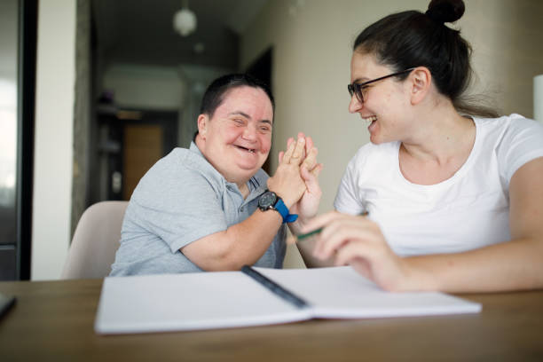
LeDeR
Learning from the lives and deaths of people with learning disabilities and autistic people
Learning Bulletin
Issue 8
May 2025
Frimley ICB LeDeR Programme contact:
frimleyicb.leder@nhs.net
Bracknell Forest North East Hampshire and Farnham Royal Borough of Windsor and Maidenhead Slough Surrey Heath

Slide 2
What is “LeDeR”?
LeDeR is a service improvement programme which aims to improve care, reduce health inequalities, and prevent premature mortality of adults with a learning disability and autistic adults by reviewing information about the health and social care support people received.
The LeDeR programme collates and shares the anonymised information about the deaths of people with learning disabilities and/or autistic people so that common themes, learning points and recommendations can be identified and taken forward into policy and practice improvements.
This bulletin summarises learning from LeDeR reviews with the aim of sharing insights and promoting improvement across our health and social care system.
Bracknell Forest North East Hampshire and Farnham Royal Borough of Windsor and Maidenhead Slough Surrey Heath

Slide 3

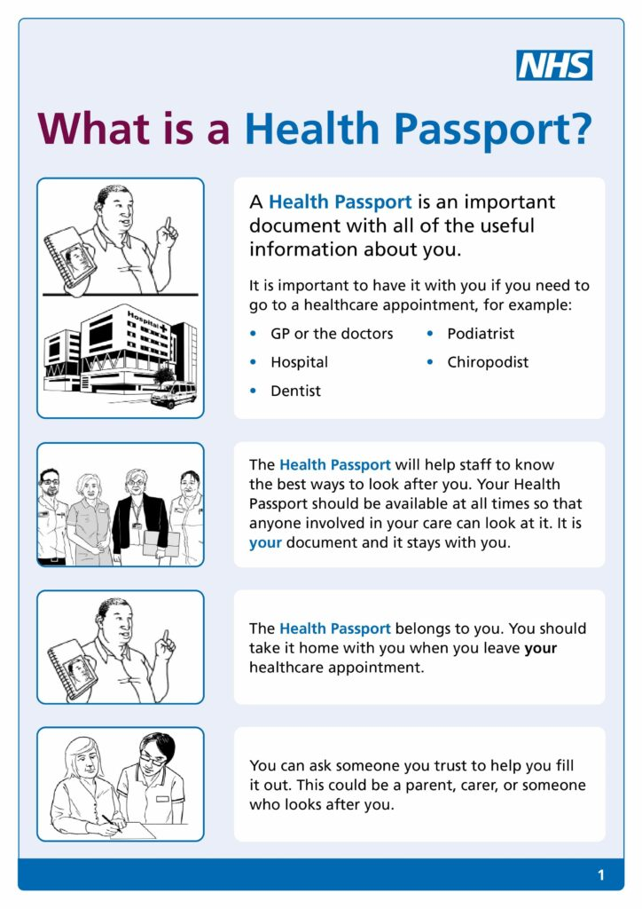
In the previous issue: Cancer screening. This issue focuses on Health and Care Passports
Since August 2024, lack of or no reference to Health passports appear repeatedly in the top 5 themes for Frimley ICB LeDeR reviews. The value and importance of these person-centred documents needs to be promoted and remains a priority for the Learning into Action group for our system.
What is a health and care passport
It’s good practice for people with a learning disability and autistic people to have a health and care passport which can be regularly updated in response to changes in their health and wellbeing and interaction in the health and care services they use. How, when and who to involve in completing and updating a passport should be guided by the person who owns the passport – local systems should consider what opportunities there may be to prompt a conversation about the health and care passport, for example, during the learning disability annual health check.
It is good practice to have a document as:
a resource for clinical and administrative health and care staff that contains information about the patient to support them to deliver personalised care.
a health and care passport that is owned by the individual. Each person decides what they want to include, who they want to support them to complete it and who it should be shared with.
a resource to support a patient with a learning disability and autistic patients to think about what they want health and care staff to know about them to provide effective care and support and inform care planning.
a tool to support and enable health and care staff to meet key legal duties including the Equality Act 2010, Reasonable Adjustments and the Mental Capacity Act 2005.
a signpost to more detailed information including key care plans such as, eating and drinking, communication and advanced care plans.
What a health and care passport is not
it is not a replacement for clinical records.
it is not for the recording of clinical advice or decisions.
it is not a substitute for recording information on the Reasonable Adjustment Digital flag.
it does not replace the need to talk with the patient and their family or key individuals about their care and support.
it is not a care plan nor should it contain care planning information.

Slide 4
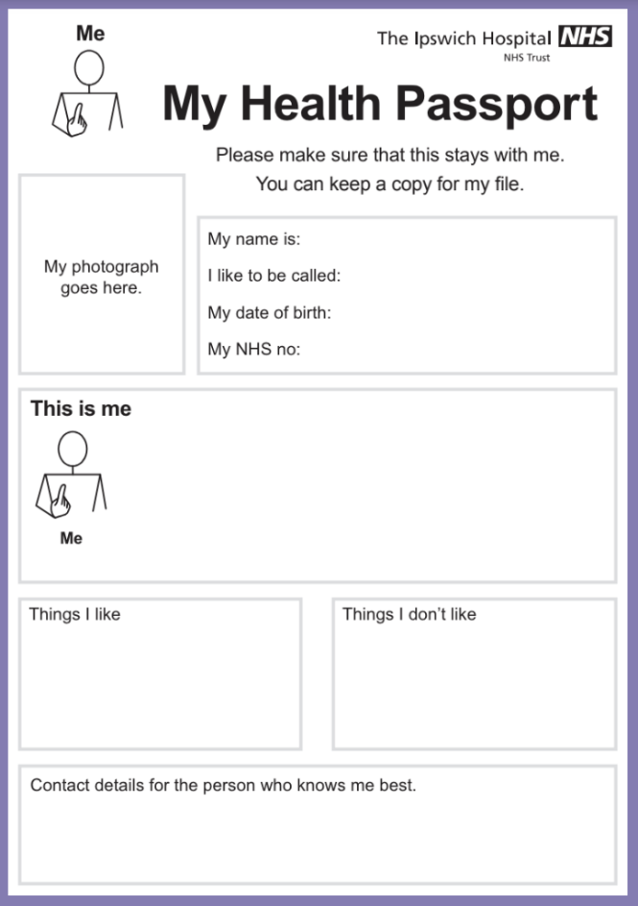
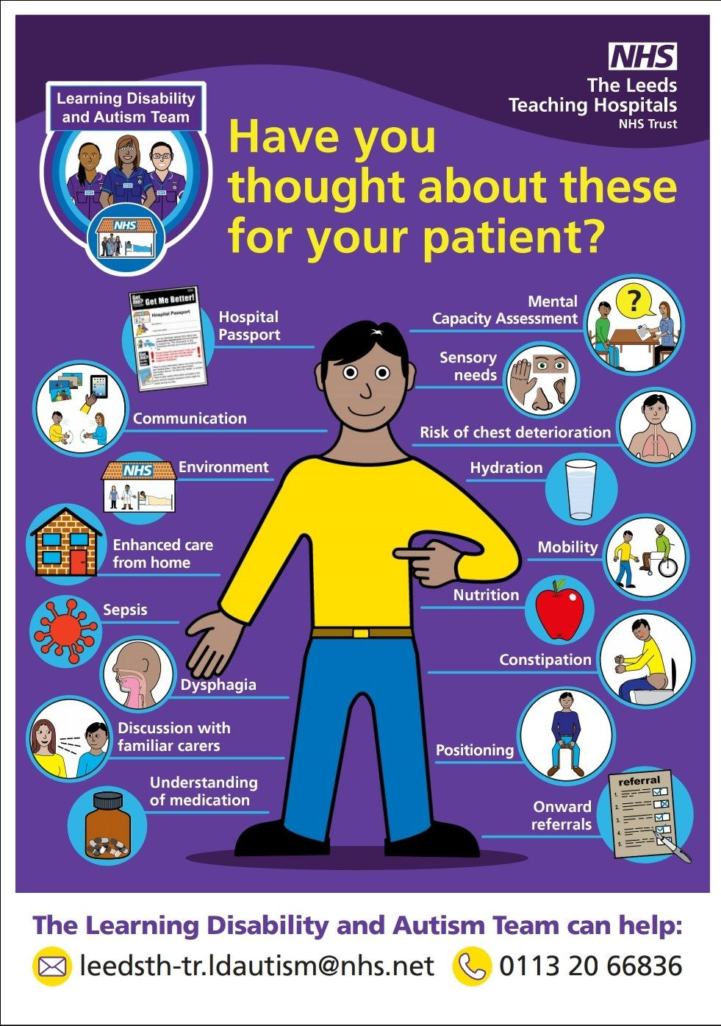
Health and Care passport continued
Benefits of a health and care passport
Empower patients and carers – enabling better informed clinical decisions and shared decision making
Improve patient safety
Provide consistent, clear, patient centred information
Reduce health inequalities
Can support organisations and professionals to meet their legal duties including:
  Mental Capacity Act –
    particularly supporting best interest decision making and the requirement to include the individual in a decision that affects them if they have been assessed as not having capacity. The content of the passport should give clinicians insight into how to involve someone in a decision that affects them
  Equality duty: reasonable adjustments
    Providing details which complement information held on the Reasonable Adjustment Digital Flag held on the NHS Spine and provide detail of details related to other protected characteristics including race, culture and ethnicity
Who could benefit from having a health and care passport
Anyone could benefit from having a health and care passport. This guidance is focused on people with a learning disability and autistic people as two groups in particular who could benefit. The content of the passport will be different from person to person – reflecting the needs of the individual.
A passport for a person who has a mild learning disability, who communicates verbally, lives independently and does not have any long-term conditions is likely to look very different to someone who has a profound learning disability, uses communication aids, needs support with all aspects of daily and has a number of long-term conditions.
If there is more information held elsewhere, such as in a communication passport, or an eating and drinking plan then the health and care passport can contain this and inform the reader where, and how, to access additional information.
“it’s a good way to prompt people to think about what needs to be done if someone does needs help” (Family carer adviser, NHS England)

Slide 5
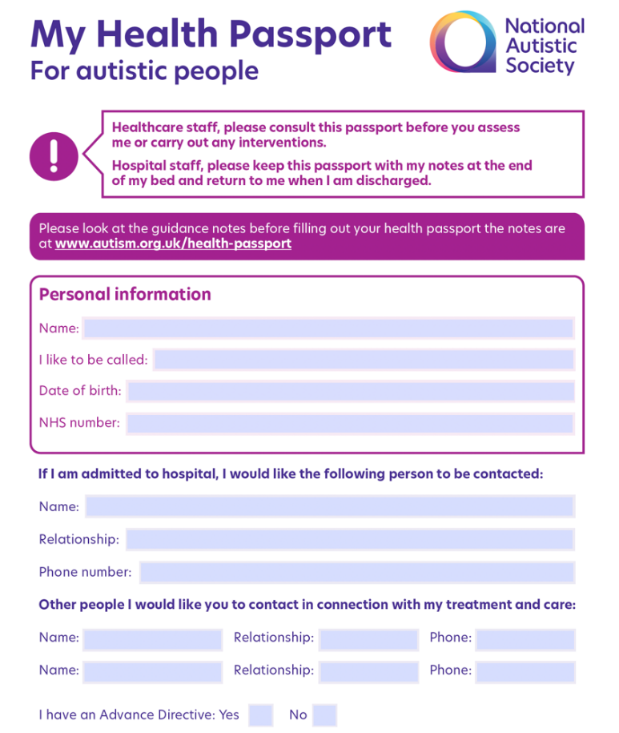

Health and Care passport continued
NHS England » Health and care passports: implementati
Guiding principles for a health and care passport for people with a learning disability and autistic people
The content is owned by the person – and is person centred.
Structure and format should support planned and unplanned (emergency) contact with health and care services – to ensure widely applicable in all situations.
Information governance in relation to the storage and sharing of individual health and care passports must be in line with the principles of patient confidentiality – ensure individuals add to care records safely.
Health and care staff should be aware of the value of health and care passports, take note of and incorporate the content of the passport into the care and support provided to the individual – translate the information for everyday care and promote with all staff to utilise.
The passport must be portable to enable its use in a range of settings and locations
The passport can be in a physical or digital form or a combination of formats - Approximately one third of people with a disability do not have basic digital skills.
Supporting a process for people to review their health and care passports – ensure up to date and prompt as required, e.g. AHC.
Health and care passports build on information held in the reasonable adjustments digital flag, giving additional detail to support individuals.
What can YOU do???
Ask if your patients / Clients have an up to date health and care passport – encourage completion if not
Include essential details of reasonable adjustments / fears / dislikes can be clearly explained and support excellent care
Ensure they and their family / carers know where it is situated
Multiple copies could be of benefit to share with all health and care professionals that join their care journey but it’s essential to maintain patient confidentiality at all times
Review the document if / as needs or situations change
There are various versions of Health passport so be mindful when reviewing records, one may be included already
Continue to promote good communication around the topic and understand it’s value within all settings
Links: Health and Care Passport template and guidance - NHS England » Health and care passports
The plain English and easy read guidance on how to the complete the health and care passport template is for people with a learning disability, autistic people, their families and carers.
Reference: NHS England » Health and care passports: implementation guidance June 2024

Slide 6

Some key learning points from recent LeDeR reviews…
Cancer Screening
Bowel / Breast / Cervical screening should be offered to all appropriate patients within the designated age groups. It is vital that clear reasoning / explanations are provided, and any anxieties acknowledged with reasonable adjustments being put in place. Lack of screening should be followed up to understand why this has occurred and to support compliance in the future. GPs are encouraged to share their lists of eligible people with LD with the NHS screening hubs so that tailored information can be sent to people with their invitations. Capacity also needs to be considered. Noted to be an LiA priority.
Medical Documentation
All contacts / discussions / assessments / interventions / plans need to be documented clearly and with the appropriate detail to evidence care plans and ensure all those involved are aware of the direction of care. This is key for effective multi-disciplinary care team working, supports informed decisions and continuity of care. Clinicians also have a legal obligation to complete, following a duty of care and professional standards.
Health Passport
An up-to-date health passport can help hospital staff care for and interact with an individual in the best ways. Professionals and carers can help in ensuring a passport is in place and goes with the individual on admission. This was noted as an LiA priority.
Clinical Intervention
Timely and effective intervention / treatment should be given to all patients in need. Following a holistic and thorough assessment, plans should be put in place following guidelines. This also requires staff to be competent to complete tasks required of them, E.g. management of PICC lines, and to have knowledge of the patients’ presentation, complaint and needs.
Immunisations
Immunisations must be regularly provided, invitations sent / provided and followed up. All actions documented.
Clinical Assessment
Comprehensive and appropriate assessments for the presenting complaint should be completed for all patients with regular reviews carried out as per national guidelines advise. E.g. Care plan reviews, X-rays screened thoroughly, Falls and VTE assessments. All need to utilise a holistic approach.
Pain Assessments
This needs to be recognised and managed well to offer good quality care and life. In patients with limited or no communication skills or difficulty understanding what is happening, knowing your patient well and listening to family / carers is key to recognising changes to behaviour or presentation. There are numerous tools to help including: The Abbey Pain scale, DisDat, NCCPC-R, Wong-Baker faces, UPAT – Universal Pain assessment tool.
Education and awareness with easy read literature should also be provided to support and promote patients to ask for help and know their bodies. E.g. Leeds NHS trust have ‘Tell me about your pain’ toolkit.
Communication
Is essential to ensure high quality care is provided to all patients. It needs to be effective and inclusive from initial contact and throughout the care journey. This includes with family and carers, between NHS and private providers and essentially working between acute / primary care, supporting colleagues for best practice. Communications with Care homes is crucial from any provider service. They need to be involved in the management and discharge planning of all their residents / patients with attention provided to medicine changes. They can often contribute valuable behavioural and general knowledge of the individuals.
Mental health and capacity
An individual’s capacity should be assessed on a decision -by -decision basis, beginning from an assumption that the person has capacity.
This is an essential part of ensuring the right care is provided at the right time and place.
Please ensure appropriate language is used, it is clearly documented and timed / dated so all Health professionals are aware at that specific time of the circumstance.
Bracknell Forest North East Hampshire and Farnham Royal Borough of Windsor and Maidenhead Slough Surrey Heath

Slide 7

We’re doing a lot of good things too. Here is some good practice picked up by our reviews…
From 3 recent reviews discussed at our Sign off group, the team complimented the high quality care provided to the individuals in relation to General practice. Input was comprehensive, proactive and went above and beyond to address any needs arising. Reasonable adjustments were evident throughout.
Carers from the new placement worked with the individual for two months prior to relocating to ensure they knew them and felt comfortable
When carers asked for increased medication for behaviour challenges, the Psychologist emphasised the importance of using the strategies devised for managing such behaviour rather than increasing medication
Comprehensive medical reviews were completed, and a new patient assessment within 7 days of moving to a new placement
Syringe driver was cited on upper back to prevent patient seeing it and pulling it out when agitated
Pain patch prescribed when nurses felt she had pain as patient did not like taking tablets
During an exacerbation of asthma, she declined to go to hospital, so her home were given an oxygen saturation monitor. Antibiotics chosen which was just one tablet daily - she would often just take one antibiotic tablet and feel the course was over
Acute LD liaison nurse worked hard to get an appointment for her with a female gastroenterologist at a site she could support her at
Realisation from pre-hospital and resuscitation team that end of life rather than resuscitation was required
CTPLD Community nurse trained carers re end of life care so she did not have to be taken to hospital / hospice or nursing home
GP checked breasts in the Annual health checks as mammograms had been declined
Early input from Palliative care team and family liaison to ensure he was comfortable, and wishes were respected
She was under the District nurses for pressure damage to her bottom, she was bedbound and doubly incontinent. Despite this and her anaemia, the wound had started to improve
Managing fears and phobias of individual to assess healthcare services in a timely manner
Bracknell Forest North East Hampshire and Farnham Royal Borough of Windsor and Maidenhead Slough Surrey Heath

Slide 8
Patient Story – what could have been done differently??
Female with mild to moderate Learning disability. Recently diagnosed with Breast cancer following a mammogram review for neurofibromatosis.
Lives alone with carer / support worker input. Recent bereavement of mother.
Good attendance at yearly mammograms and understanding of her conditions
T/C saying appointment needed the next day – had to go alone as needs time to get someone to go with
Received bad news on her own – consider other life stresses, e.g. recent bereavement
Intense radiotherapy needed and had to arrange support workers / sister to accompany her for 2 weeks
Transport would have been helpful for treatment sessions but as not eligible, had to pay for SW etc mileage, petrol. A Doctors note would have been needed otherwise.
Letters and information given can be hard to understand, reliant on others to help – Easy read essential
Need support around you at times like this – a support team, friends, family
One doctor was amazing – Recent Rheumatoid Arthritis diagnosis. Planned appointment for last of the day so had time, could be longer, wrote all down for me and talked through clearly.
Take away thoughts:
Time – give time, make time
Listen – to their requirements, needs, wants
Planning – scheduling time of day / length of appointment that’s needed, how will / can they get there, will they need support, e.g. carer, transport, voluntary transport / agencies
Information -clear and in understandable format is essential
Other Support – e.g. psychological to manage diagnosis and other life stresses / demands
Bracknell Forest North East Hampshire and Farnham Royal Borough of Windsor and Maidenhead Slough Surrey Heath

Slide 9
National resources and training available:
Joint webinar: supporting people with a learning disability and autistic people with a forensic history - 14 May, 10:00am-12:30pm
NHS England and the Ministry of Justice invite commissioners, and clinicians working in mental health hospitals, to a webinar enhancing collaboration in supporting people with a learning disability and autistic people who have a forensic history. Key discussions include understanding offences, developing strong discharge applications, and lived experience insights.
Speakers will include the Ministry of Justice (MoJ) casework section, consultant psychiatrists, and the NHS England Learning Disability and Autism National Clinical Director.
To register, visit Supporting People with a Learning Disability and Autistic people with a forensic history | NHS England Events
For any inquiries, please contact Andrew Jazaerli at Andrew.jazaerli@nhs.net
New podcast aimed at primary care teams focuses on health inequalities
Primary care colleagues including mental health professionals explain in a new podcast why they are using new ways of working.
Transforming Primary Care, produced by NHS England North East and Yorkshire focuses on the improvements that not only make it easier and quicker for patients to get the help they need, but reduces pressure on staff too.
The podcast explores the multi-disciplinary team in primary care and also features a discussion around how digital technology is being used to increase access to NHS services, addressing known health inequalities
NHS ConfedExpo 2025 - Mental health, learning disability and autism sessions
The Mental Health, Learning Disability and Autism team will be delivering a number of sessions at #NHSConfedExpo 2025, discussing:
Joint working to improve homes for people with a learning disability and autistic people
Thinking differently about highly restrictive staffing practices in the community.
There will also be a main stage panel session with Claire and a panel of experts who will be hosting a discussion “Making the shift from hospital to community for mental health”. The session will provide the audience with perspectives and learnings of how the mental health sector has developed models of care in the community, and what they have learnt through this process.
NHS ConfedExpo is the UK's leading health and care conference dedicated to driving improvements in care. View the full agenda and book your pass.
A reminder that April was Bowel Cancer Awareness Month. Find resources and training for healthcare professionals plus patient information including posters for patient waiting rooms on SSCA’s events calendar. Click here: Bowel Cancer Awareness Month. ➢ Find information about the Bowel Cancer Screening Programme and resources to improve uptake on the SSCA website: https://surreyandsussexcanceralliance.nhs.uk/our-work/prevention-early-diagnosis/screening-and-immunisation/bowel-screening
Bracknell Forest North East Hampshire and Farnham Royal Borough of Windsor and Maidenhead Slough Surrey Heath

Slide 10
Further resources and training available:
Screening Materials:
Cervical cancer screening video https://vimeo.com/769007467/a7cb5e2ef9
Breast cancer screening video https://vimeo.com/769006029/3b509bd6bf
Annual Health Check https://vimeo.com/769003679/a92801765f
Annual Health Check (Makaton version) https://vimeo.com/806387559/3721239f2c
Bowel Cancer screening video https://vimeo.com/769004795
Breast follow up video https://vimeo.com/832083432?share=copy
Cervical follow up video https://vimeo.com/832081270?share=copy
Colposcopy Treatment https://vimeo.com/832088080?share=copy
Bowel follow up video https://vimeo.com/832086347?share=copy
LeDeR – Resource
Easy Read Leaflets for use in Primary Care
To promote and support equitable and high-quality services, NHS England have resources available at LeDeR - Resource Bank
There are a variety of Easy read guides and short films to help provide clarity and understanding to our populations.
We encourage services to make use of any of the resources here that would help ensure people with learning disabilities and autistic people are supported to access the care and treatment they need.
Health and Care Passport template and guidance - NHS England » Health and care passports
The plain English and easy read guidance on how to the complete the health and care passport template is for people with a learning disability, autistic people, their families and carers.
Bracknell Forest North East Hampshire and Farnham Royal Borough of Windsor and Maidenhead Slough Surrey Heath

