Slide 1


Changing lives, one job at a time
We work with disadvantaged job seekers to move them closer to employment by getting to know them well, creating a development plan, supporting with job applications and ultimately providing support in the workplace.
We work to inspire and support the business community to realise a society where equal opportunities and life chances exist for all.
The Vision
Preparing young people to have sustainable and progressive careers in the local labour market and to become active citizens in an ever-changing world.

Slide 2

What is a Supported Internship?
Supported Internships are for young people age 16-24 with an Education Health and Care Plan who have a commitment to moving on from full time education into employment.
A supported Internship must be primarily built around a work placement and is a partnership between an education provider, a supported employment business and a host business site.
Students will collaborate with a host business and the Employment Coach to undertake an unpaid programme of work and relevant study at college or school.
A Supported Internship is a pathway for young people to move from education into paid employment, but with support and guidance.
We believe that early intervention is vital to help young people with SEND find and retain
meaningful employment.

Slide 3
What young people learn whilst on the SI program?
Travel Training
Communication and Social Skills
Personalised Skills Portfolio
Young Person
Emotional Regulation and Resilience
Employment Prep
Job Specific Skills/ Mandatory training
Notes:
Lets talk in a bit of detail about these – next slide

Slide 4
How does it work?
The Supported Internship runs in line with an academic year, but to be funded must be for a minimum of 6 months.
Generally, 3 days per week are spent at their host business site, supported by an Employment Coach, the coach will provide support for the student and business throughout, but the time spend onsite will be tailored off gradually as the student settles and grows in confidence to increase their independence.
Students can, where appropriate, try their hand at different job rotations which contribute to the student’s employment aim.
Generally, 1 day per week is spent at their education setting carrying out a personalised programme around employability and life skills.
The Employment Coach supports the young person if they are ready for paid work, to find employment at the end of the Internship either with the host business, or elsewhere if there is no vacancy available. The skills and experience gained will help build a CV and confidence.
When employment is found Ways into Work provides Supported Employment teams will continue to offer guidance where requires called In work support.

Slide 5
Hosting a student
We are looking for new host businesses to help support in our Route to Recruit programme for 2025/2026. As a host we hope you will gain by;
Being part of a meaningful journey for young individuals with SEND. Helping them to transition from education into paid employment and the labour market.
Participate in the government DofE ‘National Disability Strategy’.
Grow your Diversity & Inclusion numbers as a business.
Be able to smoothly fill vacancies after the young person has proven themselves and in bedded in the team after a ‘working interview’
Recruit and retain a dedicated, hard working and diverse workforce.
Give opportunity to young people who require a stepping stone

Slide 6
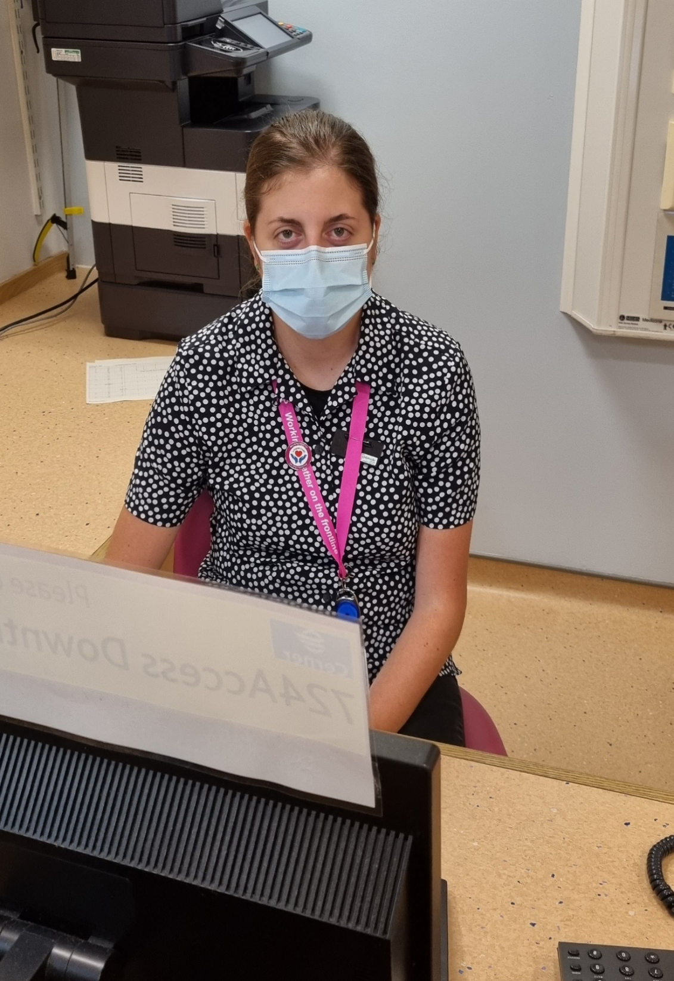
Case studies
Lily and Josh graduated from Route to Recruit in 2021. Both secured paid roles at the Royal Berkshire Hospital with the teams where they undertook their work placements. Both are working in Non–Clinical Support Assistant roles which have been job carved by our Route to Recruit team in collaboration with their respective managers. Job carved roles are fantastic examples of strength-based recruitment. These roles cater to our students’ skillset but importantly free up the time of their clinical colleagues to undertake the specialised tasks that they trained for – so ultimately benefitting everyone, patients included.
After impressing staff during her internship, Lily, who has a mild learning disability, started her part time job with the team in the Jim Shahi Unit. As a very caring, genuine and helpful individual, Lily is a perfect fit for her role, helping the team with a range of tasks including reception, admin, collecting patient meds, supporting with lunches and housekeeping.
From the way Lily conducts her job, you can tell that she is so proud to be an ‘essential worker’ and part of the Cardiac team, especially as she herself has a heart condition and is now working with the team that have supported her since it was diagnosed - she feels super safe in the workplace!

Slide 7
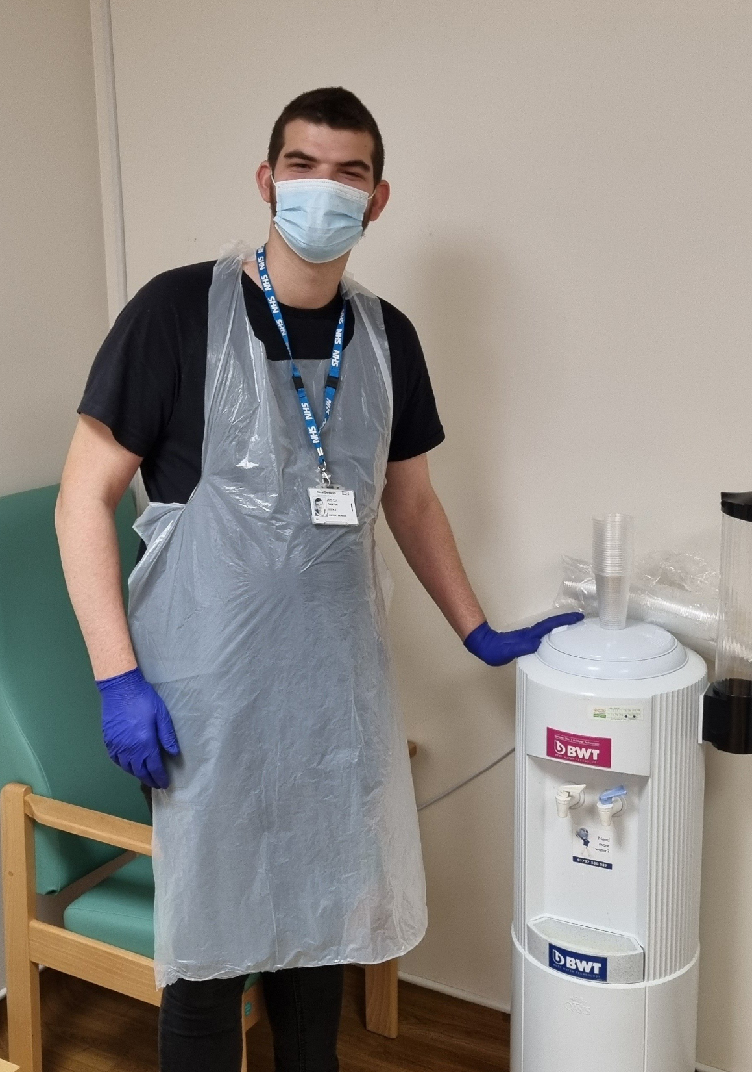
Case Study (continued)
Josh, who has Autism, is also making his mark at RBH. Josh started his internship working in the League of Friends Café. As the pandemic took grip Josh wanted to undertake a role where he could help patients and provide support to the clinical teams who he could see were under pressure.
The Minor Injuries Clinic provided the perfect opportunity for Josh and following a successful placement he was offered a part time role as a Non-Clinical Ward Support Assistant.
Like Lily, Josh is a vital member of the team - restocking supplies, cleaning, admin, running errands and getting drinks for patients. Lily and Josh have come so far since starting on the Supported Internship. Both gaining confidence, maturity and professionalism due to the invaluable support of the teams they were embedded in at RBH and our Ways into Work Job Coaches.
Since the programme began back in 2012, 35 graduates have gone on to secure paid employment at the Trust in a range of roles including portering, catering, main stores, mattress library and A&E. Many of those remain working at the Trust, some of which have now been in post for 10 years and still learning, developing and thriving in their roles.

