Slide 1

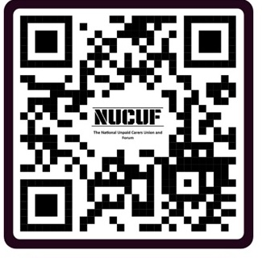
Do you provide care for a loved one for more than 35 hours a week?
We are a non-profit organisation of unpaid carers who provide support and reassurance to unpaid carers.
Scan the QR code
or visit: www.nucuf.org

