Slide 1
NHS Health Checks
Engaging Practices

Slide 2
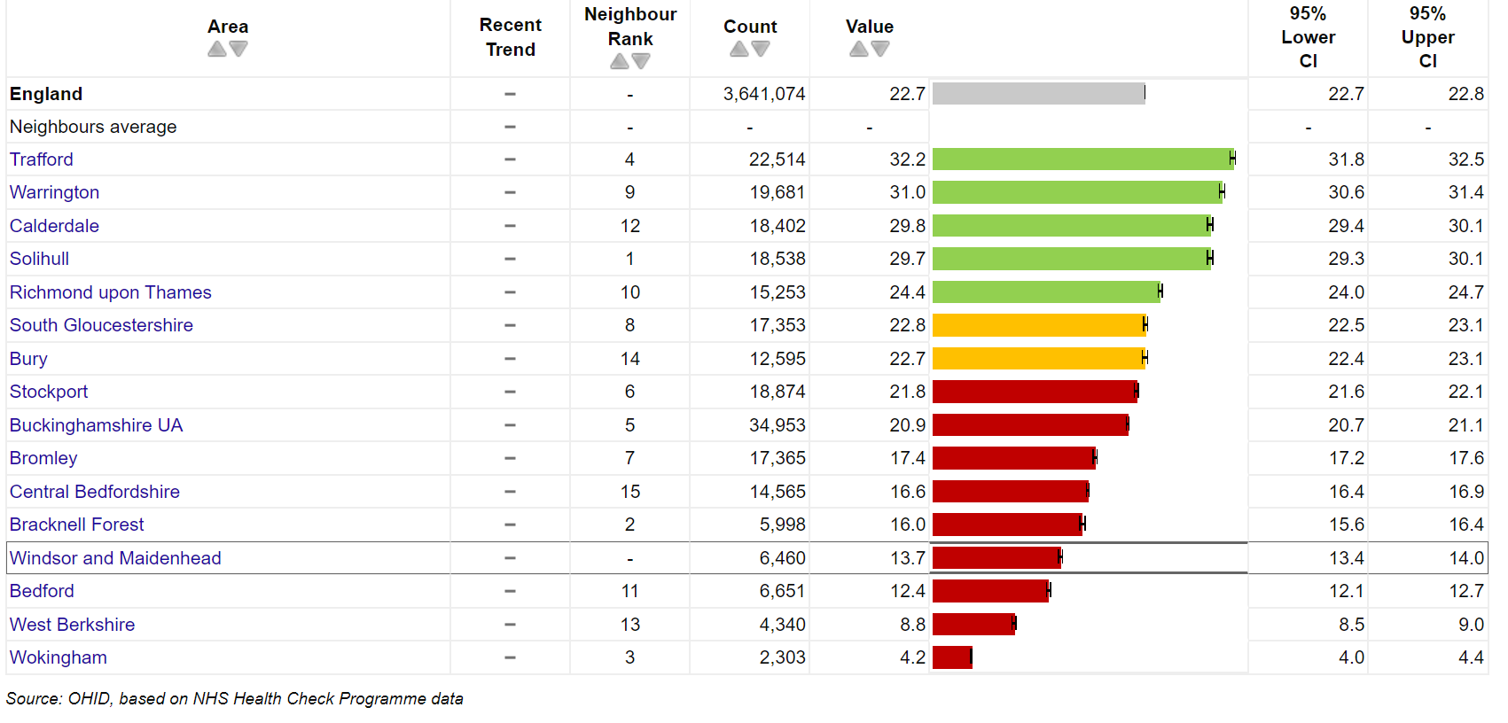
Background
NHS Health Check's (NHS HC) were recommissioned in April 2024 for 2+1 years
The NHS HC numbers in RBWM are low:​
People receiving an NHS Health Check 2020/21 Q1 – 2024/25 Q1 Proportion %:
 | 2023/24 Q3
 | Health Checks invites offered to TEP | Health Checks received by TEP
RBWM | 960 (2%) | 627 (1.3%)
SE | 4.1% | 1.7%
England | 5.2% | 2.1%

Slide 3
NHS Health Check Benefits
NHS HCs are positioned as a key enabler of at scale action to improve CVD outcomes & reduce CVD-related health inequalities.
Improves the quality of patient care
Reduces inequalities in access to proactive care

Slide 4
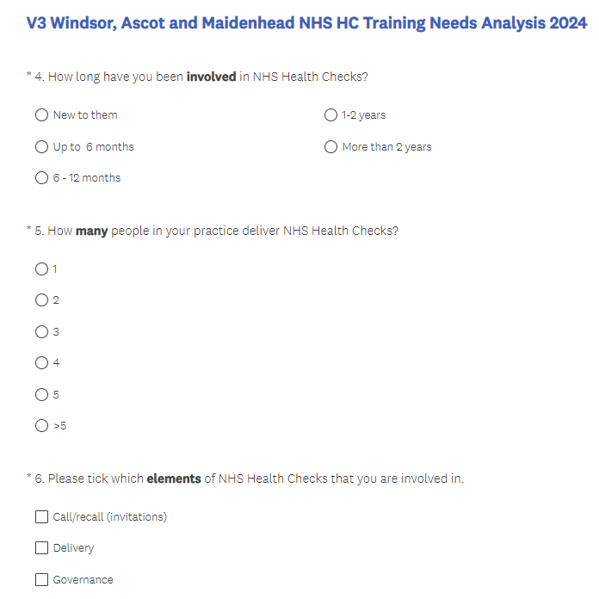
Training Needs Analysis (TNA)
What is it? ​
  Gives us an insight into training needs​
Why we need it?​
  Surgeries have previously mentioned they would like more training, but we don’t know specifics. ​
  The TNA will give us information on any issues practices may have in carrying out the NHS HC’s ​
Who should answer the questionnaire?
  HCAs, Nurses, or anyone conducting the
  NHS HCs.
How long will it take?
  7-9 minutes to fill out

