Slide 1


All about: changes to your Kooth service
kooth.com
Notes:
The good news is that Kooth will continue to support you, but there will be some changes to how that happens from 1st November.

Slide 2

Key changes:
New age criteria – moving forward the service will focus on supporting young people aged 11-17 years.
New support options – as well as the existing online support options of articles, discussion boards, and self-directed tools like journaling and goal setting, Kooth will now be able to offer single-session chats with a practitioner. These sessions must be booked in advance and will focus on "here and now" difficulties.
Notes:
Long-term, structured support with a named worker and drop-in chat support will no longer be offered from 1 November 2024 just because they are provided by existing services in your area.

Slide 3

Referral and sign-up process
If you are aged 11-17 you can be referred for support by a parent, carer or professional (such as a GP or teacher), or you can sign up yourself with the support of a parent.
Please note that the sign-up process requires some personal details, including first and last name, and a method of contact such as a phone number or email.
Notes:
While you won’t be anonymous anymore, the service will still be confidential unless you tell us something that makes us concerned for your safety.

Slide 4
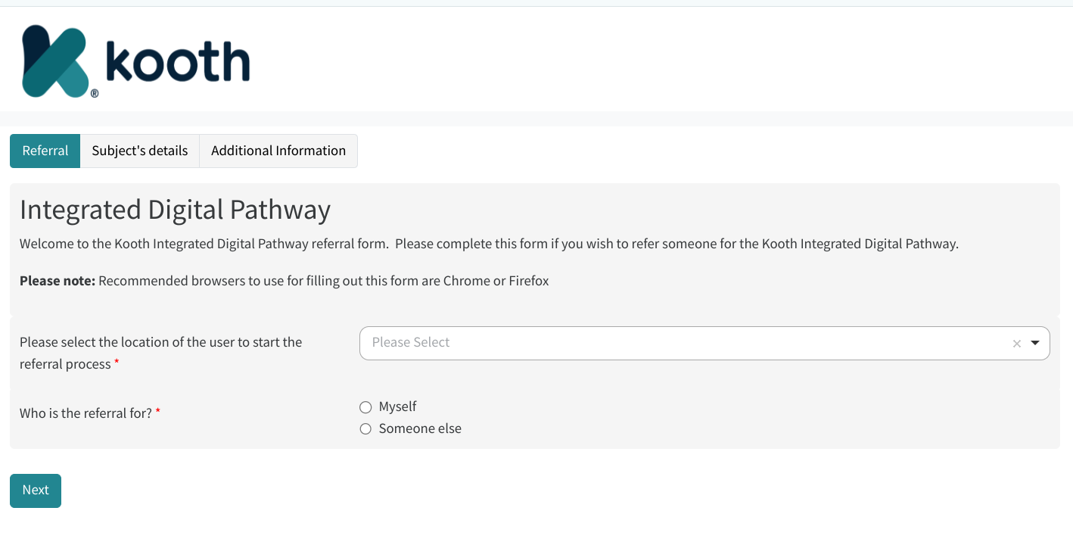
It’s really simple to sign up
Just click on our referral form to sign up.
Notes:
As you can see it’s really simple to sign up. You can do it yourself, or get an adult to sign up for you (like a parent or teacher).

Slide 5

What if I already use Kooth?
If you currently have an account with Kooth this will have closed on 31st October.
If you wish to continue to use the services you will need to re-register through the new sign-up process, either through referring yourself with parental/carer support or by being referred by a parent, carer or professional.
Notes:
Anyone aged 10 years or aged over 17 years will be signposted to other services who can help such as Mental Health School teams and Talking Therapies for those aged 17+.
This includes NHS Talking Therapies Berkshire Healthcare - a friendly and approachable NHS service that treats common issues like depression, stress, anxiety or phobias in those aged 17 years and up.
If you already use Kooth and currently have a named worker, these changes will be discussed together (you may have already chatted with your practitioner) and a plan for next steps of support will be co-designed and agreed.

Slide 6



Slide 7

Any questions?

