Slide 1


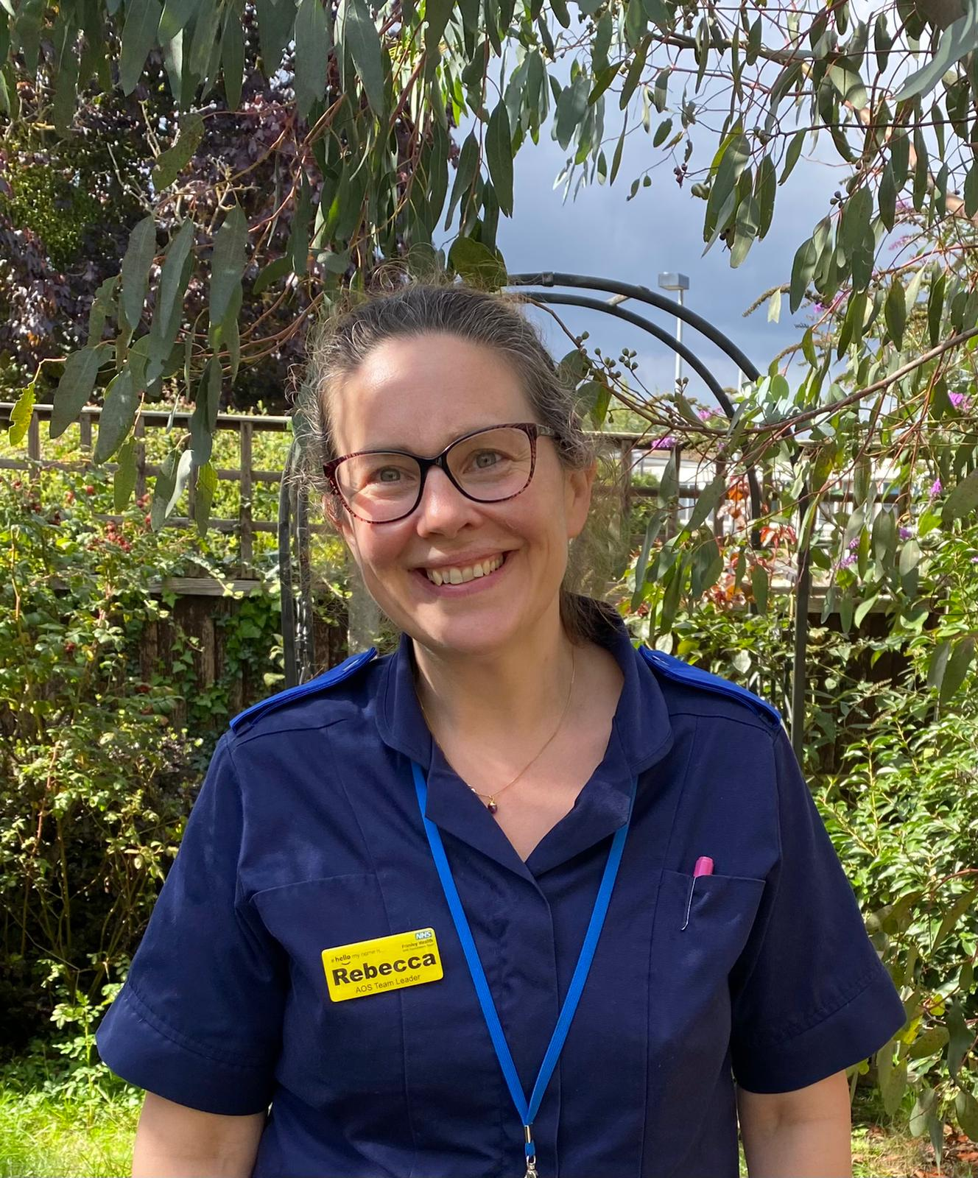
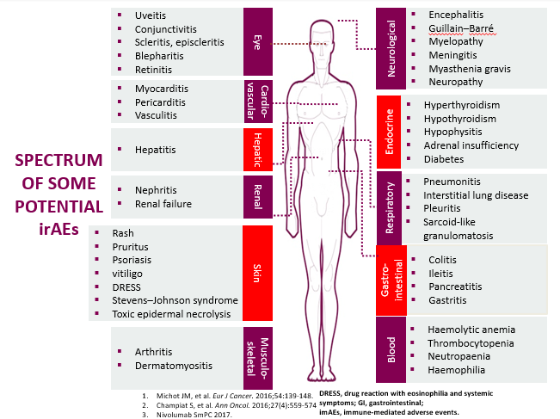
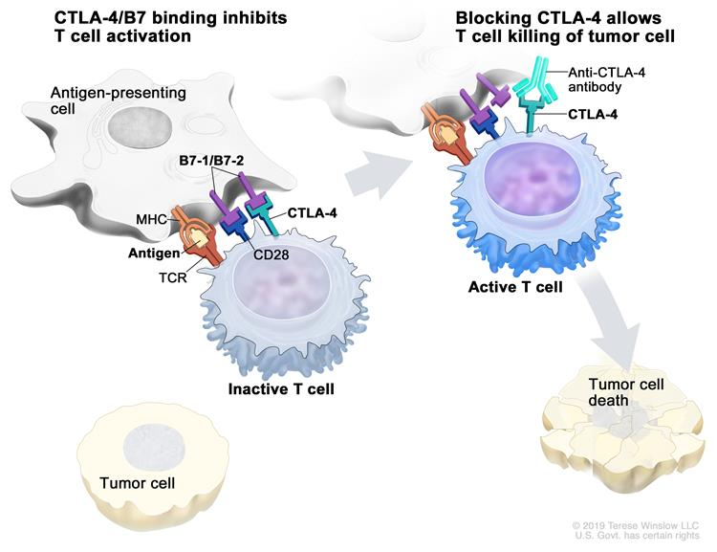


Free Cancer Care Across Boundaries (CCAB) Webinar
13th Oct 2022, 13:00-14:00
Topic : Immunotherapy Toxicities and management
Speaker: Rebecca Kirby (AOS Team Leader/TYA Lead Nurse, FHFT)
CCAB Registration Link-

