Slide 1

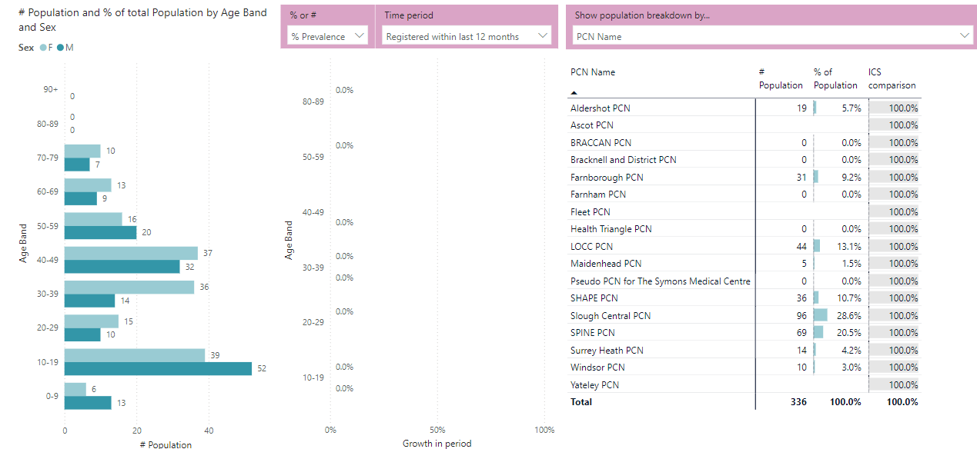
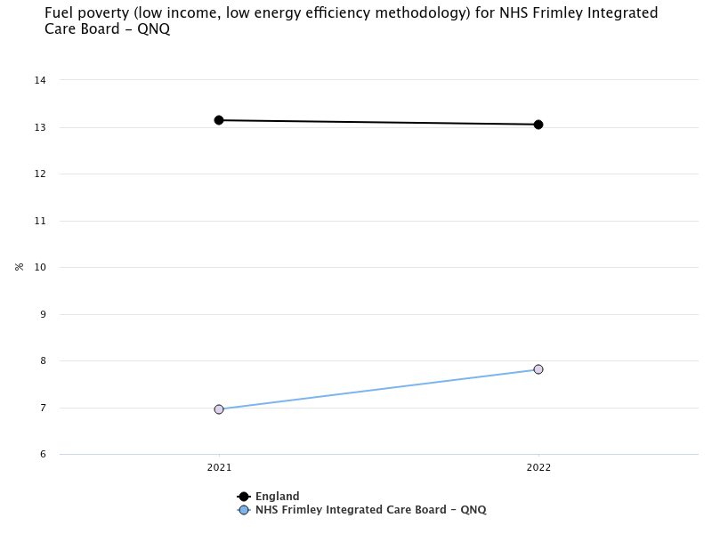
Fuel Poverty – System Approach
How many people are affected in England?
Over 3.17 million households (2023)
Almost 13.0 % of all households
Energy bills set to increase again soon by up to 10%
Areas to be covered by the service:
East Berkshire, Surrey Heath, and Rushmoor
Fuel poverty is a national problem. As a system fuel poverty is on the increase.
There is compelling evidence that the drivers of fuel poverty (low income, poor energy efficiency, and energy prices) are strongly linked to cold homes.
Evidence shows that living in cold homes is associated with poor health outcomes and an increased risk of morbidity and mortality for all age groups; furthermore, studies have shown that more than one in five (21.5%) excess winter deaths in England and Wales are attributable to the coldest quarter of housing.
Notes:
Connected Care data Criteria used - residents that are in low energy rating homes (E,F and G), in deprivation decile 1-4 and with a resident diagnosed with Asthma, and COPD and has a child living in the home.

Slide 2
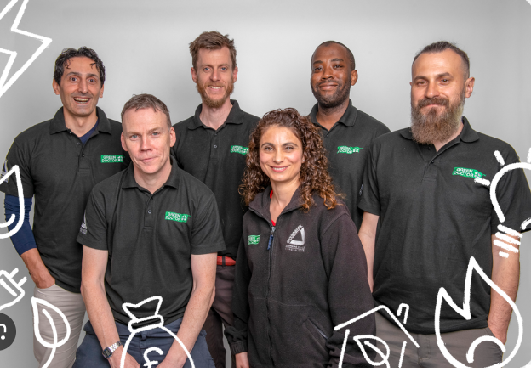

Green Doctors Thames Valley
Helping struggling households with energy bills & smarter consumption
Referral form link:
https://groundwork.my.salesforce-sites.com/thamesvalleygreendoctors
Email: Beatriz.Belfrage@groundwork.org.uk
Website: www.groundwork.org.uk/greendoctor
Freephone:
0300 365 3005
www.groundwork.org.uk/greendoctor
Notes:
How you can help – Green Doctors
Explanation of referral service
Priority services register
Referrals to schemes for measures

Slide 3
Green Doctors Service
Green Doctors are a team of expert energy advisers, delivering effective energy advice via home visits and telephone consultations. For 18 years the Green Doctors have helped over 45,000 UK households save money, stay warm and improve energy efficiency at home. Green Doctors is a flagship national programme of the UK based community charity Groundwork.
Green Doctors works within the local support ecosystem, partnering with:
Local Authorities,
NHS services (e.g. Social Prescribing Link Workers),
Citizens Advice
Food Banks and warm rooms
Emergency and Fire Services
and many more onwards referral organisations
to deliver free home visits/phone consultations, where we give advice on bills and provide referrals to further services to improve health and well-being of residents.
Notes:
How you can help – Green Doctors
Explanation of referral service
Priority services register
Referrals to schemes for measures

Slide 4
Green Doctors: Our aims
Improve health & wellbeing; reduce the impacts of cold homes
Service user
income
maximisation
Enable behavioural change and taking action
Notes:
How you can help – Green Doctors
Explanation of referral service
Priority services register
Referrals to schemes for measures

Slide 5
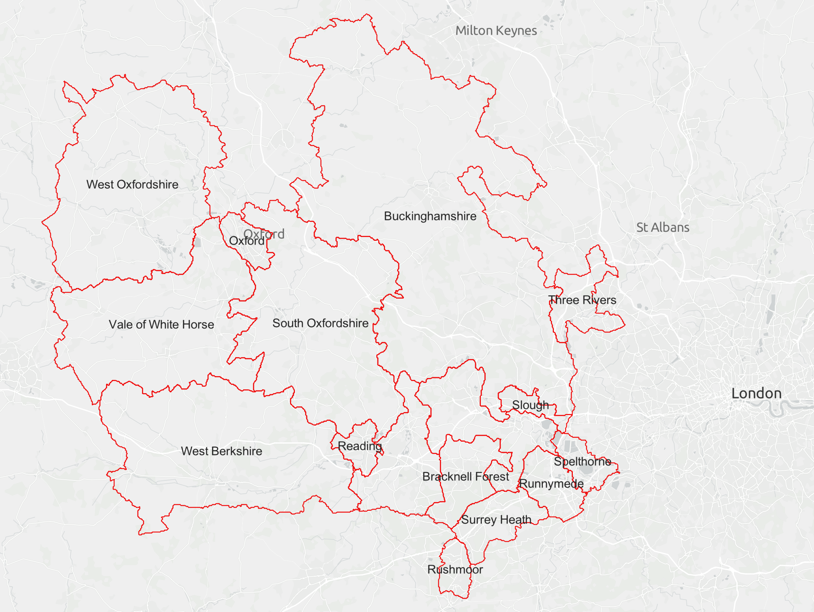
Green Doctors Thames Valley: where we operate

Slide 6
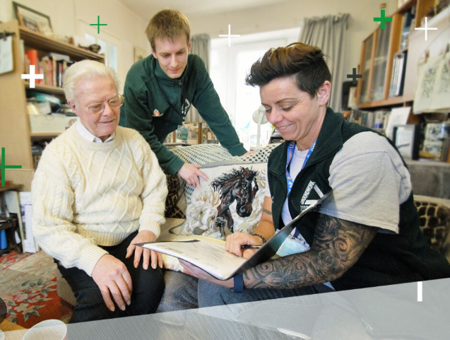
Green Doctors service general eligibility criteria
Respiratory issues
Disability or physical health condition
Low income
Living with debt
Mental health conditions
Dementia
In emergency accommodation
Poor housing conditions
In receipt of benefits
Household with 1 or more children
Single parent household with 1 or more children
Household with 1 or more people over 65
A member of the household is pregnant
Illustration by storyset on Freepik

Slide 7
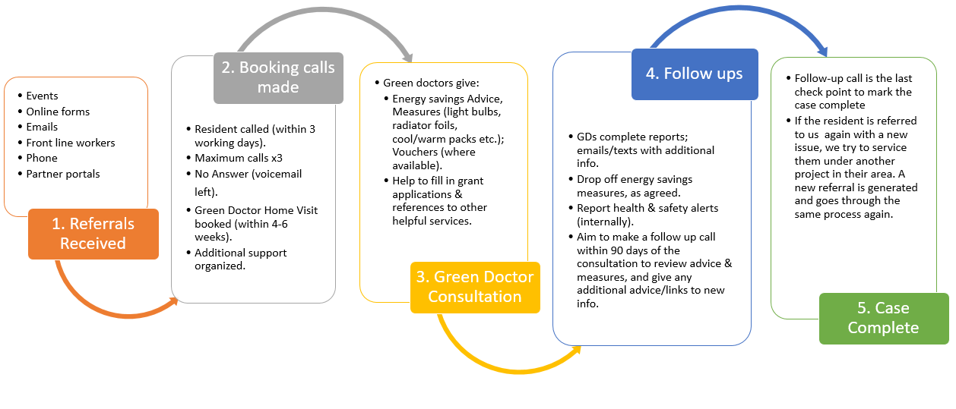
Green Doctor Service: Booking and Delivery Process​

Slide 8
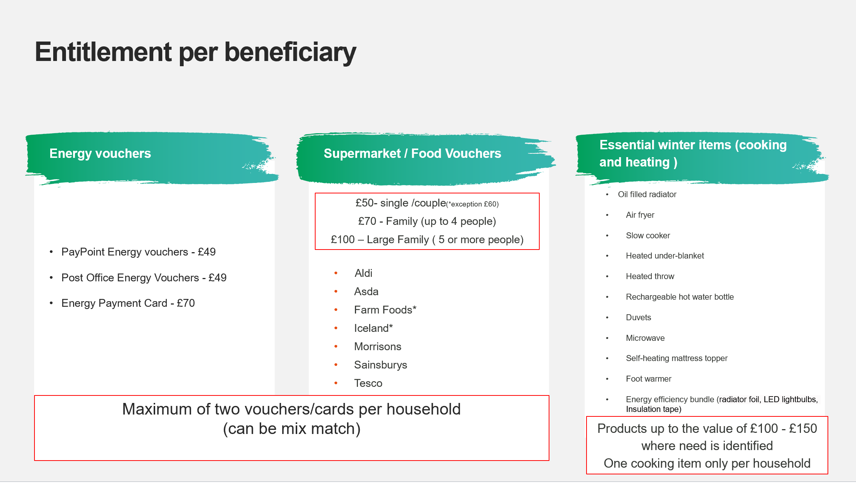
Additional Support funds Green Doctors can distribute: Cadent Winter Support Fund

Slide 9
Additional Support funds Green Doctors can distribute: Cadent Stay Warm Stay Well
Winter Warm Packs, containing:
1x thermal socks
1x thermal gloves
1x hot water bottle
1x fleece scarf
1x fleece blanket
1x thermal hat
1x insulated travel mug
1x thermometer card

Slide 10
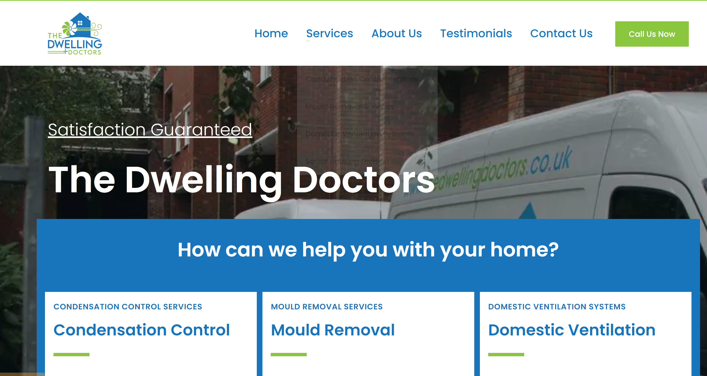
Additional Support funds Green Doctors can distribute: Cadent Household Repair Fund
The fund is aimed at helping to
prevent heat loss or
excess damp in a property
The Green Doctors have partnered with
Dwelling Doctors (pictured) to conduct a
free survey of properties and identify
the cause of damp, mould and draughtiness.

Slide 11
Additional Support funds Green Doctors can distribute: referral pathway for Home Upgrade Grant 2 (HUG2)
Onwards referral service for programmes like Home Upgrade Grant 2 (HUG2):
Energy saving improvements can I get for my home
insulation and ventilation upgrades to keep your home comfortable in both the winter and summer and help cut your energy bills
upgrade to a low carbon heating system to cut your carbon emissions (Please note the new heating system to be installed cannot be a gas or oil boiler.)
heating controls that help save you money because you only use the heat when you need it
energy-efficient hot water systems to keep your water warmer for longer and save you money
solar PV to generate free electricity
Grant eligibility
be a private domestic dwelling in England with an EPC rating of D, E, F or G.
2. in a pre-qualified postcode area (Indices of Multiple Deprivation Deciles 1-3, residents will be informed if this applies to their home) or
3. have a household income of no more than £36,000 (before tax or any other deductions).

Slide 12
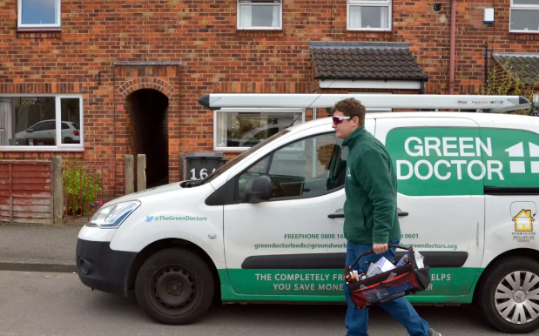
Questions?
Notes:
How you can help – Green Doctors
Explanation of referral service
Priority services register
Referrals to schemes for measures

