Slide 1

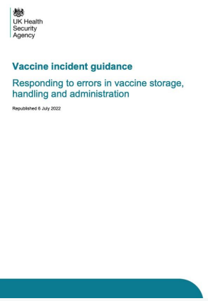
A Cold Chain Incident – What should you do?
Label and isolate vaccines involved or embargo the fridge
Determine when the cold chain was last guaranteed
Identify and keep a log of any patients who may have received an affected vaccine
Contact the vaccine manufacturers to ascertain the stability of the vaccines
Inform the Screening and Immunisation Team (Don’t dispose of any vaccines until you have)
Contact details for Screening and Immunisation Teams
  Hampshire and Isle of Wight: england.hiow-sit@nhs.net
  Surrey and Sussex: PHE.Screening-ImmsSSAT@nhs.net
  Thames Valley: england.tvatpublichealth@nhs.net
Ensure all staff are familiar with UKHSA Vaccine Incident Guidance as part of their Immunisation Training
Date: Aug 2024

