Slide 1

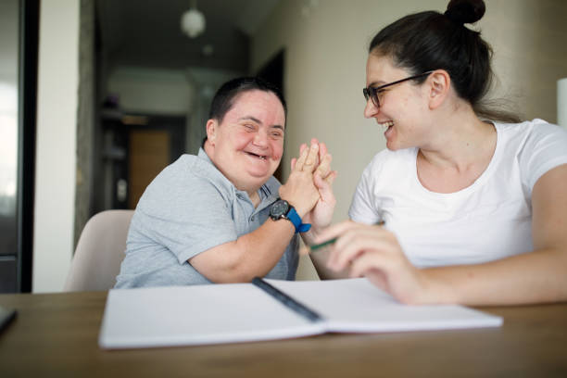
LeDeR
Learning from the lives and deaths of people with learning disabilities and autistic people
Learning Bulletin
Issue 5
August 2024
Frimley ICB LeDeR Programme contact:
frimleyicb.leder@nhs.net
Bracknell Forest North East Hampshire and Farnham Royal Borough of Windsor and Maidenhead Slough Surrey Heath

Slide 2
What is “LeDeR”?
LeDeR is a service improvement programme which aims to improve care, reduce health inequalities, and prevent premature mortality of adults with a learning disability and autistic adults by reviewing information about the health and social care support people received.
The LeDeR programme collates and shares the anonymised information about the deaths of people with learning disabilities and/or autistic people so that common themes, learning points and recommendations can be identified and taken forward into policy and practice improvements.
This bulletin summarises learning from LeDeR reviews with the aim of sharing insights and promoting improvement across our health and social care system.
Bracknell Forest North East Hampshire and Farnham Royal Borough of Windsor and Maidenhead Slough Surrey Heath

Slide 3


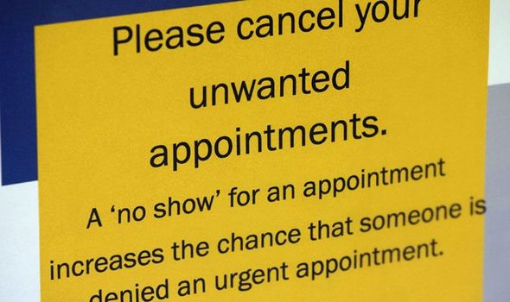
In the previous issue, we focused on the importance of Screening and Resources. The focus for this bulletin is DNAs – did not attend:
When a patient misses their appointment, it is referred to as a ‘Did Not Attend’ (DNA) or ‘Was Not Brought’ (WNB). During 2021/2022, nearly 7.5 million outpatient appointments were missed by patients, often for reasons outside of their control, and often linked to health inequalities. We know Non-attendance is a complex problem.
Patients told NHSE that when they miss an appointment, it often stems from difficulties with processes / communication, and they were more likely to miss an appointment if they had a poor experience of attending a healthcare appointment previously.
Some examples for DNAs are:
Patient has forgotten about the appointment / Patient has not attended because they felt they no longer needed the appointment / Patient unaware of appointment / Transport issues / Difficulty arranging support for the time of the appointment / Cost issues / Patient has not been brought to the appointment by a carer or guardian responsible for their care (‘was not brought’).
We know that some people with learning disabilities and autism can find it hard to use health services. Some of the above reasons will apply, yet we need to be mindful of further considerations / reasonable adjustments:
Did the individual / carers understand the importance or need for the appointment?
Are double appointments / early or late times considered / consistent staffing to accommodate their needs?
Are different ways of communicating required?
Has Easy read documentation been provided to help understanding?
Any help been offered with managing issues of consent in line with the Mental Capacity Act?
Are the individual / carers orientated well to time and place?
Use of an advocate to help understand any reasons that may cause a person to DNA (family or volunteer).
We know vulnerable patient meetings are conducted to provide a level of safety netting, but there are patients who are not known to services or not recognised as vulnerable.
There are numerous resources available for clinicians to support promoting the importance of screening / appointments and education for all people. These include: LeDeR - Resource Bank. [click link to access]
Frimley ICB are currently commencing works to address these issues. The ICS Safeguarding group is discussing further in the August meeting.
Bracknell Forest North East Hampshire and Farnham Royal Borough of Windsor and Maidenhead Slough Surrey Heath

Slide 4

Some key learning points from recent LeDeR reviews…
END OF LIFE - ADVANCE CARE PLANNING
An Advance Care Plan can guide family, carers, and healthcare professionals at a time when an individual may be too sick to make or communicate decisions. This needs to be handled sensitively and clearly communicated to those involved – what it means and why. It can help to convey a person’s wishes for later in life.
In some cases, we have seen this left too late, e.g. 6 hours prior to death. The ReSPECT process creates personalised recommendations for a person’s clinical care and treatment in a future emergency in which they are unable to make or express choices. It is also important to ensure they are reviewed when circumstances change.
CANCER SCREENING
Bowel / Breast / Cervical screening should be offered to all appropriate patients within the designated age groups. It is vital that clear reasoning / explanations are provided, and any anxieties acknowledged with reasonable adjustments being put in place. Lack of screening should be followed up to understand why this has occurred and to support compliance in the future. GPs are encouraged to share their lists of eligible people with LD with the NHS screening hubs so that tailored information can be sent to people with their invitations.
Capacity also needs to be considered.
CHOKING AWARENESS
SALT referrals / assessments are completed for dysphagia and choking when signs are noted. Training is provided regularly to carers / families to promote awareness and what the risk factors are. Within this, silent choking needs to be highlighted and how this can be managed. There can often be no outward signs and therefore a risk of death. Supported living accommodations should also have a level of knowledge to support management of this.
MENTAL HEALTH AND CAPACITY
An individual’s capacity should be assessed on a decision-by-decision basis, beginning from an assumption that the person has capacity.
This is an essential part of ensuring the right care is provided at the right time and place.
Please ensure appropriate language is used, and that it is clearly documented, timed and dated, and shared so that all health professionals are aware. We have seen cases where no MCA was completed whilst a person was being cared for at home by family.
LISTENING TO CARERS / FAMILIES
Carers and families should be listened to regarding individuals’ as they will know them best. Health professionals could misinterpret behaviours as indicating distress when this is normal for the person involved. Also, they should feel able to raise any queries with ease about their loved one / person in care, e.g., carers were unsure about feeding back queries regarding food and fluid intake.
IMMUNISATIONS
People with a Learning Disability can miss out on AHC and vaccinations (Influenza / shingles / pneumococcal / covid). Promoting reasonable adjustments, educational videos / promotion and MECC have all supported and encouraged uptake. Early vaccinations should be offered for highly vulnerable people. This continues to be a regular learning point raised.
COMMUNICATION
A broad topic encompassing numerous areas and essential among all services to clarify who is doing what, why, when and where. This is relevant to direct patient care and within commissioning services. Good communication results in positive collaboration and excellent holistic co-ordinated care.
Bracknell Forest North East Hampshire and Farnham Royal Borough of Windsor and Maidenhead Slough Surrey Heath

Slide 5

We’re doing a lot of good things too. Here is some good practice picked up by our reviews…
Good overall monitoring of individuals’ health
Praise was given to the wider professional network who showed consistent support and an approach that was culturally sensitive and competent, allowing the family to access support as required
Good communication reported amongst the supported living environment and all services involved with patient care
Holistic, consistent and thorough care provided by GP and GP practice staff
GP provided Flu vaccine at Annual Health Check (AHC) due to dosage being missed whilst an inpatient
SALT referral completed following observations of possible choke / cough post eating and drinking
Regular support from Frimley Park Hospital LD Liaison Nurses during admission
Bracknell Forest North East Hampshire and Farnham Royal Borough of Windsor and Maidenhead Slough Surrey Heath

Slide 6
Further resources and training available:
Bespoke, local and Small – Small Supports for people with complicated lives and support needs
National Development team for Inclusion (NDTi) are pleased to launch a new monthly programme of online events for 2024; people involved in the programme and the day-to-day delivery of support to people will be sharing their thoughts, words and much learning over the coming months.
These events will mostly be on the last Thursday of the month between 12 and 1pm, so please come along, bring your lunch and spend an hour learning more about the work of Small Supports Organisations and the NDTi programme.
The link to the page with more details and registration links is here.
For more information, please email Nic Crosby – nic.crosby@ndti.org.uk.
Reasonable Adjustments Digital Flag: Health and social care staff training now available
Staff training for the Reasonable Adjustment Digital Flag is now available on the eLearning for healthcare website. This training is available to all health and social care staff and support organisations to meet their obligations under the Reasonable Adjustment Digital Flag Information Standard. Under this Standard, organisations must provide training as mandated within the Health and Social Care Act (2012).
The training has been developed with subject matter expertise and has been thoroughly tested across a range of clinical and administrative professions. The training will support staff working across health and social care to be able to provide the right care and treatment by making sure that the reasonable adjustment needs for disabled people are supported.
This is a single, short module covering the background, what reasonable adjustments are and the 6-step process to identify people with a disability or impairment (including autistic people and people with a learning disability) and their reasonable adjustment needs, to make access to care fair.
Maximising the contribution of AHPs in mental health, learning disability and autism settings
NHS England has produced a practical toolkit on maximising the contribution of Allied Health Professionals (AHPs) within mental health, learning disability and autism settings.
The toolkit is intended as a guide for commissioners of mental health, learning disability, and autism services about the opportunities that AHPs present to this workforce. It can be used to support local and regional workforce decision-making. The document gives examples about the services the AHP community offers, and how they can be most efficiently and effectively utilised across primary and secondary care.
Bracknell Forest North East Hampshire and Farnham Royal Borough of Windsor and Maidenhead Slough Surrey Heath

Slide 7
Further resources and training available:
National Guidance on Meeting the Needs of Autistic Adults Webinar
A webinar on National Guidance for Meeting the Needs of Autistic Adults in Mental Health Services was held in May, and the recording is available on the FutureNHS platform.
Introduced by Tom Cahill, National Director for Learning Disabilities and Autism, the webinar was aimed at ICB leads and mental health commissioners. The session helped equip colleagues with an understanding of 10 key principles set out in National Guidance to improve the quality, accessibility and acceptability of care and support for autistic adults to meet their mental health needs, both in the community and in inpatient settings. The webinar also provided an overview of the complementary national guidance to support integrated care boards to commission acute mental health inpatient services for adults with a learning disability and autistic adults. Those who were unable to attend the live event are encouraged to watch the recording.
Autism Central: New Podcast and Webinar Series for Professionals, Parents, and Carers
Autism Central, funded by NHS England, is thrilled to announce the launch of two new educational series designed to support parents and carers of autistic adults, young people and children.
The podcast series, Sensory Processing Focus, will be hosted by Holly Sprake-Hill, a neurodivergent occupational therapist, and will bring together autistic people, parents, carers, and professionals to explore sensory processing. Key episodes will include:
Sensory Needs of Non-Speaking Children
Experiencing Sensory Differences as an Autistic Person
Sensory Processing as a Non-Speaking Autistic Person
There is also a new webinar series from Autism Central called Finding the Balance, which will include six insightful episodes.
For more information, visit Autism Central.
Bracknell Forest North East Hampshire and Farnham Royal Borough of Windsor and Maidenhead Slough Surrey Heath

Slide 8
Further resources and training available:
Screening Materials:
Cervical cancer screening video https://vimeo.com/769007467/a7cb5e2ef9
Breast cancer screening video https://vimeo.com/769006029/3b509bd6bf
Annual Health Check https://vimeo.com/769003679/a92801765f
Annual Health Check (Makaton version) https://vimeo.com/806387559/3721239f2c
Bowel Cancer screening video https://vimeo.com/769004795
Breast follow up video https://vimeo.com/832083432?share=copy
Cervical follow up video https://vimeo.com/832081270?share=copy
Colposcopy Treatment https://vimeo.com/832088080?share=copy
Bowel follow up video https://vimeo.com/832086347?share=copy
Easy Read Leaflets for use in Primary Care
To promote and support equitable and high-quality services, NHS England have resources available at LeDeR - Resource Bank
There are a variety of Easy read guides and short films to help provide clarity and understanding to our populations.
We encourage services to make use of any of the resources here that would help ensure people with learning disabilities and autistic people are supported to access the care and treatment they need.
Health and Care Passport template and guidance - NHS England » Health and care passports
The plain English and easy read guidance on how to the complete the health and care passport template is for people with a learning disability, autistic people, their families and carers.
Bracknell Forest North East Hampshire and Farnham Royal Borough of Windsor and Maidenhead Slough Surrey Heath

