Slide 1
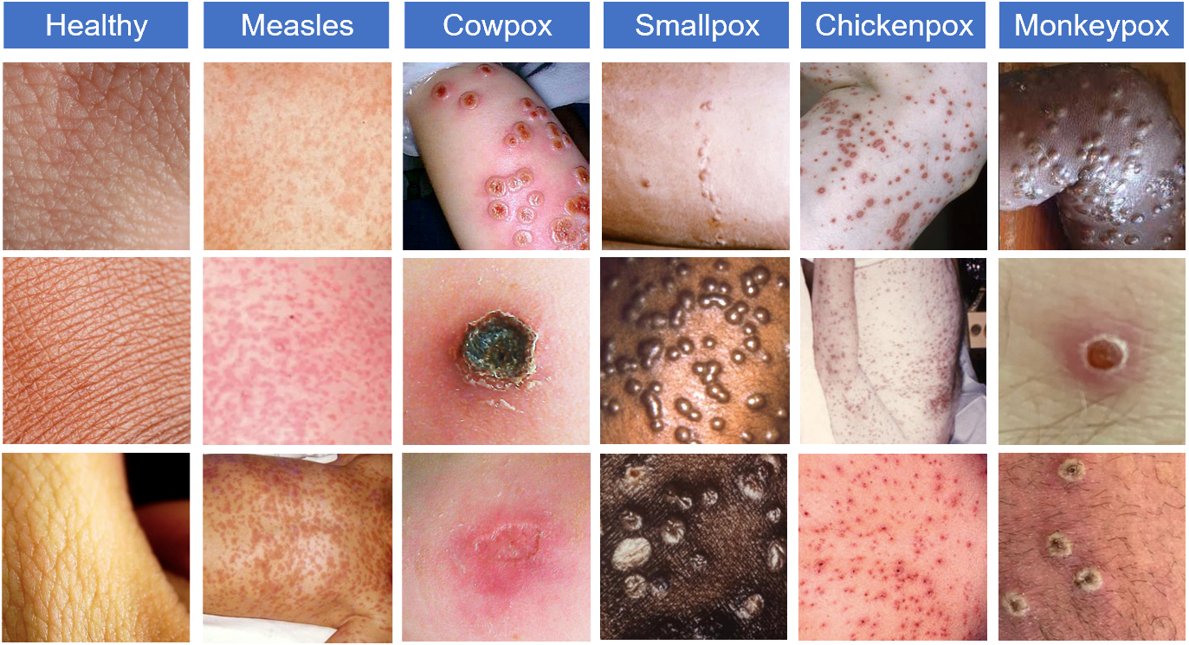
Example skin images of Monkeypox, Chickenpox, Smallpox, Cowpox,... | Download Scientific Diagram (researchgate.net)

