Slide 1

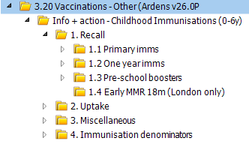
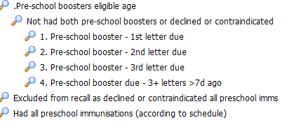
Information on running searches within EMIS to improve uptake of Pre-school boosters
As children of this age start school, it is important that they are protected against a range of unpleasant and often serious childhood diseases.
Please complete the following actions.
Search: Please use the Recall search below within EMIS to identify all children who have not had both pre-school boosters
(Please use this LINK to view the childhood immunisation resources developed by Ardens to assist practices)
2. Text the suggested following text message: -
Is your child starting school in September? Our records show that your child is not up to date with their pre-school immunisations. Give your child the best protection against serious childhood diseases as they grow up. Contact your child’s GP practice to book their appointment. https://www.nhs.uk/vaccinations/4-in-1-preschool-booster-vaccine/ www.nhs.uk/mmr
Bracknell Forest North East Hampshire and Farnham Royal Borough of Windsor and Maidenhead Slough Surrey Heath

