Slide 1

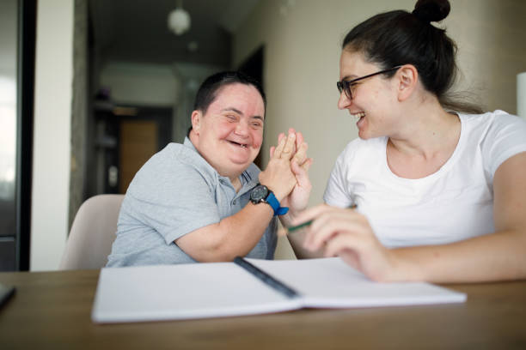
LeDeR
Learning from the lives and deaths of people with learning disabilities and autistic people
Learning Bulletin
Issue 4
April 2024
Frimley ICB LeDeR Programme contact:
frimleyicb.leder@nhs.net
Bracknell Forest North East Hampshire and Farnham Royal Borough of Windsor and Maidenhead Slough Surrey Heath

Slide 2
What is “LeDeR”?
LeDeR is a service improvement programme which aims to improve care, reduce health inequalities, and prevent premature mortality of adults with a learning disability and autistic adults by reviewing information about the health and social care support people received.
The LeDeR programme collates and shares the anonymised information about the deaths of people with learning disabilities and/or autistic people so that common themes, learning points and recommendations can be identified and taken forward into policy and practice improvements.
This bulletin summarises learning from LeDeR reviews with the aim of sharing insights and promoting improvement across our health and social care system.
Bracknell Forest North East Hampshire and Farnham Royal Borough of Windsor and Maidenhead Slough Surrey Heath

Slide 3
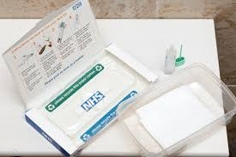
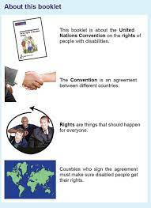
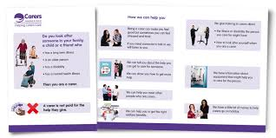
In the previous issue, we focused on the importance of Capacity. The focus this bulletin is SCREENING AND RESOURCES available to support:
From National statistics, it is known people with a learning disability and or autism have a lower compliance rate with Cancer screening compared to people without. This also applies to our Frimley ICS population and levels can vary between PLACE. From our LeDeR reviews, there can be no evidence of screening offers at times to no follow ups for invitations declined or ignored.
There are a number of reasons this may occur, including lack of understanding and or support, fear and anxiety and lack of reasonable adjustments made. It is vital that the importance of screening is explained to people in ways they can understand, and reasonable adjustments considered to support this. This might involve easy-read literature, videos, and explanations by a clinician or carer. Annual health checks can also be supportive in the promotion of screening.
There are numerous resources available for clinicians to support promoting the importance of screening and education for all people. We encourage services to make use of these which include:
LeDeR - Resource Bank
See page 7 of the bulletin for further resource details.
It is important that we do not assume that someone with LD or an autistic person would not have the capacity to make an informed choice about screening. A mental capacity assessment can establish the capacity to choose, and a best interest decision can be documented for someone found not to have capacity.
Frimley ICS are also focussing on this topic in the Core 20 plus 5 workstream.
Bracknell Forest North East Hampshire and Farnham Royal Borough of Windsor and Maidenhead Slough Surrey Heath

Slide 4

Some key learning points from recent LeDeR reviews…
ADVANCE CARE PLANNING - DNACPR
An Advance Care Plan can guide family, carers, and healthcare professionals at a time when an individual may be too sick to make or communicate decisions. This needs to be handled sensitively and clearly communicated to those involved – what it means and why. It can help to convey a person’s wishes for later in life.
In some cases, we have seen this left too late. The ReSPECT process creates personalised recommendations for a person’s clinical care and treatment in a future emergency in which they are unable to make or express choices. It is also important to ensure they are reviewed when circumstances change.
CARERS’ ASSESSMENTS
Carers’ assessments should be offered routinely to anyone who acts as a carer. This will help to ensure that they can talk about how they are coping, and any additional support needed can be scoped. All healthcare professionals should be able to support / signpost carers appropriately. At times, people may not acknowledge they are a carer and statistics show they are twice as likely to experience poor health compared to non - carers. This indicates the need for in depth assessment / discussion.
REASONABLE ADJUSTMENTS
This is a legal requirement to make sure health services are accessible to all people. There may be a long-term dislike and difficulty in having tests completed, e.g. blood tests, medical monitoring carried out or screening avoided for example. Health professionals should be aware of and understand patients’ needs to be able to support and complete tasks in the most appropriate and supportive manner. Longer and time of day for appointments, family to escort, resources to understand etc. Annual health checks and plans, Health passports and an up-to-date LD register can support these works.
LISTENING TO CARERS / FAMILIES
Carers and families should be listened to regarding an individuals’ communication methods as they will know them best. Health professionals could misinterpret behaviours as indicating distress when this is normal for the person involved.
MENTAL HEALTH AND CAPACITY
An individual’s capacity should be assessed on a decision -by -decision basis, beginning from an assumption that the person has capacity.
This is an essential part of ensuring the right care is provided at the right time and place.
Please ensure appropriate language is used, it is clearly documented and timed / dated so all Health professionals are aware at that specific time of the circumstance.
IMMUNISATIONS
People with a Learning disability can miss out on AHC and vaccinations (Influenza / shingles / pneumococcal / covid). Promoting reasonable adjustments, educational videos / promotion and MECC have all supported and encouraged uptake. Early vaccinations should be offered for highly vulnerable people.
MDT WORKING – decision making
Care provision can often be extremely well co-ordinated between Care homes / Supported living accommodations / Community teams / Primary and Secondary care. Yet, at times, it is noted with complex medical patients the lack of collaborative working or communication can affect full investigations being completed in a timely fashion and therefore the long-term management of patients. This can also provide further stress and anxiety for carers or loved ones.
Bracknell Forest North East Hampshire and Farnham Royal Borough of Windsor and Maidenhead Slough Surrey Heath

Slide 5

We’re doing a lot of good things too. Here is some good practice picked up by our reviews…
Demonstration of holistic care provided by all professionals involved
Family member / main carer allowed to stay and support the individual in hospital as required and needed
Compassion and attention given to aiming for the end of life scenario desired by the individual
Reasonable adjustments were made to accommodate vaccinations and blood tests
GP practice provided spare medications for use as tablets would occasionally be spat out for vital medications
The Care home facilitated good progress with her after she had initially been deemed palliative
Excellent holistic care provided from GP / GP practice
Bracknell Forest North East Hampshire and Farnham Royal Borough of Windsor and Maidenhead Slough Surrey Heath

Slide 6
Further resources and training available:
-
Bespoke, local and Small – Small Supports for people with complicated lives and support needs
National Development team for Inclusion (NDTi) are pleased to launch a new monthly programme of online events for 2024. These events will mostly be on the last Thursday of the month between 12 and 1pm. The link to the page with more details and registration links is here.
For more information please email Nic Crosby – nic.crosby@ndti.org.uk.
- National Autism Webinar - Meeting the needs of autistic adults in mental health services – Wednesday 15 May
ICB Exec leads and mental health commissioners are invited to attend this webinar, which focuses on the recently published national guidance: meeting the needs of autistic adults in mental health services.
This webinar will equip ICB leads with an understanding of 10 key principles to improve the quality, accessibility and acceptability of care and support for autistic adults to meet their mental health needs, both in the community and in inpatient settings. In this webinar, we will cover:
To attend this webinar, please register on the NHS England events webpage.
- Reasonable Adjustments Digital Flag: Health and social care staff training now available
Staff training for the Reasonable Adjustment Digital Flag is now available on the eLearning for healthcare website. This training is available to all health and social care staff and support organisations to meet their obligations under the Reasonable Adjustment Digital Flag Information Standard. Under this Standard, organisations must provide training as mandated within the Health and Social Care Act (2012).
This is a single, short module covering the background, what reasonable adjustments are and the 6-step process to identify people with a disability or impairment (including autistic people and people with a learning disability) and their reasonable adjustment needs, to make access to care fair.
Bracknell Forest North East Hampshire and Farnham Royal Borough of Windsor and Maidenhead Slough Surrey Heath

Slide 7
Continued…
Screening Materials:
Cervical cancer screening video https://vimeo.com/769007467/a7cb5e2ef9
Breast cancer screening video https://vimeo.com/769006029/3b509bd6bf
Annual Health Check https://vimeo.com/769003679/a92801765f
Annual Health Check (Makaton version) https://vimeo.com/806387559/3721239f2c
Bowel Cancer screening video https://vimeo.com/769004795
Breast follow up video https://vimeo.com/832083432?share=copy
Cervical follow up video https://vimeo.com/832081270?share=copy
Colposcopy Treatment https://vimeo.com/832088080?share=copy
Bowel follow up video https://vimeo.com/832086347?share=copy
Easy Read Leaflets for use in Primary Care
To promote and support equitable and high-quality services, NHS England have the below link of resources available:
LeDeR - Resource Bank
There are a variety of Easy read guides and short films to help provide clarity and understanding to our populations.
We encourage services to make use of any of the resources here that would help ensure people with learning disabilities and autistic people are supported to access the care and treatment they need.
Bracknell Forest North East Hampshire and Farnham Royal Borough of Windsor and Maidenhead Slough Surrey Heath

