Slide 1

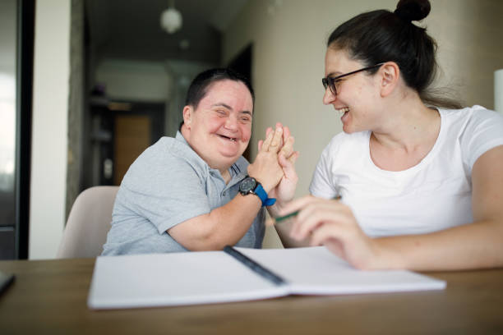
LeDeR
Learning from the lives and deaths of people with learning disabilities and autistic people
Learning Bulletin
Issue 2
October 2023
Frimley ICB LeDeR Programme contact:
frimleyicb.leder@nhs.net
Bracknell Forest North East Hampshire and Farnham Royal Borough of Windsor and Maidenhead Slough Surrey Heath

Slide 2
What is “LeDeR”?
LeDeR is a service improvement programme which aims to improve care, reduce health inequalities, and prevent premature mortality of adults with a learning disability and autistic adults by reviewing information about the health and social care support people received.
The LeDeR programme collates and shares the anonymised information about the deaths of people with learning disabilities and/or autistic people so that common themes, learning points and recommendations can be identified and taken forward into policy and practice improvements.
This bulletin summarises learning from LeDeR reviews with the aim of sharing insights and promoting improvement across our health and social care system.
Bracknell Forest North East Hampshire and Farnham Royal Borough of Windsor and Maidenhead Slough Surrey Heath

Slide 3
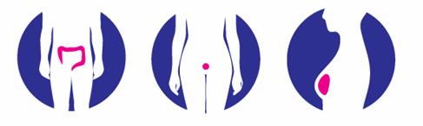
In the previous issue, we focused on the importance of Annual Health Checks and Health Action Plans. Here we look at some of the other learning and good practice from recent LeDeR reviews…
Cancer Screening
Latest data show that the percentage of eligible people with LD screened in Frimley ICB is significantly lower compared to the eligible general population. Decline rates are also higher among the LD population.
Frequently, LeDeR reviews have found that eligible people with LD have either declined or simply not responded to screening invitations. There is often no documented reason for this, and no evidence as to whether mental capacity has been assessed in relation to a decision.
In some cases, cervical screening has been declined because the individual is not sexually active. While sexual history may influence someone’s risk, it shouldn’t determine whether they can have cervical screening.
Many people, not just people with LD or autistic people, are anxious about screening procedures. It is vital that the importance of screening is explained to people in ways they can understand. This might involve easy-read literature, videos, and explanations by a clinician or carer. Information and resources: Population screening: supporting people with a learning disability - GOV.UK (www.gov.uk)
It is also vital that anxieties are understood, and reasonable adjustments offered to make procedures more tolerable. This might involve, for example, being accompanied by someone for support, or consideration of medication that might help during the procedure.
It is important that we do not assume that someone with LD or an autistic person would not have the capacity to make an informed choice about screening. A mental capacity assessment can establish the capacity to choose, and a best interest decision can be documented for someone found not to have capacity.
Clinicians, carers and family can offer information and support to an individual if they have not responded to a screening invitation. GPs can check on people on their LD registers and, importantly, this can be discussed at the Annual Health Check. An explanation and support plan may make the difference as to whether someone receives the screening to which they are entitled.
GPs are encouraged to share their lists of eligible people with LD with the NHS screening hubs so that tailored information can be sent to people with their invitations.
BOWEL
CERVICAL
BREAST
Bowel cancer screening is offered to people starting from the age of 50-60 up to 74 in England.
Breast cancer screening is offered to women (including some transgender women), some transgender men and some non-binary people aged 50-70 in the UK.
Cervical screening is offered to women, some transgender men and some non-binary people aged 25-64 in the UK.
Bracknell Forest North East Hampshire and Farnham Royal Borough of Windsor and Maidenhead Slough Surrey Heath

Slide 4

Some other key learning points from recent LeDeR reviews…
ADVANCE CARE PLANNING
An Advance Care Plan can guide family, carers, and healthcare professionals at a time when an individual may be too sick to make or communicate decisions. It can help to convey a person’s wishes for later in life. In some cases, we have seen this left too late. The ReSPECT process creates personalised recommendations for a person’s clinical care and treatment in a future emergency in which they are unable to make or express choices.
HOSPITAL PASSPORTS
An up-to-date hospital passport can help hospital staff care for and interact with an individual in the best ways. Professionals and carers can help in ensuring a passport is in place and goes with the individual on admission.
CARERS’ ASSESSMENTS
Carers’ assessments should be offered routinely to anyone who acts as a carer. This will help to ensure that they can talk about how they are coping, and any additional support needed can be scoped.
COMMUNICATION WITH FAMILIES AND CARERS
Families and carers usually know a person best, and, with the individual’s consent where appropriate, should be involved in care and treatment. We must listen to families and carers and keep them informed; they often have crucial information which can help an individual to get the very best care.
CONTINUING HEALTHCARE
When someone’s healthcare needs change, they may require a higher level of support. This may mean that they are eligible for additional funding via ‘Continuing Healthcare’. Health and care professionals should consider when this may be appropriate and expedite an assessment.
DISCHARGE PLANNING
Ensure all parties involved (patient, carers, hospital team, GP etc.) are part of the discharge process so everyone is apprised of the ongoing issues, and potential problems can be addressed before discharge. It is crucial that when a person is discharged it is to the right place (have their needs changed?) and that they are followed up
END OF LIFE – PALLIATIVE CARE
In one case, we found that the palliative team had not been involved soon enough. The palliative care team, especially in the community, could have acted as a link for other teams and carers to enable improved multi-disciplinary working. With the support of the LD team the palliative care team could have provided physical and psychological support to the patient at a time when they needed it.
Bracknell Forest North East Hampshire and Farnham Royal Borough of Windsor and Maidenhead Slough Surrey Heath

Slide 5

We’re doing a lot of good things too. Here is some good practice picked up by our reviews…
His parents said they were very well supported by the hospice team and were supported to be with person until he passed away. They had positive feedback for the service.
The patient did not attend her mammogram, so easy read information was sent, and the matter discussed with her carers. Following that, she underwent the procedure successfully.
The family praised the care received at the care home. The care home manager went above and beyond staying with her when her family could not be with her. They made it possible for end-of-life care to take place at home rather than being moved to a hospice.
The family praised Frimley Park Hospital as they treated their loved-one like a VIP or guest. The family were overwhelmed by how kind and tolerant all the staff were; they went the extra mile to look after him when he went for surgery.
He was fully involved with his DNACPR and died where and how he wanted to.
Bracknell Forest North East Hampshire and Farnham Royal Borough of Windsor and Maidenhead Slough Surrey Heath

