Slide 1

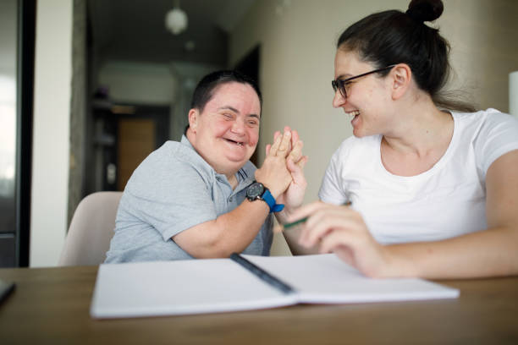
LeDeR
Learning from the lives and deaths of people with learning disabilities and autistic people
Learning Bulletin
Issue 3
March 2024
Frimley ICB LeDeR Programme contact:
frimleyicb.leder@nhs.net
Bracknell Forest North East Hampshire and Farnham Royal Borough of Windsor and Maidenhead Slough Surrey Heath

Slide 2
What is “LeDeR”?
LeDeR is a service improvement programme which aims to improve care, reduce health inequalities, and prevent premature mortality of adults with a learning disability and autistic adults by reviewing information about the health and social care support people received.
The LeDeR programme collates and shares the anonymised information about the deaths of people with learning disabilities and/or autistic people so that common themes, learning points and recommendations can be identified and taken forward into policy and practice improvements.
This bulletin summarises learning from LeDeR reviews with the aim of sharing insights and promoting improvement across our health and social care system.
Bracknell Forest North East Hampshire and Farnham Royal Borough of Windsor and Maidenhead Slough Surrey Heath

Slide 3
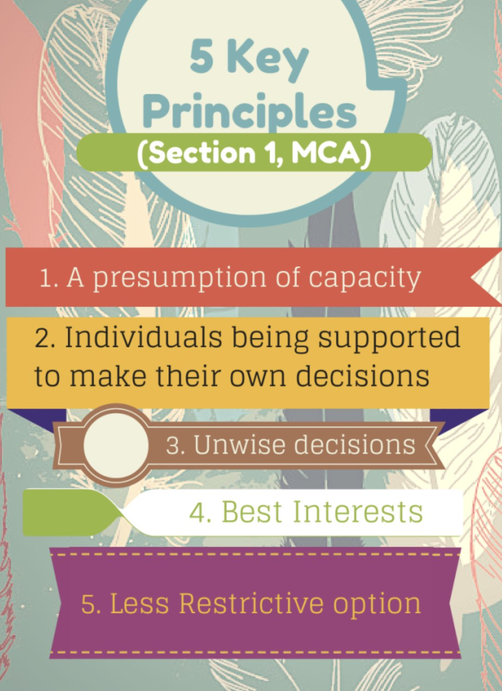
In the previous issue, we focused on the importance of Cancer Screening. Here we look at some of the other learning and good practice from recent LeDeR reviews…
MENTAL CAPACITY ASSESSMENTS AND BEST INTEREST DECISIONS
This aims to protect those who lack the mental capacity to make their own decisions about their care / treatment and to help them take part as much as possible in decisions affecting them.
AN INDIVIDUAL’S CAPACITY SHOULD BE ASSESSED ON A DECISION -BY -DECISION BASIS, BEGINNING FROM AN ASSUMPTION THAT THE PERSON HAS CAPACITY.
Steps should be taken to help the person make their own decision. Were family / carers consulted and involved? We must listen to families and carers and keep them informed; they often have crucial information which can help an individual to get the very best care.
It applies to those persons aged 16 and over who are habitually resident or present in England and Wales, for all decisions whether life-changing or everyday matters.
Decision makers can vary from family / friends / carers to healthcare professionals, Power of Attorney and Court Protections.
Independent Mental Capacity Advocates (IMCA) and Relevant Person’s Representatives (RPRs) are also available to support decisions.
If a person is assessed as lacking capacity, any decision taken on their behalf should be done in their Best Interests.
Often a best interest meeting is held to being those together to discuss and reach a consensus.
Best interests decision making should not be based on assumptions or imposing beliefs onto other people.
Best Interest meetings are most appropriate for complex decisions such as decisions about a person’s care package, where the person should live, or for having serious medical treatments.
Both should be documented clearly, explanation provided and timed / dated.
It must NOT be assumed that someone does not have capacity because they have a learning disability.
Bracknell Forest North East Hampshire and Farnham Royal Borough of Windsor and Maidenhead Slough Surrey Heath

Slide 4

Some other key learning points from recent LeDeR reviews…
ADVANCE CARE PLANNING - DNACPR
An Advance Care Plan can guide family, carers, and healthcare professionals at a time when an individual may be too sick to make or communicate decisions. This needs to be handled sensitively and clearly communicated to those involved – what it means and why. It can help to convey a person’s wishes for later in life.
In some cases, we have seen this left too late. The ReSPECT process creates personalised recommendations for a person’s clinical care and treatment in a future emergency in which they are unable to make or express choices.
HOSPITAL PASSPORTS
An up-to-date hospital passport can help hospital staff care for and interact with an individual in the best ways. Professionals and carers can help in ensuring a passport is in place and goes with the individual on admission. E.g. an individual wears their glasses 24/7 and becomes agitated / upset when taken away at night. LiA group priority.
CARERS’ ASSESSMENTS
Carers’ assessments should be offered routinely to anyone who acts as a carer. This will help to ensure that they can talk about how they are coping, and any additional support needed can be scoped. All healthcare professionals should be able to support / signpost carers appropriately.
AUTISM ASSESSMENT
For any patients with autistic traits, formal assessment and diagnosis should be completed to ensure appropriate support is available and put in place. This includes advice and help understanding behaviours for all involved.
COMMUNICATION WITH patients
Healthcare professionals are known for using abbreviated or medical jargon that is not fully comprehended by patients. This was noted in one case and how reasonable adjustments / resources were available via the LD nurses / team to promote understanding for all involved.
IMMUNISATIONS
Influenza and Pneumonia was one of the most frequently cited causes of death (for all ages) reported to LeDeR between 2018 – 2021. People with a Learning disability can miss out of AHC and vaccinations. Promoting reasonable adjustments, educational videos / promotion and MECC have all supported and encouraged uptake.
ANNUAL HEALTH CHECKS
NHSE ambition by 2023/24 at least 75% of people aged 14 and over on a Learning disability register will receive an AHC and associated Health action plan. Evidence suggests that providing annual health checks to people with learning disabilities in primary care is effective in identifying previously unrecognised health needs, including those associated with life-threatening illnesses.
GPs in Frimley ICS have made great strides in increasing the number of Annual Health Checks and Health Action Plans completed. These are being regularly audited for Quality and effectiveness.
Bracknell Forest North East Hampshire and Farnham Royal Borough of Windsor and Maidenhead Slough Surrey Heath

Slide 5

We’re doing a lot of good things too. Here is some good practice picked up by our reviews…
Annual Health Checks were completed and these supported attempts to address general health and lifestyle issues.
LiA group focusing on the Quality of AHCs also
CTPLD Quality of care – professionals meeting was arranged by the CTPLD nurse indicating excellent holistic and patient centred care.
Bracknell Forest North East Hampshire and Farnham Royal Borough of Windsor and Maidenhead Slough Surrey Heath

