Slide 1
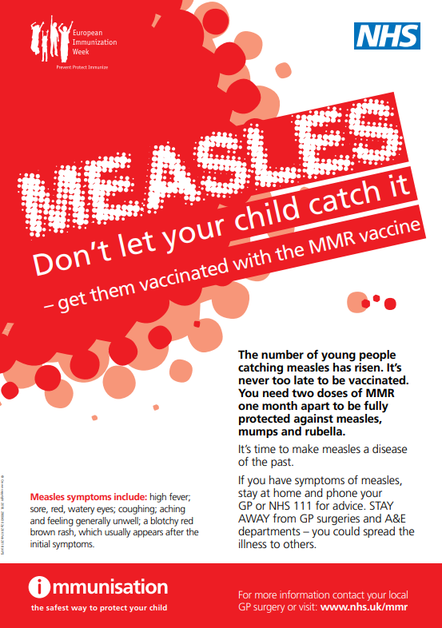
Measles, Mumps and Rubella (MMR) Vaccine
Frequently Asked Questions (FAQs)
February 2024

Slide 2
MMR vaccine protects against three infections
MMR vaccine protects against three infections measles, mumps and rubella. These are viral infections that can quickly spread to unprotected children and adults, they spread more easily than flu or the common cold.
Measles
Measles is a very infectious viral illness that is spread by coughs and sneezes. If you are not protected and have even passing contact with someone who has measles, the chances are that you will be infected too. If you catch measles, you will probably feel very poorly and be off school or work for around 10 days. There is no treatment or cure for measles.
Symptoms of measles include fever, sore red eyes, and rash. It can be a very serious infection for some people.
Complications are more likely to occur in certain groups including people with weakened immune systems, babies under one year old and pregnant women. Complications can include chest and ear infections, fits, diarrhoea, encephalitis (infection of the brain) and brain damage. Those who develop complications may need to be admitted to hospital for treatment.
Measles is serious, around one in 5,000 individuals with measles is likely to die and since 2006, there have been 3 deaths from measles in England and Wales.

Slide 3
Mumps
Mumps is a viral illness that is spread by coughs and sneezes or close contact with someone who already has the infection.
Symptoms of mumps usually last around 2 weeks and can include headache and fever but the most common symptom is swelling of the glands at the side of the face. This can give you the appearance of having a ‘hamster face’ and can cause pain and difficulty swallowing.
Complications of mumps can be very painful and can include inflammation of the ovaries or testicles, and in rarer cases, the pancreas. Mumps can also cause viral meningitis and encephalitis (infection of the brain). Although permanent hearing loss after mumps is rare, around one in 20 people infected may have temporary hearing loss.
There is currently no medication to cure mumps so treatment is focused on relieving symptoms. If you develop mumps you will probably need some bed rest and painkillers during this time. You may also need to eat soft foods that do not require a lot of chewing. Most cases of mumps now occur in young adults who haven’t had 2 doses of MMR vaccine.
Rubella
Rubella is a viral illness, often called German measles, that is now rare in the UK thanks to the success of the MMR vaccine. It is spread in a similar way to mumps and measles. For most people, it is usually a mild condition that gets better in 7 to 10 days without treatment. However, if pregnant women develop rubella it can be very serious for their unborn baby.
Symptoms of rubella include a rash, cold-like symptoms, and aching joints.
Complications of rubella are rare but if a pregnant woman catches rubella during pregnancy, there can be devastating consequences for her unborn baby which could lead to the baby being born with cataracts (eye problems), deafness, heart problems or brain damage.
https://www.gov.uk/government/publications/mmr-for-all-general-leaflet/mmr-for-all-general-guide

Slide 4
MMR Programme
The objective of the immunisation programme is to provide two doses of MMR vaccine at appropriate intervals for all eligible individuals.
The MMR vaccine is a single injection that is administered into the thigh of young children or the upper arm of older children or adults.
It is a live vaccine which means that it contains weakened versions of measles, mumps and rubella viruses. These have been weakened enough to produce immunity without causing disease.
The MMR vaccine gives long lasting protection with just 2 doses of the vaccine.
The first dose is given at the age of 12 months and the second dose is given at around 3 years and 4 months, before starting school.
Having both doses gives long lasting protection against measles, mumps and rubella. In adults and older children, the 2 doses can be given with a one-month gap between them.
https://www.gov.uk/government/publications/mmr-for-all-general-leaflet/mmr-for-all-general-guide

Slide 5
MMR vaccine
There are 2 different brands of MMR vaccine available in the UK. These are called Priorix (porcine free) and MMRVaxPro.
The main ingredient of the MMR vaccine is a small amount of weakened measles, mumps and rubella viruses.
The MMR vaccine does not contain mercury (thiomersal).
Parents not wishing their children to have the porcine gelatine-containing MMR vaccine should be offered the Priorix® vaccine.
A full course of 2 doses will provide protection against measles, mumps and rubella.
Your practice can order Priorix vaccine via ImmForm.
Please note, like almost all vaccines, Priorix is not completely free of animal products in it’s production. Guide to the use of human and animal products in vaccines - GOV.UK (www.gov.uk)
https://www.gov.uk/government/publications/vaccines-and-porcine-gelatine/vaccines-and-porcine-gelatine

Slide 6
Considerations for MMR vaccination from the first birthday onwards
https://assets.publishing.service.gov.uk/government/uploads/system/uploads/attachment_data/file/1179084/UKHSA-12599-algorithm-immunisation-status-from-1September2023.pdf
MMR vaccine considerations
Doses of measles-containing vaccine given prior to 12 months of age should not be counted.
2 doses of MMR should be given irrespective of history of measles, mumps or rubella infection or age.
If a child is less than 3 years and 4 months, give second dose of MMR with pre-school dTaP/IPV unless particular reason to give earlier.
Second dose of MMR should not be given if the child is less than 18 months of age except where protection against measles is urgently required.
A minimum of 4 weeks should be left between the first and second doses of MMR.

Slide 7
General principles for vaccination of individuals with uncertain or incomplete immunisation status
Unless there is a documented or reliable verbal vaccine history, individuals should be assumed to be unimmunised, and a full course of immunisations planned.
Individuals coming to UK part way through their immunisation schedule should be transferred onto the UK schedule and immunised as appropriate for age.
If the primary course has been started but not completed, resume the course – no need to repeat doses or restart course.
Plan catch-up immunisation schedule with minimum number of visits and within a minimum possible timescale – aim to protect individual in shortest time possible.
https://assets.publishing.service.gov.uk/government/uploads/system/uploads/attachment_data/file/1179084/UKHSA-12599-algorithm-immunisation-status-from-1September2023.pdf

Slide 8
Healthcare workers
Protection of healthcare workers is especially important in the context of their ability to transmit measles or rubella infections to vulnerable groups. While they may need MMR vaccination for their own benefit (including protection against mumps), they should also be immune to measles and rubella for the protection of their patients. As set out in the Greenbook, satisfactory evidence of protection would include documentation of:
  Having received two doses of MMR2, or
  Positive antibody tests for measles and rubella.
All staff should be up to date with their routine immunisations. See Chapter 12 Green Book Chapter 12 for more information.
Green book. Chapter 21 – page 11
https://assets.publishing.service.gov.uk/government/uploads/system/uploads/attachment_data/file/855154/Greenbook_chapter_21_Measles_December_2019.pdf

Slide 9
MMR Vaccination and Older Adults
The decision on when to vaccinate older adults needs to take into consideration the past vaccination history, the likelihood of an individual remaining susceptible and the future risk of exposure and disease:
Individuals who were born in the UK between 1980 and 1990 may not be protected against mumps but are likely to be vaccinated against measles and rubella. They may never have received a mumps-containing vaccine or had only one dose of MMR and had limited opportunity for exposure to natural mumps. They should be recalled and given MMR vaccine. If this is their first dose, a further dose of MMR should be given from one month later.
Individuals born between 1970 and 1979 may have been vaccinated against measles and many will have been exposed to mumps and rubella during childhood. However, this age group should be offered MMR wherever feasible, particularly if they are considered to be at high risk of exposure. Where such adults are being vaccinated because they have been demonstrated to be susceptible to at least one of the vaccine components, then either two doses should be given, or there should be evidence of seroconversion to the relevant antigen.
Individuals born before 1970 are likely to have had all three natural infections and are less likely to be susceptible. MMR vaccine should be offered to such individuals on request or if they are considered to be at high risk of exposure. Where such adults are being vaccinated because they have been demonstrated to be susceptible to measles or rubella, then either two doses should be given or there should be evidence of seroconversion to the relevant antigen.
Green Book Chapter 21 – Page 10 https://assets.publishing.service.gov.uk/government/uploads/system/uploads/attachment_data/file/855154/Greenbook_chapter_21_Measles_December_2019.pdf

Slide 10
Pregnancy and breast-feeding
Rubella is very serious if a pregnant woman catches it in the early stages of pregnancy, because it can profoundly damage the unborn child.
As the MMR vaccine is live, it is contraindicated in pregnancy.
Before pregnancy women should have had two doses of MMR vaccine. If they are not sure, they should check with their GP.
During pregnancy the MMR vaccine is not recommended.
After baby has been born, MMR vaccinations can be given so that the future pregnancies are protected
MMR vaccine can safely be given to breast-feeding women.
Green book. Chapter 28
https://www.gov.uk/government/publications/rubella-the-green-book-chapter-28
Thinking of getting pregnant? Leaflet to encourage women thinking about getting pregnant to get vaccinated against German measles
https://www.gov.uk/government/publications/thinking-of-getting-pregnant-make-sure-you-re-protected-against-german-measles

Slide 11
Resources
Green book https://assets.publishing.service.gov.uk/government/uploads/system/uploads/attachment_data/file/855154/Greenbook_chapter_21_Measles_December_2019.pdf
MMR General Guide
https://www.gov.uk/government/publications/mmr-for-all-general-leaflet/mmr-for-all-general-guide
Vaccination of individuals with uncertain or incomplete immunisation status: from 1 September 2023 Incomplete immunisation
https://www.gov.uk/government/publications/vaccination-of-individuals-with-uncertain-or-incomplete-immunisation-status/vaccination-of-individuals-with-uncertain-or-incomplete-immunisation-status-from-1-september-2023
National Measles Guidelines
https://assets.publishing.service.gov.uk/media/65bb924dcc6fd600145dbe4d/20240123_national-measles-guidelines-February-2024.pdf
Elearning for Health – Vaccine preventable disease Measle Mumps and Rubella
https://learninghub.nhs.uk/

