Slide 1

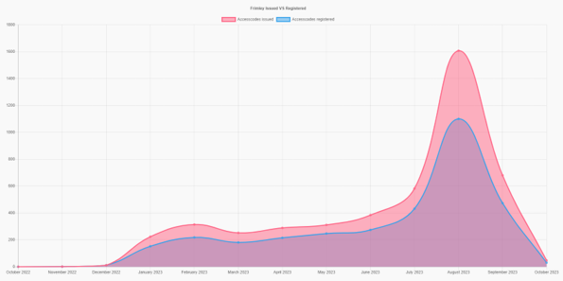


Upper Gordon Road case study, getUBetter
What is getUBetter:
getUBetter is an app / digital platform for anyone 18 years old or older who requires self-management support for a new, recurrent, or long-term MSK condition. This makes it suitable for approximately 80% of all MSK patients within the ICS. Conditions covered include common muscle, bone and joint problems such as back, neck, shoulder, elbow hip, knee, ankle pain, and tendinopathy. It is not for those who require targeted physiotherapy or medical management, e.g. rheumatological condition, bony injury or anterior cruciate ligament (ACL) injury.
Frimley ICB now have over 6,000 patients who have registered with getUBetter, with 71% repeatedly going into the app and using its functions.
What we did:
Upper Gordon Road as one of the early adopters, were keen to encourage patients with MSK problems to utilise this app to recover and live well. We decided to send out a bulk text message to our patients via Accurx to tell patients about getUBetter and how to sign up.
We used this message:
25% of adults live with some form of muscle or joint pain.
Upper Gordon Road Surgery is now offering you access to a FREE app, to help you manage your muscle or joint problems. The app will guide you day-by-day, through a sequence of exercises and tips, to help you get better. You can select a condition and start managing your symptoms.
To get started, click this link https://app.getubetter.com/request-access/1/7cce53cf90577442771720a370c3c723?t=1 select a condition, enter your email address, click send
Results:
It was quick and easy to set up and send in Accurx. We achieved the following results after sending the mass message:
Effect of batch messaging:
Before the batch test
85 Patients signed up | 65 Patients registered
After the bulk messages
725 Patients Signed up | 458 Patients registered
Conclusion / recommendation:
It has been very well received by patients and clinicians and there were no unintended consequences. We would encourage other practices to follow the same process to help patients receive timely advice and to start their recovery with getUBetter.

