Slide 1
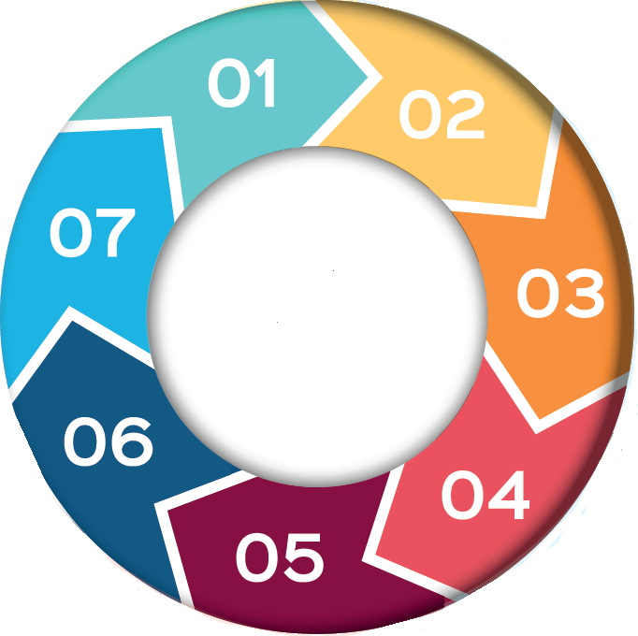
Predatory Marriage – 7 Minute Briefing
1. Introduction
Predatory Marriage is the practice of intentionally targeting and marrying a vulnerable (often older) person in order to gain access to their estate and assets upon their death. Predatory Marriage relies on grooming and coercion to exert control over another person to persuade them to marry for financial, material or other gain.
2. Legislation
In UK law, marriage and civil partnerships rely on consent. The Marriage Act 1989 requires that two adult parties agree to a marriage, it is implicit that they understand and agree to marry by giving informed consent which is dependent on capacity to make decisions as determined by the Mental Capacity Act 2005.
The Anti-Social Behaviour, Crime and Policing Act 2014 created the criminal offence of forced marriage. It is a criminal offence to marry a person who lacks the mental capacity to consent to the marriage, regardless of any pressure. It is also a crime to pressure someone to marry by any means.
3. What Does Predatory Marriage Look Like?
Grooming: Predators may identify a vulnerable target and spend time “grooming” them to persuade them that they hold them in high esteem and to make them feel valued and loved. Predators often describe themselves as the victims carer. The predator may move into the home
Isolation: Predators may spend time creating physical and emotional divisions between the individual and their friends and family to ensure only their voice is heard in isolation.
Harassment: Predators may stimulate or create conflict and division within families & friendship networks
7. Additional Resources and further Reading
Predatory marriage - Ann Craft Trust
https://www.predatorymarriage.uk/
Choice & decision making in Marriage
Predatory marriage: what is it and what you can do
6. What to do?
Raise concerns with the registrar
Concerns should be reported to the police and local authority
Discuss the case with the Forced Marriage Unit
Advise the family to seek specialist legal advice
Consider applying for a Forced Marriage Protection Order
Consider a ‘caveat in expectation of marriage’ via a specialist solicitor
5. Things to consider
The registrar should interview adults separately to ascertain capacity and consent, and stop any marriages where concerns are raised
Legally in the UK a marriage will always revoke a Will so anyone who marries (or who re-marries) would need to make a new Will to be clear about their wishes upon death.
Once married, the predator is entitled to make decisions regarding funeral arrangements which may eclipse any decisions made with family members prior to the marriage taking place.
Predatory Marriage relies on coercive control and is a form of forced marriage.
Lasting Power of Attorney does not protect against a coercive predatory marriage
4. Signs, Indicators, and examples
The signs and indicators are similar to other types of abuse, the person may appear isolated, withdrawn, fearful or unsure about their relationship or the people around them.
When dementia is present, the victim may not be confused or fearful. Presenting as ‘pleasantly confused’ should not be interpreted as consenting
One example of predatory marriage is that of JB here who was targeted in Leeds by a younger man and covertly married in November 2015, this predatory marriage only came to light following her death in March 2016.

