Slide 1

CQC Webinar for General Practice
What’s changed and areas to consider
Emily Woodward-Stammers, Place Based Quality Lead
Paul Tattam, Place Based Quality Lead
Mary Rose Cabildo, Place Based Quality Lead
Bracknell Forest North East Hampshire and Farnham Royal Borough of Windsor and Maidenhead Slough Surrey Heath

Slide 2
How CQC monitor, inspect and regulate GP practices
Each month CQC will review the information they have
This approach will:
  help to prioritise activity
  involve publishing a statement on the website for lower risk services. This will let providers and the public know that based on the intelligence held at that time, the CQC have not found any evidence that the rating or quality of care at that service needs reassessing.
CQC will continue to:
focus on safety and how effectively a service is led
have structured conversations with providers, with a focus on safety and leadership
Incoming Single Assessment Framework will move away from KLOEs & bring in quality statements
use the specific existing key lines of enquiry (KLOEs) to monitor a service
use digital methods and local relationships to have better direct contact with people who are using services, their families and staff in services
target inspection activity where we have concerns
Notes:
SAF and quality statements - https://www.cqc.org.uk/about-us/how-we-will-regulate
How CQC use information- https://www.cqc.org.uk/what-we-do/how-we-use-information/how-we-use-information
How CQC inspect and regulate - https://www.cqc.org.uk/about-us/how-we-do-our-job
New SAF - https://www.cqc.org.uk/news/our-new-single-assessment-framework
Video on new regulatory approach - https://www.youtube.com/watch?v=mJ0tlir02TY

Slide 3
When CQC have concerns or issues flagged they will consider ways that they can seek assurance on information
This may include:
  Direct Monitoring Activity
    Calls to providers to review the issues and seek assurances that the practice knows and understands its own data/information
  Desktop inspections/Request for Information
    Seek information when required – this might be based on concerns raised
    Follow up on previous minor breaches that can be addressed remotely
  CQC carry out remote Inspections
    Clinical Records Searches (may be remote or on site)
    Remote activity forms part of all inspections, most being remote and onsite combined
    Only online providers will have a fully remote inspection
    Remote Interviews with a cross-section of Staff, Care Homes and PPG reps
  CQC may carry out full face to face inspection
  During a monitoring call the inspector will focus on the specific key lines of enquiry. For more information on the types of questions you may be asked, please visit Monitoring questions for GP practices - Care Quality Commission (cqc.org.uk)
Notes:
Length of DAM calls - depends on questions asked as to the length of the call - not intended to be burdensome
Desktops are about following up on previous minor breaches that can be addressed remotely - rather than following up on new concerns raised.
CQC will seek information when required. if based on concerns raised, they do so in order to gain a practice's version of events & gain assurance that the practice has acted accordingly
Remote activity forms part of all inspections as a whole. Most inspections nowadays are remote & onsite combined. Only online providers have a fully remote inspection
DMAs are generally undertaken by a centralised team now, so it may not be the location's usual inspector doing it.
CQC will work with providers if they want more onsite time.

Slide 4
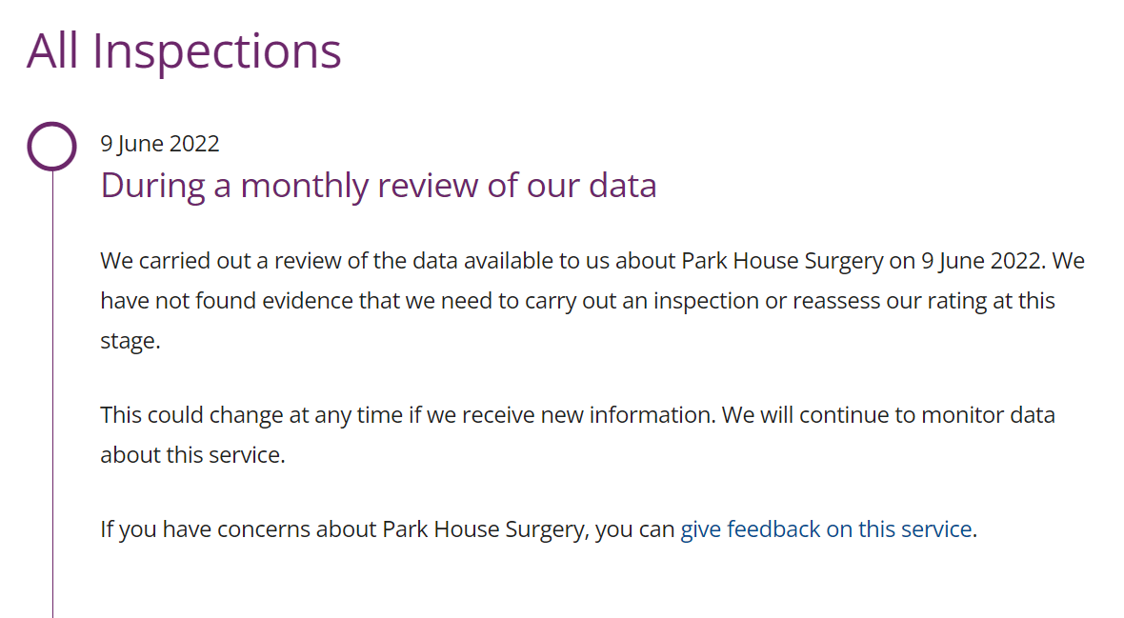
CQC Published Statement

Slide 5
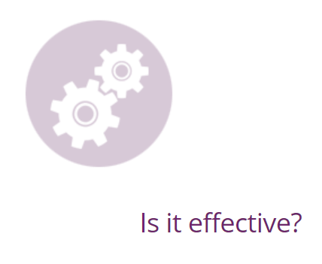
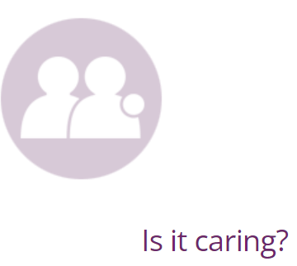

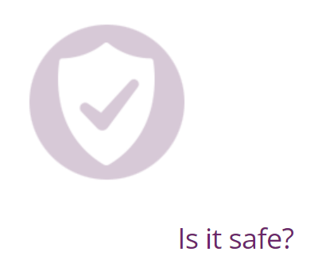
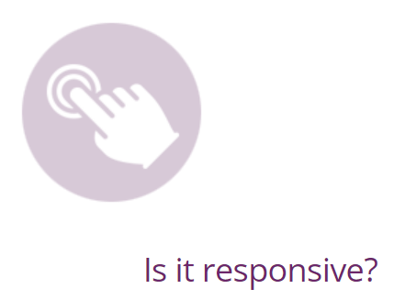
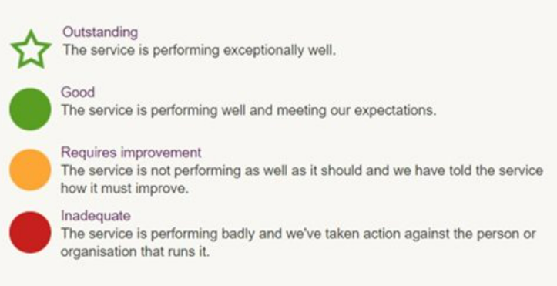
Quality Statements – how CQC regulate
A focus on what matters to people who use health and social care services and their families
Ratings and the five key questions remain and stay central to approach
Under each key question there is a set of topic areas and quality statements. The statements describe what good care looks like and will link to the regulations
To make judgements more structured and consistent, CQC have also developed six categories for the evidence collection:
  Peoples experience of health care services
  Feedback from staff and leaders
  Feedback from partners
  Observation
  Processes
  Outcomes
Notes:
KLOEs will be replaced by Quality Statements, supported by evidence requirements
https://www.cqc.org.uk/about-us/how-we-will-regulate/evidence-categories

Slide 6
Safeguarding and protection from abuse
Managing risks
Safe care and treatment
Medicines management
Track record
Learning when things go wrong
Notes:
https://www.cqc.org.uk/guidance-providers/healthcare/key-lines-enquiry-healthcare-services
By safe, we mean people are protected from abuse and avoidable harm

Slide 7
Outstanding: People are protected by a strong comprehensive safety system, and a focus on openness, transparency and learning when things go wrong
Good: People are protected from avoidable harm and abuse. Legal requirements are met
Requires improvement: There is an increased risk that people are harmed or there is limited assurance about safety. Regulations may or may not be met
Inadequate: People are not safe or at high risk of avoidable harm or abuse. Normally some regulations are not met
Notes:
https://www.cqc.org.uk/guidance-providers/healthcare/key-lines-enquiry-healthcare-services

Slide 8
Assessing needs and delivering evidence-based treatment
Monitoring outcomes and comparing with similar services
Staff skills and knowledge
How staff, teams and services work together
Supporting people to live healthier lives
Consent to care and treatment
Notes:
https://www.cqc.org.uk/guidance-providers/healthcare/key-lines-enquiry-healthcare-services
By effective, we mean that people's care, treatment and support achieves good outcomes, promotes a good quality of life and is based on the best available evidence

Slide 9
Outstanding: Outcomes for people who use services are consistently better than expected when compared with other similar services
Good: People have good outcomes because they receive effective care and treatment that meets their needs
Requires improvement: People are at risk of not receiving effective care or treatment. There is a lack of consistency in the effectiveness of the care, treatment and support that people receive. Regulations may or may not be met.
Inadequate: People receive ineffective care or there is insufficient assurance in place to demonstrate otherwise. Normally some regulations are not met
Notes:
https://www.cqc.org.uk/guidance-providers/healthcare/key-lines-enquiry-healthcare-services

Slide 10
Kindness, respect and compassion
Involving people in decisions about their care
Privacy and dignity
Notes:
https://www.cqc.org.uk/guidance-providers/healthcare/key-lines-enquiry-healthcare-services
By caring, we mean that the service involves and treats people with compassion, kindness, dignity and respect

Slide 11
Outstanding: People are truly respected and valued as individuals and are empowered as partners in their care, practically and emotionally, by an exceptional and distinctive service
Good: People are supported, treated with dignity and respect, and are involved as partners in their care
Requires improvement: There are times when people do not feel well-supported or cared for or their dignity is not maintained. The service is not always caring. Regulations may or may not be met
Inadequate: People are not treated with compassion or involved in their care. There are breaches of dignity and significant shortfalls in the caring attitude of staff. Regulations are not met. Normally some regulations are not met
Notes:
https://www.cqc.org.uk/guidance-providers/healthcare/key-lines-enquiry-healthcare-services

Slide 12
Person-centred care
Taking account of the needs of different people
Timely access to care and treatment
Concerns and complaints
Notes:
https://www.cqc.org.uk/guidance-providers/healthcare/key-lines-enquiry-healthcare-services
By responsive, we mean that services meet people's needs

Slide 13
Outstanding: Services are tailored to meet the needs of individual people and are delivered in a way to ensure flexibility, choice and continuity of care
Good: People's needs are met through the way services are organised and delivered
Requires improvement: Services do not always meet people's needs. Regulations may or may not be met
Inadequate: Services are not planned or delivered in a way that meets people's needs. Normally some regulations are not met
Notes:
https://www.cqc.org.uk/guidance-providers/healthcare/key-lines-enquiry-healthcare-services

Slide 14
Leadership capacity and capability
Vision and strategy
Culture of the organisation
Governance and management
Management of risk and performance
Management of information
Engagement and involvement
Learning, improvement and innovation
Notes:
https://www.cqc.org.uk/guidance-providers/healthcare/key-lines-enquiry-healthcare-services
By well-led, we mean that the leadership, management and governance of the organisation assures the delivery of high-quality and person-centred care, supports learning and innovation, and promotes an open and fair culture

Slide 15
Outstanding: The leadership, governance and culture are used to drive and improve the delivery of high-quality person-centred care
Good: The leadership, governance and culture promote the delivery of high-quality person-centred care
Requires improvement: The leadership, governance and culture do not always support the delivery of high-quality person-centred care. Regulations may or may not be met
Inadequate: The delivery of high-quality care is not assured by the leadership, governance or culture. Normally some regulations are not met
Notes:
https://www.cqc.org.uk/guidance-providers/healthcare/key-lines-enquiry-healthcare-services

Slide 16
What does an inadequate practice look like?
Safe
No analysis of significant events
Safeguarding protocols not robust and staff not appropriately trained
Not screening staff properly when recruiting
Unsafe medicines management processes - incl. acting on safety alerts
Effective
No clinical audits or evaluation of the service
Not caring for patients using up-to-date best practice
lack of appraisals, supervision & training for staff. Monitoring of LTC. limited.
Caring
Little concern for patient's privacy and dignity in reception and waiting areas
No lists of people at the end of life or sharing this information with out-of-hours services
Poor GPPS data & limited action taken by practice to improve
Responsive
Poor availability of appointments at times which suit patients
Difficult to contact the practice by telephone
No same-sex clinicians
Poor GPPS data & limited action taken by practice to improve
Well-led
Absence of vision for the organisation
Lack of clarity in roles and responsibilities to run the practice day-to-day
Poor visibility of leaders and no whole-practice meetings
Ineffective governance processes, poor oversight of systems & processes
Notes:
https://www.cqc.org.uk/sites/default/files/20180628%20Healthcare%20services%20KLOEs%20prompts%20and%20characteristics%20FINAL.pdf

Slide 17
Registration and Notifications
Registration
You must register with CQC to carry on any of the regulated activities. You also need to let CQC know if your registration details change
Apply to register as a new provider
Apply to be a registered manager
Make changes to your registration
Activities we regulate
Registration: flu vaccination arrangements
GP federations: your guide to registration
Notifications
You need to notify CQC about certain changes, events and incidents that affect your service or the people who use it
Death of a person using the service
Deprivation of liberty application
Abuse or allegations of abuse
Serious injury
Incidents reported to the police
GP mythbuster 21: Statutory notifications to CQC
All notifications
*** REMEMBER! If you have made amendments to registered manager/partnerships, you also need to update statement of purpose (SOP). Please ensure your SOP is up to date and matches the changes made ***
For any queries, please contact the CQC customer service team 03000 616161
Notes:
Providers need to notify us of registration changes as well. A notification is needed, then an application needs to be submitted. But this process could be subject to change with the new provider portal coming.

Slide 18
Useful information and links
GPs: information for providers
GPs: information for providers - Care Quality Commission (cqc.org.uk)
Key lines of enquiry for healthcare services
Key lines of enquiry for healthcare services - Care Quality Commission (cqc.org.uk)
GP mythbusters
GP mythbusters - Care Quality Commission (cqc.org.uk)
GP mythbuster 12: Accessing medical records during inspections
GP mythbuster 12: Accessing medical records during inspections - Care Quality Commission (cqc.org.uk)
CQC video on new regulatory approach
https://www.youtube.com/watch?v=mJ0tlir02TY
Provider and CQC FAQs for meeting employment requirements (regulation 19, Schedule 3
fid2932547-employment-requirements-regulation-19.pdf (cqc.org.uk)
Arden’s CQC searches
https://www.ardens.org.uk/cqc/
CQC Clinical Searches Update Webinar
https://www.youtube.com/watch?v=yGshX-w98yU
The Oliver McGowan Mandatory Training in Learning Disability and Autism
https://www.hee.nhs.uk/our-work/learning-disability/oliver-mcgowan-mandatory-training-learning-disability-autism
Guidance for providers
https://www.cqc.org.uk/guidance-providers/healthcare/key-lines-enquiry-healthcare-services
Key questions and quality statements
https://www.cqc.org.uk/about-us/how-we-will-regulate/five-key-questions-and-quality-statements

Slide 19
Contact Details
For further information or support, please contact the Place Based Quality Leads:
Paul Tattam | paul.tattam1@nhs.net | 07787221297
Mary Rose Cabildo | Maryrose.cabildo1@nhs.net | 07867159581
Emily Woodward-Stammers | e.woodward-stammers@nhs.net | 07825054045
ICB Infection Control Team | frimleyicb.ipcteam@nhs.net
Practice CQC Pre-Inspection Pack to support practices in their ongoing reviews of their preparedness in meeting the regulations which we hope you will find helpful ☺
Bracknell Forest North East Hampshire and Farnham Royal Borough of Windsor and Maidenhead Slough Surrey Heath

Slide 20


