Slide 1
Accelerate Programme
Primary Care Transformation Team
Rachel Hinde, Programme Lead
November 2022

Slide 2
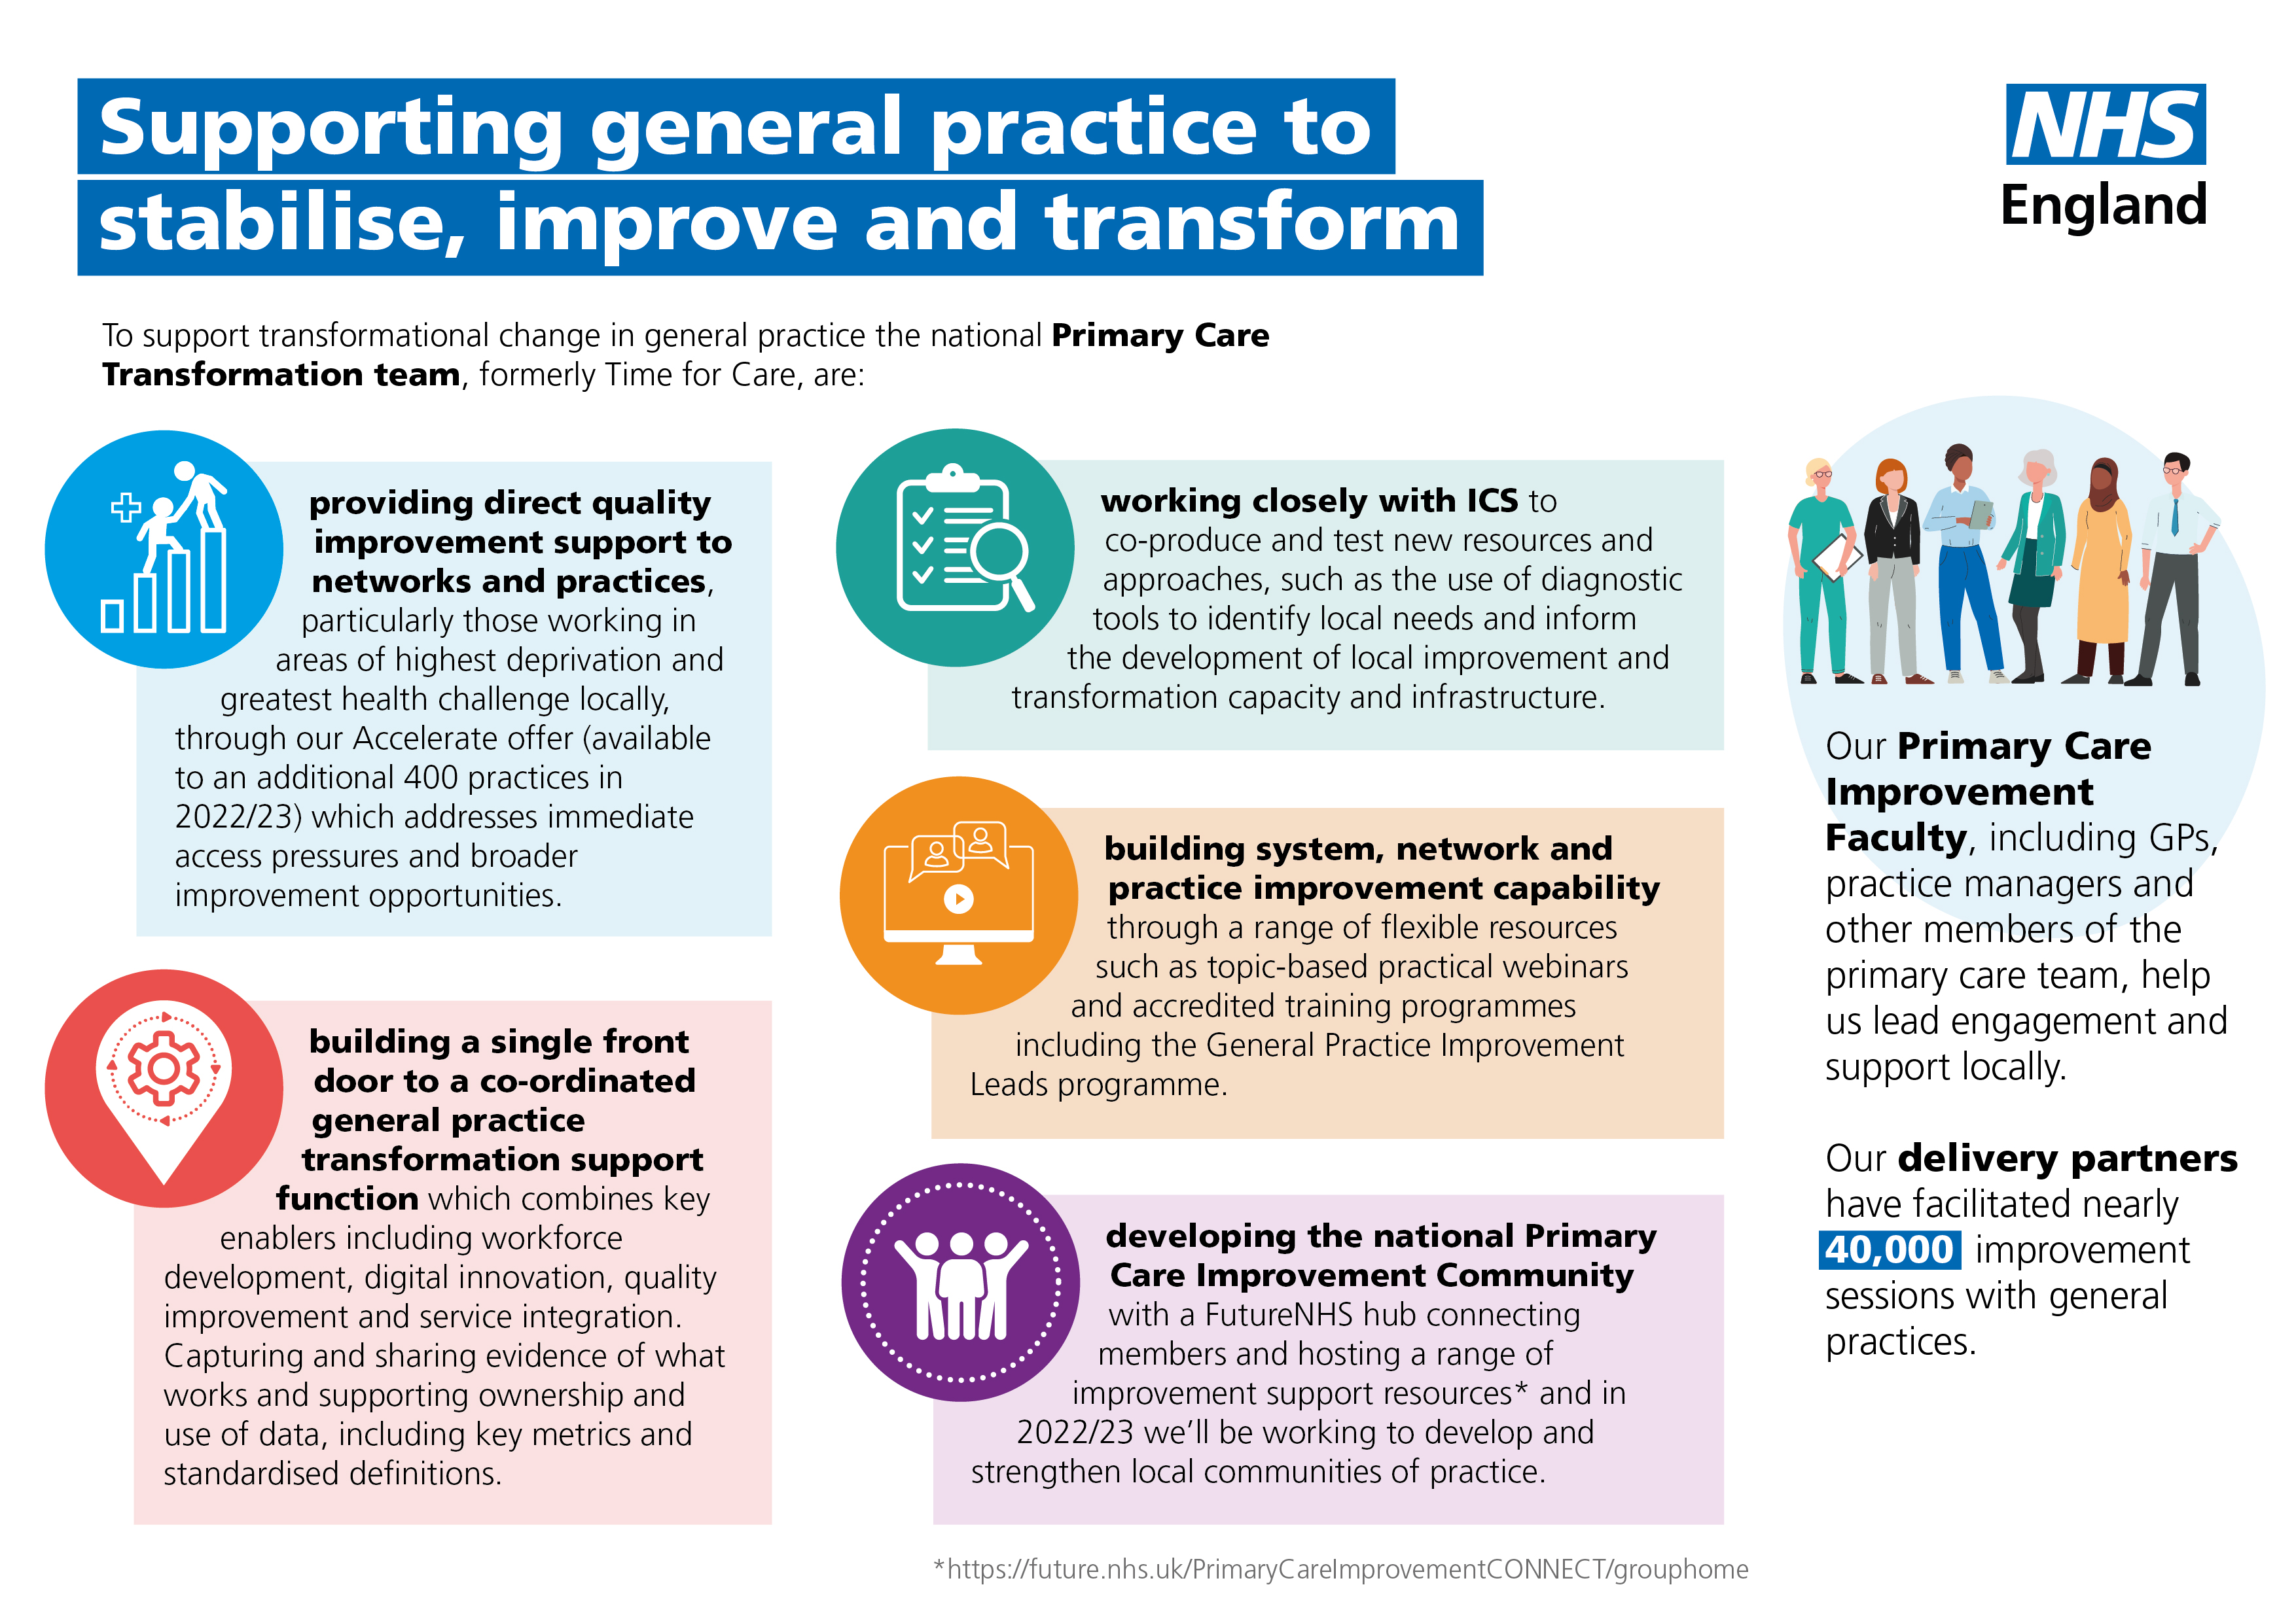

Slide 3
Who is the Accelerate Programme for?
Practices locally identified as having challenges such as the following.
Located in an area of high deprivation
Experiencing a high level of complaints
Where Healthwatch have concerns
Practices are nominated and should be willing to work with us to receive hands-on support
Programme offers intensive support over a short period and an opportunity for support delivered over a longer period of time too
This programme is not for practices where contractual remedial measures are being taken.

Slide 4
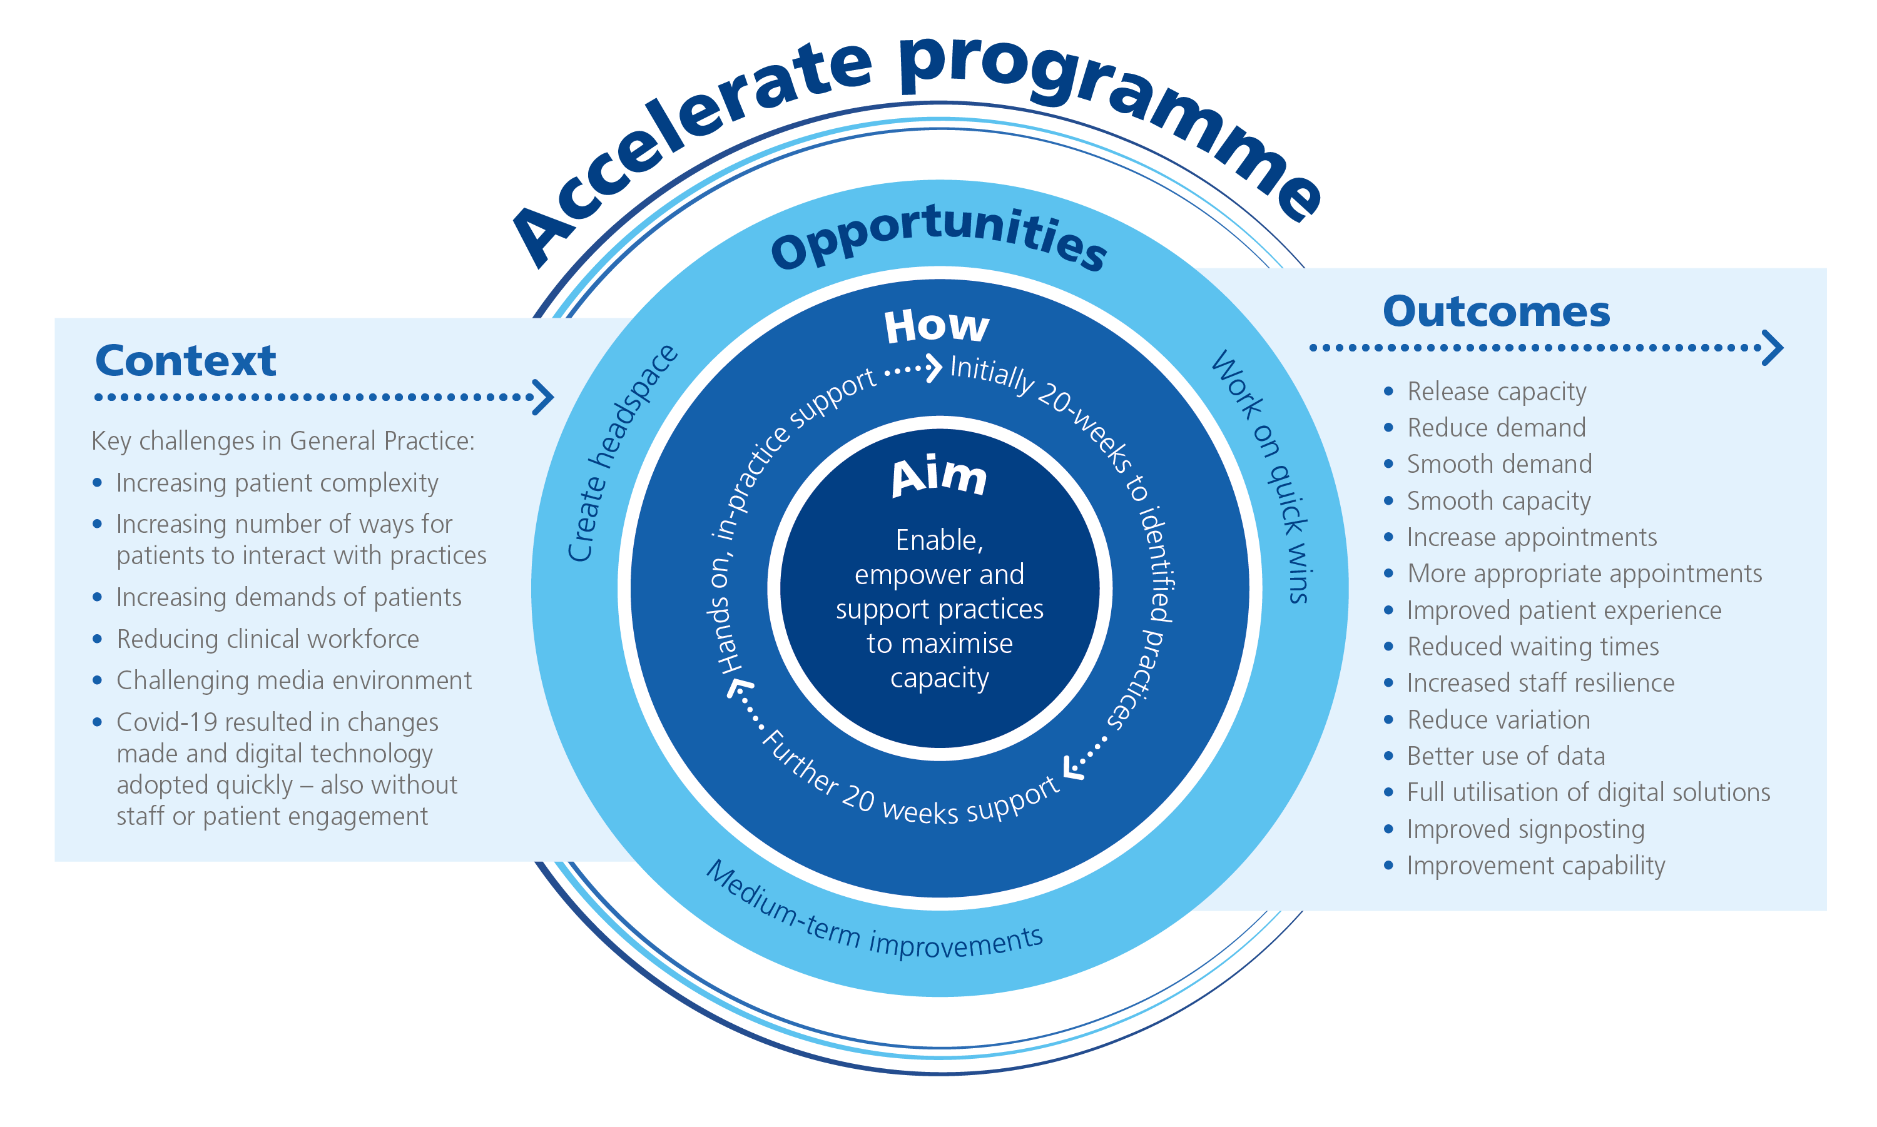
Direct QI Support to practices

Slide 5
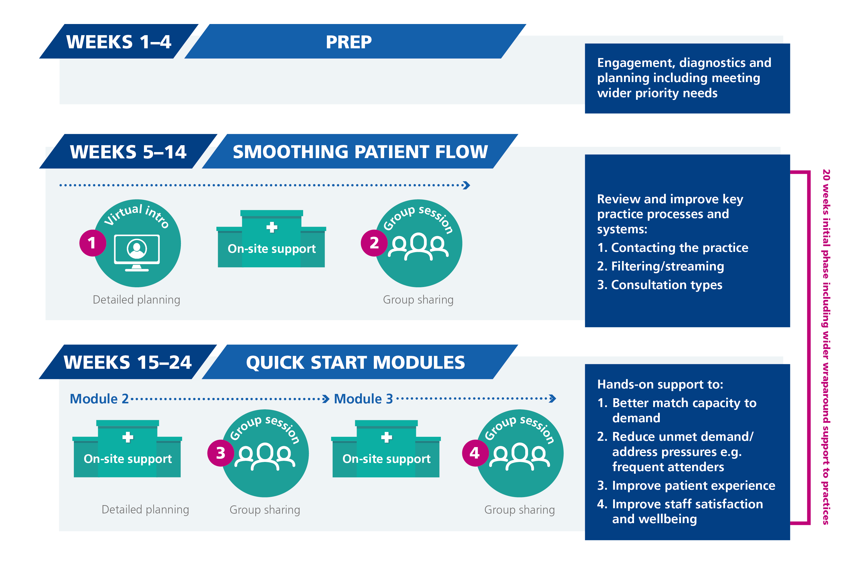
Accelerate Programme Delivery Model

Slide 6
Engagement Fees
The Programme will provide funding for participating practices. Every effort is made to minimise the administration burden of the funding and to make it more streamlined and easier for Practices to receive this payment.
The breakdown of the engagement fee for the first 20 weeks (new practices) is:
£5k on completion of the first 10 weeks of the programme (all 6 SPF OSV)
£5k on completion of the full 20 weeks (all 6 QS OSV)
The breakdown of the engagement fee for Carry Over practices (2 QS Modules) is:
£6k on completion of all 6 OSVs or
£3k on completion of 3-5 OSVs (ie if the practice does not complete both modules)

Slide 7
Benefits
Opportunity to invest in your practice / PCN
Opportunity to address current challenges – demand and capacity
More hands on with support - much of ‘heavy lifting’ (e.g coding data) now being picked up by AIP delivery partners
Can support with CQC, QOF, IIF
An engagement & completion fee available (which can be used for backfill)
Staff Experience:
"It makes such a difference having a process in place and a plan coming, I feel so much better knowing this." Practice Manager, London.​
​
"Each staff members feels valued and is empowered to think creatively about implementing changes, which will benefit us and the patients, while utilising staff in the most appropriate and efficient way." GP Partner, London.​
​
"Having a staff safety protocol/plan in place will give staff greater confidence that they are supported" Practice Manager, London.​
Examples of impact
Changes to the practices telephone system were applied to reduce demand on appointment booking and general enquiries. They now open dedicated appointment, enquiry and results request lines at designated times, improving productivity and efficiency at reception and improving patient access and experience. They have reduced the number of patients waiting on the phone from 100 to 25 and reduced waiting times from 90 minutes to 10 mins (with a message for caller number 26 to either try again later or call back the next day if not urgent).
Used practice data to understand how long patients wait before their call is answered at different times and on different days of the week. They were able to improve access to the practice by changes to the rota of reception staff to ensure more capacity when demand was higher.
Case studies from AIP programme are available on the FutureNHS web portal: https://future.nhs.uk/PrimaryCareImprovementCONNECT/view?objectId=27427152

Slide 8
Practice webinars
Practices can sign up to a webinar to learn more about the programme. There is one link for all the webinars: Accelerate Phase V Introductory Webinar Registration Form. . Dates of the webinars are:
W/C 28th Nov 2022
Mon 28th Nov 4pm
Tues 29th Nov 12 pm
Weds 30th Nov 12pm
Thurs 1st Dec 4pm
Dec 2022
Mon 5th Dec 4pm
Tue 6th Dec 12pm
Weds 7th Dec 4pm
Thurs 8th Dec 12pm

Slide 9
PCNs
All practices in a PCN are very welcome to sign up for the webinars and the programme
All practices in a PCN that sign up will receive on-site visits and will be grouped with other practices in the PCN for their group based sessions
Practices need to sign up individually as our experience is that if someone else signs them up they then drop out

