Slide 1

Psicon NEH ADHD Service
Dr Dan Simmonds, Consultant Clinical Psychologist, Director
Dr Jo Black, Service Manager, Neurodevelopmental Lifespan Service
23rd June 2021

Slide 2
Who are Psicon?
Independent organisation, we work primarily to support the NHS throughout England to improve neurodevelopmental pathways
Clinically led, neurodevelopmental experts
Multidisciplinary team – paediatrics, psychology, psychiatry
Working in NEH&F providing ADHD service since 2017
Significantly reduced waiting times for autism and ADHD assessments across Hampshire
NICE guideline compliant assessments and reviews

Slide 3
The Service
ADHD Assessment
Screened with Connors questionnaires completed by parent and school
Descriptive information obtained from parent and school
Observation of the child in clinic
Developmental history and diagnostic interview with parent(s) and child in clinic
ADHD medication initiation and titration
Medication initiated for moderate to severe ADHD after families have considered all options and potential side effects of medication
Follow up at 4-6 weeks, 3 months, and 6-12 months to titrate
Once stable on medication, child is transferred to shared care for GP to continue to prescribe
Annual reviews for children on shared care
If not stable on medication, dosage adjusted, and review process re-started from beginning

Slide 4
Who can refer?
Psicon accept direct referrals from:
GPs
Hampshire CAMHS
Hampshire Autism Service (currently provided by Psicon)
Surrey Children’s Community Service (provided by Children and Family Health Surrey)
Psicon do not accept referrals from:
Schools
Parent/guardian(s)

Slide 5
Who can be Referred?
For ADHD assessment and/or medication initiation, titration, and annual review:
CYPs registered at NEH GP surgery (not Farnham)
Princes Gardens Surgery The Cambridge Practice The Wellington Practice Giffard Drive Surgery
Voyager Family Health Alexander House Surgery Jenner House Surgery Mayfield Medical Centre
North Camp Surgery Richmond Surgery Fleet Medical Centre The Border Practice
Crondall New Surgery Oakley Health Group Branksomewood Healthcare Centre
CYPs aged 6 years to 11 years 364 days
Without mental health presentation

Slide 6
Exclusion Criteria
12 years or older (refer to Hampshire CAMHS)
Under 6 years old (refer to Behaviour and Neurodevelopmental Service at Children and Family Health surrey)
Registered with Farnham GP (refer to Surrey Emotional Well Being and Mental Health Service for Children and Young people (previously known as Surrey CAMHS))
Suspected or confirmed comorbid mental health difficulties (refer to Hampshire CAMHS who will decide whether ADHD assessment should be carried out by CAMHS or Psicon based on mental health presentation)
CYPs at risk of self-harm or suicide (refer to Hampshire CAMHS)
If there is any uncertainty about whether the child needs mental health support in addition to, or instead of, ADHD assessment and treatment, please refer to Hampshire CAMHS

Slide 7
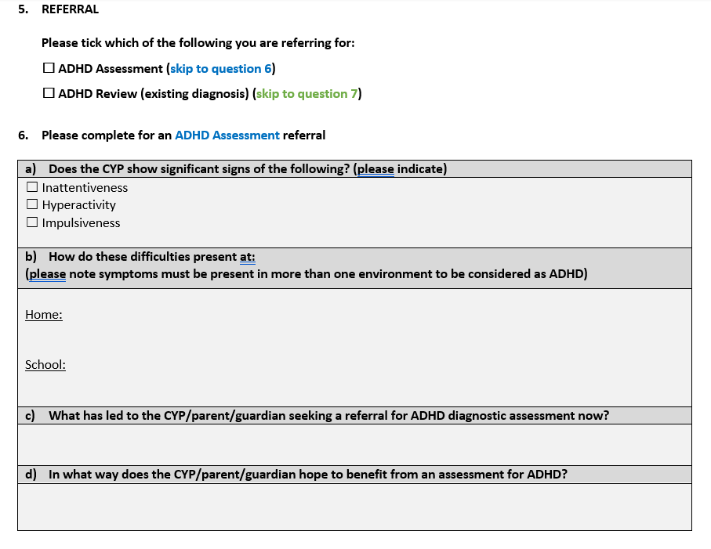
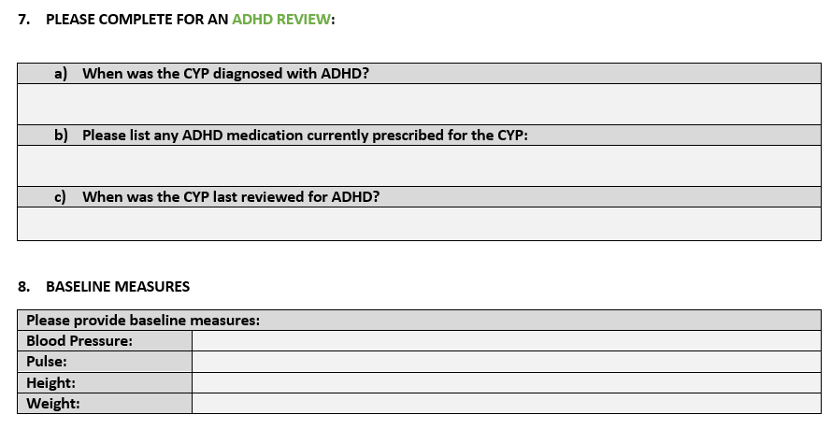

Slide 8
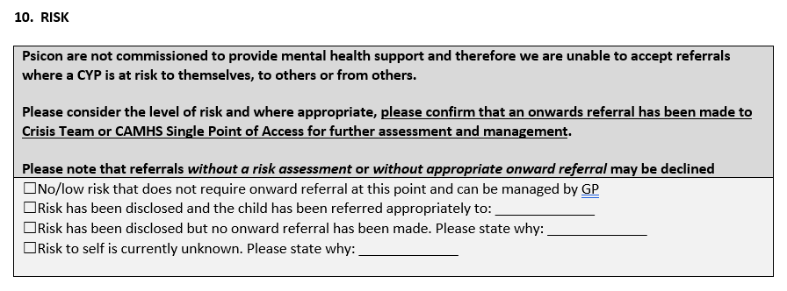

Slide 9
Making a Referral
Show family has tried other strategies to support child and improve problematic behaviours
Objective validation of the parents report:
Objective evidence of inattention/hyperactivity/impulsivity across multiple settings (e.g. home and school)
Your own observations of the child in the clinic room (e.g. are they unable to keep still, interrupting conversations etc)
Your opinion or the opinion of other professionals (e.g. paediatrician, SENCO)
Indicate that risk and mental health have been considered prior to the referral

Slide 10
We Value Your Opinion
Is there anything we could improve about the referral process? Email feedback@psicon.co.uk
For help with referrals please call us 8:30-5:30 Mon-Fri: 01227 379 099

