Slide 1
Vaccination of patients eligible for a 3rd dose as part of their primary course and subsequent booster – supporting information
11th January 2022
CONFIDENTIAL / NOT FOR SHARING

Slide 2
Reference documents
NEW! An Operational note published 7 January 2022 on the booster offer for 12-15 year olds who are severely immunosuppressed
An Operational note published 21 December on priority access for clinically vulnerable
An Operational note published 10 December on the booster dose offer for severely immunosuppressed adults
JCVI advice on the UK vaccine response to the Omicron variant, advising severely immunosuppressed individuals who have completed their primary course (3rd dose) should be offered a booster dose
An Operational note published 29 November 2021 ensuring that all patients who are severely immunosuppressed are identified, contacted and receive a 3rd dose – all regional returns now received
An Operational note published 26 November 2021 confirming the capability within the National Booking Service for patients that are severely immunosuppressed to book their 3rd dose is now available
An Assurance process published 30 September 2021 identified immediate actions to be taken by systems and GP practices to identify patients eligible for a 3rd dose including details on how to access the GPIT Vaccine Dashboard
A System letter published 2 September 2021, asked systems to start vaccinating eligible patients from 13 September 2021
JCVI guidance advises that a third primary dose be offered to individuals aged 12 years and over with severe immunosuppression in proximity of their first or second COVID-19 vaccine doses in the primary schedule
CONFIDENTIAL / NOT FOR SHARING

Slide 3
Access to Foundry data on the vaccination of the Severely Immunosuppressed
National uptake is currently 91.2% for patients eligible for a 3rd primary dose with 105,640 patients also now eligible for their booster dose.
The Severely Immunosuppressed uptake report is accessible from the Uptake (GP registrations) tab in the Foundry VVE tool, or directly from this link https://ppds.palantirfoundry.co.uk/workspace/report/ri.report.main.report.25adb274-24e9-4efd-a5c6-918e30892738
A excellent training video for this contour report is available. If there is any feedback on the video please send it to vaccination.operationaldata@nhs.net
Filters at the top of the page allow users to drill down to specific STPs and GP practices, to look at the different delivery models, and to look at different date ranges. Note that if any filter is selected, users must click on the Apply button for the filters to be applied.
Please note that the report takes several minutes to load.
The report includes tables for total uptake as a proportion of the severely immunosuppressed cohort, total numbers of 3rd doses given, breakdown by ethnicity, time between doses, and the number of people that have not yet received a 3rd doses (broken down by time since 2nd dose).
The Foundry reports are also being updated to include data on boosters following the latest JCVI guidance however we are aware that there may be a potential data issue regarding the % uptake for booster doses that the programme is currently investigating.

Slide 4
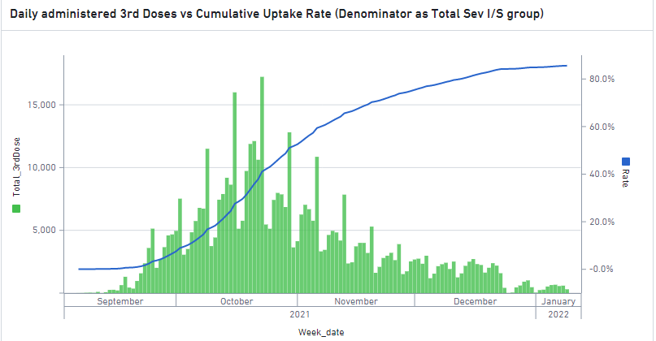
National: Immunosuppressed Uptake
44k > 26 weeks since second dose
Regions | Eligible for 3rd Dose [2nd Dose > 8weeks] | 3rd Dose Uptake | 3rd Dose % uptake | Outstanding > 26 weeks | % Outstanding > 26 weeks
EoE | 67,032 | 61,704 | 92.1% | 5,328 | 7.9%
Lon | 56,804 | 48,121 | 84.7% | 8,683 | 15.3%
Mids | 98,518 | 90,231 | 91.6% | 8,287 | 8.4%
NEY | 80,779 | 74,087 | 91.7% | 6,692 | 8.3%
NW | 59,917 | 54,064 | 90.2% | 5,853 | 9.8%
SE | 81,464 | 75,739 | 93.0% | 5,725 | 7.0%
SW | 57,756 | 54,286 | 94.0% | 3,470 | 6.0%
Total | 502,270 | 458,232 | 91.2% | 44,038 | 8.8%
Delivery Model | Uptake | % DM Uptake
Hospital Hubs | 18,468 | 4.0%
Hospital Hubs - SAIS | 40
LVS - Detained Estate | 72
LVS - Military | 2
LVS - PCN | 322,235 | 70.3%
LVS - Pharmacy | 69,715 | 15.2%
Unknown | 521 | 0.1%
Vaccination Centres | 47,179 | 10.3%
Grand Total | 458,232 | 100%
Data Source: Immunosuppressed Foundry Report: Severely Immunosuppressed Uptake (palantirfoundry.co.uk).

Slide 5
National: Severely Immunosuppressed ICS Uptake
National average % uptake: 85.6%; Top 10 ICS % uptake: 90.8%
Region
STP/ICS Name
Population
3rd Jan-22
10th Jan-22
% Change
Uptake
Region
STP/ICS Name
Population
3rd Jan-22
10th Jan-22
% Change
Uptake
SW
Gloucestershire
6,977
6,360
6,409
1%
92%
SE
Frimley Health and Care ICS
6,029
5,178
5,243
1%
87%
Mid
Shropshire and Telford and Wrekin
5,460
4,970
5,007
1%
92%
NEY
South Yorkshire and Bassetlaw
14,221
12,184
12,365
1%
87%
NW
Healthier Lancashire and South
18,192
15,605
15,799
1%
87%
EoE
Norfolk and Waveney Health and
14,055
12,637
12,839
1%
91%
Cumbria
Care Partnership
Mid
Northamptonshire
7,673
6,522
6,616
1%
86%
Mid
Herefordshire and Worcestershire
9,279
8,385
8,471
1%
91%
EoE
Mid and South Essex
11,031
9,339
9,462
1%
86%
SW
Somerset
6,460
5,803
5,892
1%
91%
NW
Cheshire and Merseyside
23,136
19,496
19,806
1%
86%
SW
Bath and North East Somerset,
8,812
7,926
8,037
1%
91%
Mid
Leicester, Leicestershire and
10,298
8,648
8,804
2%
85%
Swindon and Wiltshire
Rutland
Mid
Lincolnshire
9,002
8,041
8,143
1%
90%
Mid
Nottingham and Nottinghamshire
9,284
7,702
7,885
2%
85%
SW
Dorset
8,825
7,897
7,971
1%
90%
Health and Care
EoE
Suffolk and North East Essex
12,679
11,312
11,435
1%
90%
EoE
Cambridgeshire and Peterborough
9,922
8,118
8,413
3%
85%
NEY
Humber, Coast and Vale
19,611
17,428
17,619
1%
90%
Mid
Staffordshire and Stoke on Trent
12,296
10,919
11,045
1%
90%
NEY
West Yorkshire and Harrogate
21,225
17,125
17,470
2%
82%
SW
Cornwall and the Isles of Scilly
7,043
6,257
6,326
1%
90%
(Health and Care Partnership)
Health and Social Care Partnership
EoE
Bedfordshire, Luton and Milton
8,741
6,977
7,131
2%
82%
SE
Surrey Heartlands Health and Care
9,319
8,247
8,347
1%
90%
Keynes
Partnership
NW
Greater Manchester Health and
22,795
18,158
18,459
1%
81%
SE
Buckinghamshire, Oxfordshire and
16,565
14,611
14,795
1%
89%
Social Care Partnership
Berkshire West
Lon
South West London Health and
11,434
8,982
9,145
1%
80%
SW
Devon
12,569
10,996
11,221
2%
89%
Care Partnership
Mid
Joined Up Care Derbyshire
10,150
8,891
9,051
2%
89%
Mid
The Black Country and West
12,382
9,483
9,671
2%
78%
SE
Hampshire and the Isle of Wight
17,417
15,330
15,529
1%
89%
Birmingham
SE
Sussex Health and Care
18,581
16,213
16,550
2%
89%
Mid
Birmingham and Solihull
9,095
6,927
7,066
2%
78%
Partnership
Lon
Our Healthier South East London
13,168
9,717
9,931
2%
75%
SW
Bristol, North Somerset and South
9,481
8,341
8,430
1%
89%
Lon
North West London Health and
15,764
11,464
11,714
2%
74%
Gloucestershire
Care Partnership
Mid
Coventry and Warwickshire
9,658
8,374
8,472
1%
88%
Lon
North London Partners in Health
11,124
8,018
8,207
2%
74%
NEY
Cumbria and North East
30,370
26,255
26,633
1%
88%
and Care
EoE
Hertfordshire and West Essex
14,213
12,238
12,424
1%
87%
Lon
East London Health and Care
13,413
8,839
9,124
2%
68%
SE
Kent and Medway
17,483
15,017
15,276
1%
87%
Partnership
Data Source: Severely Immunosuppressed Uptake (palantirfoundry.co.uk).

Slide 6
How the GP COVID-19 Vaccine Dashboard can help
The GP COVID-19 vaccine dashboard has been developed by NHS Digital to help Primary Care Networks (PCNs) increase vaccination uptake across their local communities.
It's accessible via NHS smartcard and is an optional tool to help the vaccination rollout. Further information is available here.
Severely immunosuppressed individuals
From the 4 October 2021, the dashboard contains a published list of immunosuppressed patients (aged 12 upwards), who have been identified as eligible for a 3rd primary dose of a COVID vaccine. For more information on this feature, see the latest release video and the user guide.
Guidance from the Joint Committee on Vaccination and Immunisation (JCVI) was used to generate the patient list from data sources that NHS Digital collect from, including hospitals, GP practices, and community pharmacies (via the NHS Business Services Authority).
From the 9th December 2021, the dashboard has been updated to include eligibility for a booster dose 3 months post their 3rd primary dose as per the latest JCVI guidance. Deceased patients will also be removed from the data. The updated page - now called Immunocompromised - will provide you with a downloadable list of this patient group for your practice(s) with information on their condition, vaccine history and proposed due dates for their 3rd dose and a booster dose.
Troubleshooting and help available: If GP practices have any queries and need additional support to access the dashboard please advise them to contact the NHS Digital national service desk on ssd.nationalservicedesk@nhs.net or 0300 303 5035.

Slide 7
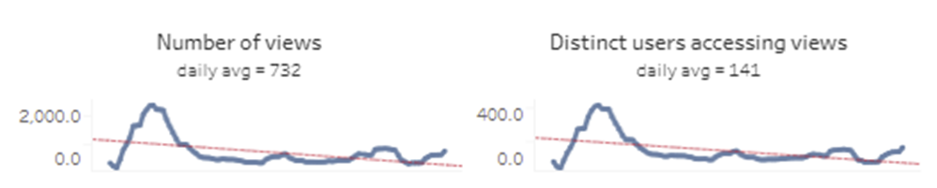
Dashboard usage by practice code
Headlines:
Since 1 October 2021, 73.7% of active practices have accessed the GPVAX dashboard (4,925 practices). This represents a 2% rise or 126 extra GP Practices having logged on since reporting in December.
Since 8 December 2021, 36.9% of active practices have accessed the GPVAX dashboard (2,465 practices), whilst 63.1% active practices have not (4217 practices).
There are 6682 open and active practices as of 10 January 2022.
GP COVID-19 Vaccine Dashboard Summary of Usage – data as of 10-Jan-22
Since the dashboard went live in late July, a total of 4,625 unique users have accessed the dashboard recording 73,883 page hits
Usage increased significantly following the go live of 3rd primary dose information in October with a peak of 420 users per day and over 2,300 page hits in mid-October. It then reduced to a steady state level of around 100 users logging a day
Usage has grown since the first working week of January with the latest figure of 155 users logging on and 800 page views in the past 6 days.
* Data downloaded on 10-Jan-22. Previous value: 4,799. Calculation: (new value - old value) / old value ×100 >> (4925-4799) / 4799 * 100 = 0.5%

Slide 8
GP Covid-19 Vaccine Dashboard site data
This data was provided by NHS Digital on 10-Jan-22. Information on the data is as follows:
  For count of practices not accessed since Oct-21:
    There is no record of a successful login for any users for the Practice since 1st October 2021 when the 3rd dose list was first published (source: usage data for the dashboard, CIS (smartcard data)
  For count of practices not accessed since Dec-21:
    There is no record of a successful login for any users for the Practice since 8th December 21 when boosters were first promoted for this group (source: usage data for the dashboard, CIS (smartcard data)
  The GP Practice has an active ODS code (source: ODS)
The data can be filtered by NHS Region, PCN, ICS and CCG
Detailed practice data embedded here:
NHS Region | Current no of practices not accessed since Oct-22 | % Change from previous week* Negative change is good as indicates more Practices have accessed the dashboard | Current no of practices not accessed since Dec -22
London | 638 | -2% | 456
Midlands | 350 | -6% | 410
North West | 258 | -11% | 391
South East | 244 | -4% | 400
North East and Yorkshire | 152 | -16% | 387
East of England | 59 | -5% | 167
South West | 56 | -20% | 249
* Calculation: (new value - old value) / old value ×100.

