Slide 1

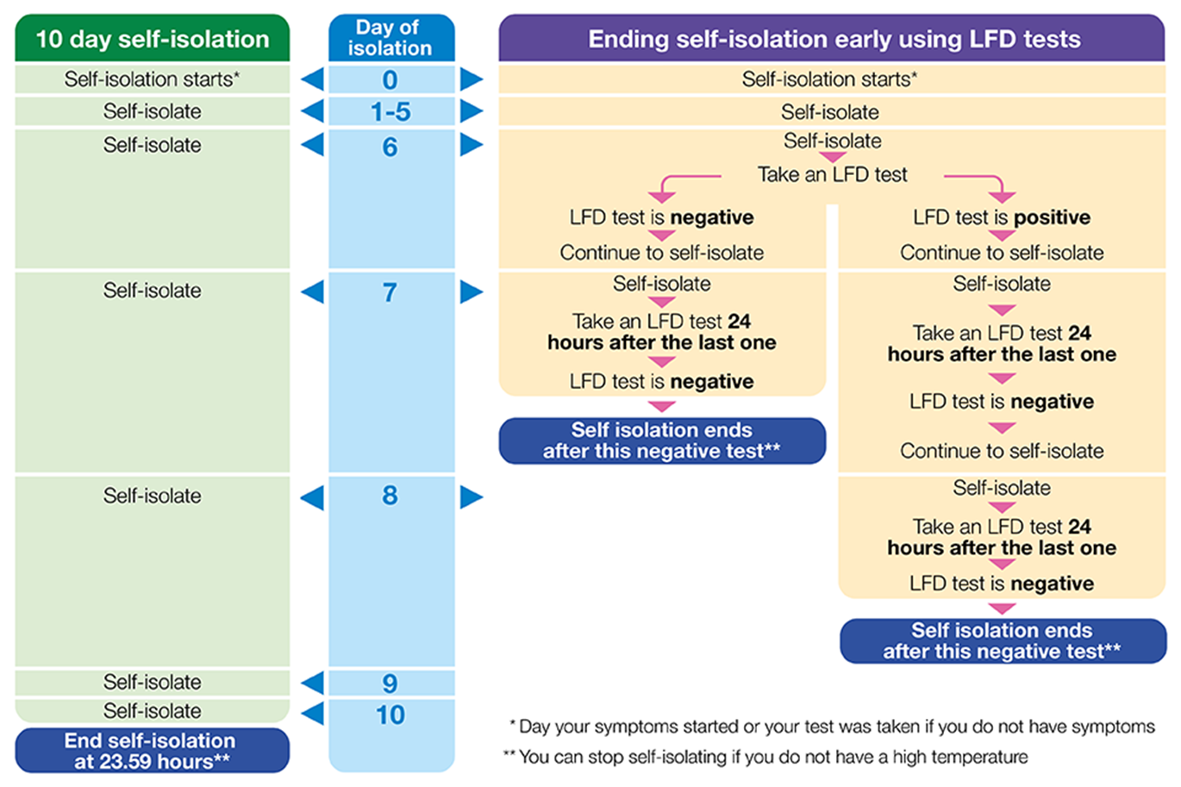
Infection Prevention and Control Team
If you have any queries or require support with a possible outbreak please contact the IPC team:
Vanessa Seeboruth: 07785469880
Summer Kanyepi: 07503304071
IPC Email: frimleyccg.ipcteam@nhs.net
Coronavirus (COVID-19): guidance - GOV.UK (www.gov.uk)
COVID-19: infection prevention and control (IPC) - GOV.UK (www.gov.uk)
Coronavirus » Primary care (england.nhs.uk)
Infographic Tweeted by Susan Hopkins 31 December 2021
Infection Prevention and Control Team January 2022

