Slide 1

Mental wellbeing & suicide prevention
Katie Simpson
Clinical Lead mental health Frimley nhs icb

Slide 2
Overview
RISK FACTORS for mental health problems
Looking after our mental health
Suicide prevention

Slide 3
Dr Laura Ingenhaag
My story

Slide 4
Overview
RISK FACTORS for mental health problems
Looking after our mental health
Suicide prevention

Slide 5
Scale of the problem
I in 4 people have been affected by a Mental Health problem.
A 2018 survey Mental Health Foundation found that almost three quarters (74%) of people have at some point felt so stressed they felt overwhelmed or unable to cope.
Pandemic effects: 56% UK adults reported feeling stressed, anxious or depressed re effects of pandemic on their future
67% of CYP 13-25 yrs agreed pandemic will have a long lasting effect on their MH: Young Minds
YBS 2022: 67% of UK adults worried about impact of cost of living crisis 46% reported worsening mental state as a result
For some of us these difficulties may come and go, and for others they may be more long-lasting.
Notes:
YBS Yorkshire building society. Benenden health 2022 This research also showed that a quarter of the UK population’s mental health has worsened over this period of time.
“Our research also identified that females are more likely to be experiencing worsening mental health due to the cost of living crisis compared to males, with 25 percent of women expressing this worry compared to 21 percent of men. “Almost a third of the nation have experienced increased stress during the cost of living crisis, with the same amount reporting poor sleep as a result,

Slide 6
Good Mental Health
Is more than just the absence of illness, rather it’s a state of overall wellbeing.
Enjoyment of life
Having the ability to cope with and ‘bounce back’ from stress and sadness
Being able to set and fulfil goals
Having the capability to build and maintain relationships with others.

Slide 7
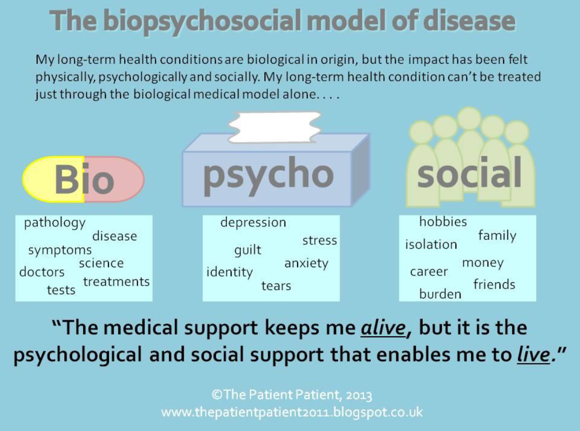
Protecting our mental health
Notes:
Not just a biochemical imbalance in fact for most serotonin/NA etc not altered (Joanna Moncrieff at UCL Jul22 Molecular Psychiatry) BUT complex interaction of the bio: inflammation, raised cortisol, insulin resistance microbiome dysfunction- gut brain axis AND social connections

Slide 8
Causes of depression
Childhood experiences
Life events
Other mental health problems
Physical health problems
Family history
Medication, recreational drugs, smoking and alcohol
Sleep, diet and exercise
Loneliness
Stress
Debt
Notes:
Family hx While this might be caused by our biology, no specific genes identified & this link could also be because we usually learn behaviour and ways of coping from the people around us as we grow up.
Cost of living crisis- 50% of UK predicted to be in fuel poverty by Jan 23. In England, the ‘Low Income, Low Energy Efficiency’ indictor is used to determine official fuel poverty. Under this, a household is considered fuel poor if; They are living in a property with a fuel poverty energy efficiency rating of band D or below, and When they spend the required amount to heat their home, they are left with a residual income below the official poverty line. In Scotland, Wales and Northern Ireland, the definition of fuel poverty is if a household spends more than 10% of its income on fuel costs and if the remaining household income is insufficient to maintain an adequate standard of living.

Slide 9
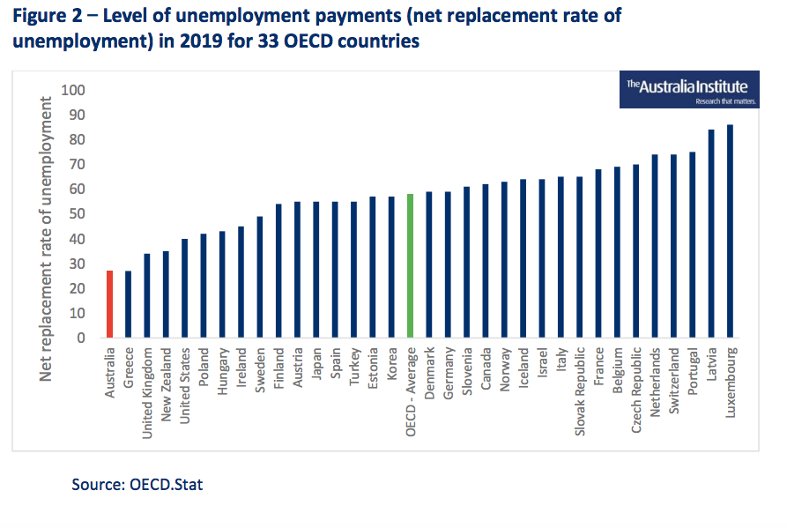
Unemployment benefits are too low
Notes:
unemployment benefit in 2022-23 will be at its lowest level in real-terms since 1990-91, at just £77.29, and is only slightly above an estimated destitution income level of £70 per week vs what is collectively seen as an acceptable standard of living, the Minimum Income Standard (MIS) rate of £230 a week. As a proportion of average earnings, it now below 14 per cent, half the level it was in the 1970’s

Slide 10
Women & mental health
Women are at higher risk of depression at all ages
The reasons why are complex and not fully understood, but it is believed they include:
The hormonal changes that women go through in their lifetime e.g. periods, pregnancy, childbirth and menopause. At these times, women are at a higher risk of struggling with depressive episodes
The demands and expectations of women in our modern world to juggle motherhood, work and relationships
Likely linked to differing cognitive coping styles- increased rumination and avoidance vs problem solving
Giurgus et al Geriatrics 2017
Notes:
Rumination occurs when stressors lead to negative moods and individuals respond to the negative moods by dwelling on them, their causes, and their implications, rather than engaging in either problem-solving or distraction. Women ruminate more than men when faced with a stressor In bot sexes:

Slide 11
Personality traits linked to depression
low self-esteem
anxious
perfectionist
self-critical

Slide 12
Brain
2% body weight
20% energy requirements
87 billion neurones
Chronic stress can affect areas of brain related to mood e.g hippocampus, amydala and pre frontal cortex
Via inflammation, reduced neuronal connection, reduced blood flow.
Notes:
Hippocampus – memories PFCworking memory and self regulatory behaviours stress leads to structutal remodelling of neurones, (retraction of dendrites and reduced synapse density) Sig raised cortisol linked to reduced hippocampal volume Initial stress seems to inc amyydala volume and then leads ti reduced size but inc reactivity Each neurone can hav 2-30,000 connections. Research shows that the hippocampus is smaller in some depressed people. For example, in one fMRI study published in The Journal of Neuroscience, investigators studied 24 women who had a history of depression. On average, the hippocampus was 9% to 13% smaller in depressed women compared with those who were not depressed. The more bouts of depression a woman had, the smaller the hippocampus. Stress, which plays a role in depression, may be a key factor here, since experts believe stress can suppress the production of new neurons (nerve cells) in the hippocampus. It may be that mood only improves as nerves grow and form new connections, a process that takes weeks. In fact, animal studies have shown that antidepressants do spur the growth and enhanced branching of nerve cells in the hippocampus. So, the theory holds, the real value of these medications may be in generating new neurons (a process called neurogenesis), strengthening nerve cell connections, and improving the exchange of information between nerve circuits. If that's the case, depression medications could be developed that specifically promote neurogenesis, with the hope that patients would see quicker results than with current treatments.

Slide 13
Overview
RISK FACTORS for mental health problems
Looking after our mental health
Suicide prevention
Notes:
Lets look at things we can all do to protect our brains and promote our MH and consider any aspects we might need to address. Perhaps pick one area to address and set a specific but realistic goal to achieve it.

Slide 14
Sleep
Optimal 7-8 hours
In terms of brain benefits: promotes neuronal plasticity, removes toxins and improves memory and creativity
Sleep efficiency 85% 7 hours = 5 hours 57minutes
Sleep schedule
Morning daylight 10 mins sunny 20-30 if overcast, dimmer lights evening
Avoid caffeine after lunch
Avoid alcohol within 2 hours bedtime
Temperature 16-18C
Wind down regime consider PMR/ meditation
CBTi via Silver Cloud/TT
Small Steps: Set a go to bed alarm, 5-10 mins daylight morning, PMR at bedtime, sleep tracker, CBTi
Notes:
Circadian disruption eg shift work causes dendritic atrophy and impairs cognitive flexibility whilst also promoting obesity and Insulin/Leptin resistance

Slide 15
Exercise
Increases brain blood flow, BDNF, insulin sensitivity, endorphins, sleep and reduces stress
Greatest differences in risk observed between low doses of physical activity, suggesting most benefits are realized when moving from no activity to at least some. Accumulating an activity volume equivalent to 2.5 hours of brisk walking per week was associated with 25% lower risk of depression, and at half that dose, risk was 18% lower compared with no activity. Only minor additional benefits were observed at higher activity levels.
JAMA Psychiatry Pierce 2022
Small Steps: Standing desk, lunchtime walk, 6000 step target
Notes:
Angiogeneis BDNF- neurogenesis and neural connectivity/ plasticicty Exercise- Improves processing speeds focus attention and memory
Inc heart rate equivalent to stress but helps body acclimatise to the feeling without the stress Small step ?Standing desk ? Lunchtime walk ? Aim for 6000 steps a day/ 2-3 session HIT/swim/ gym/yoga a week

Slide 16
Diet
A 2018 systematic review concluded that people who followed the Mediterranean diet had a 33% lower risk of depression than people who did not.
The SMILES trial was a 12-week randomized control trial of people with major depressive disorder.
At the end of the study, 32% of the diet group were considered to be in remission from depression, compared with just 8% in the control group. The trial also found that the more the participants improved their diet, the more their depression improved.
Those in the diet group increased their consumption of fruits and vegetables, whole grains, nuts and seeds, fish, and healthy fats while reducing their intake of processed foods — dietary patterns in line with the Mediterranean diet.
Small Steps: Cut sugar sweetened/artificially sweetened drinks, reduce takeaways, stop snacks
Notes:
Although this was another small-scale study — and some of the participants in each group were taking antidepressants throughout the study — the results are promising. Brain uses 10x more energy than other tissues and needs large amounts nutrients to fuction properly v susceptible to unhealthy diet. There still isn’t enough evidence to prove a causal link between the gut microbiome and depression, so we should be cautious about using food as the only treatment tool for the condition These study participants were split into two groups and randomly assigned either personalized nutritional consulting sessions or social support counselling.

Slide 17
Gut Brain connection
Gut microbiome can affect the brain in three main ways:
Vagus nerve pathway: Chemicals produced by gut bacteria can send signals to the brain through the vagus nerve, which runs from the colon to the brain.
Neuroendocrine pathway: Some gut bacteria produce an amino acid called tryptophan, an important building block for neurotransmitters, which may influence mood.
Immunoregulatory pathway: Gut bacteria interact with body’s immune system by communicating with immune cells.
Small Steps: Food diary aim 30 a week, increase fibre, probiotics live plain yoghurt, kefir, kimchi, sauerkraut

Slide 18
Alcohol & smoking
Excessive alcohol > 14 units associated with depression anxiety, reduced brain flow, brain shrinkage and adverse effects affects the function of GABA, glutamatergic, serotonergic, dopaminergic, cholinergic, and opioid neuronal systems.
Smoking: Smokers had a thinner cerebral cortex than non-smokers –i.e. smoking destroys the grey matter in smokers. This is important because the cerebral cortex is a part of the brain that is crucial for thinking skills including memory and learning
Stopping smoking has same effect on mood as taking antidepressants/ course of psychological therapy
Small Steps: Drink aware app, Staff MH & wellbeing hub
Notes:
brain shrinkage, grey matter and white matter volume, as a result of low to moderate alcohol consumption (5 to 6 mg/dl, to levels of over 90) 25ml of whisky, 300ml of beer, or 150ml of wine raises blood alcohol level 15-25 mg/dL RBWM: Referral on DXS Slough & Bracknell: Solutions for health - Text QUIT to 66777 or 0800 6226360 or 0118 4492026 or info@smokefreelifeberkshire.com or refer DXS
Surrey Heath: One you Surrey Self referral via website NEHF: Smoke Free Hampshire OR Community pharmaicists

Slide 19
Meditation
‘Rule your mind or it will rule you’ Horace 65-8 BCE
Stress and anxiety are major triggers of depression, and meditation can alter our reaction to those feelings.
Meditation has been found to change certain brain regions that are specifically linked with depression:
Medial prefrontal cortex & Amygdala, or "fear center."
These two brain regions interact to adversely affect mental health Research has found that meditation helps break the connection between these two brain regions
Hippocampus: people who meditated for 30 minutes a day for eight weeks increased the volume of gray matter in their hippocampus
(Luders et al, Neuroimage 2009, Luders et al Human Brain Mapping 2013)
Small Steps: 2-3 mins morning, Headspace app
Notes:
Meditation trains the brain to achieve sustained focus, and to return to that focus when negative thinking, emotions, and physical sensations intrude
The mPFC is often called the "me center" because this is where you process information about yourself, such as worrying about the future and ruminating about the past. When people get stressed about life, the mPFC goes into overdrive. Amygdala the fight-or-flight response, which triggers the adrenal glands to release the stress hormone cortisol in response to fear and perceived danger. . The me center gets worked up reacting to stress and anxiety, and the fear center response leads to a spike in cortisol levels to fight a danger that's only in the mind .The aim of meditation is not to push aside stress or block out negative thinking, but rather to notice those thoughts and feelings, all the while understanding that you don't have to act on them. This could be as simple as closing your eyes and repeating a single phrase or word, or counting breaths. "This helps provide some distance from those negative thoughts or stressful feelings, allowing you to recognize that, although they affect you, they are not you,“Meditation also can help prepare the brain for stressful situations. For example, meditating for a few moments before a doctor's appointment or social situation can help shift the brain and body out of the stress response and into a state of relative calm.
Yet, just as with following a proper diet and exercise, it takes time to feel results from regular meditation. "But with practice, meditation can help many people control how they react to the stress and anxiety that often leads to depression," Also evidence that people who suffer from recurrent depression tend to have a smaller hippocampus
Small stpe 2 mins a day counting breathing Box breathing kindness meditation headspace

Slide 20
Getting into nature
Across multiple studies, researchers have found a fascinating link between access to green space, such as fields, forests, parks and gardens, and a:
reduced risk of mental health problems
improved mood
increased life satisfaction
reduced stress
Increased physical activity
better physical health
Small Steps: plant on your desk, getting outside every day

Slide 21
Gratitude
Study conducted on the relationship between gratitude and death anxiety (Lau & Cheng, 2011).
Adults aged above 60 years, 3 groups. 1. Write gratitude notes and words of positivity, 2. write about their worries, and 3. given a neutral task.
The groups were then exposed to stimuli arousing death anxiety
Participants who wrote gratitude notes showed fewer symptoms of death anxiety than the other two groups. Re-examination of the results showed that with a grateful attitude in life, we gain acceptance and become less fearful of the future.
Neurobiologically: gratitude regulates the sympathetic nervous system that activates our anxiety responses, and at the psychological level, it conditions the brain to filter the negative ruminations and focus on the positive thoughts
Small Steps: start/ end each day 3 things you are grateful for, gratitude diary, positivity challenge
Notes:
83 Chinese adults . Gratitude builds emotional resilience by: Helping us to see the positive things in life Fighting the negative ruminations and rebuilding pessimistic thoughts with optimistic ones Staying grounded and accept the present situation, even if that is a harsh reality Identifying and focusing only on solutions Maintain good health by regulating our metabolic functioning and by controlling the hormonal imbalances Sustain relationships and appreciate people who are there for us. As a result, we feel more loved, cared for, and more hopeful.

Slide 22
Emotional contagion
Humans synchronise with the emotions of those around them, either unconsciously or consciously. Typically, we may mimic other people’s expressions, vocalisations and movements. At its most basic level, if someone is happy and smiles at you, the act of smiling back improves your mood.
2014 Facebook experiment Princeton University 689,000 people
Small steps: List people who bring out the best in you/find company uplifting and reach out to them and actively seek to spend more time with them, turn off SM notifications/ do a SM detox, reduce news exposure
Notes:
‘Mood contagion’ Emotion 2022 Block et al adolescent musicians became reciprocally more similar in mood to their interaction partners. The observed contagion effect was greater for negative than for positive mood. That is, although one may catch a friend’s bad mood, the friend may feel less negative in the process. These results suggest a mechanism for emotional buffering and the cost of social support. We found no evidence for social selection based on mood. Indeed, participants were remarkably tolerant of their peers’ mood fluctuations and showed no evidence of altering their patterns of social interaction accordingly.
FB: When positive expressions were reduced, people produced fewer positive posts and more negative posts; when negative expressions were reduced, the opposite pattern occurred. These results indicate that emotions expressed by others on Facebook influence our own emotions, constituting experimental evidence for massive-scale contagion via social network.

Slide 23
Self efficacy
The term self-efficacy was coined by psychologist Albert Bandura. He defined it as a person’s belief in their ability to handle and succeed in each situation. In short, it’s believing in yourself.
Recalling when you have successfully managed challenge in the past helps you manage current challenges
Paersch et al, Emotion (2022). Recalling autobiographical self-efficacy episodes boosts resilience.
Small Steps: Next time feel stressed/ challenging situation try to recall a time when you overcame in the past
Notes:
75 subjects. were instructed to recall an incredibly stressful and negatively emotional memory. They were then divided into two groups. One group was instructed to vividly recall a positive event while the other group was instructed to recall a time they felt extremely self-efficacious. Then they were instructed to recall the negative emotional memory again According to them, people can boost resilience simply by reflecting on what they’re capable of. Researchers found that the group that recalled their self-efficacious moment were better able to view the negative emotional memory in a different light than the other group. They had an easier time coping with the negative memory; some of them had an easier time after only one time recalling their self-efficacy.
The researchers stated, “our study shows that recalling self-efficacious autobiographical events can be used as a tool both in everyday life and in clinical settings to boost personal resilience.” Small/ Big step In other words, just remember how tough you are. Remember what you’re made of and it can get you through tough time

Slide 24
Loneliness
1/3 adults in UK admit to being lonely
Strong link to depression
Study in Lancet Psychiatry 2020 attributed 18% cases of depression with loneliness. After experiencing loneliness, the risk of depression persists for up to 12 years.
Small Steps: Smile at a stranger, initiate a conversation, hobby
Notes:
Juval Hari Lost connections Despite severe consequences on behavior and health, the neural basis of loneliness remains elusive

Slide 25
Problem Solving
Rational Problem Solving
A constructive problem-solving style that involves:
Defining a problem
Generating alternative solution ideas
Decision making
Implementing and evaluating the solution
Plan
S.S.T.A.
STOP: become more aware of “feeling cues”
SLOW DOWN [possible options to help “slow down”:]
Count to 10
Breathe deeply
“Smile”
“Yawn”
Meditate
Pray, etc., etc.
THINK: Use RPS approach
ACT: Carry out action plan & verify outcome.
Notes:
You can do this by: learning to understand your own thoughts and feelings Identifying at least two people who can help you when you come across a problem in your life
Setting and achieving goals can help to organise time, and can give a sense satisfaction & purpose of in life

Slide 26


Staff Mental Health & Wellbeing hubs
Live or work in Berkshire
Live or work in Surrey or NE Hants
wellbeingmatters.berkshirehealthcare.nhs.uk
0300 365 8880,
9am–4pm, Mon to Fri (except bank hols)
WellbeingLine@berkshire.nhs.uk
Email to request a call back
Managers/Team Leads email:
StaffSupportService@berkshire.nhs.uk
To discuss support for your team
www.hereforyousurreyneh.nhs.uk
hereforyousurreyneh@sabp.nhs.uk
Email to request both individual and team support
Notes:
Juval Hari Lost connections Small steps:

Slide 27


Staff Mental Health & Wellbeing hubs
Support for Individuals
Mental health support
Wellbeing coaching for trauma
Fast-tracked assessment
Coordinate
referrals
Informal chat
Follow up
Individuals
Added benefits of accessing support through Wellbeing Matters:​
Short waiting times for initial assessment​
Knowledge of relevant local and national support, including staff-specific support​
Choice - good links with nearby Hubs and access to additional interventions ​
Confidentiality & option to remain anonymous​
Notes:
Juval Hari Lost connections Small steps:

Slide 28

Staff Mental Health & Wellbeing hubs
Support for teams
Wellbeing Workshops
Wellbeing Hubs
Manager support
Outreach presentations
Teams
Support for Managers: one to one consultations to think about the wellbeing of your team
Wellbeing Hubs: Confidential and compassionate space for teams to reflect on current challenges and how best to cope with these
Workshops & Presentations: facilitated workshop sessions and presentations to your team on a range of topics focused on wellbeing
Notes:
Juval Hari Lost connections Small steps:

Slide 29

SilverCloud for Staff
referred to it by their GP.
Choose from these programmes
Space from Challenging times
Space for Sleep
Space from Stress
Space for Resilience
Space from Money worries
Space from Alcohol
Space from Anxiety and depression
Space for Mindfulness
Notes:
To sum it up, you do a little 2 minute quiz, it suggests modules to suit you, pick one, do an hour a week on it. It helps you build skills and make
Can be supported by a Berkshire Talking Therapies practitioner (with fortnightly online feedback), or - as self-help (exclusive staff-only option). New module- supporting your anxious child/teen coming in 2.12
You can access a longer list by being referred if needed, eg Health anxiety, OCD, mental wellbeing during chronic health issues, panic, phobias.

Slide 30
Support for GPs and practice staff
NHS practitioner health programme
Doctors Support Network
DocHealth
BMA counselling & peer support

Slide 31



Free apps to support mental health for NHS staff
Notes:
Headspace & unmind to dec 22 Unmind tools and training to measure and manage your personal mental health needs, to help with stress, sleep, coping, connection, fulfilment nutrition
Worklife central March 23 - help working parents and those with caring responsibilities develop skills, enhance family life, improve wellbeing and support work / life balance.

Slide 32
Overview
RISK FACTORS for mental health problems
Looking after our mental health
Suicide prevention
Notes:
Not commit

Slide 33

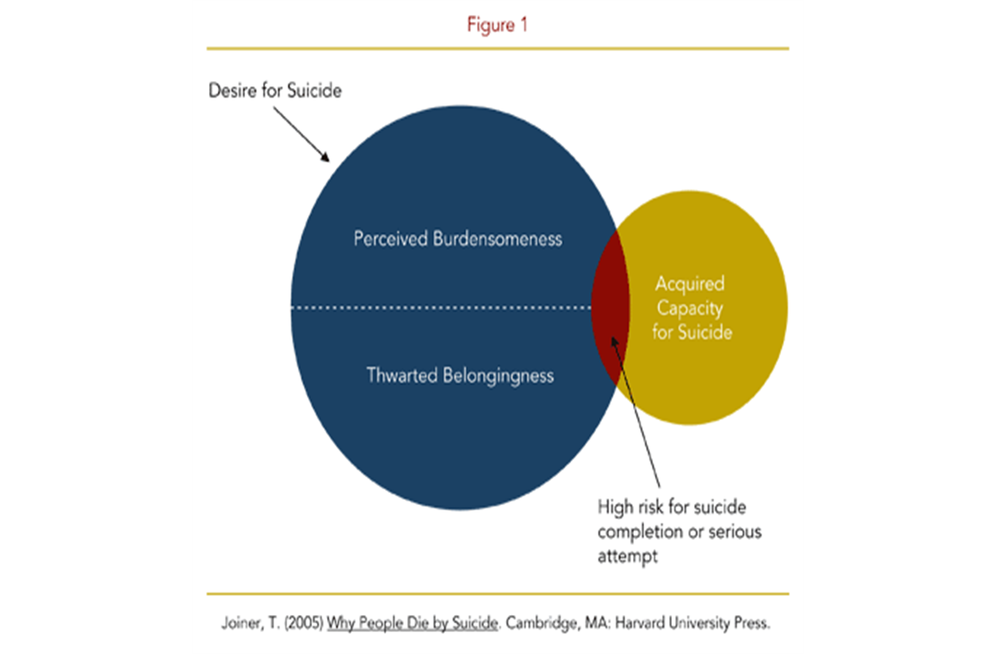
Joiner model of suicidality
Joiner model is a means to assess suicide risk
Notes:
PB: “my death is worth more to others than my living”
TB: Alienation: Loneliness, social disconnection.
Acquired capability: develop a necessary fearlessness of physical pain, injury & death
Left side= who would want to?
Right side= who is capable?

Slide 34
Perceived burdensomeness/
Feeling a burden
Calculation: “My death is worth more to others than my life”.
Thought: “I’m doing everyone else a favour”
e.g Life insurance pay out, those with LTC
Feeling of being a burden increases the risk of suicide

Slide 35

USA suicide rates:
Sept 9 2001 86 suicides
Sept 10 2001 92 suicides
Sept 11 2001 35 suicides
Lowest ever suicide
Thwarted belongingness/ Alienation
Alienation/ social disconnection increases the risk of suicide
Notes:
National crisis- people pull together – suppresses suicide rates WW2
France summer 1998 historic low rates suicide when won the world cup
Also evidence that when sports teams underperform suicide rates increase

Slide 36
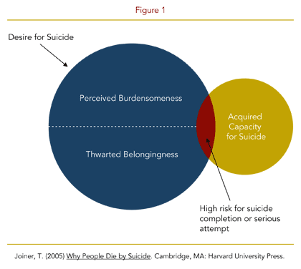
Joiner model of suicidality
Joiner model is a means to assess suicide risk
Notes:
When have simultaneous PB & TB and hold them for long enough- leads to hopelessness can set in and desire for suicide takes hold BUT without fearlessness/ capability will not complete suicide.

Slide 37

Acquired capability/Fearlessness
Fearlessness of death = high risk
Notes:
Develops via a process called habituation- get used to something that you shouldn’t get used to – c.f. NASA Space Shuttle Colombia C.f Kurt Cobain- went through a psychological process of repeated exposure to guns – lost his fear & gained as appetite- similar in all suicidal people- lose fear of something they should be very fearful of…. Get used to pain, injury,death- unnatural- we are naturally hard wired to be afraid of these thing. Fearlessness in itsefl not a bad thing e.g police, firefighters soldiers BUT when assoc with PB/TB= very risky

Slide 38
Red Flags
Well formed suicide plans- ?visualisation
Feelings of hopelessness
Lack of social support
Pain/ chronic medical illness

Slide 39
Myths about Risk-Suicide
MYTH: People who talk about suicide don’t die by suicide.
FACT: 80% of completed suicides had given definite indications of their intention.
MYTH: Talking about suicide will give some an idea to do it.
FACT: Suicidal people already have the idea. Talking about it may invite them to ask for help.
MYTH: All suicidal people are fully intent on dying. Nothing can be done about it.
FACT: 95% are undecided about it. They call for help before or after the attempt.
MYTH: Suicide is an impulsive act.
FACT: Most suicides are carefully planned and thought about for weeks.
MYTH: Suicidal people remain suicidal.
FACT: Most are suicidal for only a brief period. Timely intervention may save their lives.
Notes:
Most people with thoughts of suicide do not want to die, they want to alleviate their distress

Slide 40
The power of a therapeutic relationship
Suicidal patients noted a reduction in their suicidal thoughts if they felt that the observers were optimistic and gave emotional support. Conversely, the patients' distress was exacerbated if they perceived a lack of empathy or validation of their feelings (Pitula 1996).
Can foster feelings of hopefulness, connectedness and being cared for.
Counters feeling of being a burden and alienation/social disconnection
Nothing is more important to mitigating suicidal feelings than being listened to and being believed
Notes:
55% emergency staff admitted to disliking treating/assessing pts who self harm Botega et al (2007) emphasise that even brief training is sufficient to make significant improvements in attitudes towards suicidal patients.

Slide 41
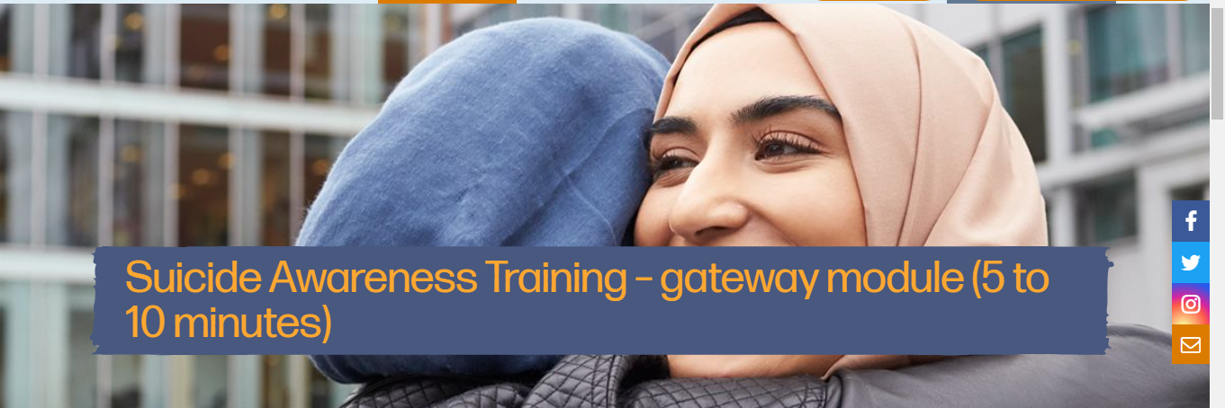
Zero Suicide Alliance
Notes:
PDP

Slide 42
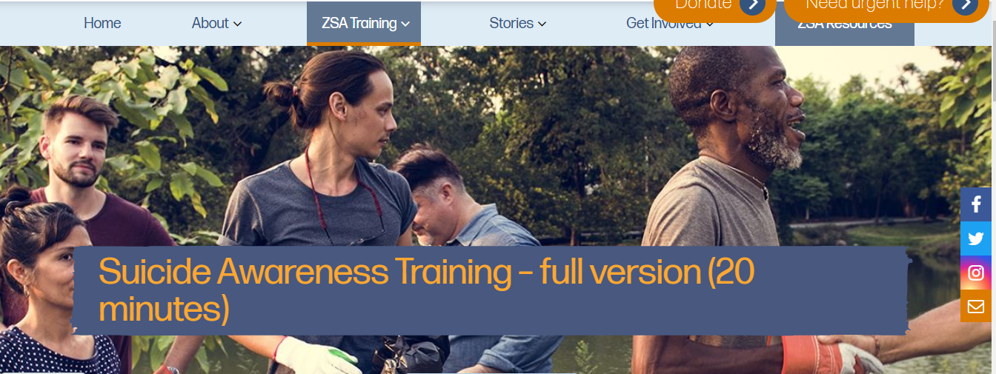
Zero Suicide Alliance

Slide 43
Crisis Support
For 24/7 support as an NHS worker – text FRONTLINE or NHSPH to 85258
East Berkshire CRHTT 0300 365 9999 or 0300 365 0300
NEHF & SH Mental Health Crisis Helpline: 0800 915 4644 or SMS text: 07717 989024
Safe Havens Aldershot, Guilford, Slough
Samaritans: Tel 116 123 (24 hours)
Papyrus Trust: Tel 0800 068 4141 (Weekdays 10am-10pm & weekends 2pm -10pm) Advice for CYP, parents & carers)
Sane Line 0300 304 7000 (4.30pm -10.30pm every day)
www.nhs.uk/conditions/suicide
CALM (Campaign Against Living Miserably) A website which offers support for distressed people, especially young men http://www.thecalmzone.net/what-is-calm/
Notes:
Safe Havens Aldershot Monday to Friday 6pm-11pm, 12:30-11pm weekends and BH Guildofrd 6-11pm 365 days a year. Slough Thurs-Sun 5-11pm

Slide 44
Postvention
SOBS Survivors of bereaved by suicide
Help is at hand Leaflet – available on-line
Suicide prevention alliance resources (www.nspa.org.uk)
Notes:
Father of a 21 yr old son who died by suicide – after the theft of his lawn mower victim support made contact after the death of his son- no support
Those bereaved by suicide have 1 in 10 chance of making a suicide attempt after a loss

Slide 45
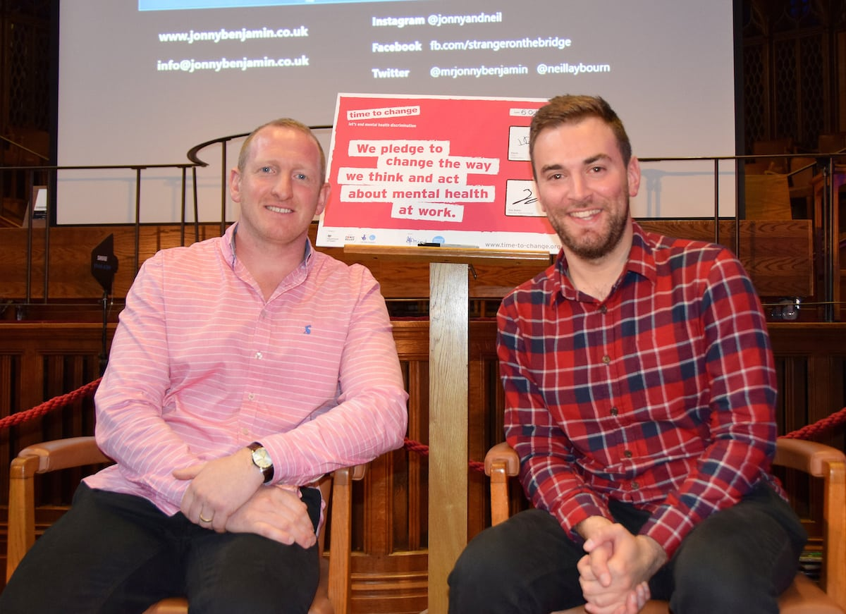
Nine simple words stopped man jumping from London’s Waterloo Bridge
‘It will get better mate, you will get better.’
Notes:
A stranger has been reunited with the suicidal man he stopped jumping from a bridge with nine words: ‘It will get better mate, you will get better.’ Jonny Benjamin, 29, had been diagnosed with schizoaffective disorder – a cross between schizophrenia and biopolar disorder – before he prepared to kill himself. Neil Laybourn, 34, was just crossing Waterloo Bridge himself when he spotted Jonny, rushed over and uttered the nine words which saved Jonny’s life. They spent the next 25 minutes talking before emergency services arrived and the pair went their own way. Jonny’s recovery was slow. It took him a long time before he started to feel better, but he eventually did, and never forgot about Neil. The problem was, he remembered Neil’s name as Mike. Launching a #FindMike social media campaign, it soon went viral. Within two weeks – and with the help of the internet – he found Neil.
Neil Laybourn (L) Jonny Benjamin (R) A stranger has been reunited with the suicidal man he stopped jumping from a bridge with nine words: ‘It will get better mate, you will get better.’
Since that fateful day, the pair have been close friends. Suicide is the biggest killer of middle-aged and young men, and friends started to campaign together on mental health issues.

Slide 46
Thank you for listening
katiesimpson3@nhs.net
lauraingenhaag@nhs.net

