Slide 1

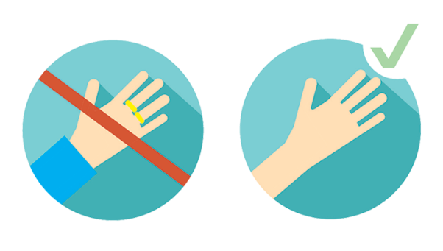



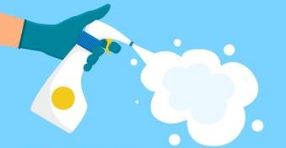
GP Practice Site – IPC guide
Are you ‘Bare Below the Elbows’?
Sleeves rolled up
No wrist watches
No rings or jewellery on the wrist
No nail varnish or artificial nails
Do you have the correct PPE?
Fluid repellent surgical mask
Gloves or aprons are required
When coming into contact with patients’ blood or body fluids
Hand hygiene is key
Hands must be cleaned:
Before vaccine preparation
After touching equipment
After contact with the surroundings
Before patient contact
After patient contact
Environmental Cleaning
Chair and vaccinating table must be cleaned after each patient
All high touch points must be cleaned regularly throughout the day
Infection Prevention and Control Team December 2021

Slide 2
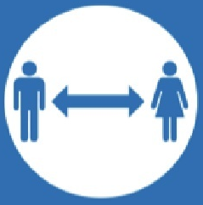
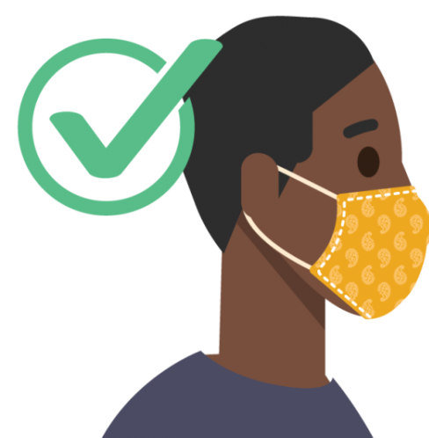
GP Practice – Patient guide
Please continue to adhere to IPC measures to protect everyone
Hand hygiene is key
Please use hand gel provided throughout your appointment
Social distancing
Please keep your distance from others
Maintain 1m, 2m where possible
Patients must wear a face covering
Please ensure that the face covering or mask:
Covers both your nose and mouth
Fits snugly
Infection Prevention and Control Team December 2021

