Slide 1
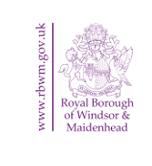

Information for Healthcare Professionals
In January 2022, Public Health at RBWM are promoting
MAN v FAT Football
Gloji
Lower My Drinking
RBWM’s Smoking Cessation Service
These services are free to those that meet the eligibility criteria.
This pack provides brief information on each service and how Healthcare Professionals can refer or signpost patients to each service.

Slide 2

MAN v FAT Football Healthy weight | Royal Borough of Windsor and Maidenhead (rbwm.gov.uk)
Men are put into teams and play in small-sided football games on a weekly basis. Weight loss is a core element of MAN v FAT Football. Each week football scores are combined with any weight loss successes to give teams an overall score. Men are also given nutrition and diet guidance to achieve targets. Men are supported by their teammates and league coach.
A 14-week football league is launching in Maidenhead on 14th January 2022.
HCPs can signpost individuals to www.manvfatfootball.org/maidenhead to sign-up using the code WMC.
Eligibility criteria for MAN v FAT Football:
Men with a Body Mass Index of 27.5+
Aged 18 years or over
Resident in the Royal Borough of Windsor and Maidenhead
Exclusion criteria for MAN v FAT Football:
Have severe/moderate frailty as recorded on a frailty register
Are pregnant
Have an eating disorder
Have a significant unmanaged co-morbidity
Have had bariatric surgery in the last two years

Slide 3
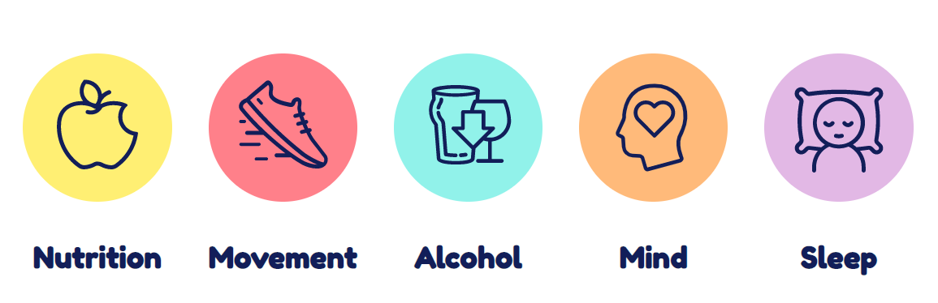

Gloji Healthy weight | Royal Borough of Windsor and Maidenhead (rbwm.gov.uk)
Gloji is a digital 12-week weight loss programme that takes a holistic approach to weight loss and incorporates nutrition, movement, alcohol, mental wellbeing, and sleep.
HCPs can refer patients to Gloji through DXS.
The Gloji Referral Form is located within the Frimley Health and Care / Dietetics / East Berkshire CCG / Referral folder.
To self-refer, individuals can visit https://www.gloji.co.uk/.
Eligibility criteria for Gloji:
Men, women, or individuals with a Body Mass Index of 30+ (or 27+ for Black, Asian, and Minority Ethnic groups).
Aged 18 years or over.
Resident in the Royal Borough of Windsor and Maidenhead.
Exclusion criteria for Gloji:
Have severe/moderate frailty as recorded on a frailty register
Are pregnant
Have an eating disorder
Have a significant unmanaged co-morbidity
Have had bariatric surgery in the last two years

Slide 4
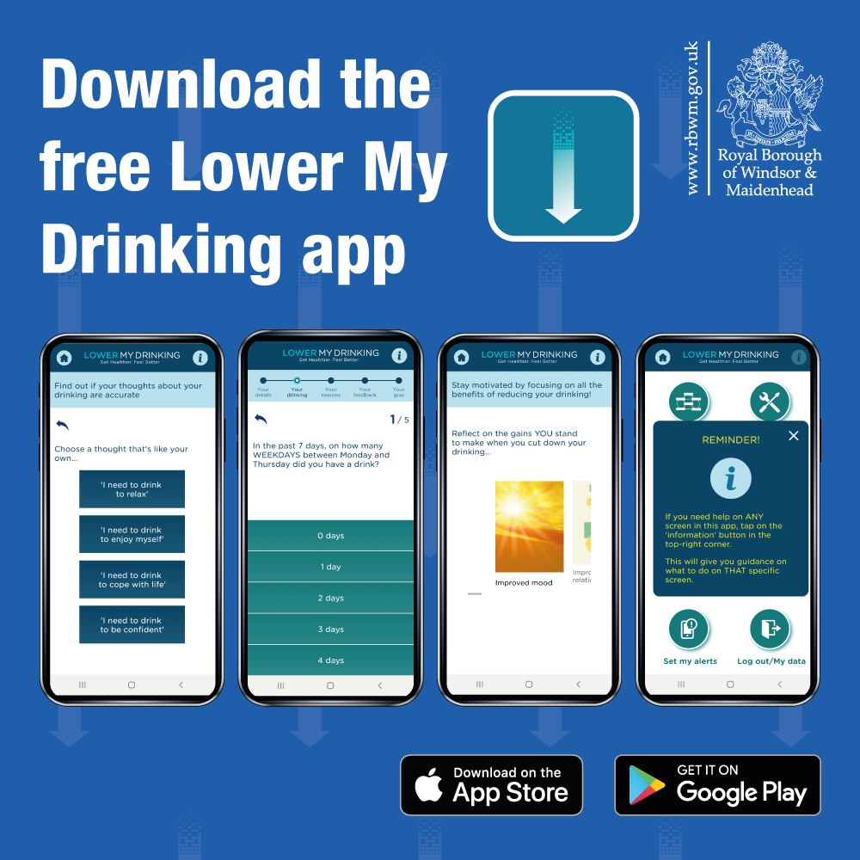
Lower My Drinking Lower My Drinking App | Royal Borough of Windsor and Maidenhead (rbwm.gov.uk)
HCPs can signpost to Lower My Drinking.
The Lower My Drinking self-assessment website https://www.lowermydrinking.com/:
Helps people find out if their drinking could be affecting their health.
In the self-assessment, individuals are asked some questions about their drinking habits and receive personalised guidance to help them cut down.
The Lower My Drinking app:
Provides further support for people whose drinking is putting their health at risk.
This app is confidential and will let individuals track, self-assess, and understand their drinking habits.
It also gives some proven techniques that can help people reduce their drinking. To download the app, visit Google Play or the App Store.
Lower My Drinking is free for people with a Royal Borough postcode at home and/or work.
To receive Lower My Drinking promotional resources, please contact charlotte.fox@rbwm.gov.uk

Slide 5



RBWM’s Smoking Cessation Service
Patients can receive specialist, one-to-one advice, and support to help them stop smoking.
HCPs can refer patients to RBWM’s Smoking Cessation Service using the referral form.
The form can be found HERE
The RBWM Smoking Cessation Service Referral Form is also on DXS, located within the Frimley Health and Care / Community Services / East Berkshire CCG / Referral Forms folder.
To self-refer, patients can:
Call or text: 07936 360109
Email: admin@resilience-rbwm.org.uk.cjsm.net
To use this service, people must be a RBWM resident.

Slide 6
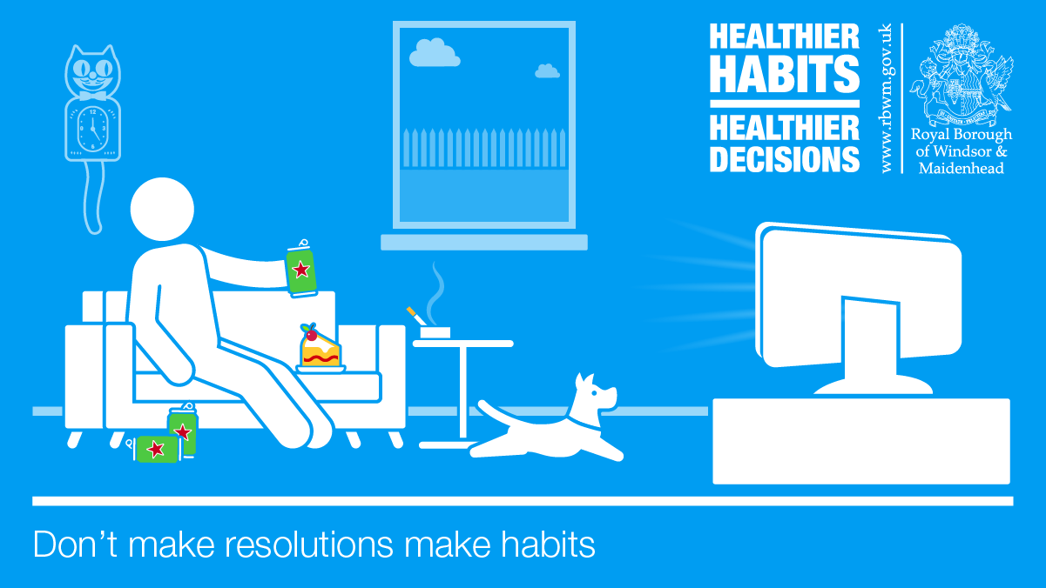
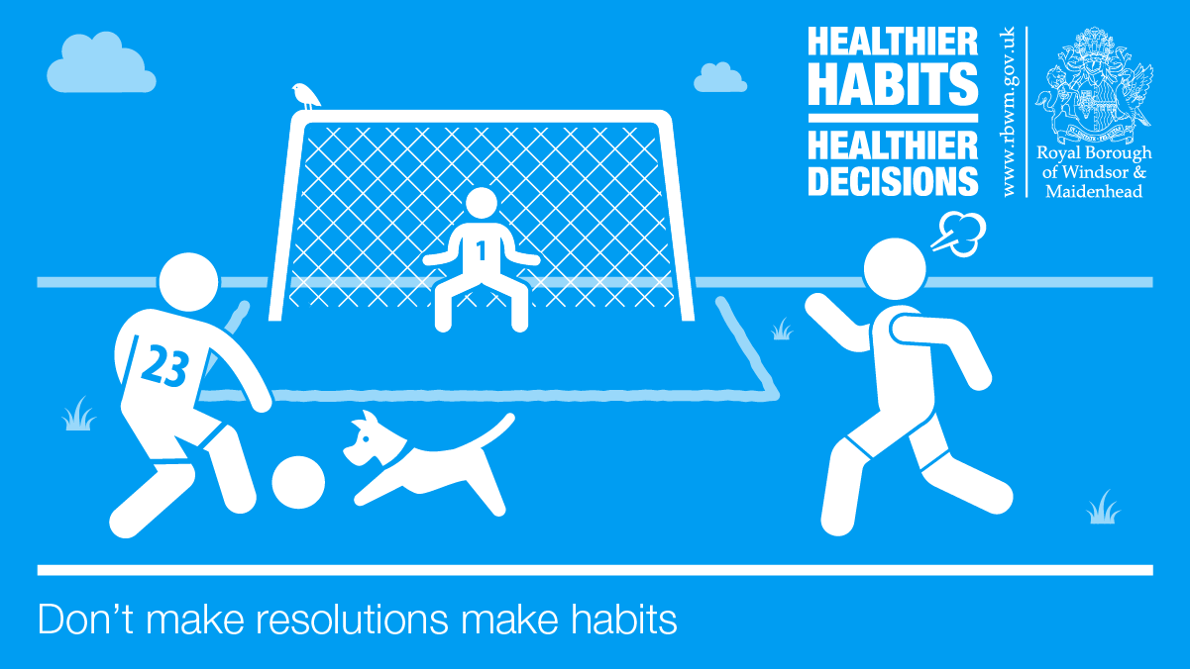
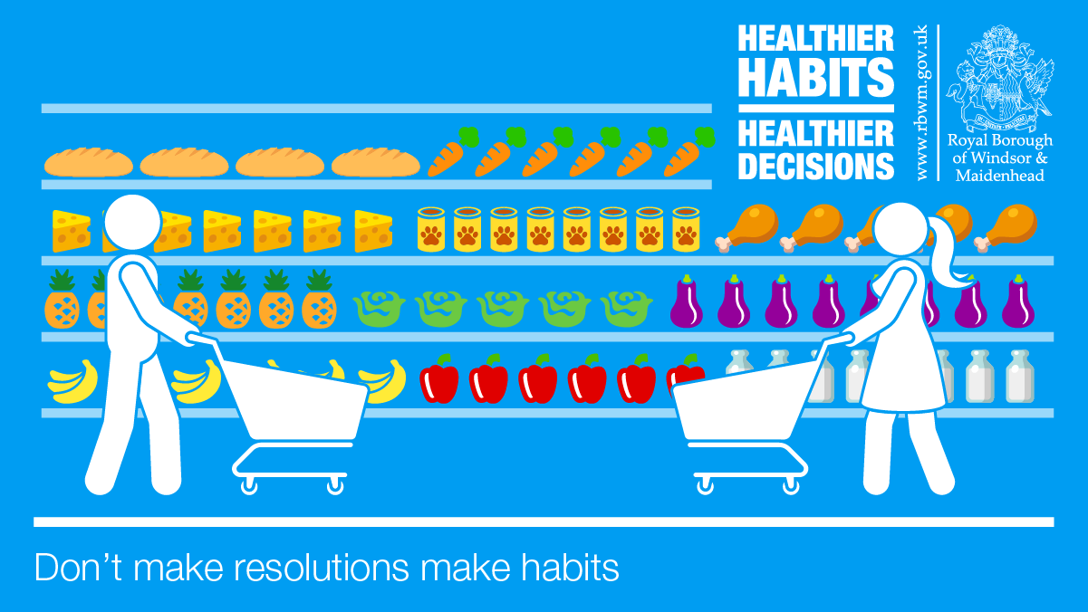
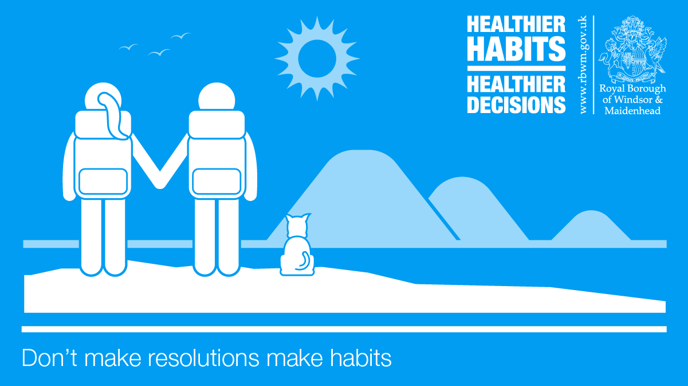
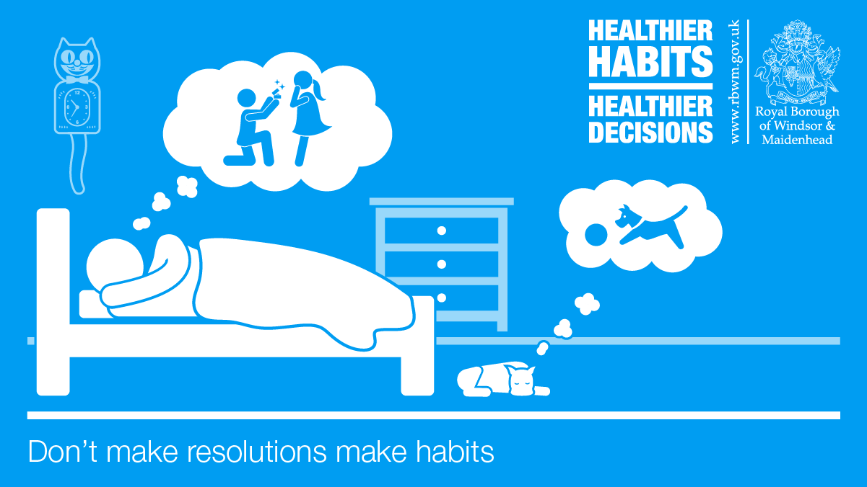
Public Health will be posting the above assets on RBWM’s Twitter, Facebook, and Next Door every Monday in January.
Please feel free to use the assets and reshare the social media posts.
Please share this pack with your appropriate contacts.
Please contact charlotte.fox@rbwm.gov.uk with any questions.

Slide 7
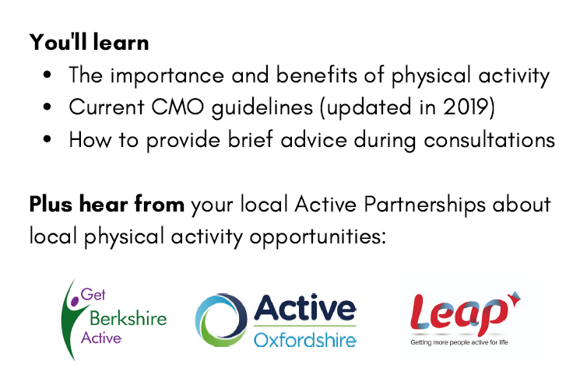
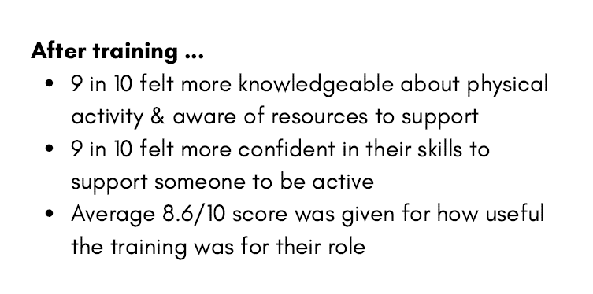
PHE Physical Activity in Clinical Care Training
The next free PHE Physical Activity in Clinical Care Trainings for Thames Valley are scheduled for
Tuesday 25th January 2022 @ 1-2pm
Thursday 27th January 2022 @ 1-2pm
This online training is available for all registered healthcare professionals in Berkshire.
For further information and to book a place go to the Oxfordshire Training Hub Events Calendar.
This training has been delivered to more than 500 health and social care roles across Thames Valley since Sept 2020.
If you have any questions or would like more support around physical activity in your role/team, please contact: Kirsty Heath, Get Berkshire Active, kirsty.heath@getberkshireactive.org

