Slide 1


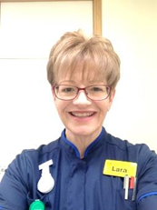
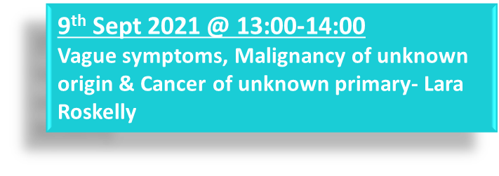

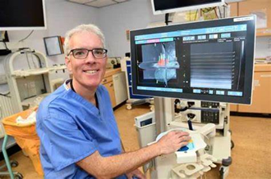

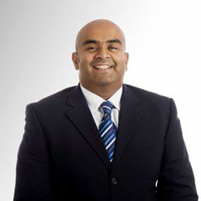


FREE WEBINARS
Cancer Care Across Boundaries (CCAB) Webinars
Sept –Oct 2021
Counts as 2 hours/month towards CPD & revalidation
https://frimleytraininghub.co.uk/cancer-care-across-boundaries/

