Slide 1







Primary Care Network: Directed Enhanced Service &
Quality Outcomes Framework Quality Improvement
Early Diagnosis of Cancer Guidance and Resource Pack
September 2021

Slide 2

How we developed this pack
We have created this guidance and resource pack in collaboration with a number of partners and would like to thank them for providing information and insight.
We would like to acknowledge Dr Chrissie Clayton, Surrey Heartlands Cancer Clinical Lead, for her support in initiating this resource.
Please note: the information in this pack is up to date as of August 2021 but may be subject to change. It is advisable to check sources for and further updates.

Slide 3
Contents
Introduction Slide 4
Introduction to SSCA Slide 5
PCN DES Specifications Slide 7
QoF QI 2021/22 Slide 12
Getting started Slide 13
Screening resources Slide 14
Practice review Slide 16
Creating a plan Slide 17
Peer review Slide 20
Safety-netting diagnostic process Slide 21
GP Support tools Slide 23
Education and training Slide 25
CRUK Facilitator Support Slide 27

Slide 4
Introduction
Long Term Plan Ambitions
We will continue to transform cancer care so that from 2028:
• An extra 55,000 people each year will survive for five years or more following their cancer diagnosis;
• Three in four cancers (75%) will be diagnosed at an early stage.
The role of primary care across the cancer pathway is vast:
Improving population health: teachable moments, lifestyle advice, smoking cessation, encouraging uptake of cancer screening programmes
Spotting the early signs of cancer and referrals: people with suspected cancer are promptly referred and informed about their referral pathway
Safety netting: putting in place agreed processes, conducting investigative tests, on-going review and follow-up of 2WW non attenders, monitoring of people with non-specific symptoms that do not meet a current referral threshold
Follow Up and on-going management: Cancer Care Reviews, acting on treatment summaries, stratified follow-up, secondary prevention, lifestyle advice and managing co-morbidities, spotting recurrence and helping to manage the consequence of treatment

Slide 5
Introduction to the Surrey and Sussex
Cancer Alliance (SSCA)
The Surrey and Sussex Cancer Alliance (SSCA) covers a population of just over 3 million people.
Our members include:
Surrey Heartlands Health and Care Partnership (ICS)
Frimley Health Integrated Care System (ICS)
Sussex Health and Care Partnership (ICS)
The work programme led by SSCA centres on implementing the priorities described in the Long Term Plan relevant to cancer. In collaboration with system partners and through the process of co-production we seek to:
To reduce variation and inequalities in the delivery of cancer services across Surrey and Sussex
To improve accessibility of cancer services across Surrey and Sussex
To improve survivorship and outcomes for patients diagnosed with a cancer
For patients to have a personalised plan for their cancer treatment and recovery that reflects their wishes
Our response to the Long Term Plan builds on our successes to date and the strong collaboration across our cancer system:
Prevention: We will reduce variation and inequalities in the delivery of prevention services across Surrey and Sussex in order to reduce the incidence of preventable cancers
Screening: We will raise awareness and improve accessibility of screening for bowel, breast and cervical cancers
Earlier & Faster Diagnosis: We will develop Rapid Diagnostic Services and work with our Primary Care Networks to deliver faster and earlier diagnosis
Treatment: We will continue to improve our world-class treatments and services for people with cancer
Personalised Care: We will develop our personalised offer of services and support for people living with and beyond cancer

Slide 6
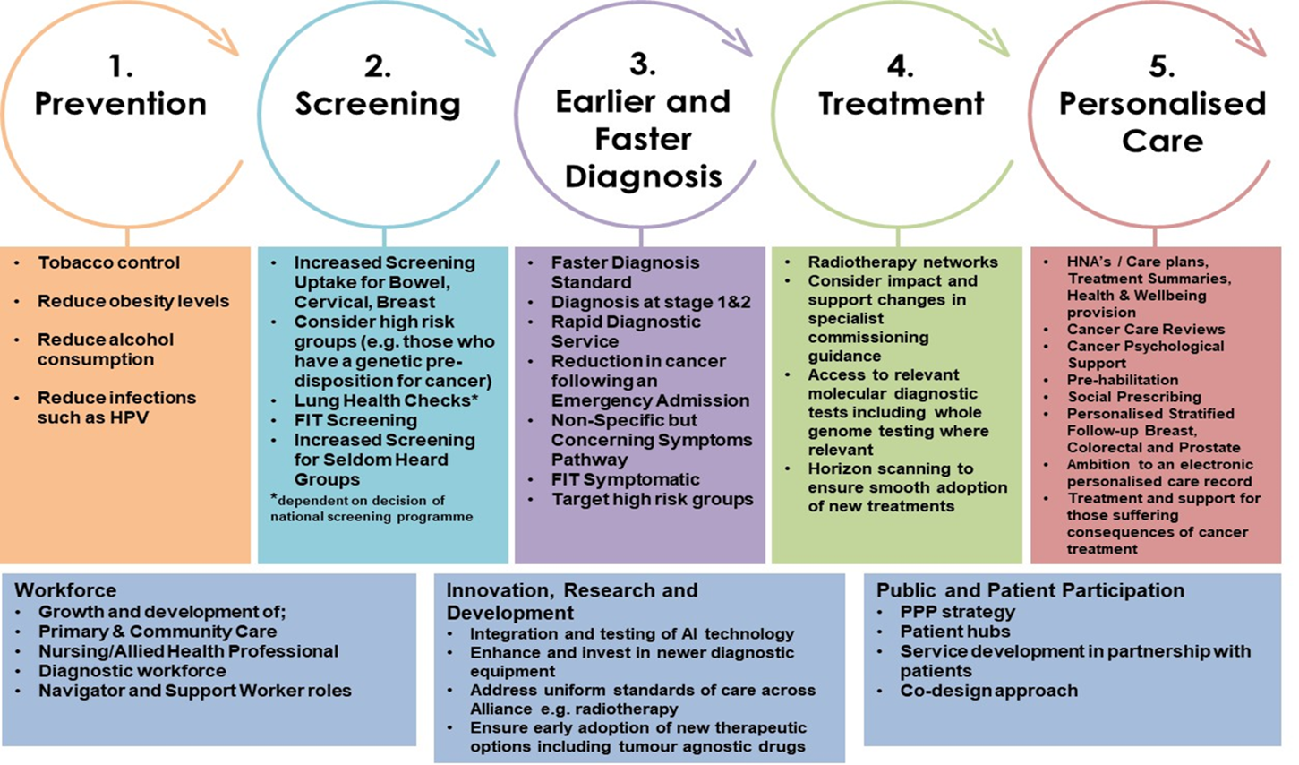
Surrey and Sussex Cancer Alliance
Workplan 2019-2024

Slide 7
PCN Directed Enhanced Service &
QoF Quality Improvement (QI)
In January 2019, NHS England agreed a new five-year framework for GP contract reform to implement the NHS Long Term Plan. This included a number of improvements to QoF in line with the recommendations of the Review of the Quality and Outcomes Framework in England published in July 2018.
Primary care networks (PCNs) were introduced at the beginning of January 2019 as part of the NHS Long Term Plan, accompanied by significant additional investment.
The Network Contract Direct Enhanced Service (DES) underpins the role of PCNs in empowering general practice within the wider NHS and improving the range and effectiveness of primary care services.
This resource pack has been developed in partnership to provide insights and resources that will support both practices and PCNs as they look to adopt QoF and DES specifications.
Click here for the PCN DES specification for 2021/22
Click here for the QoF QI 2021/22 specification

Slide 8
PCN DES specifications (1)
To achieve the PCN DES specifications, PCNs must review referral practice for suspected cancers, including recurrent cancers and also contribute to improving local uptake of National Cancer Screening Programmes.
A PCN must:
Review the quality of the PCN’s Core Network Practices’ referrals for suspected cancer, against the recommendations of NG12 and make use of clinical decision support tools and practice-level data to explore local patterns in presentation and diagnosis of cancer;
Build on current practice to ensure a consistent approach to monitoring patients who have been referred urgently with suspected cancer or for further investigations to exclude the possibility of cancer (‘safety netting’), in line with NG12; and
Ensure that all patients are signposted to or receive information on their referral including why they are being referred, the importance of attending appointments and where they can access further support.
New requirements for 2021/22
Identify and implement specific actions to address unwarranted variation and inequality in cancer outcomes, including access to relevant services.
Support the restoration of the NHS Cervical Screening Programme by identifying opportunities across a network to provide sufficient cervical screening sample-taking capacity

Slide 9
PCN DES specifications (2)
They should also:
Work with local system partners ( Public Health, ICP/CCG and the ICS cancer team) to agree the PCN’s contribution to local efforts to improve screening uptake. This should build on any existing actions and must include at least one specific action to engage with a group with low-participation locally.
Establish a community of practice between practice-level clinical staff to support delivery of these requirements.
New requirement: Identify successful improvement activity undertaken by constituent practices in support of the 20/21 QOF requirements on early cancer diagnosis. Ensure that successful practice is implemented and developed across the PCN.
A PCN must, through the community of practice:
Conduct peer to peer learning events that look at data and trends in diagnosis across the PCN, including cases where patients presented repeatedly before referral and late diagnoses.
Engage with local system partners, including Patient Participation Groups, secondary care, the relevant Cancer Alliance and Public Health Commissioning teams.

Slide 10
PCN DES specifications (3)
PCN DES compared with the QoF QI
The PCNs DES and QoF QI are complementary and recognise the pivotal role of primary care within the early diagnosis of cancer.
The QoF QI work is undertaken at an individual practice level whereas the PCN specification applies to a larger population ‘at scale’ and builds on the QI activity.
At a PCN level, practices can discuss variation, build consensus, implement best practice and hold each other to account. They can potentially benefit from operational economies of scale and a shared primary care workforce.
Useful Resources on PCN DES from Cancer Research UK
PCN DES Video Mini-Series
Examples of good practice 2020/21
Case Study Coventry Sowe Valley
Case Study Suffolk PCNs

Slide 11
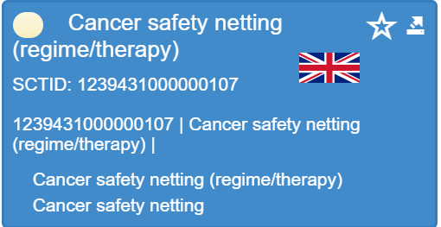
PCN DES specifications (4)
Monitoring and Reporting
PCN Dashboard
Where to access: www.networks.nhs.uk/news/primary-care-network-pcn-dashboard
Indicators:
Percentage females, aged 25-49, attending cervical screening within target period (3.5 years) – annual/PHE Fingertips
Percentage females, aged 50-64, attending cervical screening within target period (5.5 years) – annual/PHE Fingertips
The proportion of patients who were placed on an urgent referral pathway for suspected cancer where safety netting was recorded – NEW quarterly CQRS/NCDR extract (using Snomed codes)
Core Network Practices of a PCN must use the relevant SNOMED codes and other agreed approaches, some of which will be included in the Network Dashboard.
Practices will therefore need to ensure that they use the relevant codes and if necessary, re-code patients. The applicable SNOMED codes are available in the relevant business rules published by NHS Digital.

Slide 12




The QOF QI 2021-22 guidance requires
practices to:
Identify areas for improvement:
This should including assessment of screening uptake rates; referral processes and safety netting protocols
Create an improvement plan:
This should include increase in the follow up for screening; reduction in inequitable uptake; increase in safety netting; decrease in time from presentation to referral
Early cancer diagnosis: QOF indicators
QI005: The contractor can demonstrate continuous quality improvement activity focussed upon early cancer diagnosis as specified in the QOF guidance (27 points)
QI006: The contractor has participated in network activity to regularly share activity as specified in the QOF guidance. This would usually include participating in a minimum of two peer review meetings (10 points)
Implement the plan:
This should include engagement with external colleagues (eg. Public health) and patient groups where appropriate
GP Network Peer Review Meetings:
There should be a minimum of 2 GP network peer review meetings

Slide 13



Getting started
You will find key information and useful guides here to help your practice and PCN get started:
Source | Resource | Link
 | Practice and PCN level data | PHE Fingertips Cancer Services Power Bi Cervical Screening Dashboard
 | GP Contract Hub | CRUK GP Contract Hub CRUK QOF QI module on early cancer diagnosis
 | GP resources | Macmillan Resources for Professionals
 | RCGP Cancer Toolits | RCGP Cancer Resources & Toolkits

Slide 14

Screening resources
Source | Resource
 | Practice and PCN level data: PHE Fingertips Cancer Services Power Bi Cervical Screening dashboard PHE Inequalities Screening Strategy Report on Independent Review National Screening Programmes
 | Macmillan Cancer Screening QI Toolkit
 | Bowel screening resources GP Good practice guide bowel screening Reducing inequalities bowel cancer screening Bowel screening FIT Leaflet (England) Video - how to do the bowel screening test Patient leaflet - Spot bowel cancer early

Slide 15
Screening resources
Source | Resource
 | Breast Screening CRUK Breast Cancer Screening Information
 | Cervical Screening Good practice guide primary care cervical screening CRUK Cancer Insight: Cervical screening update Patient leaflet - Spot cervical cancer early

Slide 16



Practice Review
 | Screening | Review screening programme uptake rates for your practice compared to local or national baselines You may wish to focus upon inequalities in screening, particularly for those at risk and with low uptake.
 | Current referral practice | You could audit current referral practice by using the National Cancer Diagnosis Audit template or other retrospective audit of recent cancer diagnoses. Data sample suggestions: route to diagnosis; referral pathways used, including faster time pathways with tests required in primary care; time from first presentation of symptoms/signs in primary care to referral and investigations; proportion of referrals meeting Faster Diagnostic Standard. Aim to audit either a minimum of 20 consecutive cancer diagnoses or a randomly selected sample of at least 20 cases from the previous 12 months. Review how the pattern of referrals has changed following the pandemic. Have you seen a reduction and then recovery in the number of referrals for different tumour pathways. Are there differences in referrals for patients seen face to face compared with remote consultations? You may want to focus in more depth on cancers such as lung where there is often more unmet need.
 | Safety Netting | Review your current safety netting processes and ensure this is understood by the whole practice team. Consider using the CRUK safety-netting checklist or workbook.

Slide 17
Creating a plan (1)
Step 1: Define QI activities that focus on outcomes such as:
An increase in the follow-up and informed consent/refusal of screening for cervical, breast or bowel cancer.
A reduction in inequitable uptake of screening in population groups identified by the practice.
An increase in the proportion of cases where cancer diagnoses are reviewed and learnt from
A decrease in the time from presentation to referral.
An increase in the proportion of suspected cancer referrals where a demonstrably robust practice-wide system for safety-netting is used.
We encourage you to seek the views of patients and carers where this will help with quality improvement activity. You could do this through engagement with a patient participation group and/or a survey of patients.
Step 2: Decide on your AIMS
Write an aims statement of what you want to achieve from your quality improvement project including the timeframe. This will help you to be clear about what your project is and what you want to achieve.
The NHSEI Guide to developing an AIMS statement is here
Ensure these aims are SMART - specific, measurable, achievable, relevant, and time-bound.
Consider what measurements are needed to assess the effectiveness of the change and what data needs to be collected. This should be straightforward to collect regularly.

Slide 18
Creating a plan (2)
Step 3: Project Governance
Project scope – what will and won’t be done during the project?
Establish milestones – What will be done and by when?
Reporting – who need to see your work? Does it need approval and by which group?
Project team – who will do what?
PCNs and Practices should implement the improvement plan they have developed to support the objectives they have identified.
Top Tips
We recommend that these plans and associated improvement activities should involve the whole team.
PCNs and Practices are encouraged to engage with colleagues outside the practice where practical, for example public health and the screening service if addressing screening, or secondary care or other local teams e.g. your ICP or ICS Cancer Teams.
Useful Resources
Macmillan Early Diagnosis QI Toolkit
RCGP QI Toolkit for the early diagnosis of cancer
QoF QI Case Studies

Slide 19
Examples of SMART aims
1: Baseline analysis identifies x% of people eligible for screening for y cancer have not responded to invites.
SMART aim: The PCN/Practice aims to contact z% of non-responders over the next six months providing additional information to support informed decision making about screening.
2: Baseline analysis identifies only x% of eligible patients with a learning disability have responded to their screening invite.
SMART aim: The PCN/Practice aims to contact y% of non-responders with a learning disability over the next six months and provide appropriate support to make informed decisions or best interest decisions as appropriate.
3: Baseline analysis identifies only x% of new cancer diagnosis cases are reviewed and learnt from.
SMART aim: The PCN/Practice aims to increase the % of new cancer diagnosis cases which are reviewed and learnt from, by y% to z%, over the next six months.
4: Baseline analysis identifies an average of x days from initial presentation to date of referral.
SMART aim: The PCN/Practice aims to decrease the time from initial presentation to referral to under y days over the next six months. Consider tests and datasets required for faster timed pathways. (This may not be an ideal choice for smaller practices or where high-quality audit data is not available).
5: Baseline analysis identifies the proportion of suspected cancer referrals with systematic safety netting to check they are seen in secondary care as x%.
SMART aim: The PCN/Practice aims to increase the proportion of referrals with systematic safety netting to y% over the next six months.

Slide 20
Peer Review
Practices are required to take part in a minimum of two local GP PCN peer review meetings for the QOF QI.
Ideally, the first peer review meeting should take place early in the QI activity and could focus on:
Sharing the outputs of the audit and baseline work to understand the issues for each PCN/Practice.
Validation of PCN/Practice improvement plans and targets.
Alignment with the wider cancer activities and local priorities.
The second peer review meeting should take place towards the end of the QI activity and could focus on:
Celebrating success and sharing of key changes made in PCN/Practice.
Encouraging a compassionate, no-blame and active learning culture.
How these changes have been embedded and will be sustained.
Notes:
Video calls and telephone calls

Slide 21
Safety-netting diagnostic process
Cancer touches the lives of everyone. 50% of all people born since 1960 will be diagnosed with cancer in their lifetime and the other 50% will undoubtedly be affected by the cancer diagnosis of a loved one. In 2014, 17,700 people were diagnosed with cancer in Surrey and Sussex, and cancer was responsible for 7,700 deaths in the region.
Furthermore, patient demand for cancer services is increasing. In 2017/18, almost 2 million patients nationally were referred by their GP for suspected cancer, equating to more than 5,000 patients every day. When compared to five years ago, this is an increase of almost 60%.
The challenge of recognising cancer symptoms
Patients often present with symptoms that could indicate a new cancer diagnosis. Some will be easily recognised as potentially serious and acted upon, but many will be non-specific or vague e.g. fatigue, weight loss or abdominal pain.
The non-specific, undifferentiated nature of cancer symptoms is a key challenge to early diagnosis and part of the reason why so many cancers are diagnosed at a late stage, when the chance of a successful outcome is lower. Safety netting is an essential process to help manage uncertainty in the diagnosis and management of patients by providing information for patients and organising follow-up after contact with a health professional.
Safety netting is the diagnostic management strategy that ensures patients are monitored throughout the diagnostic process until their symptoms or signs are explained and results have been acted upon.
CRUK GP Insight – Safety Netting: What does it mean?
Notes:
Video calls and telephone calls

Slide 22


Safety-netting diagnostic process
Source | Resource
 | Safety-netting resources for professionals Safety netting checklist ‘Safety netting patients during the COVID-19 pandemic recovery phase’ NG12 Body Map NG12 Interactive Desk Easel National Cancer Diagnosis Audit
 | E-learning course: coding and safety-netting in the context of cancer Rapid referral guidance Electronic safety-netting toolkit
 | Suspected cancer: recognition and referral

Slide 23



GP Support Tools (1)
Source | Resource
 | Ardens is a clinical decision support tool for SystmOne & EMIS Web which: Gives clinicians easy access to the latest evidence-based resources. Promotes best practice, medicines management and patient safety Improves efficiency, maximises savings and frees up valuable resources Ensures localised standardised care is provided with supporting clinical pathways Assists contract management and accurate service evaluation Provides solutions for referral capacity and demand management Supports in upskilling staff including HCAs and nurses
 | DXS International provides NHS approved clinical support solutions for clinicians and patients, to improve outcomes, reduce costs and save lives: Point of Care - Clinical decision support – managing information overload in general practice Complete Care - Clinical templates and referral forms for EMIS Web and SystmOne – navigating complex consultation workflows
 | C the Signs uses the latest, regional and national (NICE) guidelines to help GPs identify and manage patients at risk of early cancer: Sign posting to the most appropriate test, investigation Fully localised and configured to CCGs and local Trusts Digital 2WW forms are integrated into the tool, ensuring latest forms available Automated safety netting to track and monitor patients on cancer pathway Embedded patient information leaflets

Slide 24


GP Support Tools (2)
Source | Resource
 | AccuRx: Chain provides quick, direct line of contact between staff and patients and reduces the number of calls made to patients. Increase uptake on invites through SMS Text service Send patient information directly to them Messages saved and coded Survey templates Track usage
 | www.qcancer.org/ The QCancer tool provides absolute risk of all cancers combined, as well as a breakdown of risk for 12 different cancer types individually. There is a calculator for men and one for women which calculates the risk of a patient having a currently undiagnosed cancer. Integrates with EMIS web

Slide 25


Education and Training (1)
Source | Resource
 | Gateway C is a free online cancer education platform developed for primary care professionals across England, aiming to improve cancer outcomes by facilitating earlier diagnosis and improving patient experience. The platform assists users to confidently identify, refer and support patients with symptoms on a suspected cancer pathway.
 | Coding and Safety Netting in the Context of Cancer Cancer Awareness Impact evaluation Improving care for LGBT people living with cancer Patient experience and health inequalities Physical activity and cancer
 | CRUK RCGP bite sized videos on primary care and cancer matters Cancer awareness and prevention for professionals

Slide 26

Education and Training (2)
Source | Resource
 | Alcohol and Tabaco Brief interventions Obesity Cancer in the community Engaging with people and communities eGP on-line General Practice Assistant Resources NHS Screening programmes Person Centred Approaches Personal Health Budget Population Health Management Social Prescribing

Slide 27

CRUK Facilitator Support
CRUK Facilitator Surrey & Sussex
Building on the work of Cancer Research UK in Surrey and Sussex over the past 5 years, SSCA has funded a CRUK health professional facilitator to work with PCNs to support and promote the early diagnosis of cancer.
Rachel Hinxman can provide free, tailored, facilitation and support at PCN meetings, learning sessions and workshops on the following:
Practical advice on meeting the PCN DES and QoF QI on early cancer diagnosis
Help with understanding PCN-specific cancer data (Fingertips Cancer Profiles) and NCDA reports
Education sessions on safety netting and QI tools
Awareness sessions for non-clinical staff on cancer prevention and screening programmes
Assist with quality improvement projects and creating an improvement plan
Signpost to toolkits and evidence for healthcare professionals
Access cancer information resources for patients
To find out more about how we might be able to help,
please email rachel.hinxman@cancer.org.uk.
Notes:
Video calls and telephone calls

Slide 28
We hope that you find this pack useful as you start work towards the QoF QI and PCN DES Specifications in 2021-22.
If you have any questions, please contact us through our email: rsch.sscaadmin@nhs.net

