Slide 1
The NHS Digital Weight Management Programme
Regional Resource Pack
July 2021

Slide 2
Purpose of this Pack
The NHS Digital Weight Management Programme (NHS DWMP) is LIVE and accepting referrals.
This pack has been prepared by the NHS England and Improvement Obesity Team as a resource for colleagues to use when:
  Talking about the NHS Digital Weight Management Programme
  Seeking to support increased numbers of referrals
Contents:
  Background information about the DWMP
  Aims, intentions and benefits of the programme
  The weight management enhanced service
  Key messages for communications
  Brand guidelines
  Resources for systems
  Resources for general practice (GP toolkit; poster; FAQs)
  Resources for service users (service user information leaflet)
  Social media guidelines
  Website guidelines
  Information about the NHS DWMP commercial provider’s communications
  Further information
  Slides for systems to use when presenting about the NHS DWMP

Slide 3
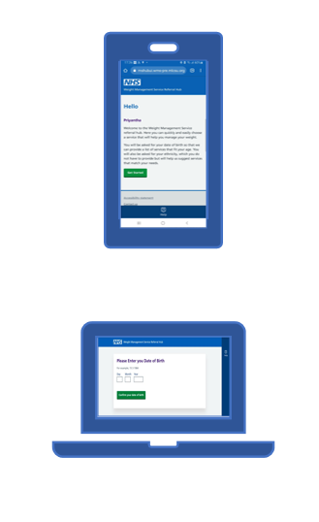
What is the NHS Digital Weight Management Programme?
The NHS Digital Weight Management Programme (NHS DWMP)
For adults living with obesity who also have diabetes or hypertension or both
Available via all General Practices in England
Referral (by all General Practice staff) via the existing established e-referral System (e-RS).
Clinical templates available for SystmOne, EMIS and Vision IT systems via: https://www.england.nhs.uk/digital-weight-management/
Behavioral & lifestyle interventions delivered over 12 consecutive weeks
Option for Service Users to participate via an App or web-based platform
Provided at no cost to local systems

Slide 4
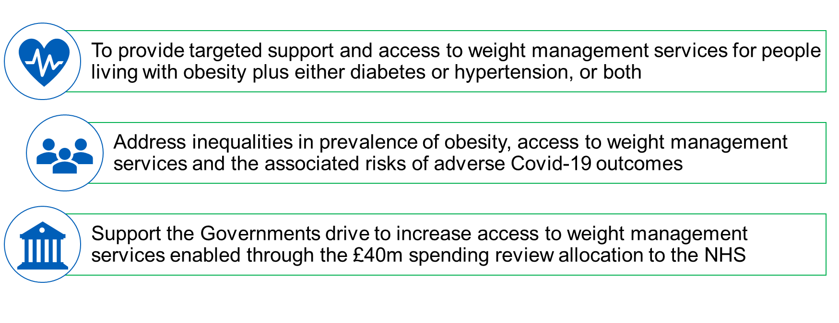
Aims, intentions, and benefits of the programme
50 mins

Slide 5



The Weight Management Enhanced Service is now active
Participating practices will receive funding for referring people living with obesity into weight management services
Services included are NHS DWMP, Local Authority funded tier 2 weight management services, NHS Diabetes Prevention Programme and tier 3 and 4 services
NHS DWMP should be the “default option” for people living with obesity plus either diabetes or hypertension, or both
Notes:
We hope this phase will provide an opportunity:
For all General Practices to be aware of the programme, to download clinical templates and to become accustomed to making referrals ahead of the proposed GP incentive;
For all ICSs to drive awareness of the programme and to work with a practices, especially in areas of greatest need, to maximise referrals in the early adopter phase;
For Local Authorities and ICS/CCGs to work together to ensure this offer lands constructively in local areas alongside any other available offers. This may involve supporting General Practices to understand the range of weight management offers available within their respective geography

Slide 6
Key Messages
You can adapt and use the messages below to raise awareness about the NHS DWMP through regional engagement and the communication vehicles you have
The programme offers online access to weight management services for those living with obesity plus diabetes, or hypertension, or both. It is intended to improve:
  inequalities in prevalence of obesity,
  access to weight management services, and
  risks of adverse health outcomes associated with obesity.
It is accessible by e-referral from all General Practices in England. The new services are commissioned by NHS England and are available at no cost to local systems.
Referrals can me made from any member of staff working in general practice, not just GPs.
The programme offers free, 12-week digital support through apps and websites to help patients manage their weight and improve longer term health outcomes. There is additional support (through human coaching) available to those with characteristics that may make them less likely to complete a weight management programme.
Comprehensive information on this, and how practices can start referring is all available at: https://www.england.nhs.uk/digital-weight-management/.
50 mins

Slide 7


Brand
The programme should always be referred to as: The NHS Digital Weight Management Programme.
This should not be abbreviated to an acronym in any external facing materials.
Branding should always follow NHS Identity Guidelines.
The NHS Digital Weight Management banner can be included alongside any external communications
The NHS Digital Weight Management banner can be included in email signatures
PNG banner image to download here:

Slide 8
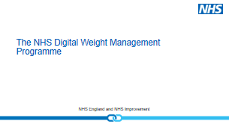
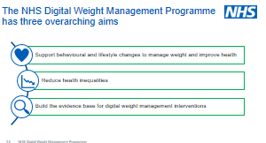
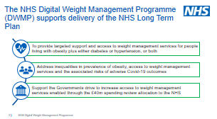
Resources for Systems
The National NHS England and Improvement Obesity Team have a set of slides which can be used to promote the programme and covers:
  The aims of the NHS Digital Weight Management Programme
  How the NHS Digital Weight Management Programme complements other tier 2 Local Authority commissioned weight management services.
  How general practices can start referring into the programme
Powerpoint slides to download here:
50 mins

Slide 9
Resources for Systems
The NHS England and Improvement Obesity Team have approved bulletin copy that you can use to send in your regional and system bulletins to inform colleagues of the NHS Digital Weight Management Programme.
“NHS England and Improvement has launched the Digital Weight Management Programme (DWMP) for people living with obesity who also have either diabetes, or hypertension, or both. All General Practices in England can refer patients to the programme and will now receive funding for referrals to weight management services, including the DWMP, as set out in the recently announced enhanced service.
The DWMP provides a new service option that GPs and practice staff can offer to their patients, providing them with free access, via their smartphone or computer, to a 12-week behavioural and lifestyle intervention.
Whilst we recognise the considerable pressures on General Practice at this time, excess weight has been associated with poorer COVID outcomes, as well as a range of other health conditions; we would therefore encourage General Practice staff to engage with patients who may be eligible to discuss the benefits of referral.
For comprehensive information and details on how your Practice can start referring please see: https://www.england.nhs.uk/digital-weight-management/.”

Slide 10
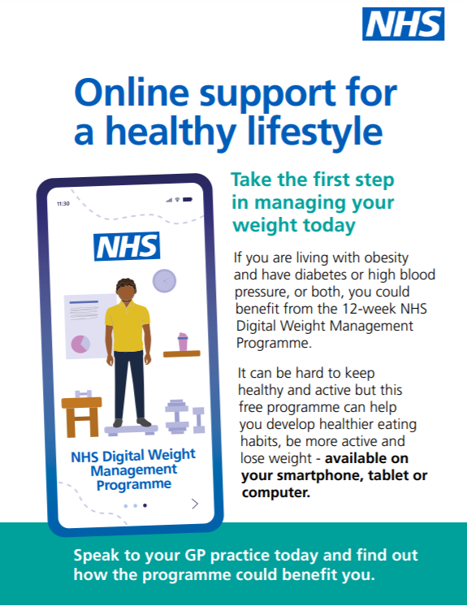
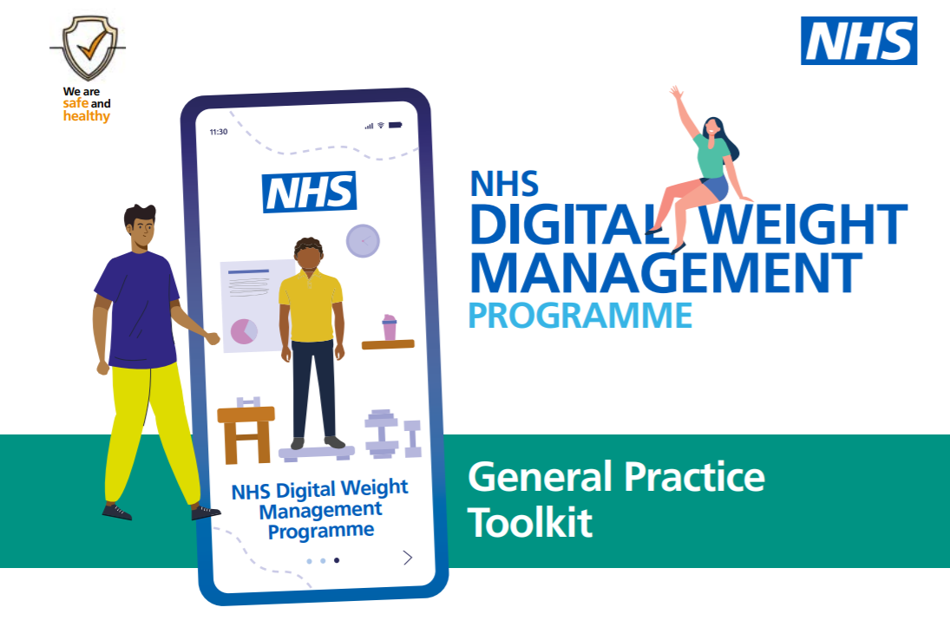
Resources for General Practice teams
The National NHS England and Improvement Obesity Team have created a General Practice toolkit, poster and extensive FAQs to support general practices to refer into the programme.
These resources can be distributed to general practices to support healthcare professionals to refer and promote the programme within their GP practice.
These resources are available to download from the template site via the NHS England website: https://www.england.nhs.uk/digital-weight-management/
The FAQs are aimed at healthcare professionals and are based on feedback the programme has received to date.
PDF versions to download here:
FAQs:
General Practice poster:
General Practice Toolkit:
50 mins

Slide 11
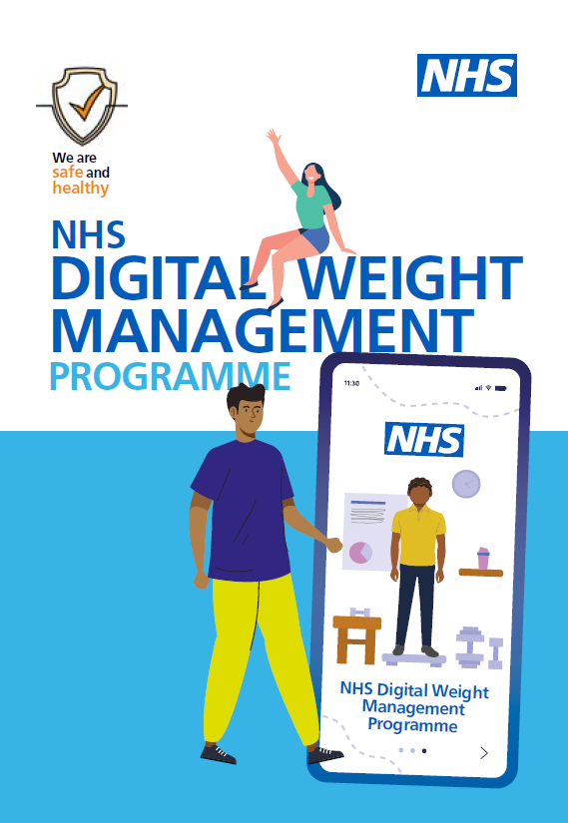
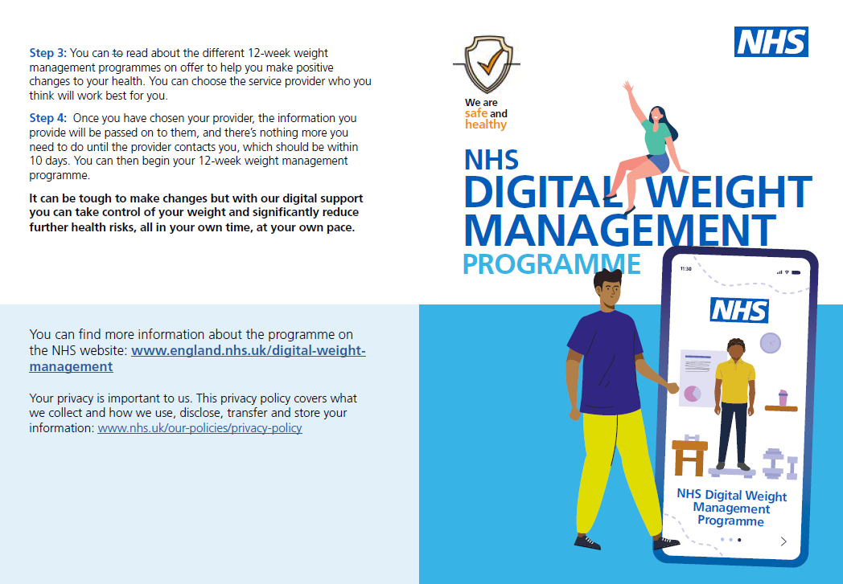
Resources for Service Users
The National NHS England and Improvement Obesity Team have created a patient information leaflet which provides service users information about the referral process and the programme.
General practice healthcare professionals should distribute these to patients after they’ve had a conversation with the patient about the programme.
The leaflet is available to download via the NHS England website in A4 folded or A5: https://www.england.nhs.uk/digital-weight-management/
PDF versions to download here:
Service User Leaflet- A5:
Service User Leaflet- A4 folded:
50 mins

Slide 12
Social Media (1)
From Thursday 1st July 2021, 9am Regions, ICSs, CCGs, GP practices, can announce the NHS Digital Weight Management Programme through social media. The following text is pre-approved and can be posted on the platforms as indicated below. Social media copy is intended for health professionals and the public.
Facebook
The new NHS Digital Weight Management Programme supports adults living with obesity, who also have either diabetes or high blood pressure or both, to improve their health and manage their weight.
Obesity is a serious health concern which increases the risk of many other health conditions, for example type 2 diabetes, cardiovascular disease, joint problems, and some cancers.
The NHS Digital Weight Management Programme is a 12-week lifestyle and behavioural intervention that people can access online via their smartphone or computer. It can be hard to keep healthy, but with support from the NHS Digital Weight Management Programme you can take control of your weight and significantly reduce further health risks.
Speak to your GP practice in XX area to find out more about the programme or visit our website: https://www.england.nhs.uk/digital-weight-management/

Slide 13
Social media (2)
Twitter
The new NHS Digital Weight Management Programme is here to help people living with obesity to live healthier lives. Available at GP practices in XX now: https://www.england.nhs.uk/digital-weight-management/ #NHSObesityServices #NHSPrevention
If you’re living with obesity and have a diagnosis of diabetes or high blood pressure, the NHS Digital Weight Management Programme is here to support you. Speak to your GP practice in XX to find out more: https://www.england.nhs.uk/digital-weight-management/
It can be hard to keep healthy, but with support from the NHS Digital Weight Management Programme you can take control of your weight and significantly reduce further health risks. Talk to your GP practice to find out if you’re able to participate: https://www.england.nhs.uk/digital-weight-management/
The NHS Digital Weight Management Programme is available by referral from general practices in XX area! Find out more on the website: https://www.england.nhs.uk/digital-weight-management/

Slide 14
Social media (3)
LinkedIn
The NHS Digital Weight Management Programme supports adults living with obesity who also have either diabetes or hypertension or both, to improve their health and manage their weight.
Obesity is a serious health concern which increases the risk of many other health conditions. For example, type 2 diabetes, cardiovascular disease, joint problems, and some cancers.
Available via referral from all general practices in XX area, the NHS Digital Weight Management Programme is a 12-week lifestyle and behavioural intervention that people can access online via their smartphone or computer.
You can find out more on our website: https://www.england.nhs.uk/digital-weight-management/

Slide 15
Social media (4)
Instagram
Do you need support to live more healthily and manage your weight?
The NHS Digital Weight Management Programme helps people living with obesity to live healthier lives and manage their weight. If you have either diabetes or high blood pressure or both, you could benefit from the NHS Digital Weight Management Programme.
Speak to your GP practice to find out more or search NHS Digital Weight Management Programme

Slide 16
Statements and posts on websites
From 1st July 2021, 9am , regions, CCGs, ICSs and General Practices can add content onto websites. There is flexibility in content of the communication but the order of the text needs to be consistent. Therefore when constructing content, it should follow the order below:
Programme narrative - This should provide an outline of the NHS Digital Weight Management Programme and eligibility criteria.
Quote from organisation/ person of influence within community - To personalise the message, you may want to seek approval from a healthcare professional within the region that has engaged with the programme and follow regional protocol for clearance. Alternatively, you may want to use the approved quote from NHS England’s National Clinical Director for Diabetes and Obesity:
    Professor Jonathan Valabhji, NHS England’s National Clinical Director for Diabetes and Obesity, said:
    “The NHS Long-Term plan committed the NHS to a stronger focus in preventing illness and reducing the serious health concerns that people living with obesity can experience, including the higher risks of more severe outcomes with Covid.
    “The new NHS Digital Weight Management Programme will offer online access to weight management services for tens of thousands of people living with obesity who also have diabetes or hypertension or both, with a strong focus on reducing health inequalities, improving quality of life and longer term health outcomes.”
Eligibility and referral process
Link to NHSE (NHS England) NHS Digital Weight Management website - https://www.england.nhs.uk/digital-weight-management/
Example text:
The NHS Digital Weight Management Programme is for people living with obesity who also have either diabetes, or hypertension or both. Professor Jonathan Valabhji, NHS England’s National Clinical Director for Diabetes and Obesity said, “[approved quote as above]”. People wishing to participate in the NHS Digital Weight Management Programme will need to be referred by their GP practice. They will need to have a BMI greater than 30, and have diabetes or high blood pressure, or both. The BMI threshold will be lower at 27.5 for people from Black, Asian and ethnic minority backgrounds, as people from these groups are at an increased risk of conditions such as type 2 diabetes at a lower BMI. The 12-week programme is accessible through a smartphone or computer with internet access.

Slide 17
Our Commercial Providers
The commercial providers of the NHS Digital Weight Management Programme can announce their partnership with the NHS on social media at 5pm on 1st July 2021.
Press releases and media planning of the Providers will be coordinated and approved by the NHS England and NHS Improvement Media Team before publication through the NHS Obesity Team.
The NHS Digital Weight Management Providers:
Level 1 | Level 2 | Level 3
Slimming World | MoreLife Ltd | Liva Healthcare
MoreLife Ltd | Oviva Ltd | Second Nature
Second Nature | Xyla Healthcare | Xyla Healthcare
Xyla Healthcare

Slide 18


Further information
If you have further questions, email the NHS England and NHS Improvement Obesity Team:
For further information regarding the NHS Digital Weight Management Programme and how practices can start referring, visit our website
https://www.england.nhs.uk/digital-weight-management/
england.wmp-prevention@nhs.net

