Slide 1
Community Cardiology Service (including ECHO)
- Frimley North (East Berkshire)
Inclusion criteria:
Suspected Heart failure (new)
Murmurs/valve disease
Screening – first degree relatives of a patient diagnosed with dilated or hypertrophic cardiomyopathy, bicuspid aortic valve, aortopathy.
Abnormal ECGs – in patients who have not previously been diagnosed as abnormal
Cardiomegaly on CXR
Exclusion criteria:
1. Patients who are obviously very ill e.g., Acute pulmonary oedema
2. Where there is a definite history of chest pain – that patient really needs to be referred to the Rapid Access Angina Clinic for further suitable investigations.
3. Obesity - 130 kg or more.
4. Paediatrics - Unfortunately we are not accredited for patients under 16 years old.
5. Patients who are well known to the hospital - Those patients who are well known to the hospital, are better served if they are referred back to the hospital where their history and investigations are documented. The only exception to this is where the patient has a Rockwood frailty score > 5.

Slide 2
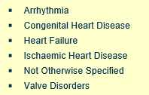
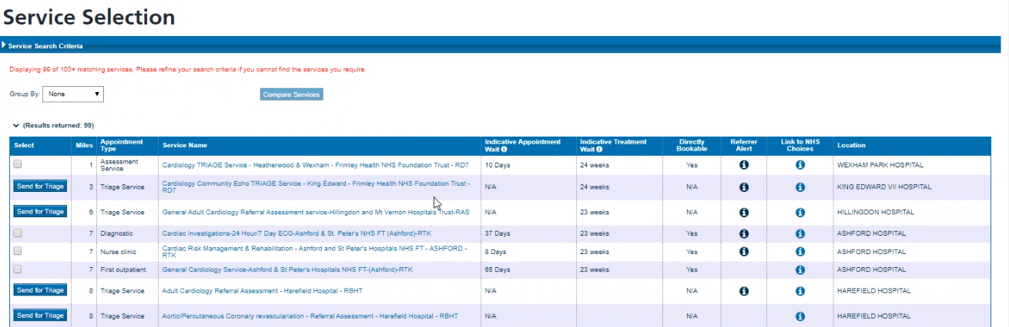
Speciality: Cardiology
Clinic Types:
Age Range: 18+
The following service should then be visible for you to select: Cardiology Community Echo Triage Service King Edward - Frimley Health NHS Foundation Trust- RD7 (please see below screen shot)
How to Refer on eRS: Frimley North GPs ONLY

Slide 3
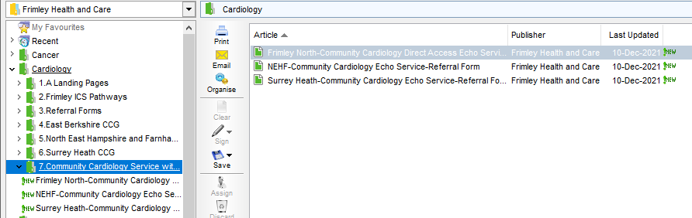
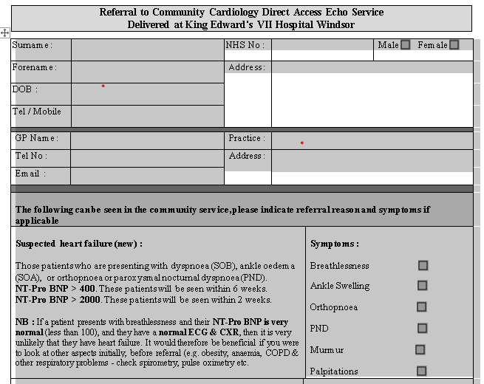
Referral forms are on DXS –
Located in: Frimley Health and Care Folder/Cardiology/Community Cardiology Service with Echo (see screenshot below)

