Slide 1

Shingles Vaccination Best Practice Pack
August 2023

Slide 2
Contents
Slide Number | Contents
3 | Programme Changes
4 | Flowchart of Changes to Shingles Programme 1 September 2023 to 31 August 2024
5 | Practice Checklist
6 | Resources - Guidance
7 | Resources - Training
8 | Resources - Promotional
9 | Vaccine Co-administration
10 | Top Tips
11 | Contact Us

Slide 3
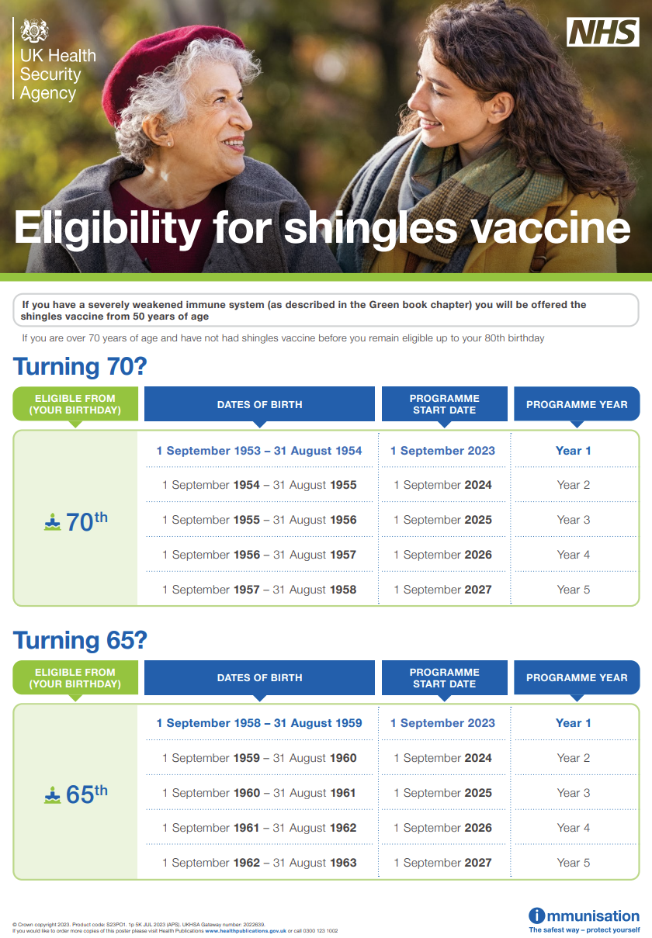
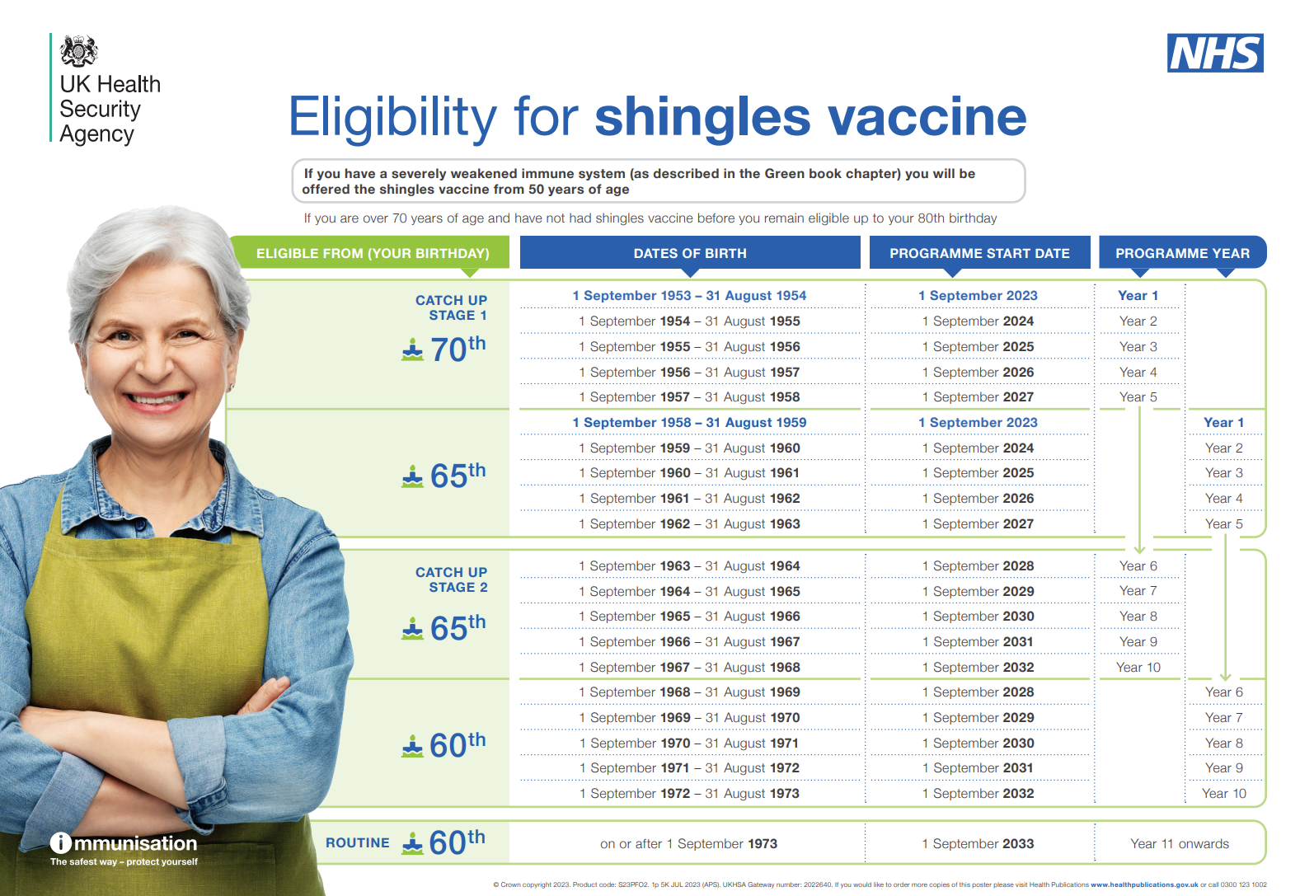
Shingles Programme Changes
Programme changes are detailed in the bipartite letter
From 1 September, Shingrix will replace Zostavax for the whole programme
Eligibility from 1 September 2023 to 31 August 2024 and dosing intervals is as per the next slide
It should be noted that all immunosuppressed patients from 50 years of age should be offered 2 doses of Shingrix from 1 September 2023
Once a patient becomes eligible for vaccine, they remain eligible until they turn 80 years of age
Eligibility posters can be ordered or downloaded here:
Full Programme Poster
Quick Guide Poster

Slide 4
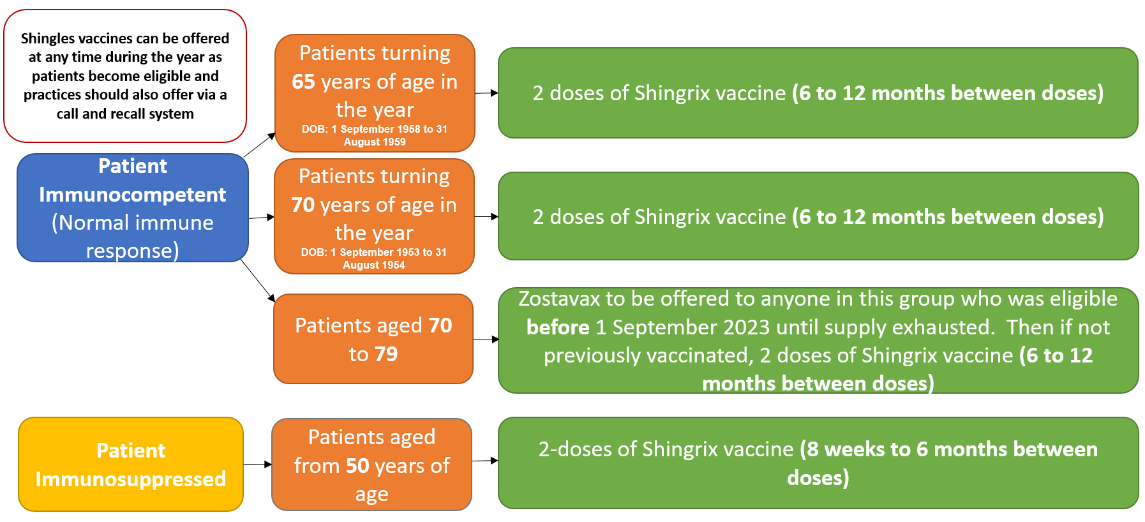
Summary of Programme Changes
1 September 2023 to 31 August 2024

Slide 5
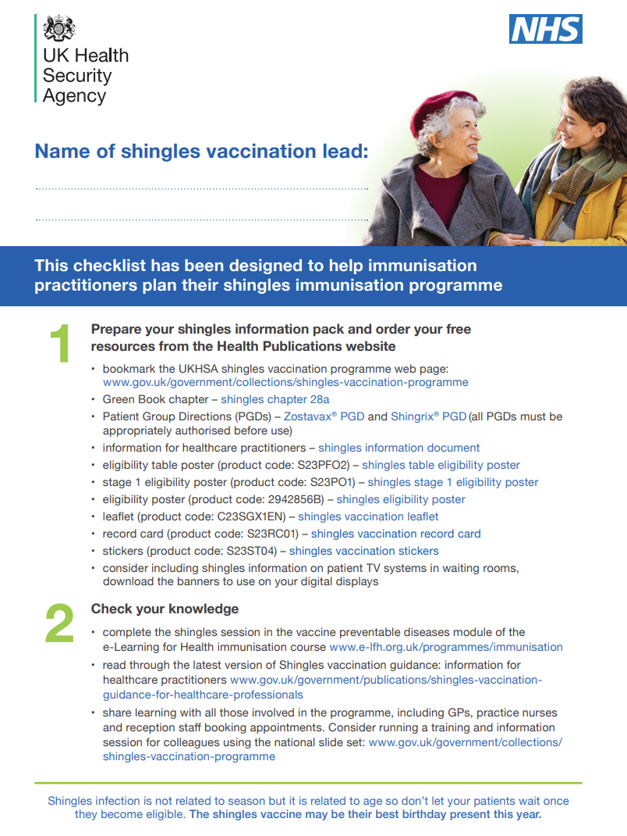
Practice Checklist
UKHSA have developed this excellent resource for practices to support the changes to the shingles programme. We would recommend that practices work through this and make use of the resources highlighted within it.
It contains:
Links to useful resources
Links to information, guidance and training on the programme changes
Practical tips on managing the changes and maximizing uptake
This can be downloaded and ordered for free from here:
Shingles checklist - Health Publications

Slide 6
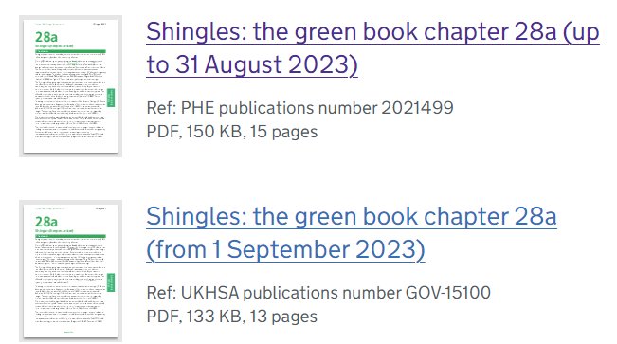

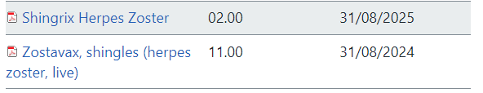

Resources - Guidance
Updated Green Book chapter (please note there are currently two versions until Zostavax stocks are depleted)
Shingles (herpes zoster): the green book, chapter 28a
Guidance for Healthcare Practitioners – a valuable resource which includes guidance on common vaccine queries
Shingles vaccination: guidance for healthcare practitioners
Zostavax and Shingrix PGDs
NHS England — South East » South East PGD downloads
Vaccine Update Shingles Special
Vaccine update: issue 340, July 2023, shingles special edition
An UKHSA webinar on the programme changes is also available here:
Link for webinar recording (18 July, 10-11.30).

Slide 7
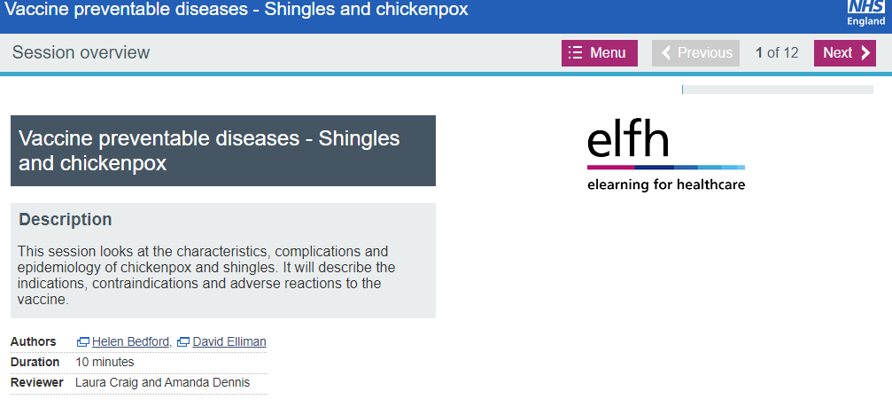
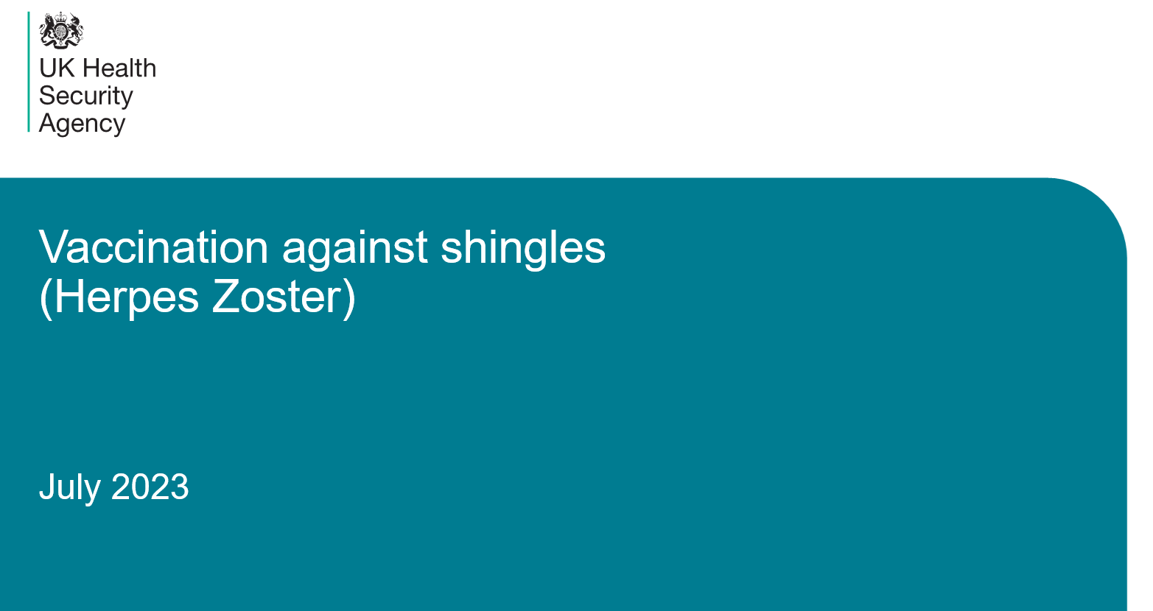
Resources - Training
E-Learning for Health – Shingles and Chickenpox programme
NHSE eLFH Hub (e-lfh.org.uk)
Shingles training slide set – available for download at the page below (link in grey box)
Shingles: guidance and vaccination programme - GOV.UK (www.gov.uk)

Slide 8




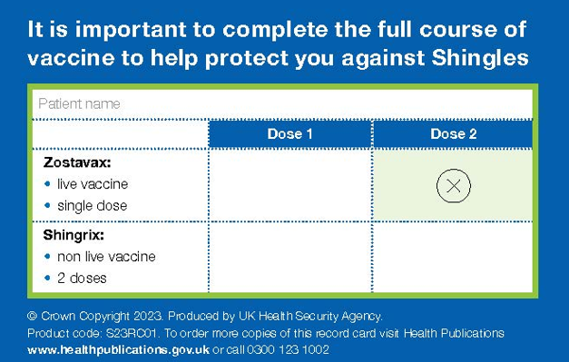



Resources – Promotional
These resources are useful to share with patients to inform them of the changes and what to expect.
Vaccination against shingles guide:
Vaccination against shingles guide from September 2023 - GOV.UK (www.gov.uk)
Shingles Aware website:
Shingles Disease Awareness (shinglesaware.co.uk)
The following materials can be downloaded and/or ordered from the Health Publications website:
Shingles Leaflet (available in accessible formats and a range of languages)
Shingles invite postcards (here and here)
Shingles Poster
Shingles stickers
Shingles record card
Shingles web and social media banners

Slide 9
Shingrix Co-Administration
Can be given with inactivated influenza vaccine
Previously, a 7-day gap was recommended between Shingrix and adjuvanted influenza vaccine. Data from a US Study looking at the co-administration of Shingrix and adjuvanted influenza vaccine has been reassuring. Administration of the seasonal influenza vaccine can therefore be an opportunity to also provide shingles vaccine, although the latter should be offered all year round, rather than purely as a seasonal programme
Shingrix can be given at the same time as the pneumococcal vaccine (PPV23), although fever and shivering were more commonly reported when PPV23 was given with Shingrix
As Shingrix is a non-live vaccine, where individuals in an eligible cohort present having recently received another inactivated or live vaccine, Shingrix vaccination should still be offered
Where Shingrix vaccine is given at the same time as another vaccine, the vaccines should be given at separate sites, preferably in different limbs. If given in the same limb, they should be given at least 2.5cm apart (American Academy of Pediatrics, 2006).

Slide 10
Top Tips
Nominate a shingles lead within the practice who will be responsible for administering, implementing and promoting the programme in the practice, sharing information on the changes in the programme to colleagues and to act as the practice expert
Ensure Zostavax stocks are used in patients aged between 70 and 80 years old who would normally have been offered Zostavax, until central supplies have been used up
Work through the practice checklist with colleagues to ensure the practice is ready for the changes to the programme
Ensure that the Shingrix vaccine is reconstituted before administration
Ensure that the practice has downloaded available resources to support the programme and identify eligible patients, for example, the Full Programme Poster and Quick Guide Poster which outlines the dates of birth of eligible patients by year of the programme

Slide 11
Contact Us
If you have any queries related to the changes to the vaccination programme, please contact us at:
england.hiow-sit@nhs.net
If you have any contractual or payment queries related to the programme, please contact:
england.htvphcontracting@nhs.net

