Slide 1

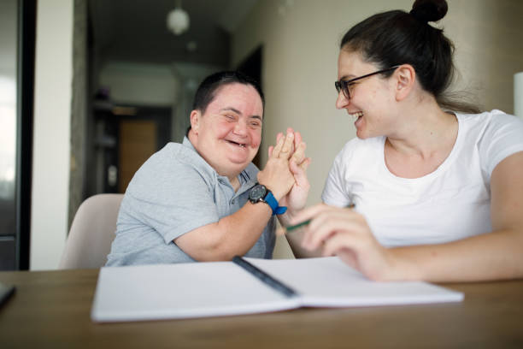
LeDeR
Learning from the lives and deaths of people with learning disabilities and autistic people
Learning Bulletin
Issue 1
July 2023
Bracknell Forest North East Hampshire and Farnham Royal Borough of Windsor and Maidenhead Slough Surrey Heath

Slide 2
What is “LeDeR”?
LeDeR is a service improvement programme which aims to improve care, reduce health inequalities, and prevent premature mortality of adults with a learning disability and autistic adults by reviewing information about the health and social care support people received.
The LeDeR programme collates and shares the anonymised information about the deaths of people with learning disabilities and/or autistic people so that common themes, learning points and recommendations can be identified and taken forward into policy and practice improvements.
This bulletin summarises learning from LeDeR reviews with the aim of sharing insights and promoting improvement across our health and social care system.
Bracknell Forest North East Hampshire and Farnham Royal Borough of Windsor and Maidenhead Slough Surrey Heath

Slide 3
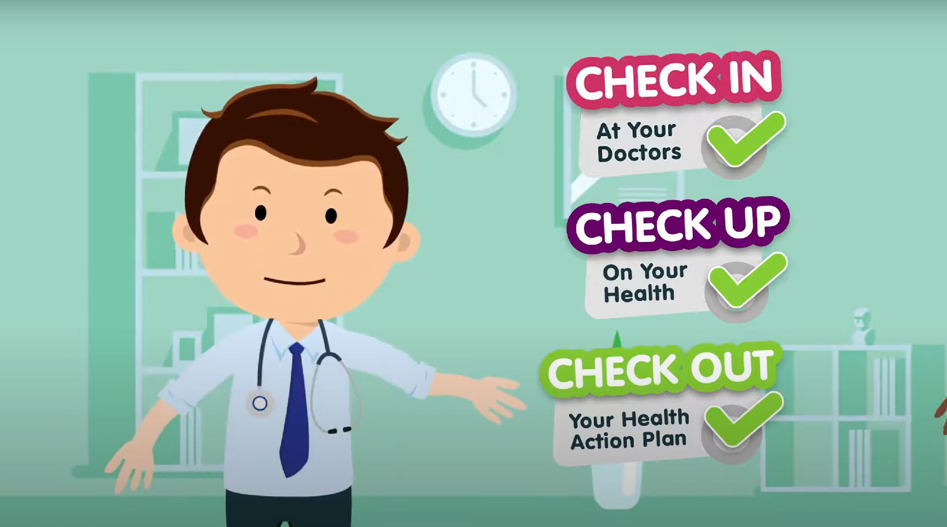
In this issue, we focus on the importance of Annual Health Checks and Health Action Plans in Primary Care…
Bracknell Forest North East Hampshire and Farnham Royal Borough of Windsor and Maidenhead Slough Surrey Heath

Slide 4
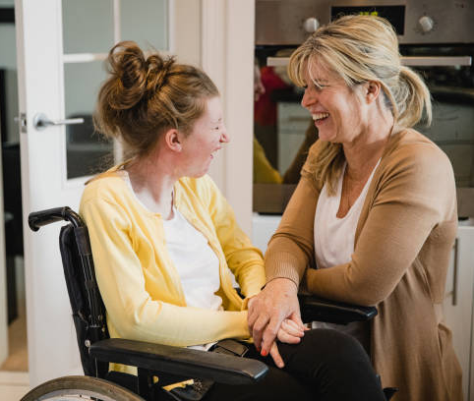
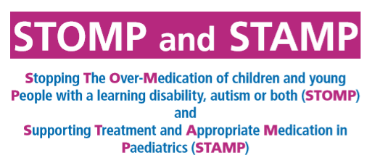
Annual Health Checks and Health Action Plans
Why are they so important?
Over the past year, GPs in Frimley ICS have made great strides in increasing the number of Annual Health Checks and Health Action Plans completed. We also need to focus on the quality of these checks. A quality audit was conducted earlier this year and the findings showed that we can improve on:
The use of accessible information and invites in line with the Equality Act 2010 and Accessible Information Standard.
Effective and consistent use of hospital passports.
Consistent application and recording of reasonable adjustments in line with the Equality Act 2010.
Robust and consistent use of Health Action Plans.
STOMP / STAMP (medication monitoring) considerations for every patient.
Promotion of national screening programmes and making reasonable adjustments to ensure fair access.
Application of the Mental Capacity Act.
Evidence suggests that providing annual health checks to people with learning disabilities in primary care is effective in identifying previously unrecognised health needs, including those associated with life-threatening illnesses.
Annual health checks and people with learning disabilities - GOV.UK (www.gov.uk).
Public Health England’s Learning Disabilities Observatory has published a systematic review of evidence concerning the impact of health checks on the health and wellbeing of people with learning disabilities.
Bracknell Forest North East Hampshire and Farnham Royal Borough of Windsor and Maidenhead Slough Surrey Heath

Slide 5
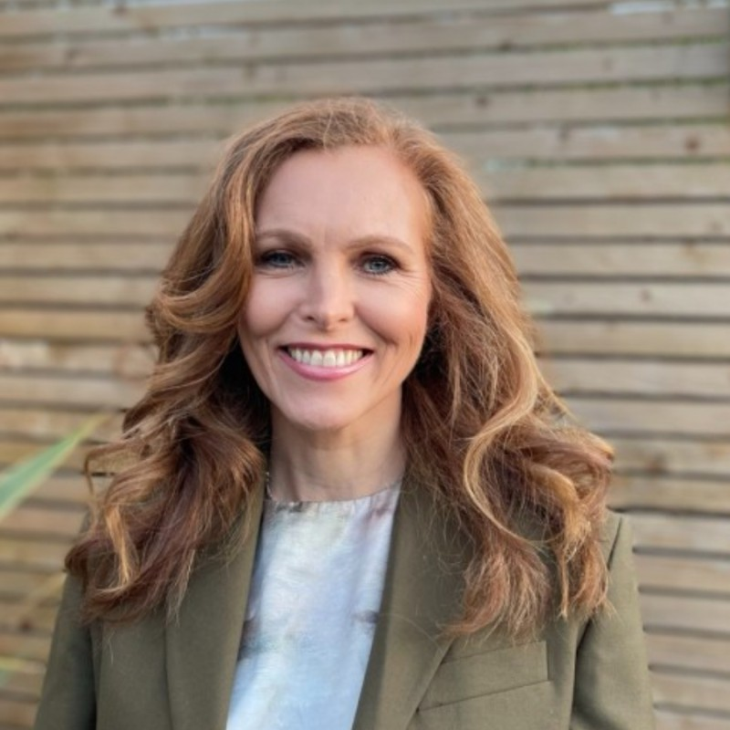
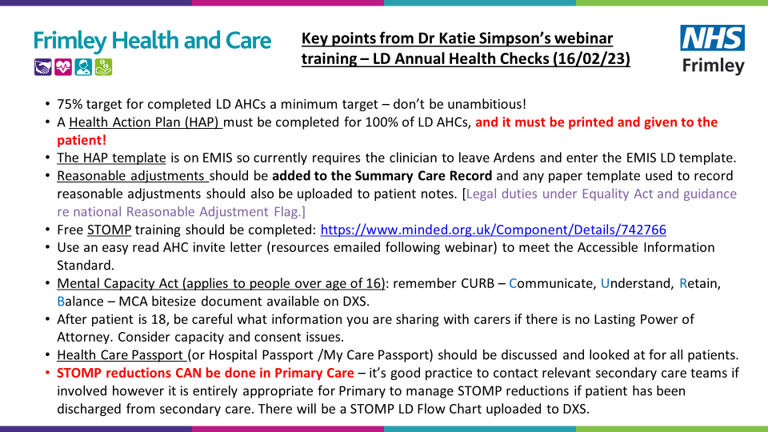
Dr Katie Simpson’s Webinars on Annual Health Checks and Health Action Plans
Katie is one of our GP Leads for Learning Disabilities and carried out quality auditing earlier this year.
Katie has delivered webinars for Primary Care, and more are planned.
Here are some of the take-aways…
DXS Update: The following documents / resources are now available on DXS: Health Action Plan; Easy Read Invitation Letter; Pre-Assessment Questionnaire; Hospital Passport. The ‘What to expect of your AHC’ letter will also be available.
Bracknell Forest North East Hampshire and Farnham Royal Borough of Windsor and Maidenhead Slough Surrey Heath

