Slide 1

Mastering SMS Communication: Being SMS Smart
Notes:
SMS was initially used primarily for appointment reminders, FFTs, and batch messaging. However, over the past few years, the functionality of two-way secured messaging has significantly increased, providing numerous benefits to GP practices.
This has led to expanded use of SMS beyond its original purpose, allowing practices to underpin a wide range of GP services.
SMS is an efficient and cost-effective means of communication that is in line with the green agenda. It has transformed the way practices communicate with patients and presents significant cost savings compared to traditional methods such as letters or phone calls.
We are encouraging practices to take simple steps to reduce costs, reduce the use of unnecessary fragments and ensure communications are clear and concise.

Slide 2

The Context
SMS was initially used primarily for appointment reminders, FFTs, and batch messaging. However, over the past few years, the functionality of two-way secured messaging has significantly increased, providing numerous benefits to GP practices.
This has led to expanded use of SMS beyond its original purpose, allowing practices to underpin a wide range of GP services.
SMS is an efficient and cost-effective means of communication that is in line with the green agenda. It has transformed the way practices communicate with patients and presents significant cost savings compared to traditional methods such as letters or phone calls.
We are encouraging practices to take simple steps to reduce costs, reduce the use of unnecessary fragments and ensure communications are clear and concise.
Notes:
Initially, SMS was used for basic tasks such as appointment reminders, FFT and batch messaging. Now SMS functionality has increased with being able to send out Questionnaires, 2-way communications, attaching files, and a lot more. SMS can be efficient and cost-effective. Saving time on printing, folding and posting letters or phone calls. We have a few steps to make SMS communications clear and concise as well as reduce unnecessary fragments.

Slide 3
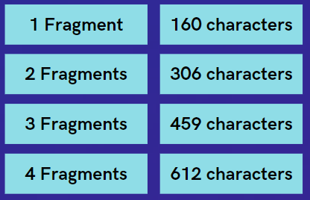
Tip 1: Understanding Fragment Boundaries
Boundaries
Each SMS message is made up of fragments, around 160 characters in length.
Each time you go over a fragment boundary, you are charged for the fragment above.
Each fragment costs around 1.85p, so you can have big savings by reducing your message to fit into 1 or 2 fragments.
From 1st June, fragments will cost 1.99pi
Notes:
Understand Fragment Boundaries.
Each SMS is made up of fragments. Each time you go over a fragment you are charged for the fragment above. So a text made up of 159 characters = 1 fragment but 162 would cost 2 fragments.

Slide 4
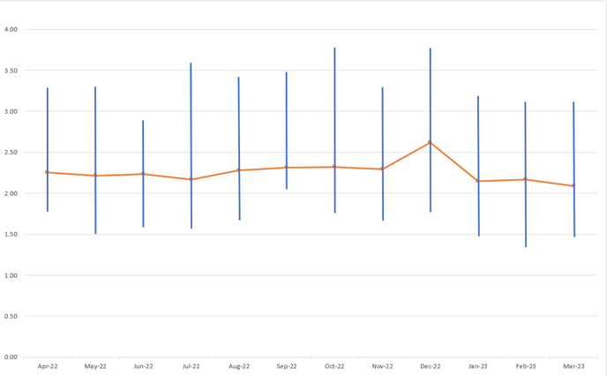
What our data shows
Frimley ICB Average Fragments per SMS v Most/Least Cost Effective Practices
The orange line represents the Frimley ICB average fragments used per SMS.
The blue vertical lines identify the lowest number of fragments and range to the highest number of fragments per SMS by practice
We plan on sharing individual practice SMS fragment reports to promote transparency, cost management, benchmarking, targeted support, and collaboration within the organisation. Empowering practices to optimize SMS communication and ultimately enhance efficiency, effectiveness, and cost-effectiveness in patient interactions.
Reminder: Each time you go over a fragment boundary, we are charged for the fragment above i.e. 305 characters = 2 fragments, 307 characters = 3 fragments
Notes:
Here is a chart displaying Frimley ICB Average Fragments per SMS v Most/Least Cost Effective Practices.
The orange line represents the Frimley Average and the blue bar represents the highest fragment practice user and ranges to the lowest.
Going back to the fragment boundaries, anything over 3.00 is using 4 fragments. We are organising for practice level data to be shared out monthly to individual practices to support.

Slide 5
Tip 2: Review SMS Templates
Examples
Evaluate your SMS templates and ensure the message content is concise and to the point.
Avoid using filler words or phrases that don’t add value to the message.
Examples of filler words/phrases are:
That
So
In order to
With regard/reference to
Just
Before (441 characters/ 3 fragments)
You have missed your appointment today, if you still need your appointment then please speak to reception to rearrange it. This is a text just to ask that in the future, if you are unable to attend your appointment then please cancel with Reception. We are currently experiencing high demand for appointments and if the appointment had been cancelled it could have been used by someone else.
After (178 characters/ 2 fragments)
Missed today's appointment? Contact reception to reschedule. In the future, cancel with reception if unable to attend. High demand for appointments, so cancellations help others.
Notes:
Reviewing SMS Templates:
Assessing your SMS templates and ensuring the message content is concise and to the point not only reduces unnecessary fragments but shorter and easier for a patient to read, which in turn can lead to better engagement.
Here is an example of a text message I was able to review and condense.
We supported Station Road Surgery by reviewing their SMS templates, from 80+ templates we were able to reduce texts by 52 fragments.

Slide 6

Tip 3: Identify your cohort for batch SMS
When sending a Batch Message, try to reduce the length of the message and ensure the messages are relevant to the cohort targeted.
(Example: If the message is not relevant to a cohort, could they be excluded, i.e. children).
Notes:
Identifying your cohorts:
As I am sure you are all aware when you do a batch message you need to upload a patient list, usually from a search. This is thinking if we are targeting the right cohort of patients, could we exclude children?
I am aware of an example whereby, I received a message that my practice dispensary was going to be closed, yet I wasn’t a dispensing patient therefore the message was irrelevant to me.

Slide 7

Tip 4: Shorten URLs
Examples
Shorten the links you send out to patients, including URLs in your practice templates. There are a number of online tools that can help with this, e.g. Bit.ly
Before (426 characters/ 3 fragments)
For more detailed information on animal and human bites, we recommend visiting the NHS website at https://www.nhs.uk/conditions/animal-and-human-bites/ There, you can find comprehensive resources and guidelines to better understand the risks, prevention, and treatment of bites from animals and humans. It's important to stay informed and educated about these incidents to ensure proper care and avoid potential complications.
After (137 characters/ 1 fragments)
Visit NHS website for information on animal and human bites: bit.ly/3NZKiVi Stay informed to prevent and treat bites effectively.
Notes:
Shortening URLs:
Using online URL shorteners and support with condensing messages. Rather than having long websites address, using tools like Bit.ly or TinyURL can shorten the website links.

Slide 8

Tip 5: Other Quick Wins
Emails
Mobile Numbers
Sending via email is free and may be preferred for sending attachments or for less digital patients.
Ensure the patient’s mobile number is correct and up to date before sending a message, as undeliverable messages still incur a cost. If your message has already failed, check whether the number is still active/correct.
Notes:
Some Other Quick Wins:
We could utilise sending sicknotes or attachments via email rather than SMS, as this could be easier for less digitally inclined patients.
Ensuring mobile numbers are correct on patient records or reviewing the failed SMS reports as even failed messages incur a charge.

Slide 9

Tip 6: Consider other routes
When sending out mass updates to patients, e.g. on practice closure or updates, consider other ways of delivering this information such as on your practice website, phone message set-up, or social media.
Did you know?
X-On customers receive a complimentary allocation of 5,000 text messages as part of their bundle. These messages can be effectively utilized for Patient Callback SMS notifications. This feature comes into play when a patient requests a callback, but unfortunately, the practice is unable to reach the patient as they don't answer the call. In such cases, a notification SMS can be sent to inform the patient about the attempted call.
Notes:
Consider other routes:
This could be sending updates via your practices website, social media or adding a message to your phone system.

Slide 10
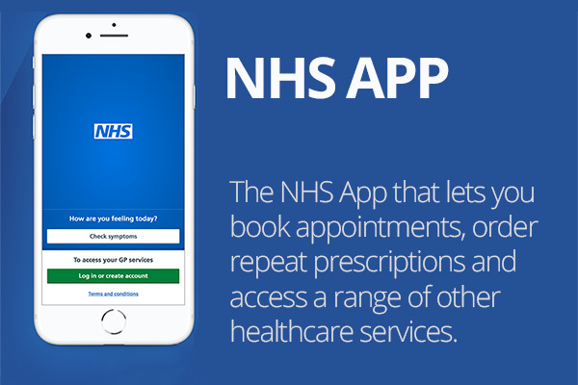
Tip 7: NHS App Notifications
Encourage patients to download the NHS app and switch push notifications on - batch messages will then default to the patient's NHS app rather than SMS as suppliers become integrated.
Patients can manage their e-RS referrals directly from the NHS App, saving a message with booking or appointment details.
If patients request their medications via the App they can also see when they have been issued, saving any calls or messages informing them.
Notes:
Lastly, NHS App Notifications.
A pilot recently ended in March 2023, where Accurx and NHS App team collaborated. If a text was sent to a patient who had an NHS App account, this would send a notification rather than a SMS, with a fail safe, if the notification wasn’t read then it would be sent as a text message. The pilot was successful and we are waiting for NHS App to confirm a date as to when this will be rolled out nationally.

Slide 11

What conversations are we having with Accurx?
We have engaged in productive discussions with Accurx regarding their support in optimising the use of SMS. During these conversations, we have addressed the following key topics:
Alignment of Templates: We have brought to Accurx's attention that their own templates do not adhere to the guidelines they advise practices to follow. This misalignment has been acknowledged by Accurx, and they have expressed their commitment to reviewing and aligning their templates accordingly.
User Interface Enhancement: A development request has been raised regarding Accurx's user interface (UI). Specifically, we have requested that the UI be designed to highlight when a text message has exceeded the character limit and entered into the next message boundary. This enhancement would assist users in composing SMS messages more effectively and prevent unintended fragmentation.
Notes:
We are in communications with Accurx to support with fragment optimisation. We have asked them to review their own SMS templates as not all adhere to their guidance. They plan on reviewing these.
We have also discussed a interface development whereby it would be made clearer when a text has crossed into the next boundary.

Slide 12
Summary
In conclusion, reducing fragments in SMS templates is essential for efficient and cost-effective communication. The tips provided in the presentation offer practical ways to achieve this goal.
By implementing these strategies, GP practices can reduce fragments in their SMS templates, ultimately leading to cost savings, improved patient engagement, and streamlined communication processes. Embracing these tips will enhance the effectiveness of SMS communication while maximizing its value in the context of primary care.

