Slide 1



Amplify EDI
13th July 2023

Slide 2
Coming up this week:
12th Orangemen’s Day (Ireland)
14th International Non-Binary People’s Day
15th St Vladimir Day Christian
World Youth Skills Day
16th International Drag Day
17th World Day for International Justice
18th Nelson Mandela’s Birthday
South Asian Heritage Month
19th Al-Hijra Islam
Muharram Islam

Slide 3
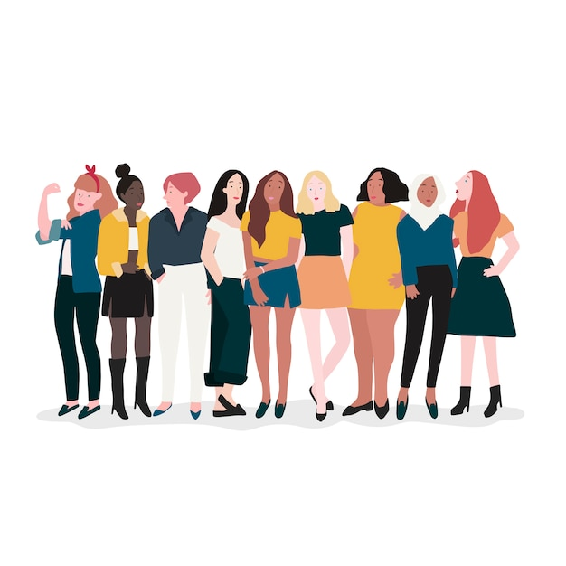
Frimley Sisterhood
Women’s Network
In-person meeting!
When?
9th August 2023
0930 to 1130
Where?
Forest Café
Bracknell
How to register?
If you’d like to attend, even for part of the time, you’re more than welcome!
Click here to register your interest and put an event reminder in your Teams diary ☺
This meeting is for anybody who works in the Frimley ICS –
You can be a woman, an ally to women, a temporary member of staff, a volunteer, or any other person involved in health and social care. We welcome everybody the same!

Slide 4

July is
Disability Pride Month!
This week we are considering hidden disabilities. They can include:
Sensory impairment not identifiable by aids such as a cane, hearing aids or glasses
Mobility impairment that fluctuates – meaning an aid isn’t always required so the disability isn’t prominent
Mental health disabilities or conditions such as ADHD, Dyslexia, Autism, or Schizophrenia
Hidden disabilities can hinder every part of a person’s life – from school / work to socialising
Living with a hidden disability can be lonely because people don’t always know what our experience of the world is like.
The comments below are part of the “We are not invisible” project – click here to find out more
Having a hidden disability means you may be discriminated against by disabled people (not being ‘disabled enough’) as well as non-disabled people
Things we wish non-disabled people understood
Program Manager at ‘We Need Diverse Books’ Alaina Leary asked people with hidden disabilities what they wish we knew – here’s a few of their comments!
Public life isn’t designed to accommodate disability
I’m constantly aware of a lack of accessibility in public spaces. Will there be seats or places to rest? How quickly can I use a bathroom? Will venues allow my medications or walking aids in?
Disability isn’t inherently negative
Our disabilities don’t stop being a part of our lives
We have to think about whether we’re ready to tell you about our disabilities
There’s no such thing as ‘normal’
Living with a disability isn’t a static experience. It is dynamic and ever-changing. Some days are great, others are more difficult.
#MyDisabledLifeIsWorthy
Ask “Do you need help?” rather than “Can I do (this thing) for you?”
The first gives me control, the second takes it away.

Slide 5

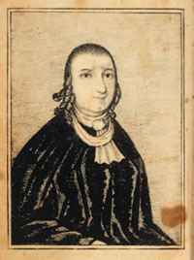

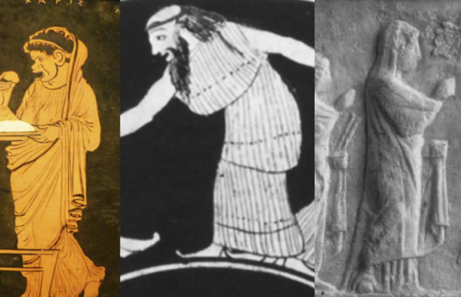
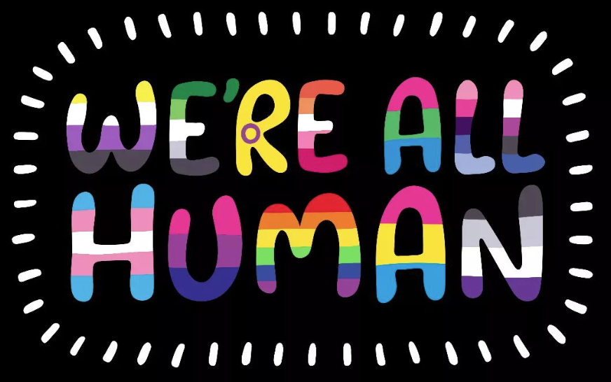
Non-Binary Awareness Day
14th July 2023
Why 14th July?
It is in the middle of International Women’s Day (8th March) and International Men’s Day (19th November)
The first ‘non-binary celebrity’ is thought to be The Public Universal Friend, an American Quaker who renounced their birth name and gender in 1776.
Click the image to find out more about The Public Universal Friend →
International Drag Day
16th July 2023
Drag refers to an entertainment style in which “Queens” or “Kings” cross-dress and exaggerate gender presentation.
The Drag Flag represents:
Purple: passion for drag
White: the body as a blank slate that help create the characters we become
Blue: self-expression & loyalty
Crown: leadership in the community
Stars: many forms of drag
The term “Drag” is first seen written in 1870, however the concept of drag, or cross-dressing, has been seen throughout history, with evidence in Ancient Greek Theatre & Religious ceremonies / rituals.
The prominence of Drag has seen resurgence with televised shows such as RuPaul’s Drag Race and Pose.
They are celebrated for giving people the opportunity to explore their identity and creativity.

Slide 6
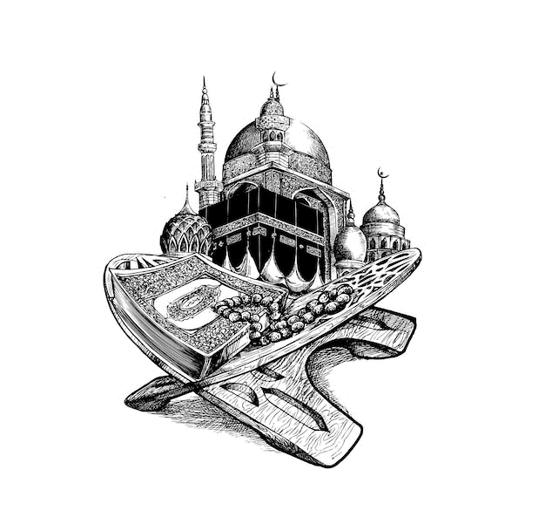
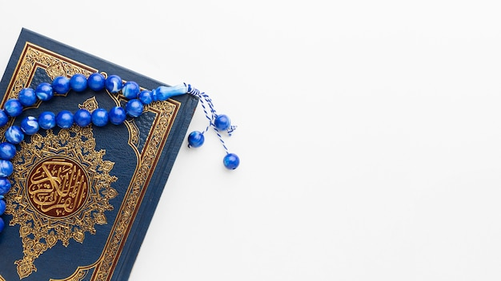
Muharram
The first month in the Islamic Calendar, Muharram is the second most holy month after Ramadan
It marks members of the Prophet’s family dying in war.
For some Muslims, it is a month containing days of abstaining from joyous events, mourning or eating as little as possible.
It is also known for the tale of Allah saving the children of Israel from the Pharoah.
Al-Hijra
The beginning of Muharram also brings in Al-Hijra – the New Year in the Lunar Calendar!
This commemorates Muhammad’s journey from Mecca to Medina to flee persecution and set up the first Islamic state –
“Hijra” means migration!
Al-Hijra is not a religious holiday and therefore doesn’t have specific rituals, but is celebrated culturally, with some people setting resolutions for their year ahead! ☺
May the New Year bring peace, prosperity & happiness to the world.
May Allah protect us.

Slide 7



18th July
to
17th August
This year’s theme is
South Asian Heritage Month 2023 is all about celebrating the stories that make up our diverse and vibrant community.
What moments in your life have shaped who you are today?
What experiences have taught you valuable lessons?
No matter who you are, we want to hear your story!
Our stories are what make us unique, and they connect us to each other in profound ways.
Whether you express yourself through art, writing, music, fashion, or food, there are so many ways to share your experiences and celebrate your heritage!
Let’s share our stories and create a sense of unity and belonging across our System!
Email your story to Cheyenne.Sparks2@nhs.net

Slide 8
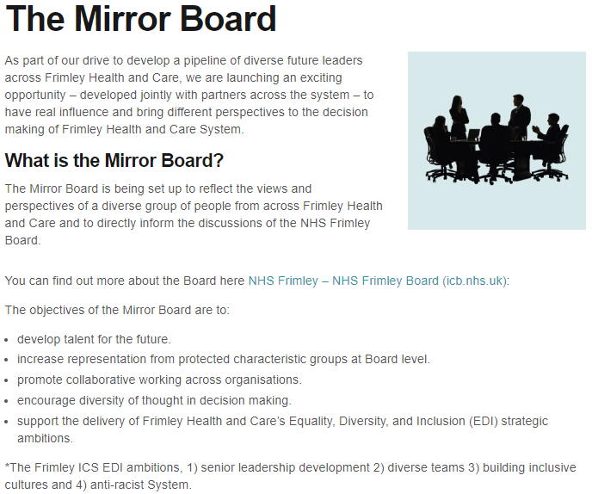
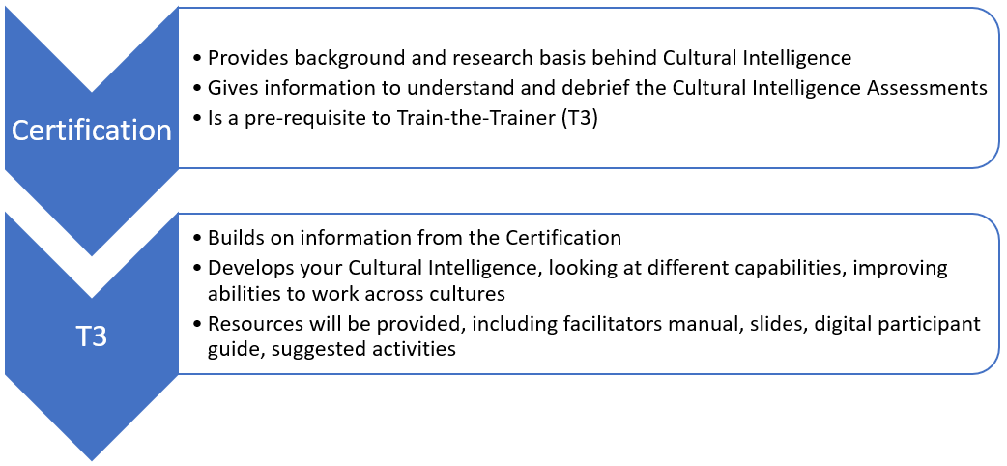
Exciting opportunities in Frimley ICS!!!
Cultural Intelligence Train-the-Trainer
6 people from across the ICS to undertake Cultural Intelligence certification, then further qualification to be able to train others!
Advert & recruitment to be released soon!!

Slide 9
