Slide 1
GLP-1 Shortages

Slide 2
GLP-1 Shortages - Background
There is an ongoing national shortage of glucagon like peptide-1 receptor agonists (GLP-1 RAs) used in the management of Type 2 Diabetes (T2DM).
This situation is not expected to resolve until into mid-2024.
Supplies of some GLP-1 RA preparations may be intermittent or exhausted within this time frame
Although other GLP-1 RA therapies may be available it is possible there will be insufficient additional capacity to accommodate switching everyone with T2DM currently prescribed an affected GLP-1 RA to an alternative brand.

Slide 3
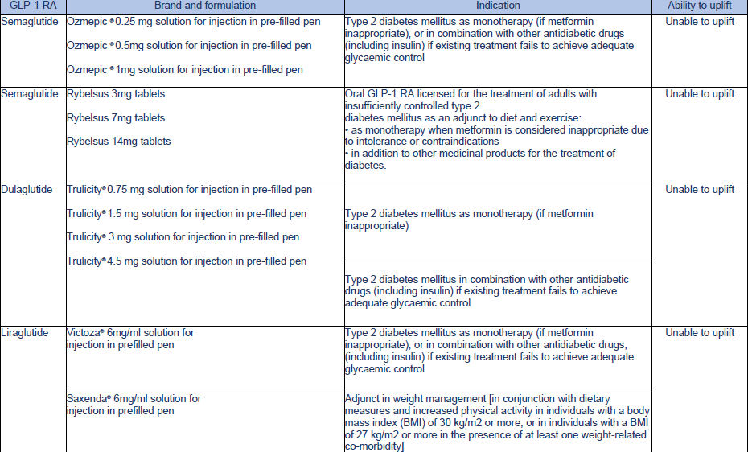
Which Products are affected…

Slide 4
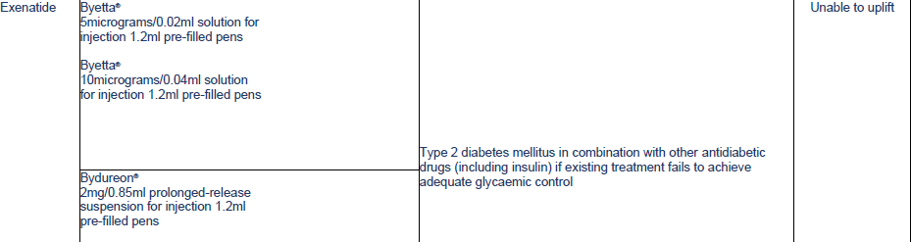
Which Products are Affected cont…

Slide 5
Where can I find up to date info on stocks…
The SPS Medicines Supply Tool will be updated for stock position of all GLP1 RAs
The SPS website will have a dedicated GLP1 RA page : Medicines Supply Tool – SPS - Specialist Pharmacy Service – The first stop for professional medicines advice
Medicines Supply Tool – SPS - Specialist Pharmacy Service – The first stop for professional medicines advice

Slide 6
Who do we expect will need to be involved in managing this shortage …
Prescribers in all care settings
NHS Diabetologists/ Endocrinologists
Specialist diabetes services and associated health care professionals
People with Type 2 Diabetes, their families, or carers
Organisations commissioning NHS services
Providers of NHS services

Slide 7
What does the DHSC say?
Actions for clinicians until supply issues have resolved:
• GLP-1 RAs should only be prescribed for their licensed indication
• Avoid initiating people with type 2 diabetes on GLP-1 RAs for the duration of the GLP1-RA national shortage.
• Review the need for prescribing a GLP-1 RA agent and stop treatment if no longer required due to not achieving desired clinical effect as per NICE CG28.
• Avoid switching between brands of GLP-1 RAs, including between injectable and oral forms.
• Where a higher dose preparation of GLP-1 RA is not available, do not substitute by doubling up a lower dose preparation.
• Where GLP-1 RA therapy is not available, proactively identify patients established on the affected preparation and consider prioritising for review based on the criteria below.
• Where an alternative glucose lowering therapy needs to be considered, use the principles of shared decision making as per NICE guidelines in conjunction with the supporting information
• Where there is reduced access to GLP-1 RAs, support people with type 2 diabetes to access to structured education and weight management programmes where available.
• Order stocks sensibly in line with demand during this time, limiting prescribing to minimise risk to the supply chain whilst acknowledging the needs of the patient.

Slide 8
Prioritisation for Clinical Review
In most cases, the need to consider alternative glucose lowering therapy will arise when a person with T2DM established on GLP-1 RA therapy is unable to source their regular GLP-1 RA prescription.
Should a particular preparation of GLP-1 RA be unavailable, and an alternative cannot be sourced, clinical teams may want to proactively identify people with T2DM established on that preparation to help planning. Consider prioritising review for people with T2DM on the affected GLP-1 RA preparation, where:
HbA_{1c} greater than 86mmol/mol in the previous 3 to 6 months.
HbA_{1c} greater than 86mmol/mol prior to starting the GLP-1 RA
HbA_{1c} not recorded in the previous 6 months.
Urine albumin creatinine ratio (uACR) greater than 30mg/mmol.
Self-monitoring glucose readings (or Continuous Glucose Monitoring, where available) persistently above individualised target range.
In all cases, the need to consider alternative glucose lowering therapy presents an opportunity for engagement and clinical review.

Slide 9
First Line of defence…
Structured education
People with T2DM requiring a change to their usual medication may welcome an opportunity to access structured education to support self-management. In addition to local services, offer access to structured education at https://healthyliving.nhs.uk/.
Weight management
Eligible people with T2DM who would like support with weight management should be signposted to available weight management programmes. In addition to local pathways, there are several nationally available options, including such as:
Adult weight management: short conversations with patients
The NHS Digital Weight Management Programme
Tier 1 and 2 weight management services
NHS type 2 diabetes path to remission programme
https://www.nhs.uk/better-health/lose-weight/

Slide 10
Review Response to GLP-1s
NICE NG28 guidance advises:
GLP-1 RA therapy should only be continued if the adult with T2DM has had a beneficial metabolic response,
defined as
a reduction of at least 11 mmol/mol [1.0%] in HbA_{1c} and
weight loss of at least 3% of initial body weight in 6 months
Where the person with T2DM has a confirmed beneficial metabolic response but GLP-1 RA is unavailable, review and discuss options for alternative glucose lowering therapy
Where there has been no beneficial metabolic response to GLP-1 RA therapy, it is clinically appropriate to withdraw GLP-1 RA therapy and consider alternative glucose lowering therapy

Slide 11
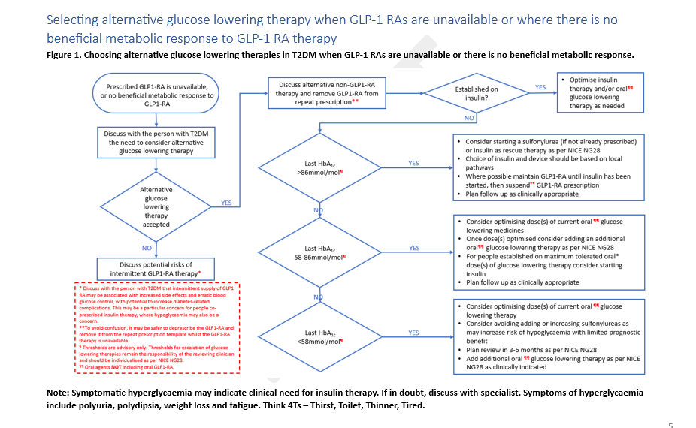

Slide 12
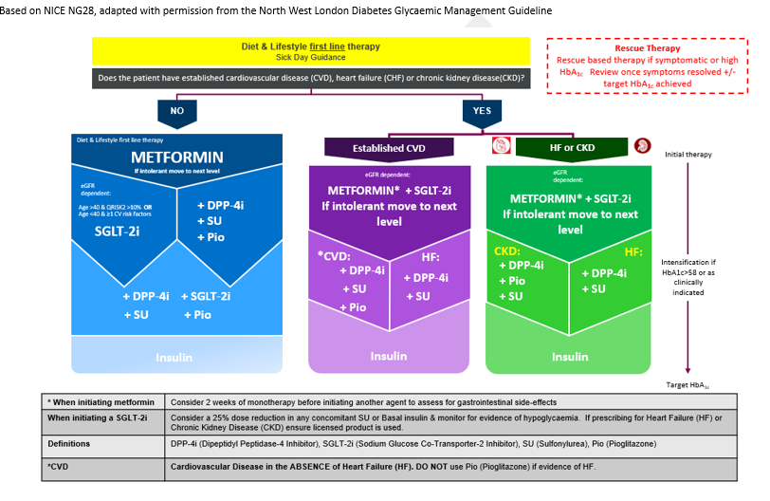
Quick Reference Guide for Oral Glycaemic Agents

Slide 13
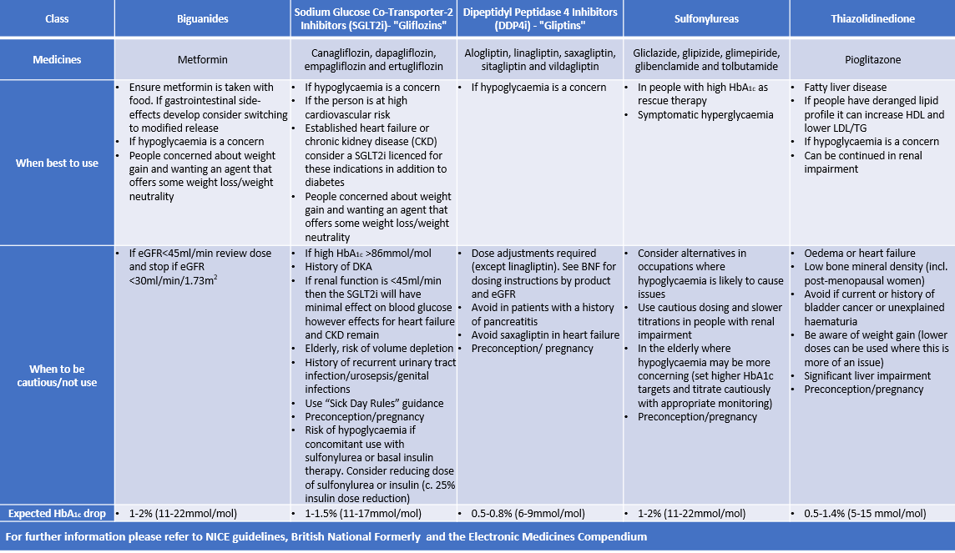
Oral Glucose lowering Therapies by Class

Slide 14
When is insulin required?
Where insulin therapy is clinically indicated, clinicians are advised to initiate in accordance with NICE NG28 https://www.nice.org.uk/guidance/ng28/chapter/recommendations - insulin-based-treatments.
. It is important to note that specific brands of insulin mentioned within NICE NG28 are unlikely to be able to take a large uplift in prescribing, therefore any decisions on insulin brand choice should be based on ongoing insulin availability noted within the SPS supply tool: https://www.sps.nhs.uk/home/tools/medicines-supply-tool/
The choice of insulin should take account of individual characteristics and clinical needs of the person with T2DM.
Where possible, utilise the full range of insulins and devices available to reduce the risk of further impacting supply chain issues.

Slide 15
Counterfeit Products
People with T2DM should be advised that GLP-1 RAs should only be obtained on prescription from registered pharmacies. It is not legal to obtain GLP-1 RA without a prescription and there is a risk that the medicine may not be genuine.

Slide 16
Re-commencing GLP-1 RA therapy when the period of national shortage has passed
The national shortage of GLP-1 RAs is expected to extend into mid-2024.
When GLP-1 RAs are regularly and reliably available again, it will be possible re-commence prescribing GLP-1 RAs for people with T2DM meeting the eligibility criteria as per NICE NG28. Where GLP-1 RA has been prescribed previously, review whether a beneficial metabolic response was achieved. Where there was no beneficial therapeutic response, consider alternative glucose lowering therapies

