Slide 1



Amplify EDI
15th June 2023

Slide 2
Coming up this week:
15th Elder Abuse Awareness Day
16th Sacred Heart of Jesus Roman Catholic
Martyrdom of Guru Arjan Dev Sikh
17th CDKL5 Worldwide Awareness Day
18th Autistic Pride Day
Father’s Day
19th Juneteenth
World Sickle Cell Day
19th – 25th Learning Disability Week
World Refugee Week
20th Ratha Yatra Hindu
21st Litha Pagan
Global Day of Recognition of ALS & MND
* Starts the evening before the date listed

Slide 3

Celebrating our workforce!
In continuing to celebrate the workforce in the Frimley System, this week looks at our colleagues in the Ambulance Service!
Ambulance service colleagues can be found in lots of places across health & social care!
Taking and responding to emergency calls
Providing safe patient transport
Supporting General Practice services as specialist clinicians
Raising awareness by attending community / public events
Working in Police Custody Suites, Emergency Departments and other community settings
To find out more, click the logo to read the UK Health & Care Professions Council website!

Slide 4


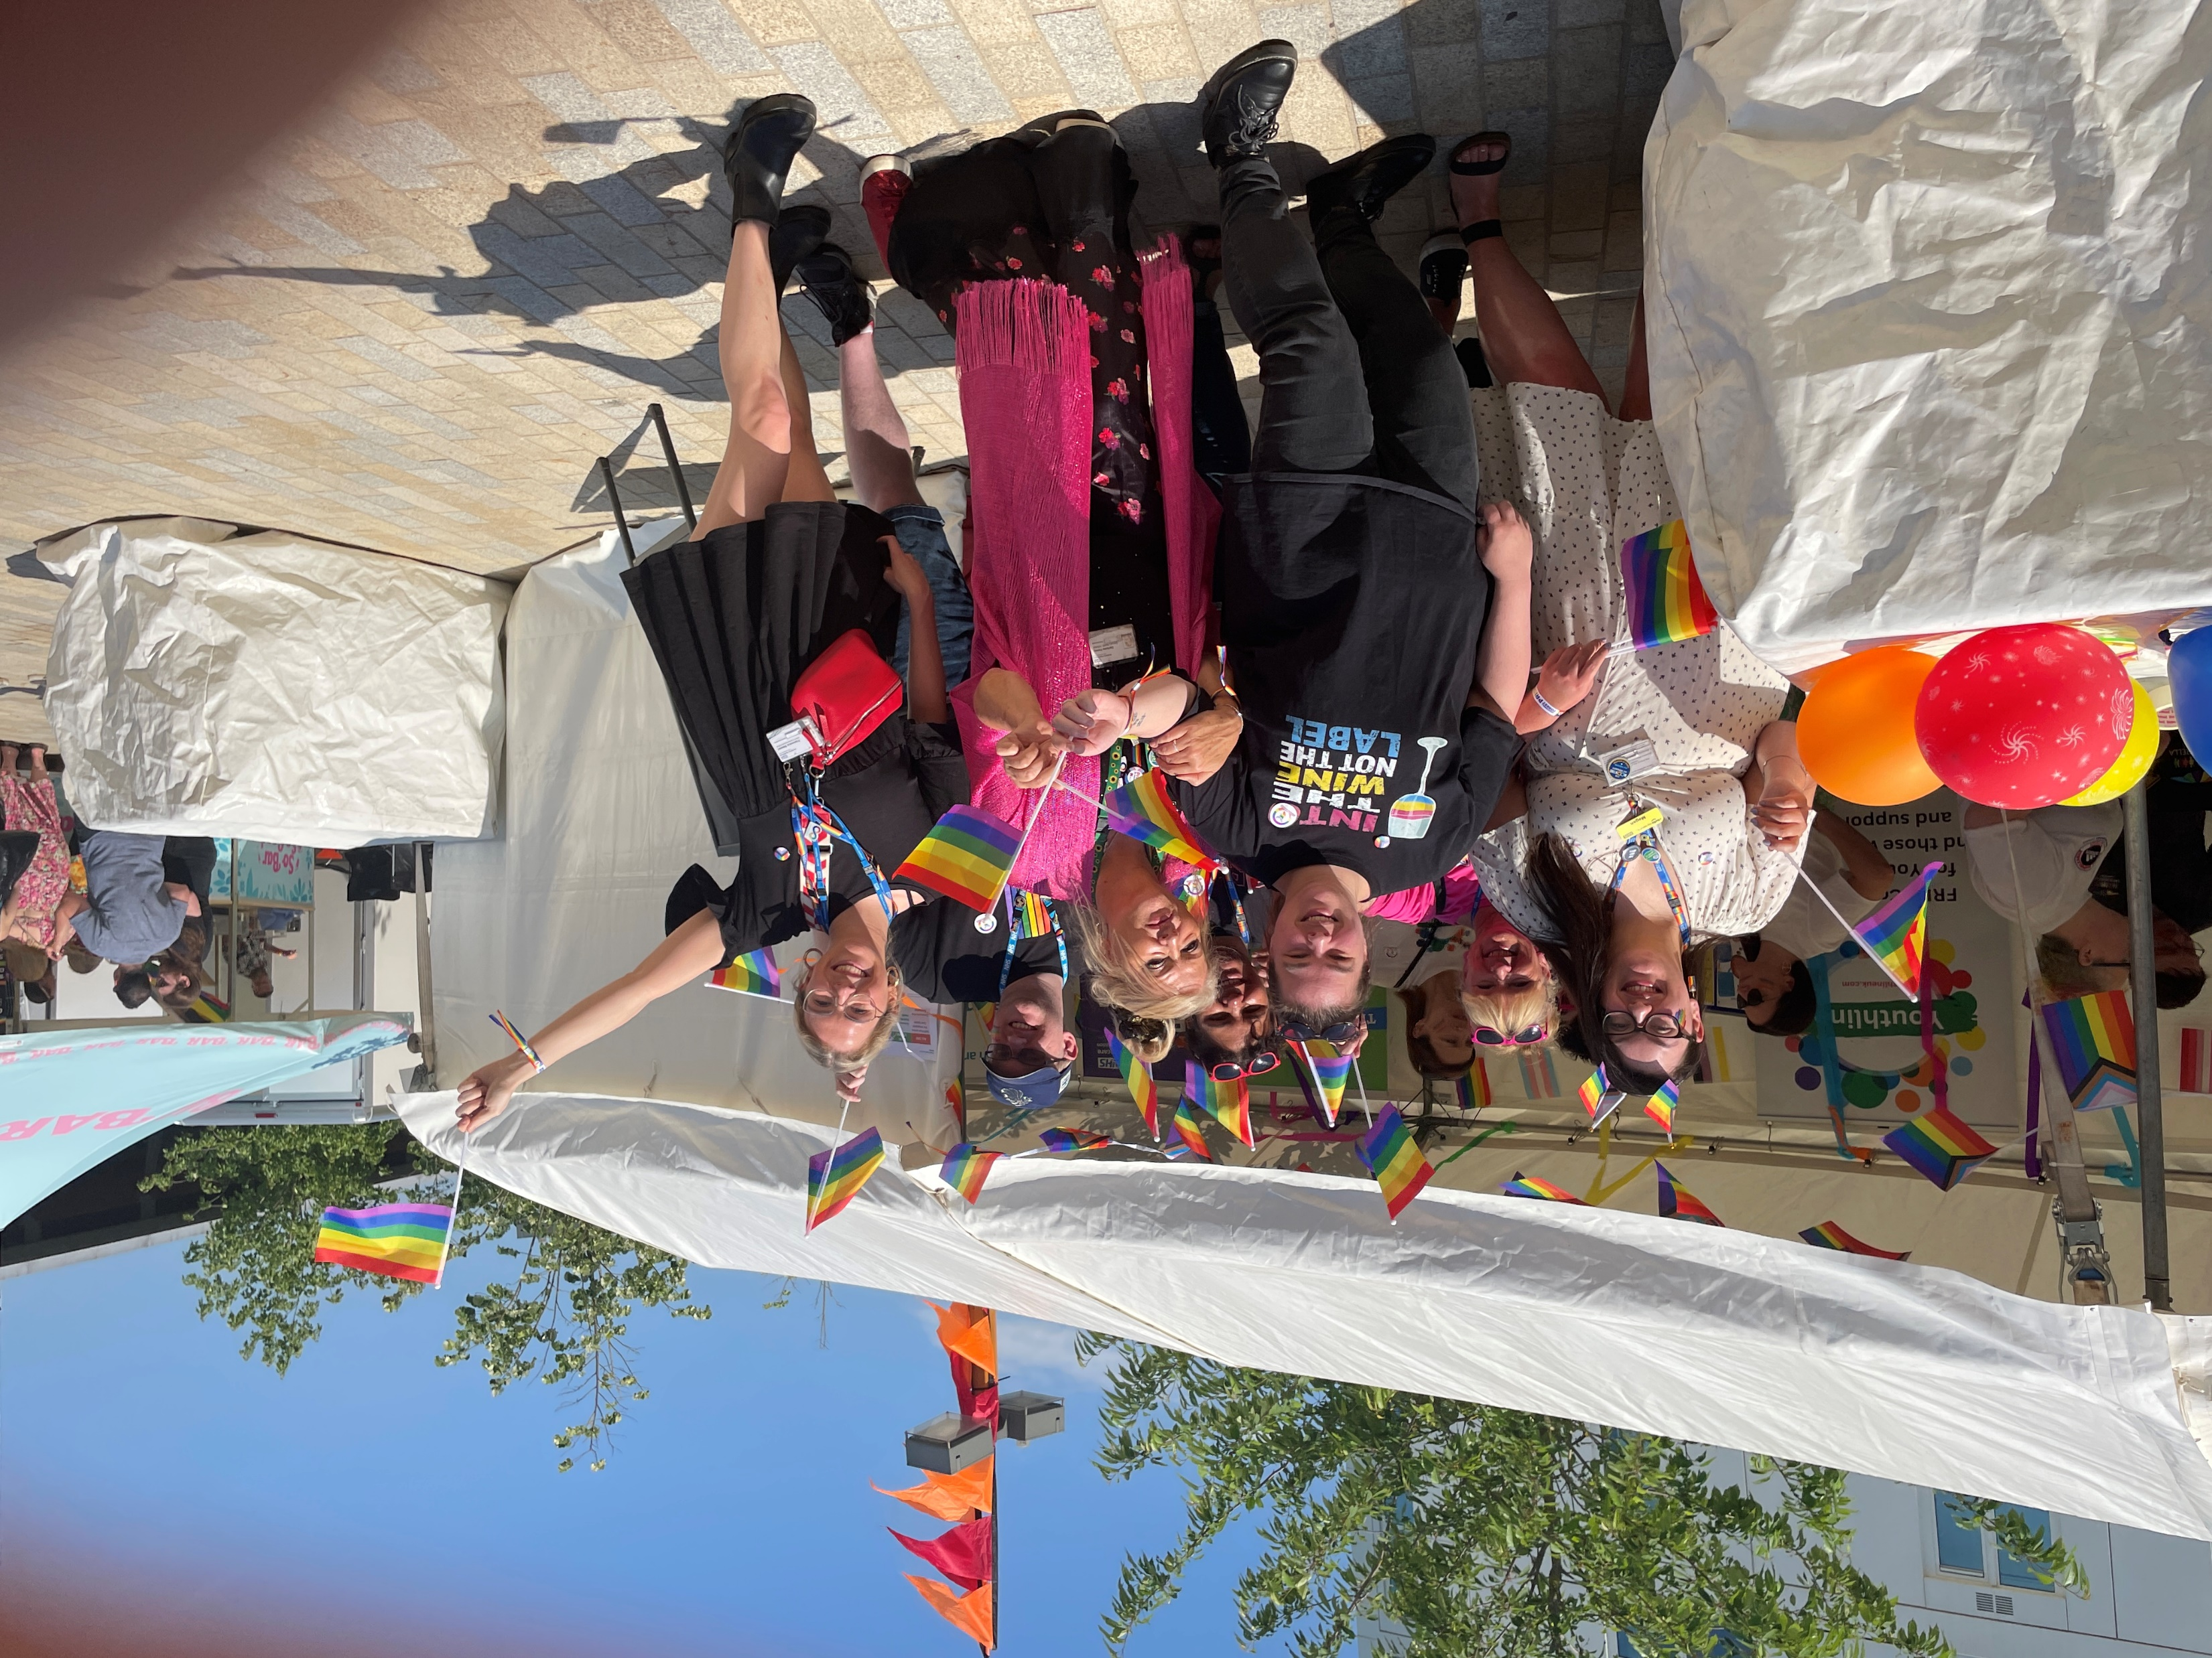
Pride Month
It is PRIDE MONTH!
Bracknell Forest Pride was held on 10th June 2023
Attendees had a wonderful day filled with live entertainment, sunshine, love and pride!
Members from across the ICS attended to meet the community, talk about the variety of roles within our System and how we provide services across health and social care ☺
Feedback about the day included:
“I think that this is so important for young people who may feel like they don’t belong and for the community as a whole to celebrate and recognise diversity and inclusion”
“A historic moment for the town!”
“It’s amazing to see how many other people there are, I don’t feel so alone anymore”
“I think today is a turning point. It is absolutely fantastic that it is finally happening. If I had something like this when I was growing up, I may not have stayed in the closet for so long.”

Slide 5

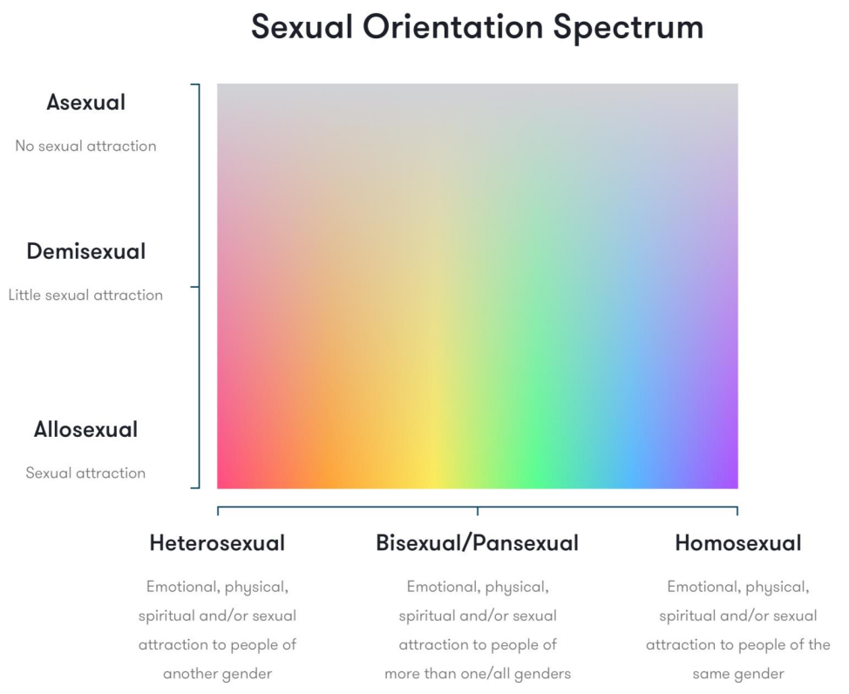

Happy PRIDE month!
‘Sexual orientation’ refers to the romantic or sexual attraction, combination or lack of these, to other people.
There are multiple models to demonstrate the spectrum of sexual orientations. While some are complex Venn Diagrams, others (below) use the colour spectrum to demonstrate.
As with gender identities, it is important to understand that each person is on a journey. A person’s sexual orientation may change as they go through life.
Given the diversity of gender identities and sexual orientations, it is important to try not to assume someone’s pronouns.
The most effective way to support someone is to ask their pronouns ☺
If you use incorrect pronouns, simply apologise and correct yourself!
Use neutral terms like “your partner” unless otherwise specified.

Slide 6

Father’s Day
18th June 2023
In the UK, Father’s Day was adopted after World War II. It followed the USA, where a church sermon honouring victims of a mining accident paved the way for a more permanent celebration equivocal to Mother’s Day.
In 2022, 1 in 9 stay-at-home parents were fathers.
Father’s Day continues to be celebrated in a variety of ways across different cultures and countries.
Chinese is widely spoken in Taiwan.
Because “Ba” means 8, and “Ba-Ba” (literally 8-8) is the informal term for father, they celebrate Father’s Day on 8th August!
Roman Catholicism has honoured the Feast Day of St Joseph, on 19th March, as a celebration of Fatherhood since the Middle Ages! This date continues to be used in Spain, Portugal & Italy.
“When you follow in the path of your father, you learn to walk like him” – Ghanian Proverb
Father’s Day is honoured by Nepali Hindus in August or September as they follow a lunar calendar. Some also mark “Buwaako much herne din” – ‘a day for looking at father’s face’. Traditionally on New Moon Day, respect is paid to deceased fathers.
In Thailand, the King’s birthday (5th December) is celebrated as Father’s Day
It is important to acknowledge and support men who may be childless (unable to have children or experienced child loss).
“A mother is gold, a father is a mirror” – Nigerian Proverb

Slide 7
LD awareness week page

Slide 8


25th Anniversary!
This year’s theme is Compassion in Action
In a world where we continue to adjust post-lockdown and respond to new developing crises, compassion is key.
We know how interconnected our world is: how something seemingly “far away” impacts everyone.
Within our own experiences are all the tools we need to be compassionate, not just to ourselves and those in our immediate circle but to all our human neighbours and our one shared home, planet earth.
Challenge yourself -
What will you do in the next week to put compassion into action?
“Our task must be to free ourselves – by widening our circles of compassion to embrace all living creatures and the whole of nature in its beauty.”- Albert Einstein

Slide 9

Ratha Yatra is a Hindu festival involving a public procession of deities on a chariot.
The festival is also marked outside of its’ Indian origins, including by some Jain groups, and in areas that Hindu’s have otherwise settled, such as Hong Kong.
According to some, despite its’ religious origins, this festival is steeped in community heritage, social sharing and cultural significance to all of its’ organisers and participants
Did you know:
The largest and most visited Ratha Yatra in the world is at Puri, in Odisha.
Did you know:
Western onlookers of the Jagannath Ratha Yatra in Puri saw such a display of unstoppable force that it is the thought to be the origin of the English word “Juggernaut”!
20th June 2023

Slide 10


Last chance
to apply for
Cohort 6
on
This 5 month leadership programme is for all staff across frontline clinical, operational and digital roles
The programme is cross hierarchical – so it benefits everyone regardless of career experience, and welcomes diversity of staff from across the System
The programme includes workshops, keynote speakers, group conversations, live system challenges, face-to-face or virtual visits and lots more!
Technology is transforming the world we live in.
Join us to harness its’ power and improve health and care outcomes across the Integrated Care System!

Slide 11

Save the date!
The
Frimley System Women’s Network
are holding their
first network meetings!
Meetings are open to every member of paid and voluntary staff in Health and Social care within Ascot, Bracknell, Farnham, Maidenhead, North East Hampshire, Slough, Surrey Heath & Windsor
Meeting 1: Microsoft Teams
Wednesday 21st June
Midday to 1.30 pm
Click here to register for the Teams launch – link goes into your Teams diary!
Check the Amplify EDI newsletter to keep up to date!
For more information, email Cheyenne.Sparks2@nhs.net

Slide 12

NHS England South East
Health & Wellbeing Events
Spring 2023
Masterclass: Leading, coaching & developing diverse teams in times of change, challenge & crisis
For leaders and managers working in health & wellbeing, retention and staff engagement.
Click here to register!
Improving staff experience: A south east masterclass
Interactive session with an opportunity to hear from colleagues about areas of good practice and explore strengthening of staff experience and workforce resilience. Professor Jeremy Dawson will provide key insights linked to the recent Staff Survey.
Click here to register!
South east event: Respecting civil behaviours across our workforce
Open to people leaders in the culture, workforce, wellbeing, retention & engagement space, and those interested in the civility & respect agenda. The civility & respect national programme is working in collaboration with the South East Region team to bring Integrated Care System leaders & People leaders together to show how civility & respect plays an important role in how to influence a positive culture in your organisation.
Click here to register!

