Slide 1



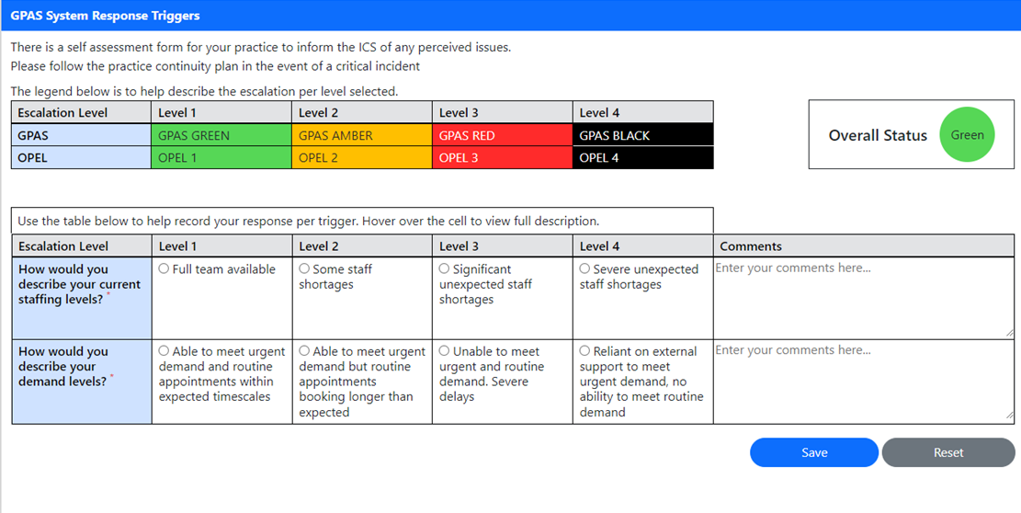
General Practice Alert System (GPAS) Update 24.05.2023
Practices only need to complete the GPAS return
We need your GPAS submission to report the system OPEL level for General Practice & to evidence the pressures in general practice to the wider system
Report by CoP on a Tuesday, you can report at anytime between the two Tuesdays, your most recent submission will be the one taken. Data in the V2 Primary Care Escalation Monitoring Tool is refreshed on a Wednesday morning and extracted for the Whole System Opel Level Report
Register / Login;
https://frimleyics.azurewebsites.net/
Mobile Tablet Laptop/Desktop
Complete via;
Complete in 3 clicks, in under 2 minutes
Click 1 - Staffing level
Click 2 - Demand level
Click 3 - Save
Bracknell Forest North East Hampshire and Farnham Royal Borough of Windsor and Maidenhead Slough Surrey Heath

Slide 2
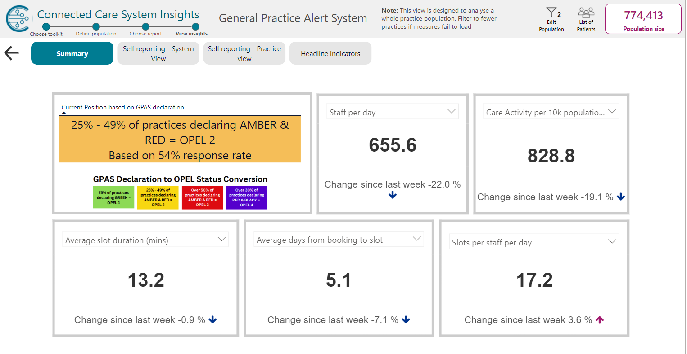
General Practice Alert System (GPAS)
Where are we in Frimley?

Slide 3
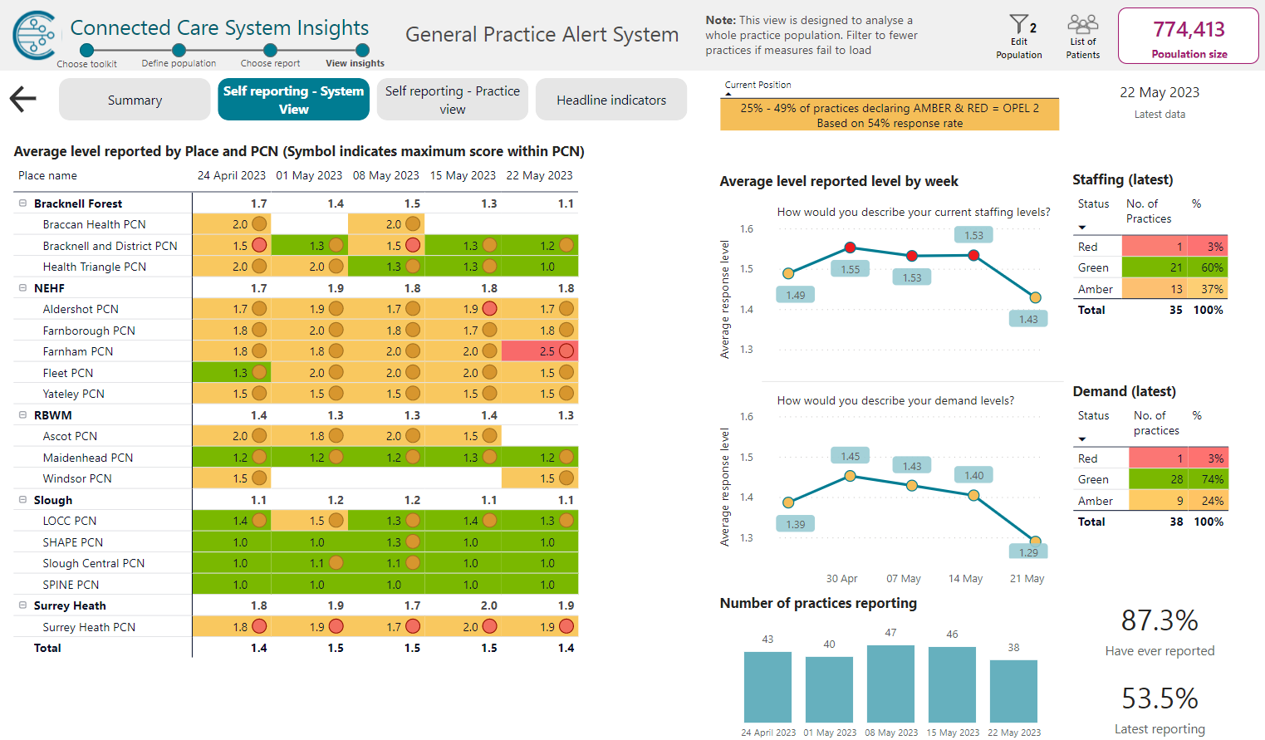
Where are we in PCNs?

Slide 4
V2 Primary Care Escalation Monitoring Tool
V2 Primary Care Escalation Monitoring Tool Connected Care System Insights - Power BI
Training Videos Connected Care System Insights V2 Training Videos - YouTube
Info & Links
If you need to register a new user, instructions on how to do this can be found on page 2 of the User Guide.
How to complete your GPAS System Response Triggers Submission Form can be found on page 10 of the User Guide.
GP Input Form User Guide
Aligning GPAS to OPEL Actions image
Queries can be sent to rachel.thompson7@nhs.net
Bracknell Forest North East Hampshire and Farnham Royal Borough of Windsor and Maidenhead Slough Surrey Heath

