Slide 1

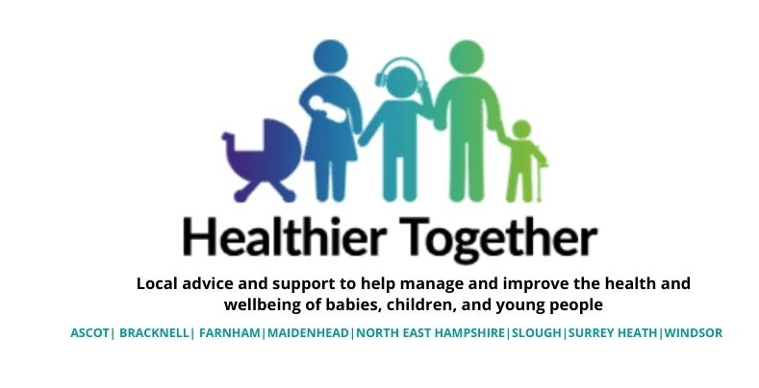
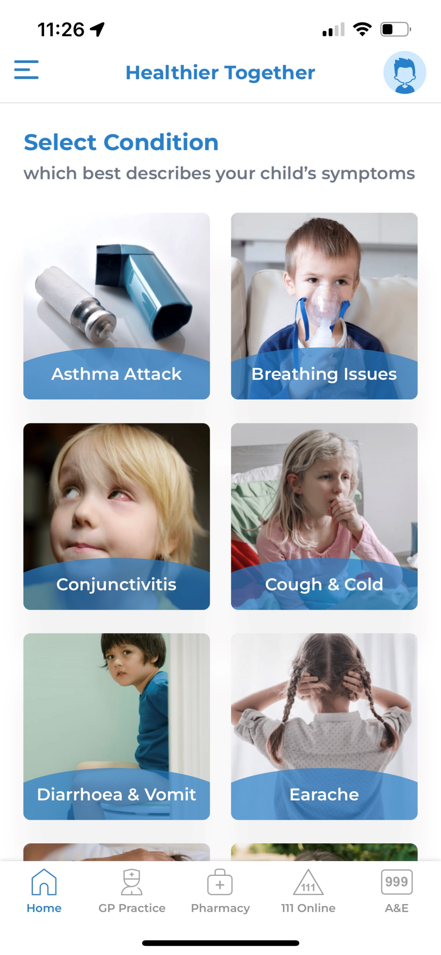
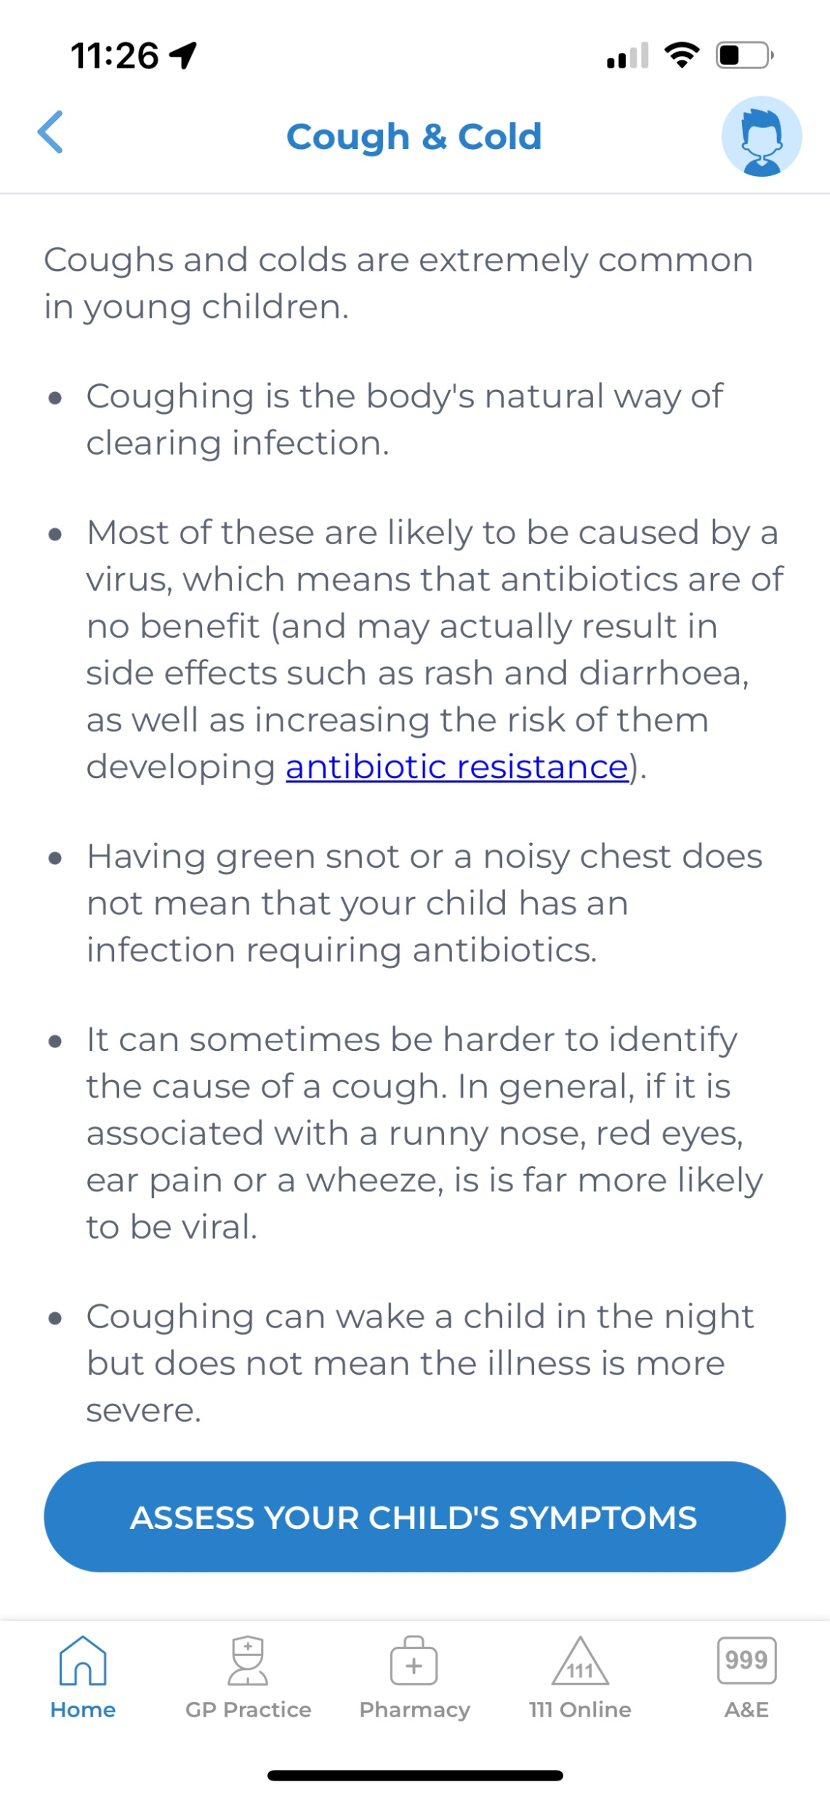
Frimley Healthier Together
App Launch
Social media content – September 2022

Slide 2
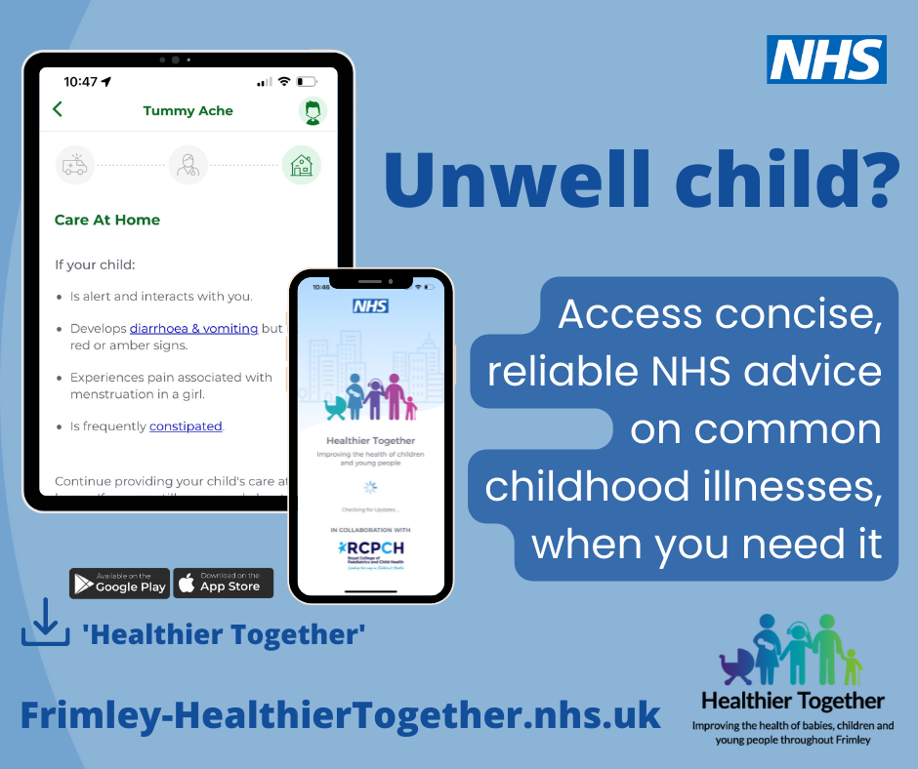
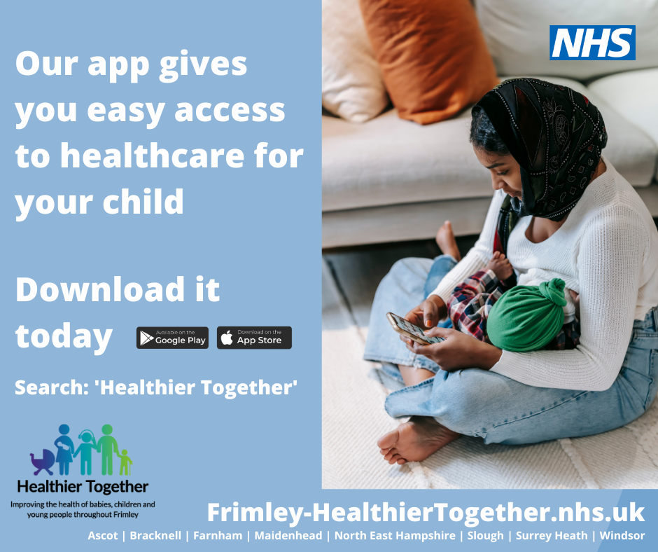
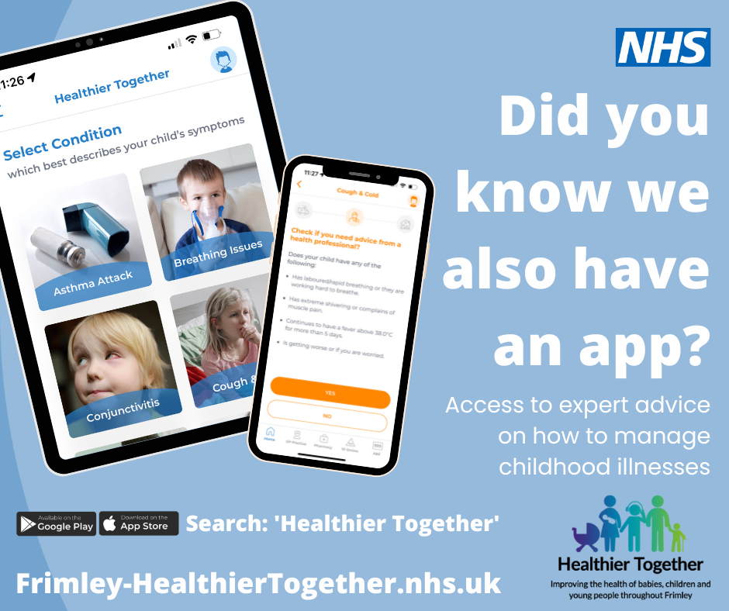
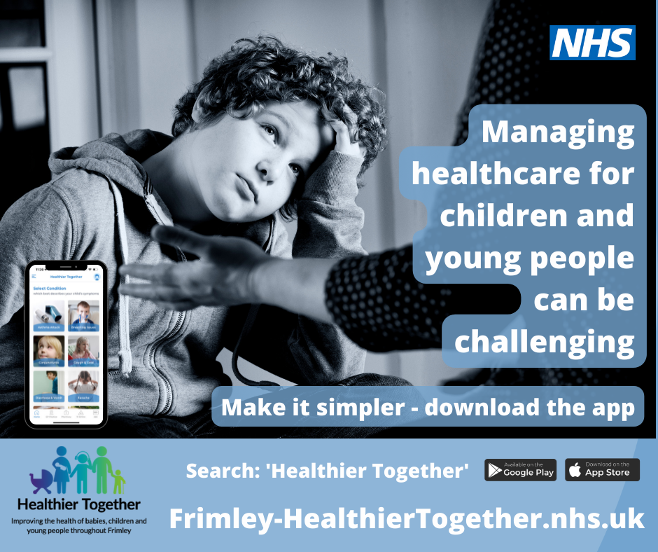
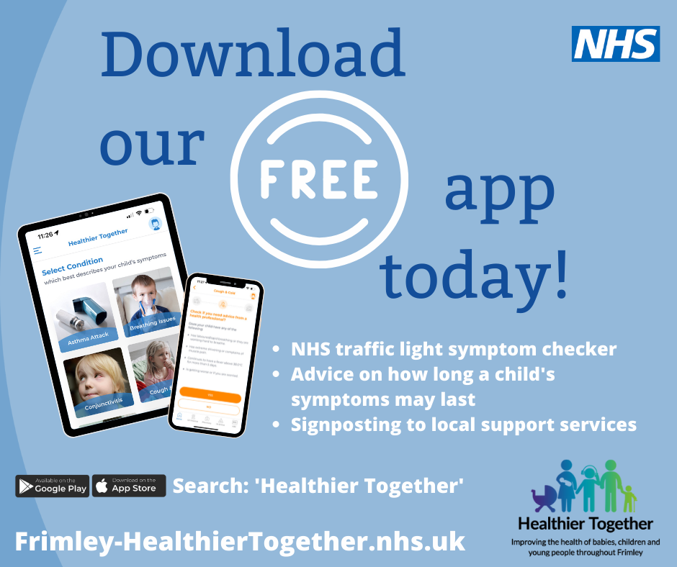
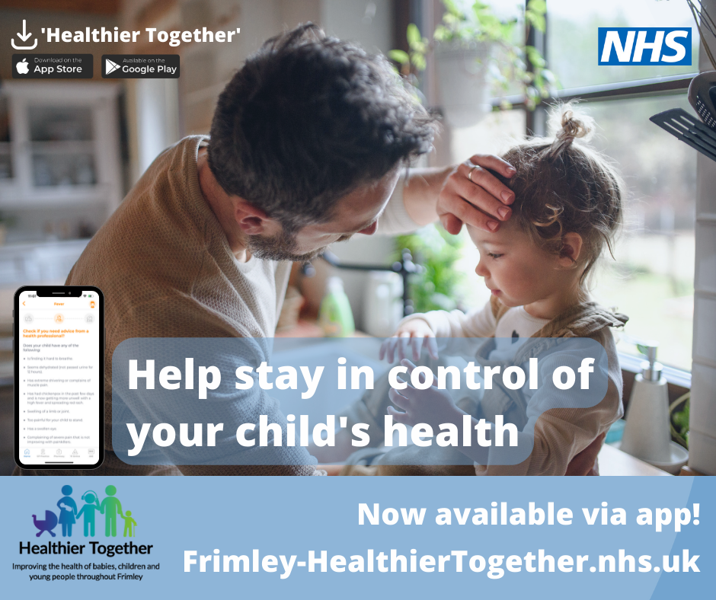
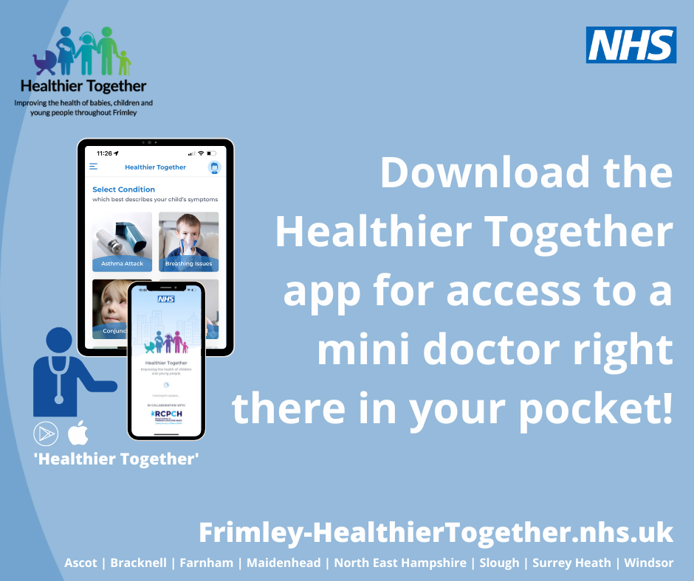
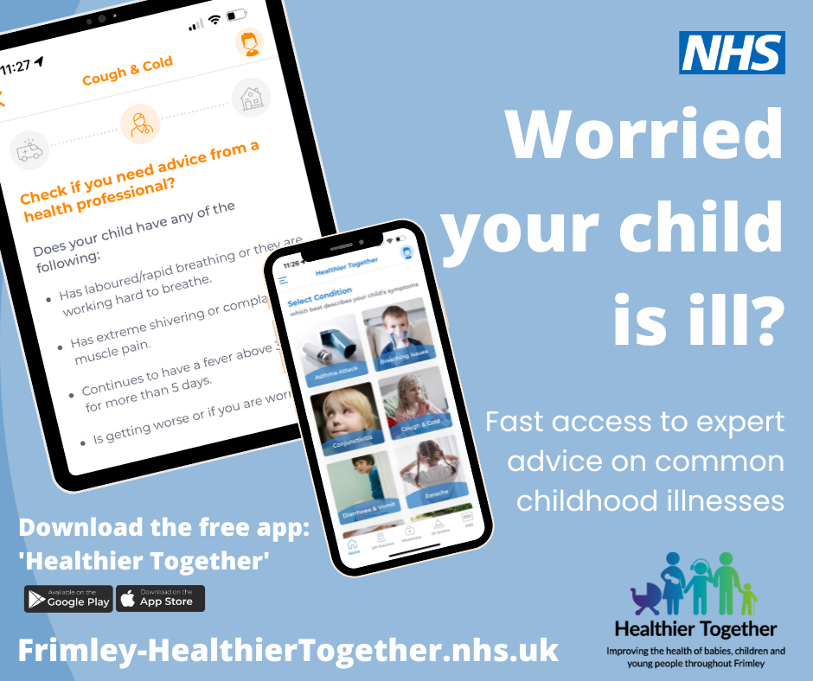
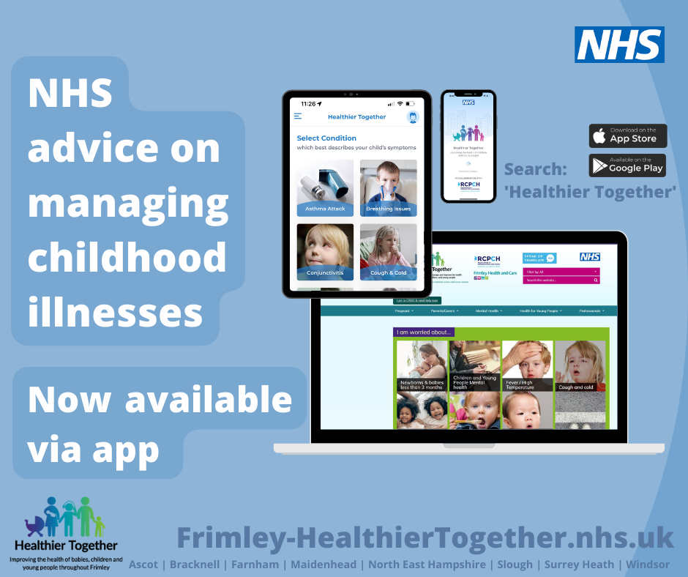
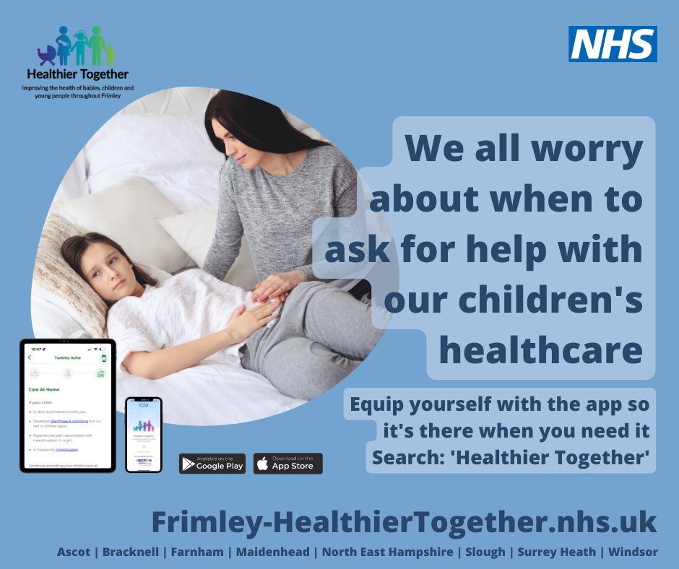
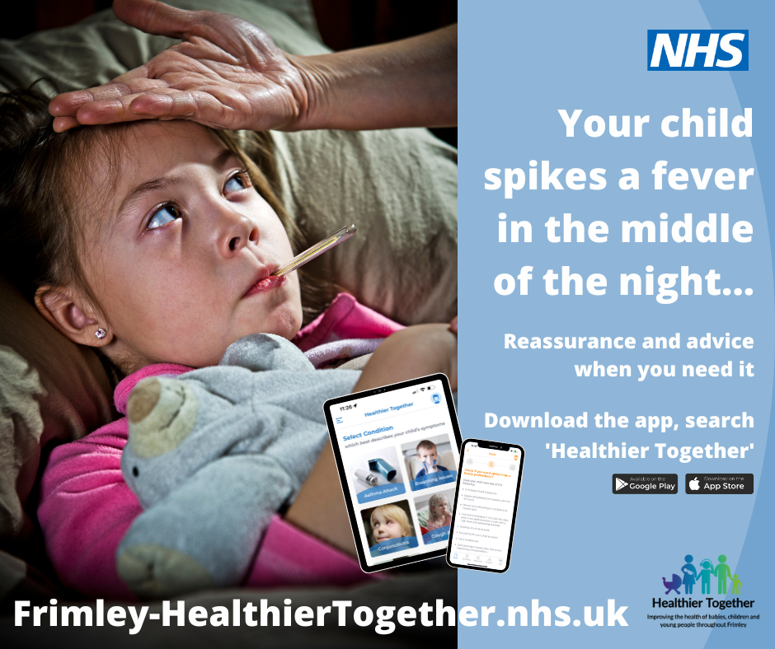
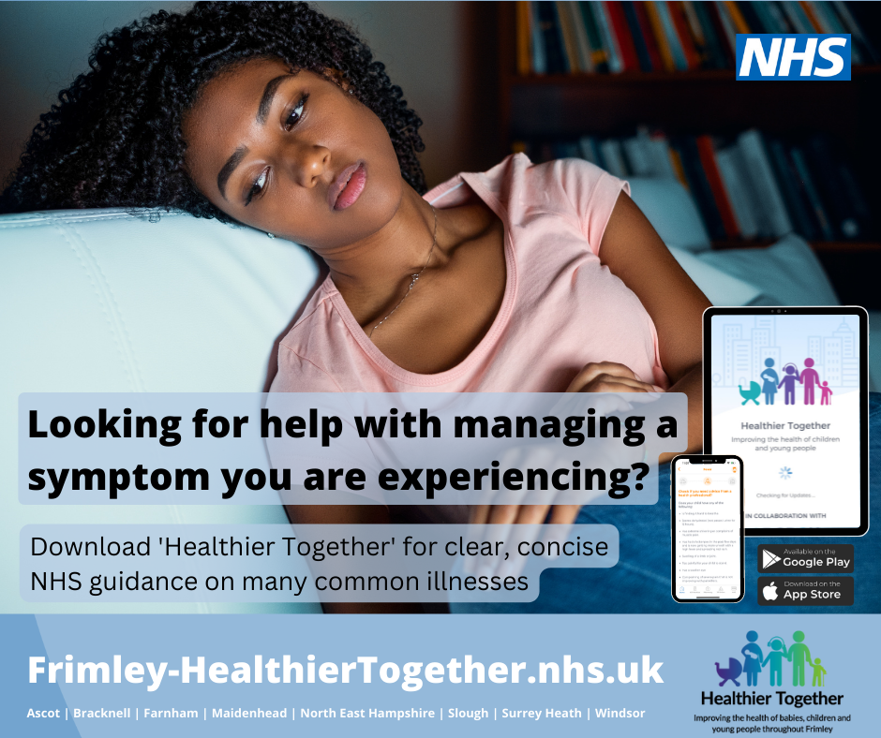
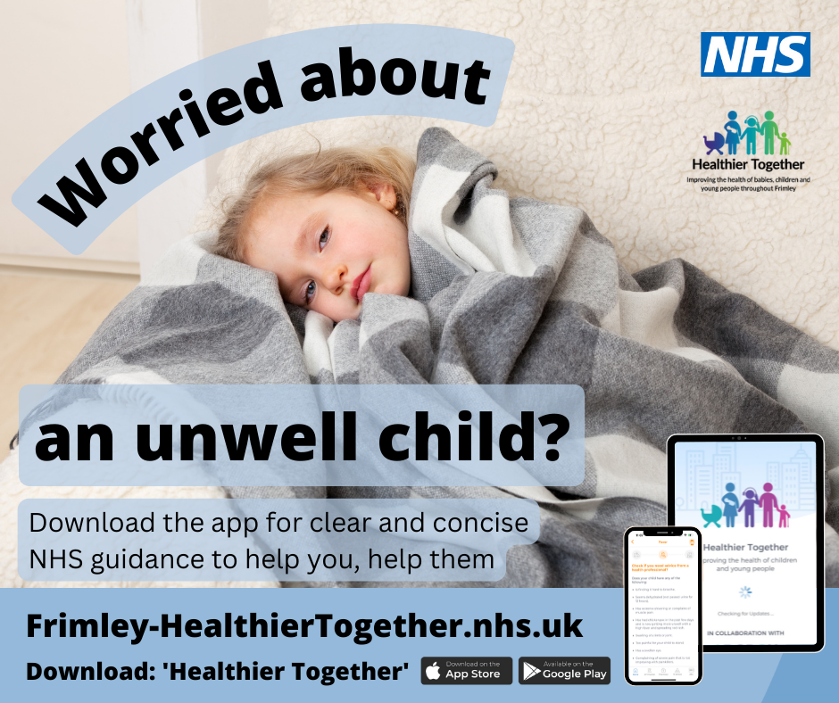
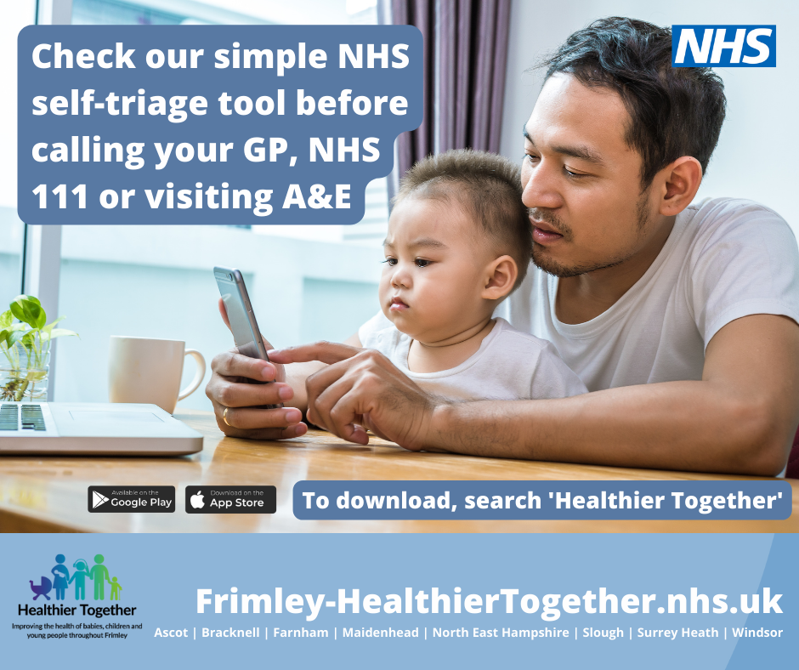
Suite of messages for campaign

Slide 3
Message one
Suitable for: Instagram / Facebook
Having an unwell child can often be stressful.
Finding concise, reliable information on how to manage their illness is tricky at times.
To solve this, our new app - Frimley Healthier Together - is available now.
Download it today for NHS support to help you manage your child’s health right there, on your phone, when you need it.
https://bit.ly/FHTApp

Slide 4
Message two
Suitable for: Instagram / Facebook / Twitter
Imagine making access to healthcare for your child easier…
Our new app gives you easy access to concise NHS traffic light symptom guidelines, so you know where to go for further medical help if your child needs it.
Download it today!
https://bit.ly/FHTApp

Slide 5
Message three
Suitable for: Instagram / Facebook
If you are caring for children and young people, managing their healthcare can be challenging at times.
To help, we’ve built an app with clear information on common childhood illnesses, including advice on what 'red-flag' signs to look out for, where to seek help if required, what you should do to keep your child comfortable and how long your child's symptoms are likely to last.
Download today! https://bit.ly/FHTApp

Slide 6
Message four
Suitable for: Instagram / Facebook / Twitter
Did you know we also have a Frimley Healthier Together app?
Available now - download it today to access a wealth of information on how to manage childhood illnesses.
https://bit.ly/FHTApp

Slide 7
Message five
Suitable for: Instagram / Facebook
Did you know we have a FREE Frimley Healthier Together app?
Developed by healthcare professionals it offers you an easy-to-follow traffic light system, providing clear information on common childhood illnesses, including advice on what signs to look out for, when and where to seek help if required, what you should do to keep your child comfortable and how long your child's symptoms are likely to last.
Simply download it today. https://bit.ly/FHTApp

Slide 8
Message six
Suitable for: Instagram / Facebook / Twitter
To help you stay in control of your child’s health, download our easy-to-use app today.
Developed by NHS professionals to provide peace of mind and help you access the best support as needed.
https://bit.ly/FHTApp

Slide 9
Message seven
Suitable for: Instagram / Facebook / Twitter
Access a mini doctor right there in your pocket.
Our app has now launched and is available for you to download today.
Ensure you have it at your fingertips when you need advice on managing childhood illness.
https://bit.ly/FHTApp

Slide 10
Message eight
Suitable for: Instagram / Facebook
If you have an unwell child at home, our app, Frimley Healthier Together, can help you access the right local healthcare support and advice for them.
It’s free to use and available now from your preferred app store.
https://bit.ly/FHTApp

Slide 11
Message nine
Suitable for: Instagram / Facebook / Twitter
NHS advice on managing childhood illnesses is now available via a simple to use app.
Download Frimley Healthier Together – it’s like having your own personal healthcare professional in your pocket.
https://bit.ly/FHTApp

Slide 12
Message ten
Suitable for: Instagram / Facebook / Twitter
Knowing when and where to access healthcare for your child or young person can be tricky. We all worry about when to ask for help.
Our new app offers NHS traffic light guidance on when and where to seek further help based on the symptoms experienced.
Equip yourself with our app so it’s there when you need it.
Get it today https://bit.ly/FHTApp

Slide 13
Message eleven
Suitable for: Instagram / Facebook
It’s the middle of the night and your child spikes a fever.
We’ve all been there and asked ourselves when we should be worried.
Our new app, Frimley Healthier Together provides simple advice on what to do based on the symptoms a child is experiencing.
Download it today to have some reassurance at your fingertips for when you need it.
https://bit.ly/FHTApp

Slide 14
Message twelve
Suitable for: Instagram / Facebook
Are you a young person looking for information on how to manage a symptom you are experiencing?
The Frimley Healthier Together app, from the NHS, can help you with many common illnesses.
Simply download today for help managing your symptoms.
https://bit.ly/FHTApp

Slide 15
Message thirteen
Suitable for: Instagram / Facebook / Twitter
If you are worried about an unwell child, Frimley Healthier Together can help you work out what is wrong with them and how to help them recover.
With clear and concise NHS guidance, you’ll be well equipped to know what to do to help them.
Download today. https://bit.ly/FHTApp

Slide 16
Message fourteen
Suitable for: Instagram / Facebook
Before rushing to call your GP, NHS 111 or visiting A&E, take a moment to use our simple NHS self-triage tool.
You can get red, amber, and green advice on a healthcare concern you have about a child in your care, meaning you can quickly get the right support, at the right time, from the right place.
Download our app today.
https://bit.ly/FHTApp

