Slide 1


Academy of Medical Royal Colleges report
Review of the interface between general practice and secondary care
Briefing pack for primary and secondary care systems, stakeholders, media teams and communication colleagues.

Slide 2

Read the report here
For any further questions about the report and case studies please email psci@aomrc.org.uk

Slide 3
Background
A joint NHS and DHSC Delivery Plan for Recovering Access to Primary Care has now been published, a key commitment in the government’s Autumn Statement.
The plan sets out a series of measures to enable transformation and support general practice to address the challenges it faces and improve patient access.
One of the four core areas of the plan focuses on cutting bureaucracy to help relieve workload pressures experienced by general practice teams, freeing them up to focus on patient care. An integral part of this is improving the primary – secondary care interface.
This interface is a key measure of success for systems. The relationship between these services is vital to our objectives to recover access and productivity by improving patient flow in and out of hospital and better managing patients in the community.
To improve interface working, NHS England commissioned the Academy of Medical Royal Colleges (AoMRC) to undertake a rapid and clinically-led review. Their report – General Practice and Secondary Care: Working Better Together – is published alongside the delivery plan.

Slide 4
Content
The report is an outstanding practical resource for Integrated Care Boards (ICBs) that sets out a series of recommendations and over 50 examples where local collaboration has successfully overcome organisational boundaries to find practical solutions to reduce unnecessary workload in both clinical settings. Examples have been grouped into three themes that seek to improve the top interface issues: culture, communication and clinical process.

Slide 5

Recommendations for systems
As part of the commitment in the delivery plan, systems should ensure local mechanisms are in place, comprising primary and secondary care clinical and managerial leaders, including LMC members, to utilise the findings and make tailored local improvements to interface working. Systems are being asked to consider the following four actions:
Onward referrals: if a patient has been referred into secondary care and they need another referral, the secondary care provider should make this for them, rather than sending them back to general practice to a further delay before being referred again.^{[1]} This improves patient care, saves time and was the most common request we heard from general practices about bureaucracy.
Complete care (fit notes and discharge letters): Trusts should ensure that on discharge or after an outpatient appointment, patients receive everything they need, rather than as too often happens now leaving patients to return prematurely to their practice which often does not know what they need. Therefore, where patients need them, fit notes should be issued for the appropriate length of time to avoid unnecessary return appointments to general practice. Discharge letters should highlight clear actions for general practice (including prescribing medications required). Also, by 30 November 2023, providers of NHS-funded secondary care services should have implemented the capability to issue a fit note electronically. From December this will provide patients with a digital fit note by text or email and if they prefer, they can still receive a paper copy.
Call and recall: for patients under their care, NHS trusts should establish their own call/recall systems for patients for follow-up tests or appointments. This means that patients will have a clear route to contact secondary care and will no longer have to ask their practice to follow up on their behalf, which can often be frustrating when practices also do not know how to get the information.
Clear points of contact: ICBs should ensure providers establish single routes for general practice and secondary care teams to communicate rapidly, e.g. single outpatient department email for GP practices or primary care liaison officers in secondary care Currently practices cannot always get prompt answers to issues with requests, such as advice and guidance or referrals, which results in patients receiving delayed care.
ICBs will need to review these actions as part of their annual assessment of interface arrangements (required as part of the NHS Standard Contract) and provide an update to their public board before the end of December 2023.
[1] The NHS Standard Contract does not explicitly require this approach for an onward referral, for non-immediate but related needs, from one provider to another, but NHSE recommends that this should also be done by the secondary care provider.

Slide 6
Recommendations for systems
Based on this engagement and the highlighted case studies, the Academy provides ten recommended interventions which could be implemented quickly to ease pressure at the interface:
Recommended action | Relevant case study
Provide easy access to general practice for secondary care clinicians via non-public phone numbers and shared email mailboxes | 'Backdoor' GP numbers in secondary care — Gloucestershire
Provide easy access to individual hospital departments via non-public phone numbers/shared mailboxes to help in the resolution of administrative queries (ideally any correspondence should link directly with the electronic health record) | Email addresses and a shared inbox for all outpatient department secretariats — Mid and South Essex Integrating emails and care records — Yorkshire
GPs giving trainee doctors regular 'show and tell' sessions on how to fill out discharge summaries in the most informative and accessible way | Primary Care Liaison Officer — North Hampshire
Establish outpatient helplines where administrative queries about hospital appointments can be directed | Outpatients helpline for hospital appointments — Morecambe Bay
Make 'fit notes' more accessible on inpatient wards and in outpatient clinics and produce guidance for secondary care clinicians on their use | Writing Fitness to work certificates — Mid and South Essex
Consider establishing regular 'interface groups' which include balanced representation from general practice and secondary care. The precise specifications should be locally determined (please see the relevant examples for varied configurations) | Integration meetings — North Central London Clinical Interface group (CIG) — North London Joint working — Scotland Medical Council — Gloucestershire Local delivery system — North Hampshire
Provide clinicians with read-only access to health record systems across the interface | SystmOne access — Leicestershire
Employ a Primary Care Liaison Officer to help in the resolution of queries between secondary care and general practice | Primary Care Liaison Officer — North Hampshire
Provide patients with a written update on where they are on the waiting list, asking if they still require or want treatment | Waiting list letter — Leicestershire
Standardise outpatient clinical letters where possible (placing particular emphasis on concise GP recommendations) | Standardisation of outpatient clinic letters and discharge summaries — Leeds

Slide 7

Themes
This engagement process found that identified case studies and interventions improved the interface in three main areas:
Culture
Communication
Clinical process

Slide 8
Case study highlights - culture
North London: Clinical Interface Group
Whittington Health NHS Trust hosts a Clinical Interface Group (CIG) which brings together hospital and GP leaders to discuss challenges and explore solutions.
This group has been in place now for 10 years and has driven positive cultural change. It has spearheaded projects such as a GP-Consultant Exchange, where doctors shadow each other and complete reflections. It has also made changes to prostate cancer pathways and developed a “traffic light” system on the Trust’s website indicating which services are running, which has been praised by local clinicians.
Mid and South Essex: Writing fit notes in hospital
Thousands of GP appointments are used each year to issue fitness to work (Med3) certificates. However, many of these are not necessary as a range of health professionals can legally issue these certificates.
Mid and South Essex NHS Trust issued guidance on how to issue Med3s, including guidance on how long patients should be signed off for.
Interface teaching for medical students
Medical students’ education can be strongly secondary care orientated. This can result in junior doctors not having a holistic understanding of how general practice works.
To address this, a GP in Oxfordshire who also works at Oxford University Medical School developed an online module for students. Topics covered what makes general practice different to secondary care, effective communication, and interface challenges.

Slide 9
Case study highlights - communication
Gloucestershire: ‘Backdoor’ GP numbers in secondary care
Communicating with general practice from secondary care can be time consuming if hospital clinicians use public facing telephone numbers.
To address this, Gloucester ICB Primary Care Network clinical directors provided ‘backdoor’ numbers for their practices to the hospital switchboards of local acute providers.
Leeds: Primary Care Access Line (PCAL)
Similarly, Leeds Teaching Hospitals NHS Trust has created a dedicated specifically to support GPs by providing advice and triage. Calls are answered by an administrator who then directs the call to specialists within the Trusts, who field calls using a rota system.
Of cases discussed through the paediatric PCAL line, 30-40% were able to be managed in the community with advice alone.
Leicestershire: Waiting list letter
Patients frequently contact general practice with questions about elective care appointments, and GPs are also frequently asked to write ‘expedite’ letters encouraging secondary care to see patients sooner.
GPs in Leicester worked together with secondary care to create a letter which was sent to all patients currently on elective care waiting lists in the area. This letter confirmed to patients that they were still on the waiting list and asked them to confirm that they still need their appointment. This reduced waiting list enquiries to general practice.

Slide 10
Case study highlights – clinical process
Mid and South Essex: Blood test discharge guidance
It can sometimes be unclear who is responsible for certain actions after a patient has been discharged from hospital. Clarifying and resolving this can cause additional unnecessary work.
An agreement was reached between hospitals and local GP surgeries in Mid and South Essex which specifies the circumstances in which the GP team or the secondary care team should be expected to order blood tests after discharge. Guidance was disseminated to inpatient wards and outpatients’ clinics within the hospital, as well as to GP surgeries.
Enfield: Patient Integrated Teams (PIT)
To help address the elective care backlog, a GP and A&E consultant in Enfield created a working group with representation from general practice and secondary care to review patients waiting for an elective urology appointment and optimise their care.
Using a bespoke platform, they extracted a waiting list dashboard to identify the relevant patient cases. The GP then conducted a desktop review of these patients to determine if they needed an MDT discussion in order to obtain an up-to-date review prior to their appointment. Initial findings suggest that 25% of patient on waiting list could be safely managed in the community.
North Hampshire: Primary care liaison officer
Errors or inconsistencies in discharge summaries are common and can cause risks for patients and additional work for GP teams.
To help prevent and resolve this, Hampshire Hospitals NHS Foundation Trust has hired a full time Primary Care Liaison Officer to act as a single point of contact for GPs and GP surgeries in the region.
The majority of queries relate to discharge medication and are resolved within 24 hours.

Slide 11

Communications materials

Slide 12

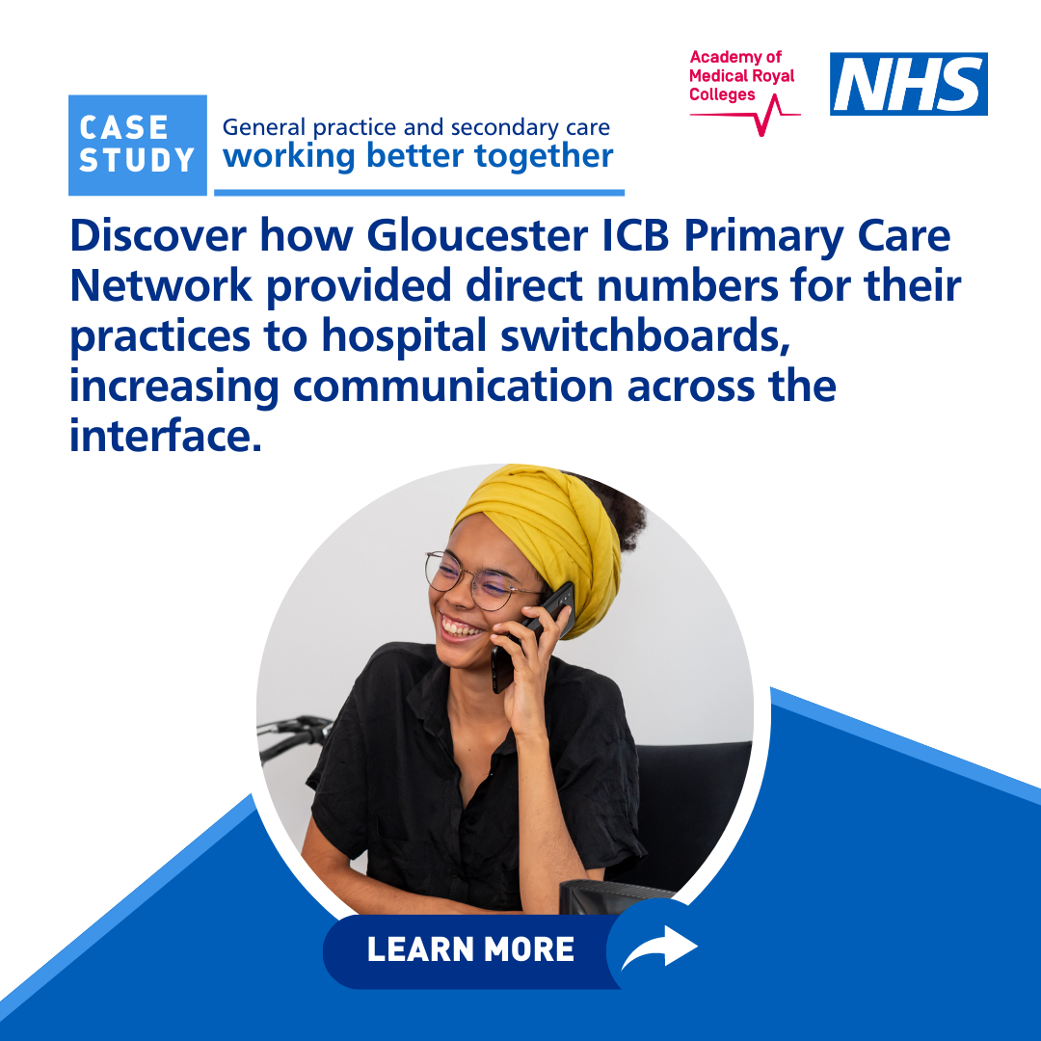
Social media assets and suggested copy
In Mid and South Essex, guidance was developed for hospital trusts that provides clear instructions for healthcare professionals on how to issue Med3s or ‘fit notes’.
Read more about this initiative and many more in a new report from @AoMRC: https://www.aomrc.org.uk/reports-guidance/general-practice-and-secondary-care-working-better-together/
The Gloucester ICB Primary Care Network provided direct numbers for all their practices to the hospital switchboards of the acute providers, reducing valuable 'hanging-on time’.
Read more about this initiative in a new report from @AoMRC: https://www.aomrc.org.uk/reports-guidance/general-practice-and-secondary-care-working-better-together/

Slide 13


Social media assets and suggested copy
Morecambe Bay NHS Trust established an outpatients' helpline which patients can call directly without involving their GP surgery - in-person GP appointment queries have reduced.
Learn more about this initiative and many more in a new report from @AoMRC: https://www.aomrc.org.uk/reports-guidance/general-practice-and-secondary-care-working-better-together/
Leeds Teaching Hospital introduced a standard format for their electronic outpatient records system. Feedback from GP teams is that it’s now quicker to determine whether there are any actions.
Learn more about this initiative in a new report from @AoMRC: https://www.aomrc.org.uk/reports-guidance/general-practice-and-secondary-care-working-better-together/

Slide 14


Social media assets and suggested copy
Hampshire Hospitals Foundation Trust employed a Primary Care Liaison Officer, acting as a go-between across general practice and secondary care. Most queries are dealt with within 24 hours.
Learn more about this initiative in a new report from @AoMRC: https://www.aomrc.org.uk/reports-guidance/general-practice-and-secondary-care-working-better-together/
A new report by @AoMRC highlights over 50 examples of healthcare systems collaborating to overcome boundaries and working together more effectively.
Get inspired and read about these initiatives: https://www.aomrc.org.uk/reports-guidance/general-practice-and-secondary-care-working-better-together/

Slide 15
Bulletin/newsletter copy
New report and recommendations of improving patient care and the working relationship between primary and secondary care A key barometer of how effectively systems are working together is the interface between general practice and secondary care. The Academy of Medical Royal Colleges (AoMRC), commissioned by NHS England, have published a report highlighting over 50 examples of systems collaborating to overcome boundaries and working together more effectively.
Improving service interfaces means staff and patients receive better care and reduces unnecessary workload for systems, making greater use of clinical time and NHS resources in all settings.
Please do share this report widely with your colleagues, networks, and systems to help transform the way staff in general practice and secondary care work together for the benefit of patients and for each other.

Slide 16
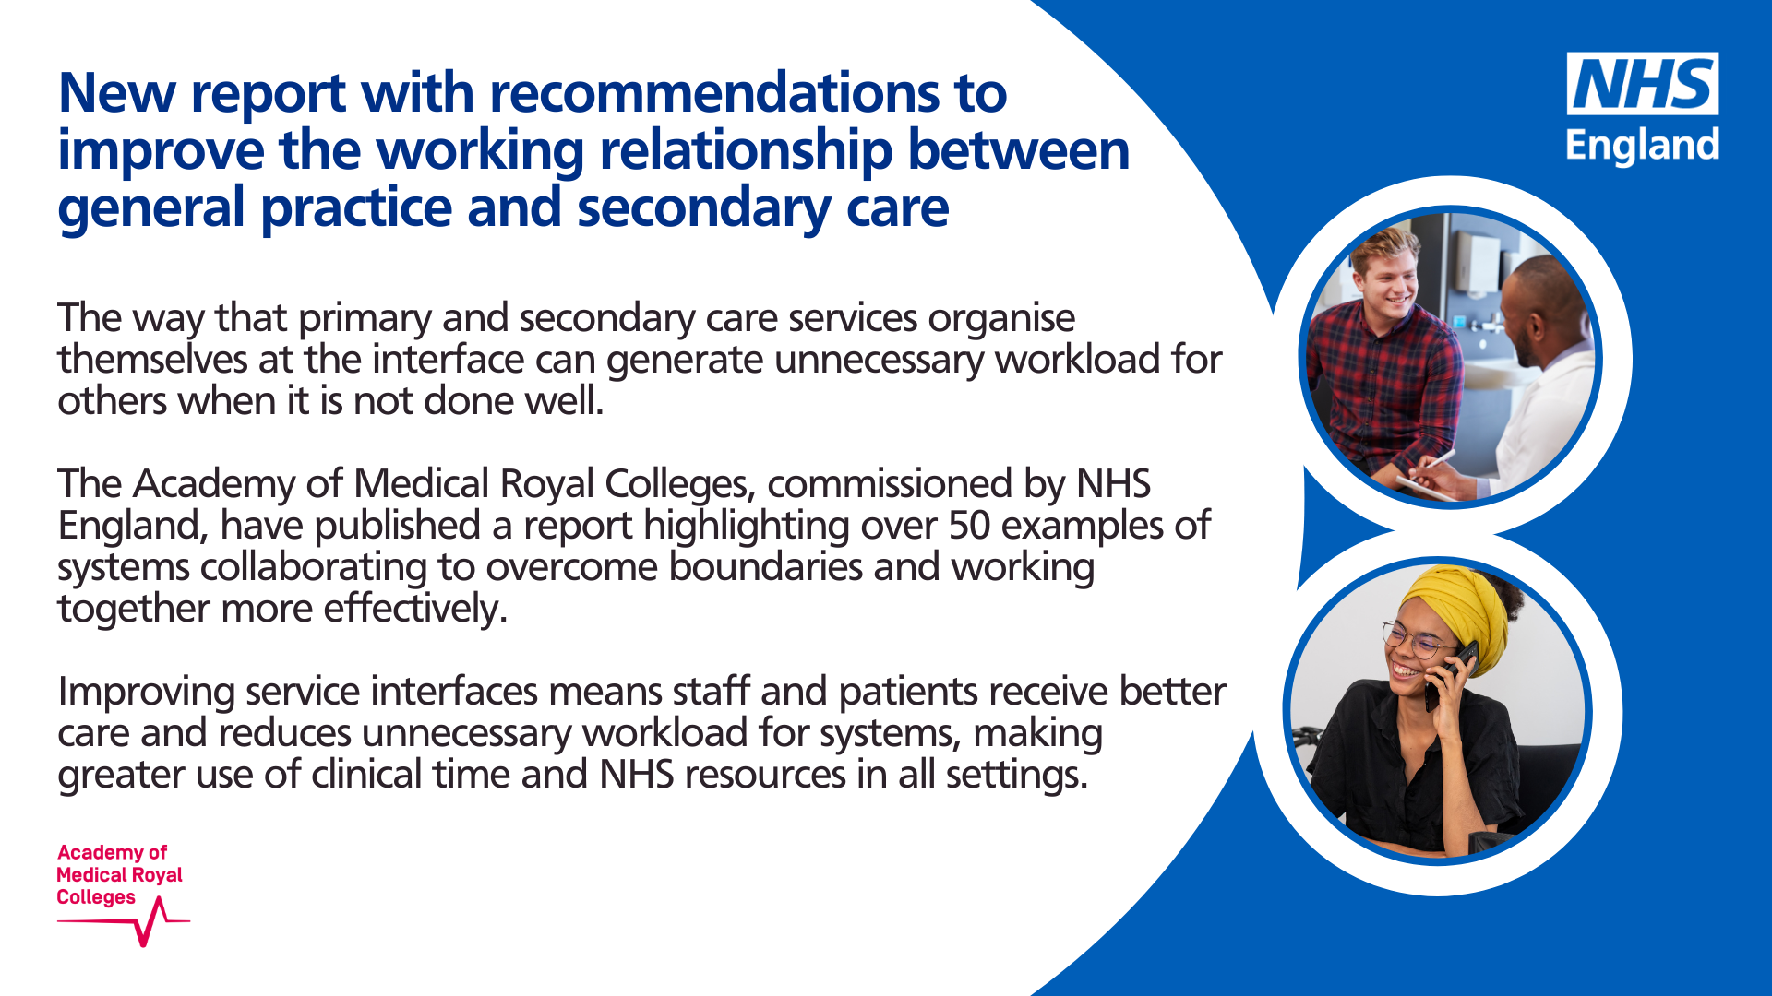
https://www.aomrc.org.uk/reports-guidance/general-practice-and-secondary-care-working-better-together

