Slide 1
Preparing for Winter in Care Homes
Infection Prevention Information
2023/24
South East Health Protection Team, UK Health Security Agency

Slide 2
Summary of presentation
Common infectious diseases to look out for this Winter in care homes
How can care homes prepare for Winter?
What is an acute respiratory illness?
Recognising outbreaks and how to report them, what information might the HPT need?
Infection prevention and control advice
What testing may be required?
When might antivirals be needed?
Who else needs to be aware of an outbreak in a care home?
When is an outbreak over?
Questions and answers

Slide 3
Infectious diseases that are more common in care homes during Winter
Residents and staff are susceptible to infections which increase over Winter:
  Acute respiratory illness – may be caused by COVID-19, seasonal Influenza (flu) or other viruses
  Norovirus (winter vomiting bug)
These can be very infectious and spread due to close contact in care home settings
Older people are also at greater risk from conditions like shingles and pneumococcal disease
Many infections can be prevented, or the severity reduced, by vaccination
Good infection control practices can reduce the risk of outbreaks occurring and stop infections from spreading

Slide 4
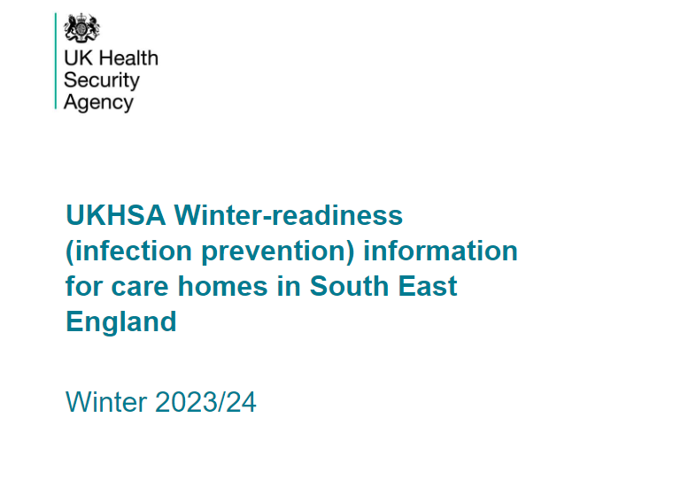
How can care homes prepare for Winter?
Work through the checklists in the UKHSA Winter-readiness pack 23/24
Ensure your residents and staff are immunised against flu and COVID-19
Have a supply of personal protective equipment (PPE)
Keep a supply of COVID-19 lateral flow devices (LFD)
Ensure your residents over 65 are immunised against pneumococcal infection
Ensure your residents aged 70-79 years are immunised against shingles
Maintain a list of residents who are eligible for COVID-19 treatments
Notes:
You should have all received the Winter-readiness pack for Care Homes, this presentation is designed to pick out key factors from it, in relation to management of seasonal inf.luenza specifically, rather than COVID-19.
The chare home guidance is due to be updated, and we will share this with you as soon as it is available.

Slide 5


What is an acute respiratory illness?
Acute respiratory illness (ARI) can be caused by a range of viruses, including influenza and COVID-19
Symptoms of acute respiratory illness can include
  Fever (high temperature) - however this is not always present in older people
  New continuous cough
  Loss or change of sense of smell or taste
  Shortness of breath
  Feeling tired or exhausted (off legs)
  Aching body
  Headache
  Sore throat
  Blocked or runny nose
  Diarrhoea
  Feeling sick or being sick
Notes:
Chief Medical Officer (CMO) letter declaring circulating flu: Annual letter issued each year once flu is ‘circulating’ in the community based on a number of flu surveillance parameters. This letter has implications for testing and antiviral prescribing.
Other common respiratory viruses (including COVID-19)
• Rhinovirus
• Adenovirus
• Parainfluenza
• Respiratory syncytial virus
• Human metapneumovirus
• COVID-19
Incubation periods vary between viruses but are usually between 12 hours and 5 days,
extending up to 8 days for parainfluenza and RSV, and 14 days for COVID-19.
Infectious periods also vary but often begin 12-24 hours prior to symptom onset and
usually extend for around 5 days afterwards. For COVID-19, the infectious period is
thought to begin 2 days prior to symptom onset and extend for up to 10 days post onset
of symptoms.

Slide 6
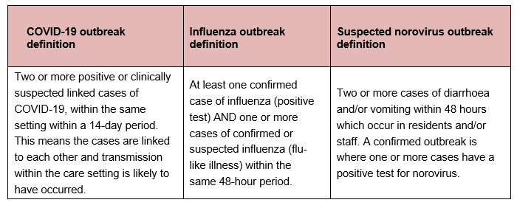
Recognising outbreaks

Slide 7
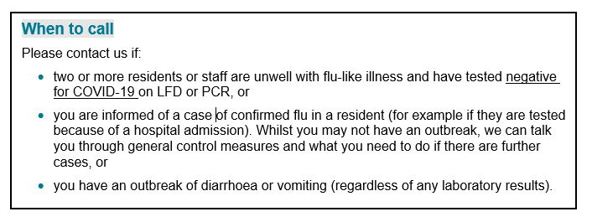
When to report an outbreak to your local UKHSA Health Protection Team (HPT): Flu/Noro
It is important that outbreaks of flu-like illness are reported to your HPT without delay - we might suggest the use of antiviral medication for cases and contacts, but the window for antiviral use is very short.
Please test for COVID-19 before contacting your HPT (using LFD testing) to rule out a COVID-19 outbreak first.
Notes:
You do not HAVE to notify your local HPT of a COVID outbreak, unless you require specific advice.

Slide 8
When to report an outbreak to your local UKHSA Health Protection Team :COVID 19
If you have an outbreak of COVID-19 in your care home (residents or staff with positive COVID-19 tests), you do NOT need to report this to your HPT if you are confident of the steps you need to take in line with published national guidance.
However, please contact us if any of the following apply:
significant increases in number of cases of COVID-19 (or you are concerned the outbreak is not under control)
more hospitalisations than expected of staff or residents due to the outbreak
more deaths than expected
difficulty in applying the outbreak control measures, e.g. due to high numbers of staff isolating

Slide 9
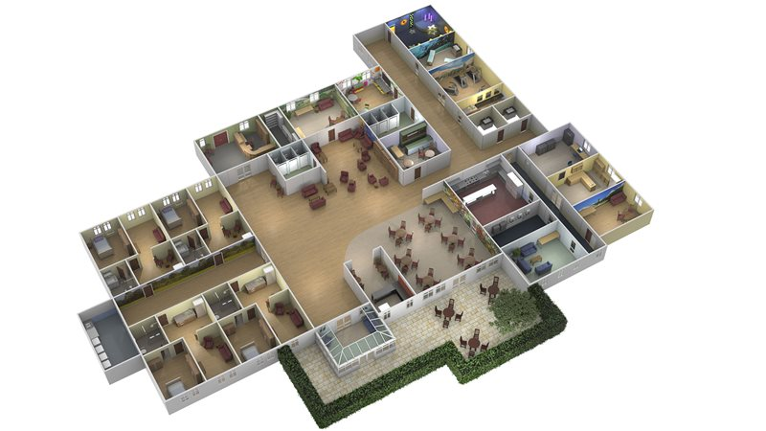
What information does the HPT need?
1. About the setting
Full name and address of the home
Contact details for manager/point of contact, including phone number and email address
Type of care home
Layout - how many floors/shared areas/special units
Total number of residents/staff in each area and how much mixing
IPC measures in place
Details of GP practice/s serving the home
Number vaccinated for COVID/flu amongst residents/staff
Notes:
Don’t be alarmed!
Don’t need all this info at first call, but this is to give an idea of the sort of questions that will be asked.
Don’t delay contacting HPT to gather all the info, but be prepared to give a basic summary
Weight and renal function of residents – would be prudent to have this information at start of season to hand, in order to pass to AV provider

Slide 10

What information does the HPT need?
2. About the cases
Reported symptoms and signs and details of medical assessment
Date of onset of first case
Date of onset of most recent case
Number confirmed cases in residents/staff
Number possible cases in residents/staff
Location of cases within the setting
Number of close contacts identified (if COVID)
Testing done so far (including any results)
Any hospitalisations or deaths

Slide 11
Infection prevention and control advice
Hand and respiratory hygiene
Ventilation
Use of PPE (Masks, gloves and apron), staff understanding of correct donning/doffing
Enhanced cleaning – equipment and environment
Cohort staff/residents
Linen management
Waste management
Isolation as recommended (5 days ARI/>48hrs for diarrhoea & vomiting)
Review visiting policy and use of communal areas.
Communications to staff, residents and families
Notes:
Transmission routes: Respiratory viruses are transmitted primarily via droplet transmission when in close contact or through direct interpersonal contact.
Transmission can also occur through aerosols (for example, produced by cough) and through indirect contact, with some evidence suggesting that respiratory viruses may remain on inanimate surfaces for several hours.
IPC recommendations are therefore based on limiting and avoiding contact, aerosol and droplet transmission, as well as environmental cleaning.
Broadly the same as COVID-19 pre-cautions
Unlikely to close to visiting due to flu. CH should discuss with LA/commissioning organisation about closing to admissions

Slide 12
Care Home Staff during an outbreak
Should be up to date with mandatory training: IPC principles, Hand and respiratory hygiene, donning and doffing of PPE, waste disposal, linen management, single use equipment, recognition of signs and symptoms. https://www.gov.uk/government/publications/covid-19-how-to-work-safely-in-care-homes
Should be vaccinated: (COVID-19 vaccines and booster doses AND seasonal influenza vaccine)
If unwell: leave work, stay home and avoid contact with people. We may advise testing if not sure if this a flu or COVID-19 outbreak. If suspected or confirmed influenza; remain off work for a minimum of 5 days post symptom onset, until feeling well. Should not work until 48 hours clear of diarrhoea and vomiting
‘At risk’ staff: Staff who are in an ‘at-risk’ group for influenza* who have NOT received this year’s flu vaccine more than 14 days ago AND who have had contact with a symptomatic resident without PPE should also be considered for antivirals. Please advise them to seek review by their own GP or occupational health.
Home staff need to have out of hours access: to generic/designated email address or phone line at weekend/out of hours in order to communicate with the HPT/ICB.
Notes:
All IPC policies should be up to date and accessible to all staff.
Hand washing Audit
Posters in ‘Winter-readiness’ pack
Access to PPE
If unwell: symptoms of resp infection and high temp or generally unwell – stay home.
LFDs available for eligible social care staff, should be taken as soon as they feel unwell (day 0).
If LFD is negative they need to repeat in 48hrs, if remains negative can return to work if well enough to do so.
If positive – follow guidance. IPC in Adult Social Care
Where possible – consider management of staff who return to work after recently being unwell.
At risk staff - Risk groups for complicated influenza:
a. Neurological, hepatic, renal, pulmonary and chronic cardiac disease.
b. Diabetes mellitus.
c. Severe immunosuppression.
d. Age over 65 years.
e. Pregnancy (including up to 2 weeks post-partum).
f. Children under 6 months of age.
g. Morbid obesity (BMI ≥40).
*includes people who are in a clinical risk group which entitles them to a free flu vaccine on medical grounds
$ in this scenario PPE would be considered as protective if worn in line with the guidance for care workers working in care homes during sustained COVID-19 transmission

Slide 13
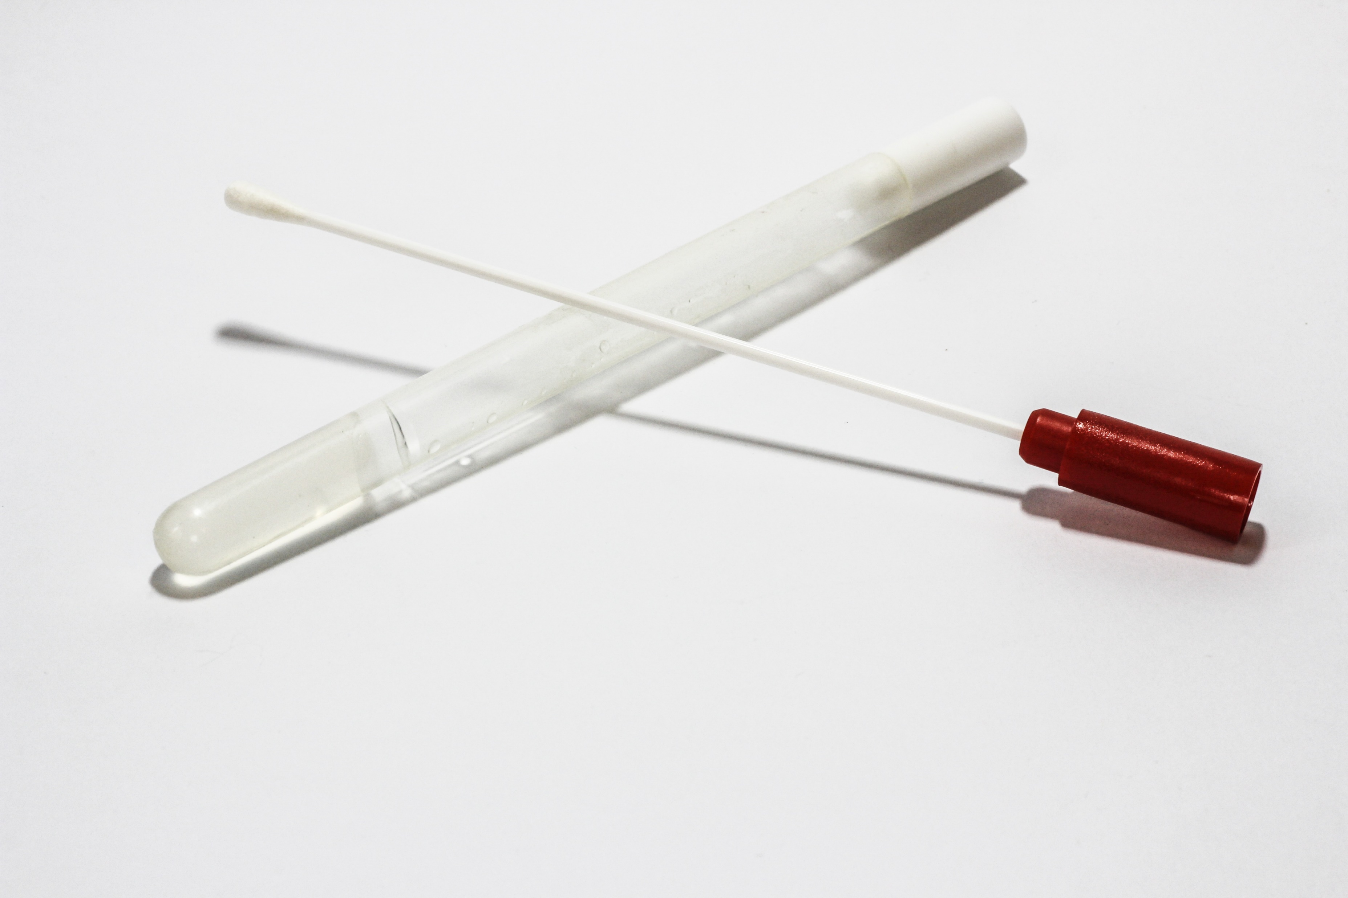
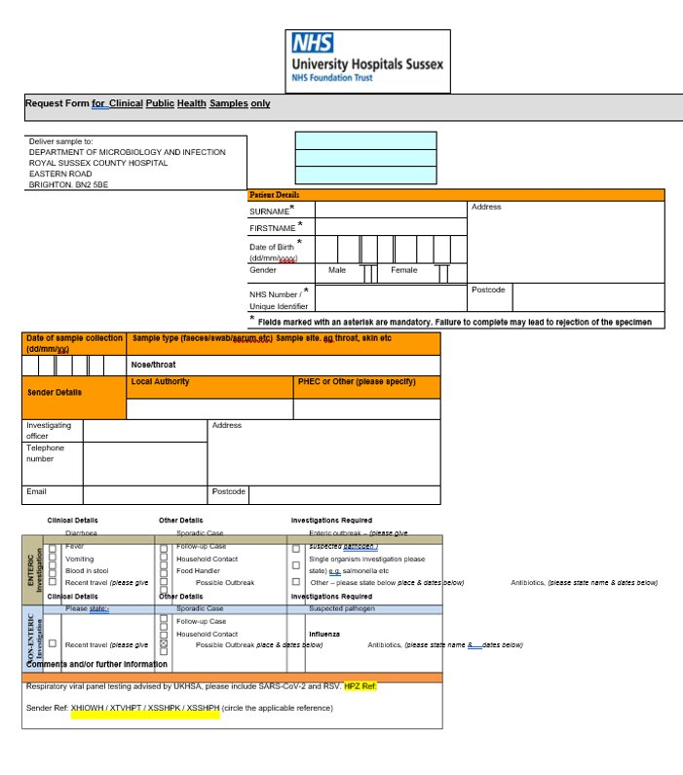
Testing
COVID
Lateral flow test for outbreak testing/symptomatic testing for those eligible for therapeutics
PCR may be required in certain circumstances – HPT will advise
Norovirus
Stool sample may be requested by GP or HPT
Flu
Swabs will be sent to care home, swab up to 5 symptomatic residents
Label the swab/specimen tube with the NAME, DOB and sex of the patient, date of collection.
Need an Outbreak Laboratory Request form for each patient and swab.
Always include the ‘HPZ reference’ number on the form
Double-bag the swabs (individually and as a group)
Await collection by a courier organised by HPT at the agreed time/date
The bag can be stored in a cool dry location awaiting collection, ideally no longer than 24 hours.
HPT will contact care home with results.
Care Home will need to inform GP of positive results
Notes:
Testing for ILI is less onerous than for COVID-19
Only need to test UP to 5 residents, not whole home.
The same swab technique as COVID-19. CHECK SWABS ARE IN DATE
Labels need to be written out, there are NO BARCODES. Can use a computer generated sticky name label, sellotape a hand written label flat to tube, or write directly on the tube (in a pen that doesn’t smudge)
Swabs should be sealed in individual specimen bags, and then all specimen bags placed together in a larger bag.
Swabs will be tested for influenza A, B and COVID-19 at a public health lab
Make sure there is a designated contact line/email address that all staff cane access including at weekends.

Slide 14

Antivirals for influenza
Can be given as treatment for cases or prophylaxis for exposed people.
Dosage and duration for treatment/prophylaxis is different
Ideally should be started <48 hours onset/contact but may be considered up to 5 days after
Should be offered to residents regardless of their influenza vaccination status
HPT will identify cohort that require antivirals based on information provided and alert ICB.
Care home will need to collate information in a list ready for prescriber identified by ICB
Care home may have to collect the antivirals, or they may be couriered to the home, depending on local arrangements
If any of the residents without a prescription for antivirals develop symptoms of flu, contact HPT so an assessment can be made regarding whether a wider group require antivirals than the initial cohort.
Notes:
Antivirals – oseltamivir (tamiflu)
Treatment dose: Oseltamivir 75mg PO twice daily for 5 days.
Prophylactic dose: Oseltamivir PO once daily for 10 days, if therapy can be started within 48 hours of last exposure; or after 48 hours on specialist advice only.
AV reduces the risk of death and duration of symptoms in the most vulnerable. For contacts it can prevent them developing flu and becoming unwell.
Prescribing clinician will be asked to review renal function (*checking with MC how this is done ?blood test/medical records)
Dependant on when the outbreak occurs in the year, depends on at which point antivirals will be recommended
Green
Amber
Red
Cohort (may be whole care home / one wing / one unit / residents only +/- staff members etc) Treatment/prophylaxis.
CH List – names, DOB, NHS no. Who needs treatment, who needs prophylaxis.

Slide 15
Who else should be aware of an outbreak in a care home?
Care home manager and staff
GP responsible for care home/affected residents
Residents
Families
Local Health Protection Team (although not for all COVID 19 outbreaks)
Also consider informing
Commissioner
Local authority
Care Quality Commission (CQC)
Integrated Care Board (ICB)
Notes:
HPT will inform ICB, lab at Brighton, and likely have discussion with prescribing GP
Care home needs to inform GP for residents, residents, families

Slide 16
End of outbreak
It is possible to get simultaneous outbreaks of COVID and flu, as well as dual infection
Care homes should continue to monitor all residents for symptoms
An outbreak of acute respiratory illness (COVID 19 or flu) can be declared over five days after the last suspected or confirmed case
An outbreak of norovirus can be declared over when all staff/residents have been symptom free for >48hours.

Slide 17
Key Messages
Be prepared
Recognise outbreaks
Contact the HPT if:
2 or more residents or staff are unwell with acute respiratory illness
and are negative for COVID 19
or
You are informed of a case of confirmed flu in a resident
or
You have an outbreak of diarrhoea or vomiting
or
You are concerned about an outbreak of COVID-19
Any questions?
Notes:
1. Be prepared ✓
• Ensure your residents and staff are immunised against flu and COVID-19 (including
boosters).
• Have a stockpile of personal protective equipment (PPE).
• Keep a supply of COVID-19 PCR and LFD tests so you are ready for testing.
• Ensure your residents over the age of 65 are immunised against pneumococcal
infection.
• Ensure your residents aged 70 to 79 years are immunised against shingles.

