Slide 1





At a glance summary - Frimley ICB Gender Pay Gap March 2023
Based on data gathered in March 2023, the mean pay gap is 20% and the median pay gap is 25%
In this organisation, women earn 75 pence for every £1 that men earn when comparing median hourly pay.
The gender pay gap
Is the difference between the average earning of men and women, expressed relative to men’s earnings.
£1
75p
The mean pay gap
Is the difference between average hourly earnings of men and women.
On average men earn £39 per hour
On average women earn £31 per hour
The mean pay gap is 20%
The median pay gap
Is the difference between the midpoints in the ranges of hourly earnings for men and women.
The median hourly rate earned by men is
£34 per hour
The median hourly rate earned by women is £26
per hour
The median pay gap is 25%

Slide 2
Gender Pay Gap - context
Legal Context: The Equality Act 2010 (Gender Pay Gap Information) Regulations 2017 require public sector organisations employing 250 staff and over to publish their Gender Pay Gap Report by end of March annually, providing ‘snapshot data’ for 31 March of the previous year. This is part of our Public Sector Equality Duty.
This report has been prepared in accordance with guidance published by the Government Equalities Office and the ‘snapshot’ information includes staff holding an employment contract on 31 March 2023, based on our Employee Staff Records (ESR).
Why is Gender Pay Gap reporting important? Gender pay gap reporting highlights differences in the average (mean or median) earnings of men and women - expressed as a percentage of men’s earnings. For example, women earn 15% less than men.
How does it help? It helps to understand equality gaps at the workplace, female and male participation at different levels and if talent is maximised and rewarded fairly and effectively. Gender Pay Gap reporting promotes accountability and transparency and informs actions to minimise equality gaps.
How is Gender Pay Gap different from Equal Pay: Equal pay deals with pay differences between men and women carrying out same jobs, similar jobs or work of equal value. Failure to ensure equal pay for roles of equal value between men and women is unlawful.
Gender Pay Gap reporting shows the average hourly pay differences between men and women and whether any one gender is disproportionately over-represented at a particular salary band. Individual component calculations (mean, median, bonus and by pay qarter) help identify what is causing the difference and inform action plans to minimise the gaps.

Slide 3
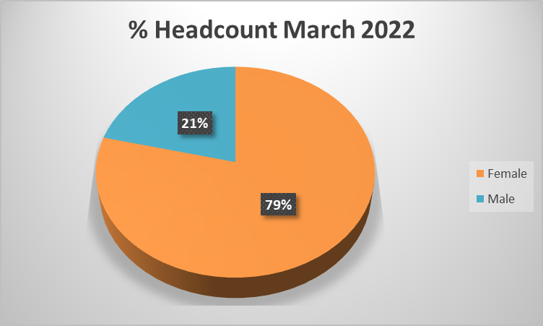
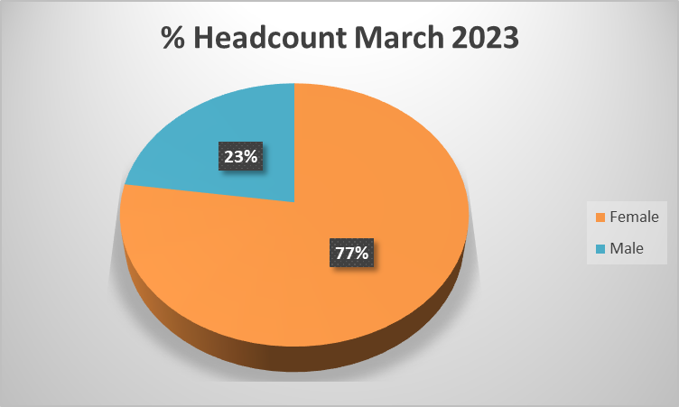
Workforce data
Frimley ICB was established in July 2022; therefore, we cannot provide an exact like-for-like comparison with the Gender Pay Gap from the previous year. However, we have reviewed the Frimley CCG workforce data and pay gap to identify any consistent themes. Initial comparison confirms that the proportion of men in the ICB in 2023 is 2% higher than proportion of the CCG workforce in 2022.
The CCG had a mean gender pay gap of 15.02% and a median gender pay gap of 25.42%. This means that the average male salary was higher than the average female salary. Women earned 74.58 pence for every £1 that men earn when comparing median hourly pay. Women’s median hourly pay was 25.42% lower than men’s.
Frimley CCG data from 31st March 2022 which confirmed that the workforce consisted 260 staff - 205 women (79%) and 55 men (21%).
Frimley ICB workforce data from March 2023 confirms that the workforce consisted of 300 staff, 285 women (77%) and 84 men (23%).

Slide 4
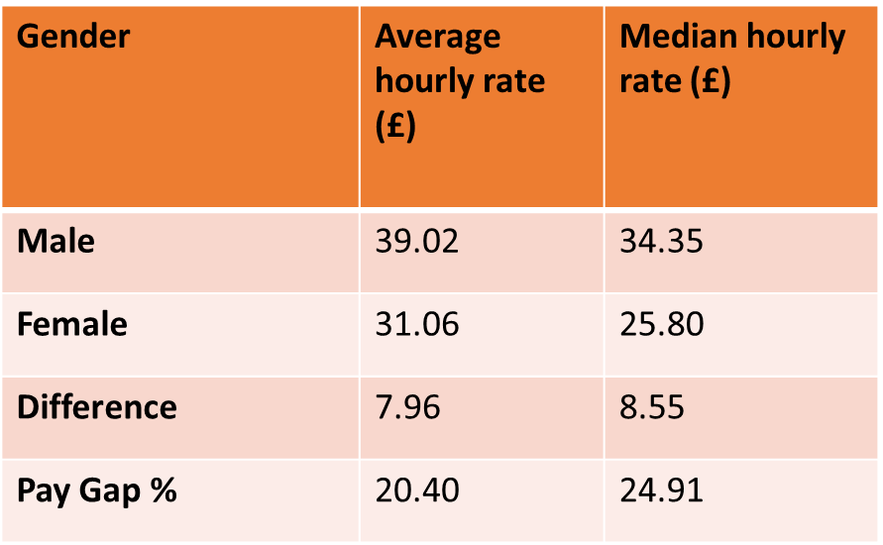
Frimley ICB Pay : Average & Median Hourly Rates
This report is based on the Government’s methodology for calculating the difference in pay between female and male employees receiving full pay. All employee data contained in this report was extracted from Frimley ICB’s ESR payroll system, snapshot as of 31 March 2023. The reporting period covers 01 April 2023 – 31 March 2024.
There are two measures of the pay gap, mean and median. Both figures are important as they can highlight the different causes of your pay gap.
The mean average is calculated by adding all individual employees’ hourly rate of pay and dividing by the total number of employees.
The median average is calculated by listing all employees’ hourly rate of pay and finding the midpoint.
The pay gap regulations require us to calculate and publish both figures.

Slide 5
Gender by quartile
The Proportion of men and women in each pay quartile (%) is calculated by ranking all employees from highest to lowest paid, dividing the workforce into four numerically equal parts (‘quartiles’) and working out the percentage of men and women in each of the four parts. (The lowest paid jobs are in quartile one).
The proportion of women employed in the organisation is 77%. The graphs highlight that women are in over-represented in the lower and lower middle quartiles (at 82.67% and 85%).
23% of the workforce are male and we see that there is a higher representation of men in quartile 4 at 34%.
This distribution is a key factor contributing to the mean and median pay gaps as it serves to bring down the average pay of females. The comparison of these quartiles suggests that the lower proportion of men in lower pay bands relative to their share of the population was a key driver of the gender pay gap in Frimley ICB.
Quartile | Female | Male | Female % | Male %
4 Upper | 56.00 | 29.00 | 65.88 | 34.12
3 Upper middle | 75.00 | 24.00 | 75.76 | 24.24
2 Lower middle | 68.00 | 12.00 | 85.00 | 15.00
1 Lower | 62.00 | 13.00 | 82.67 | 17.33

Slide 6
Further areas to explore
According to the Charted Institute of Personnel Development website dated 1 March 2023:
Gender pay gaps are often the outcome of economic, cultural, societal and educational factors.
Personal choices on working arrangements and careers are often influenced by matters outside of the individual’s control, such as the availability and affordability of childcare.
Choices available to women continue to be more constrained than those available to men.
Drivers of Gender Pay Gap
Unpaid caring responsibilities
Part-Time working
Differences in human capital
Occupational segregation
Undervaluing women’s work
Pay discrimination
https://www.cipd.org/uk/knowledge/guides/gender-pay-gap-reporting-guide/
Notes:
DATE?

Slide 7
Key drivers of Gender Pay Gap
Actions being taken to address the gender pay gap
Ensuring an equitable change programme
There is a risk that as Frimley ICB undergoes a change programme this may have a disproportionate impact on gender equality. In order to mitigate this risk, we:
Created a consistent template to ensure that job descriptions for new roles would be developed with inclusivity and accessibility in mind.
Completed ongoing Equality Impact Assessments, ensuring that at each decision-making point, anonymised ESR data was reviewed
The original consultation report was reviewed through an inclusion lens, to support use of inclusive language and to highlight the ICS ambition to improve workforce and health inequalities.
Embedded messages about inclusion into the managing change sessions that were delivered to line managers and drew out key equality themes from the post-consultation responses to ensure they were amplified.
We are reviewing job matching and potential job interview processes from an equality perspective – constantly asking whether we are doing enough to ensure that people will feel equally and fairly treated and that their needs will be considered.
Have developed inclusive approaches to recruitment and talent management
Invested in the development of our EDI Advocates
Sexual Safety in Healthcare Charter
Frimley ICB has made a commitment to meeting the requirements of the above charter by July 2024.
Notes:
DATE?

Slide 8
Our Action Plan
The table below sets out our ambitions to develop an inclusive Gender Pay action plan throughout 2024/25.
Quarter 1 24/25 | Quarter 2 | Quarter 3 | Quarter 4
1. Identify an Executive sponsor to lead on Gender Inequalities | 1. Benchmark Gender Pay Gap findings against other ICBs (both nationally and locally) | 1. Review intersectionality aspects (Ethnicity, Disability Pay Gaps) | 1. Prepare for 2024/25 Pay gap report
2. Develop a Women’s Network across the ICB | 2. Review national guides and action plans to incorporate best practice locally | 2. Understand the potential of developing local Primary Care Pay Gap review | 2. Ensure outcomes are included and reported in annual Equality report
3. Analysis of recent National Staff Survey to establish further Gender trends | 3. Establish metrics and benchmarks for monitoring improvement | 3. Review ‘additional payments’ (on-call/ uplifts etc) to ascertain contribution to Gender Pay Gap | 3. Ensure Inclusive recruitment practices are embedded and further upskill/ training for line managers
4. Engage broader staff networks (male, female, menopause, SPF etc) to further develop strategy | 4. Review leaver rates and establish any trends, learning and best practice moving forward.
Notes:
DATE?

